Slide 1
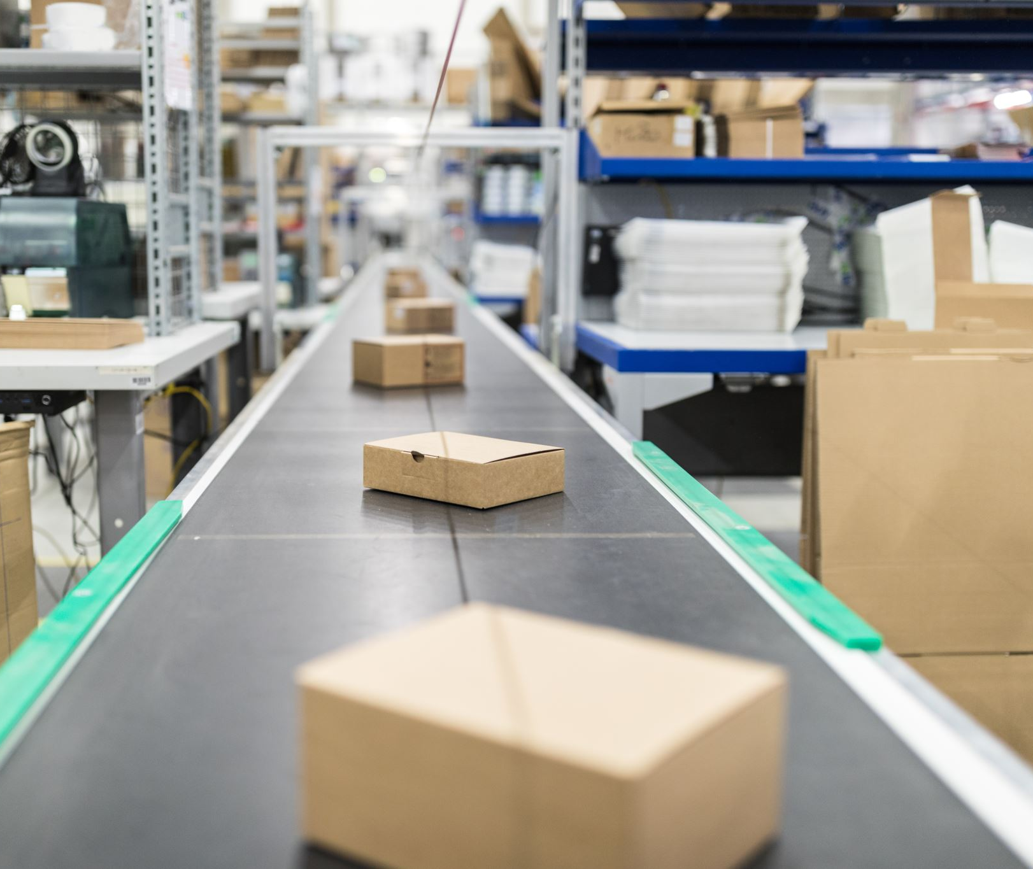
BAYES’ theorem

Slide 2

Bayes Theorem
one of the most famous equations in the world of statistics and probability
$$P\left(A | B\right)= P\left(B | A\right) ×\frac{P\left(A\right)}{P\left(B\right)}$$

Slide 3
A Framework for Updating Our Beliefs
What’s the point of probability ? => decision making under uncertainty
When you decide on an action, you are betting that completing the action will leave you better off than had you not done it.
But bets are inherently uncertain, and our knowledge about the world is never totally exact, so how do you decide whether to go ahead with it or not ?
Bayes’ Theorem gives us a quantitative framework for updating our beliefs as the facts around us change.

Slide 4
The Intuition with an example (Https://medium.com/opex-analytics/bayes-theorem-101-6a9a1ea5d4a6)
It’s 9AM on Monday morning, and you receive an email from your boss. You notice that it seems a little different from her usual notes: the message contains several grammatical errors, and ends by asking you to provide your social security number. Though you first assumed it was a legitimate email, the grammar mistakes and suspicious request convince you to send it right to the spam folder.
When making that quick decision to ignore the email from your “boss,” you unconsciously estimated several different probabilities. First, you judged the likelihood of a work email’s legitimacy to be fairly high. But then you assessed the probability that such a weird email could come from your boss to be low. You also have some general sense that phishing emails tend to be weird in a few specific ways, and you know that phishing scams are common enough that this particular email could plausibly be harmful.
With all this information swirling around in your head, you decide that the email is most likely spam. That’s pretty much all conditional probability is: determining the probability of an event given the other information that you know.

Slide 5
Taking a closer look at the formula
P(A|B) = P(B|A) * P(A)/P(B)
P(A|B) — is the probability of A given that B has already happened.
P(B|A) — is the probability of B given that A has already happened. It looks circular and arbitrary for now…
P(A) — is the unconditional probability of A occurring.
P(B) — is the unconditional probability of B occurring.

Slide 6
Taking a closer look at the formula
P(A|B) = P(B|A) * P(A)/P(B)
P(A|B) is an example of a conditional probability — one that measures probability over only certain states of the world (states where B has occurred).
P(A) is an example of an unconditional probability and is measured over all states of the world.

Slide 7
Example
Suppose that you are a recently graduated student. You have yet to hear back from some of the companies you interviewed with and are getting nervous. So you decide to calculate the probability that a specific company will make you an offer given that it’s been 3 days and they still have not called you yet.
Let’s rewrite the formula in terms of our example. Here, outcome A is “receiving an offer” and outcome B is “no phone call for 3 days”. So we can write our formula as:
P(A|B) = P(B|A) * P(A)/P(B)
P(Offer|NoCall) = P(NoCall|Offer) * P(Offer) / P(NoCall)

Slide 8
Example
P(Offer|NoCall), the probability of receiving an offer given no phone call for 3 days
=> hard to estimate
Let’s estimate the rest (arbitrarily):
P(NoCall|Offer) = 40% => no phone call for 3 days given that you have an offer.
P(Offer) = 20% => landing a job offer in general.
P(NoCall) = 90% => not getting a call back from the company for 3 days (pass on you, or they might still be interviewing other candidates)
Plug in our estimates:
P(Offer|NoCall) = 40% * 20%/90% = 8.9%

Slide 9
The Intuition Behind the Formula
Remember Bayes’ Theorem is a framework for updating our beliefs…
So where do our beliefs come in?
The prior => P(A) ⬄P(Offer)
this is our prior belief about how likely it is to receive an offer.
Or the likelihood that you will receive an offer at the exact moment that you exit the interview room.
P(A|B) = P(B|A) * P(A)/P(B)

Slide 10
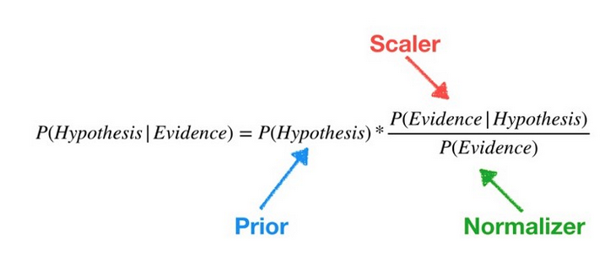
The Intuition Behind the Formula
Now, new information has come in
3 days have gone by and the company has yet to call you.
So we use the other parts of the equation to adjust our prior for the new event that has occurred.

Slide 11
The Intuition Behind the Formula
We use P(Evidence|Hypothesis) to flip the problem around by asking, “What is the probability of observing this evidence in a world where our hypothesis is true?”
So in our example, we want to know how likely it is to go 3 days without a phone call in a world where the company has definitely decided to make us an offer.
P(Evidence|Hypothesis) => the scaler
When we multiply it against the prior, the scaler scales the prior up or down depending on whether the evidence helps or hurts our hypothesis — in our case, the scaler reduces the prior because more days going by without a phone call would be an increasingly bad sign…
The scaler is the mechanism that Bayes’ Theorem utilizes to adjust our prior beliefs.

Slide 12
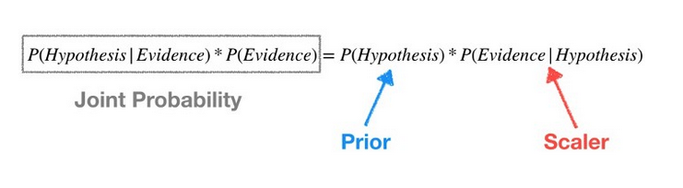
The Intuition Behind the Formula
If we leave P(Evidence) on the left side of our equation, we get a joint probability, which considers all states of the world. But we we only want the states where the evidence has occurred => P(Hypothesis|Evidence)

Slide 13
The Intuition Behind the Formula
Dividing the product of prior and scaler by P(Evidence) means we reduce the possible states to the ones where the evidence has occurred.

Slide 14
To summarize
P(Offer) =>prior
Fresh out of the interview, we start with a prior — there is a 20% chance that we will get the job we just interviewed for.

Slide 15
To summarize
As more days pass, we use the scaler to scale down our prior.
For example, after 3 days have gone by, we estimate that in a world where we get the job, there is just a 40% chance that the company would have waited this long to call you. Multiplying scaler and prior we get 20% * 40% = 8%.
P(NoCall|Offer) = scaler

Slide 16
To summarize
P(NoCall) => normalizer
Finally, we recognize that the 8% is calculated over all states of the world.
But we only care about states of the world where we have not received a phone call from the company for 3 days post interview.
In order to capture only those states, we estimate the unconditional probability of not receiving a call for 3 days to be 90% — this is our normalizer. We divide our previously calculated 8% by the normalizer, 8% / 90% = 8.9%, to get our final answer.
So in the states of the world where we have not heard back from the company for 3 days, there is an 8.9% chance that we will receive an offer.

Slide 17
Video explanation
https://www.youtube.com/watch?v=HZGCoVF3YvM&t=542s

Slide 18
Practice Problem1
Using Bayes for NLP to predict spams based on the content of an email.
Assume that the word offer occurs in 80% of the spam messages
Also assume offer occurs in 10% of desired e-mails (hams)
If 30% of the received e-mails are considered to be spams, and I receive a new message which contains offer, what is the probability that this new email is a spam?
Draw a tree diagram to help you and consider the case where you have a sample of 100 emails : you can first find the solution by counting, and then try and find it using the theorem.

Slide 19
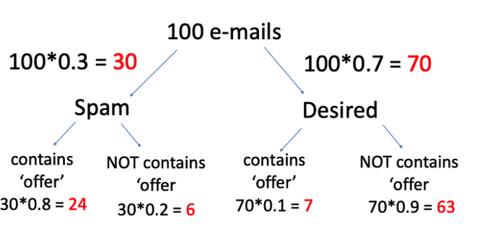

Slide 20
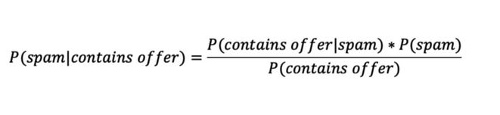
Practice Problem1
P( contains offer|spam) = 0.8 (given in the question)
P(spam) = 0.3 (given in the question)
P(contains offer) = 0.3*0.8 + 0.7*0.1 = 0.31

Slide 21
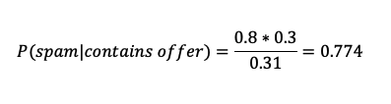
Practice Problem1
Both results should be the same :

Slide 22
Practice Problem 2
Covid-19 tests are common nowadays, but some test results can be wrong...
Let’s assume:
a diagnostic test has 99% accuracy
and 60% of all people have Covid-19.
If a patient tests positive, what is the probability that they actually have the disease?
Same as previously: take a sample of 100 patients first and find the probability using counts and then use the theorem.

Slide 23
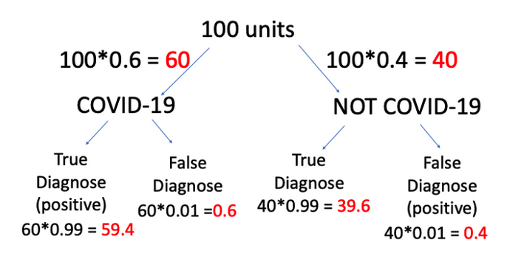

Slide 24
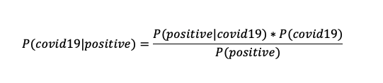
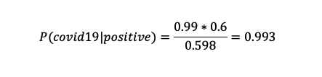
P(positive|covid19) = 0.99
P(covid19) = 0.6
P(positive) = 0.6*0.99+0.4*0.01=0.598

Slide 25
Practice Problem 3 (Monty Hall is back)
You’re on a gameshow called “Let’s Make a Deal”. There are 3 closed doors in front of you.
Behind each door is a prize. One door has a car, one door has breath mints, and one door has a bar of soap. You’ll get the prize behind the door you pick, but you don’t know which prize is behind which door. Obviously you want the car!
Imagine you pick door A.
After opening door A, the host of the show, Monty Hall, now opens door B, revealing a bar of soap. He then asks you if you’d like to change your guess. Should you?
By working through Bayes Theorem, we can calculate the actual odds of winning the car if we stick with door A, or switch to door C.

Slide 26
Practice Problem 3
The posteriors we want to compute :
1.P(prize=A|opened=B) vs. 2.P(prize=C|opened=B)

Slide 27
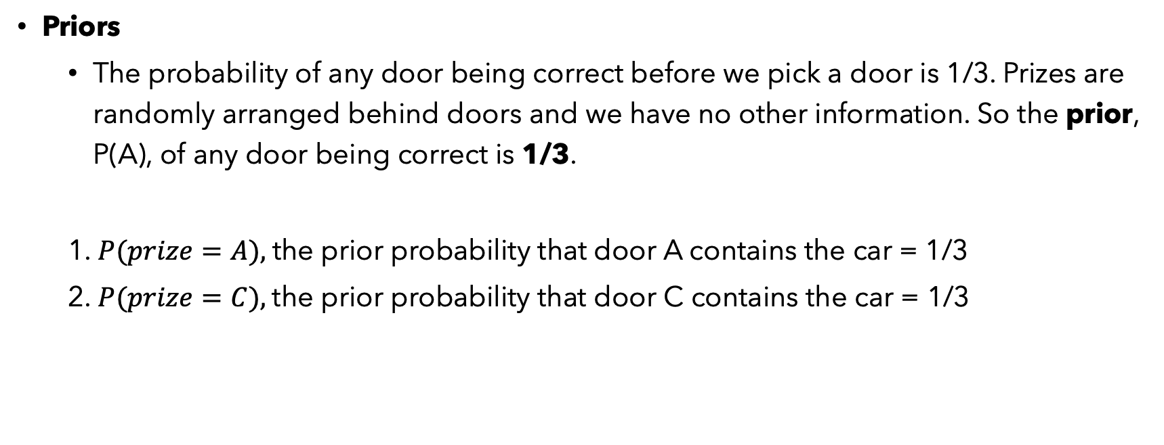
Practice Problem 3
Priors
The probability of any door being correct before we pick a door is 1/3. Prizes are randomly arranged behind doors and we have no other information. So the prior, P(A), of any door being correct is 1/3.
1. $P(prize=A),$the prior probability that door A contains the car = 1/3
2. $P(prize=C),$the prior probability that door C contains the car = 1/3

Slide 28
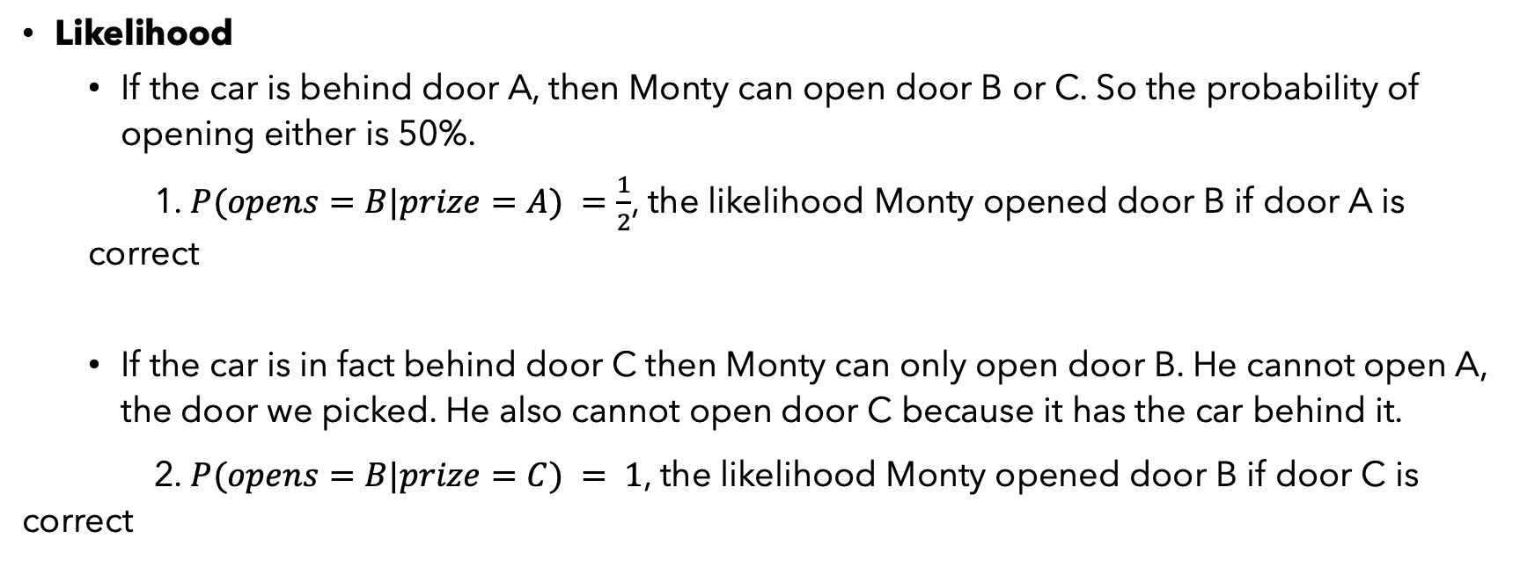
Practice Problem 3
Likelihood
If the car is behind door A, then Monty can open door B or C. So the probability of opening either is 50%.
1. $P(opens=B|prize=A) =\frac{1}{2}$, the likelihood Monty opened door B if door A is correct
If the car is in fact behind door C then Monty can only open door B. He cannot open A, the door we picked. He also cannot open door C because it has the car behind it.
2. $P(opens=B|prize=C) = 1$, the likelihood Monty opened door B if door C is correct

Slide 29

Practice Problem 3
Numerator: P(A) x P(B|A)
$P(prize=A) × P(opens=B|prize=A) = 1/3 × 1/2 = 1/6$
$P(prize=C) × P(opens=B|prize=C) = 1/3 × 1 = 1/3$

Slide 30
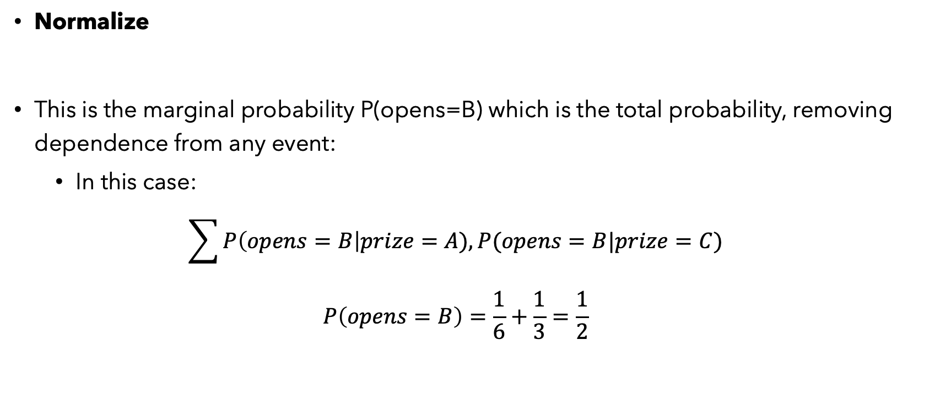
Practice Problem 3
Normalize
This is the marginal probability P(opens=B) which is the total probability, removing dependence from any event:
In this case:
$$\sum{P\left(opens=B\right|prize=A), P(opens=B|prize=C)}$$
$$P\left(opens=B\right)=\frac{1}{6}+\frac{1}{3}=\frac{1}{2}$$

Slide 31

Putting everything together:
$P\left(prize=A | opens=B\right)=\frac{\frac{1}{6}}{\frac{1}{2}}=\frac{1}{3}$
$P\left(prize=C | opens=B\right)=\frac{\frac{1}{3}}{\frac{1}{2}} =\frac{2}{3}$
=> the prize is more likely to be hidden behind door C, so we should switch !

