Slide 1
Naive Bayes Classifier

Slide 2
Set Up
Imagine we get messages from friends and family
But also unsolicited messages (advertising, scams…)
And we don’t want to sort out the messages anymore, or at least try to reduce the amount by quite a bit and create an algorithm which will automatically send most spams to a spam box.

Slide 3
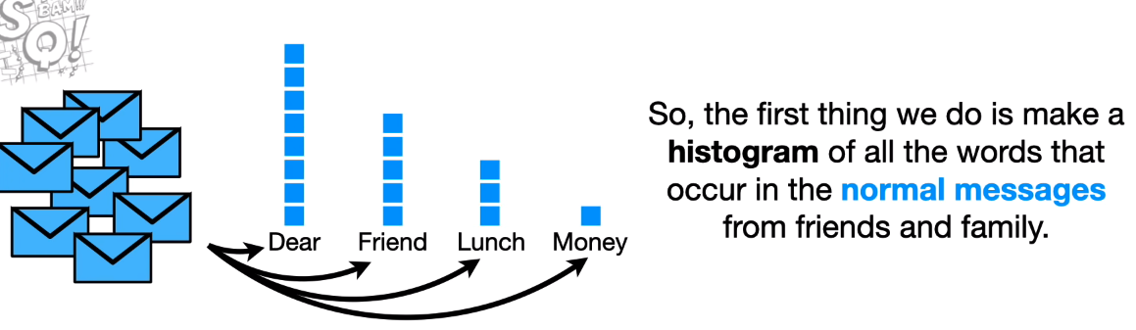
Intuition
Following pics are from https://www.youtube.com/watch?v=O2L2Uv9pdDA&t=695s

Slide 4
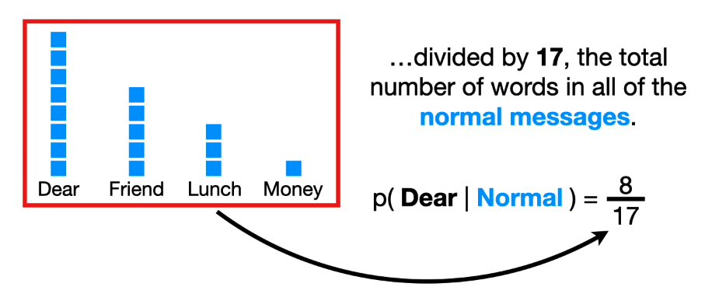
Intuition
Can use the histogram to calculate the probabilty of seeing each word given it was in a normal message

Slide 5
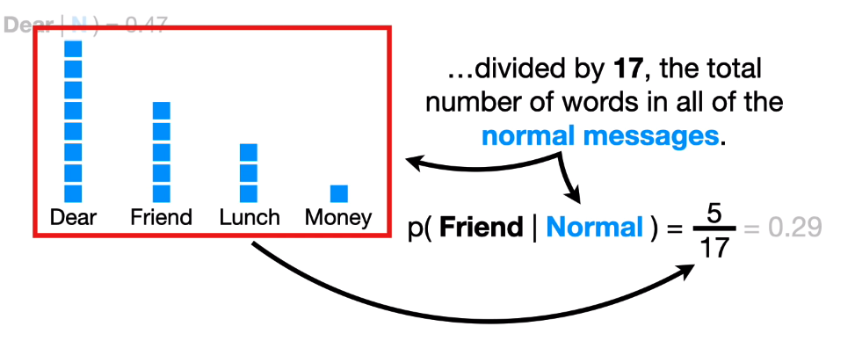
Intuition
Can repeat the process for each word we see in our normal messages (hams).

Slide 6
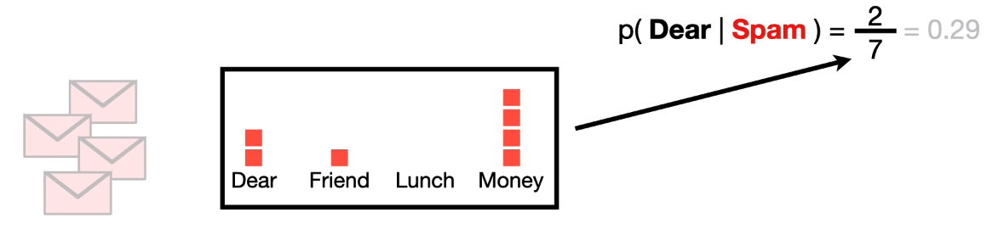
Intuition
Can do the exact same thing for our spams

Slide 7
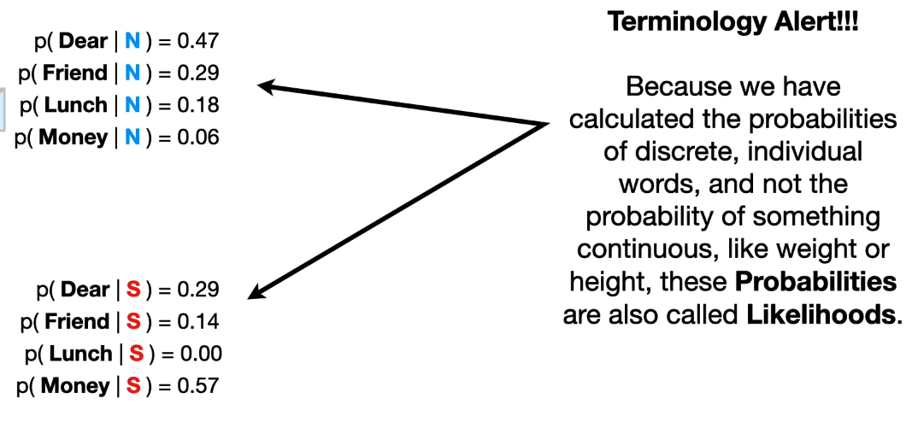
Intuition
We end up with a set of conditional probabilities or likelihoods.

Slide 8
Intuition 1st Example
Now imagine we get a message that says:
Dear friend
We want to decide where it should go:
Our normal inbox
Or our spam box

Slide 9
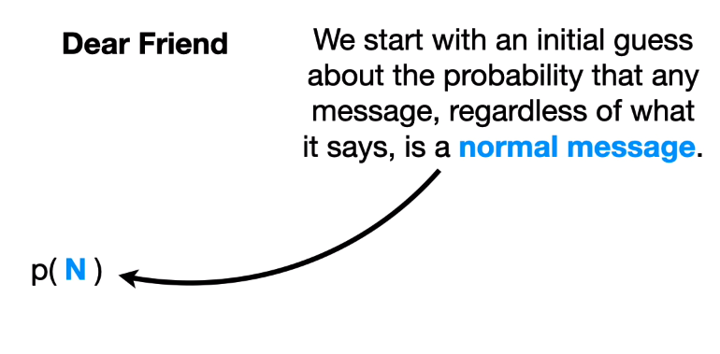
Intuition 1st Example

Slide 10
Intuition 1st Example

Slide 11
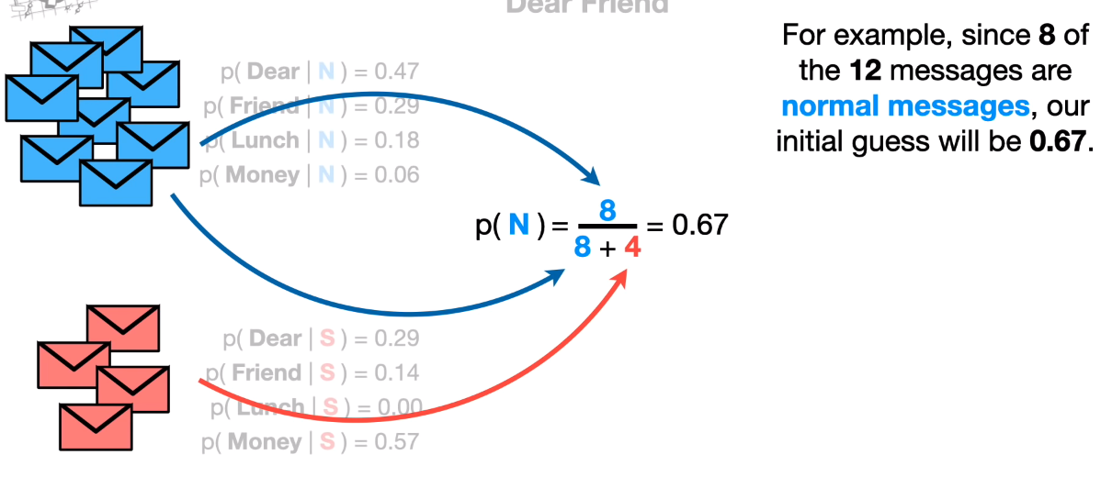
Intuition 1st Example

Slide 12
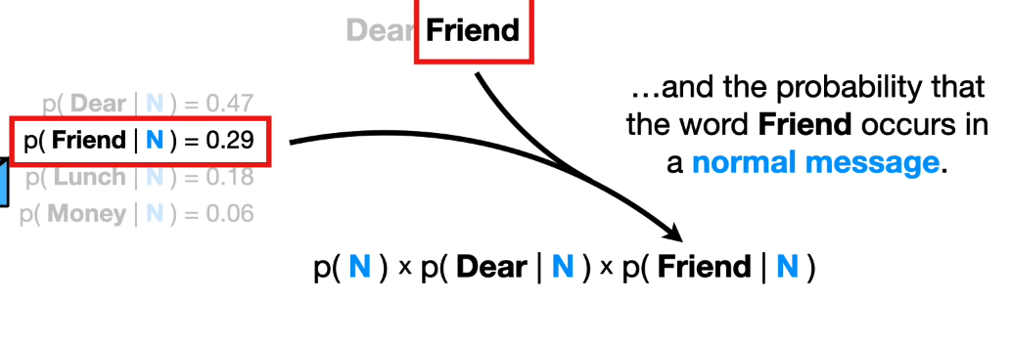
Intuition 1st Example
Multiply the probabilities with each other

Slide 13
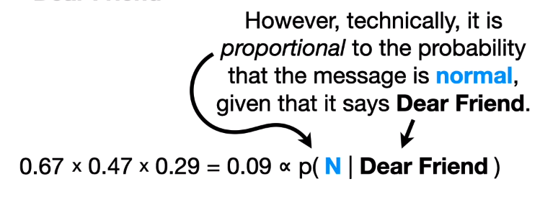
Intuition 1st Example

Slide 14
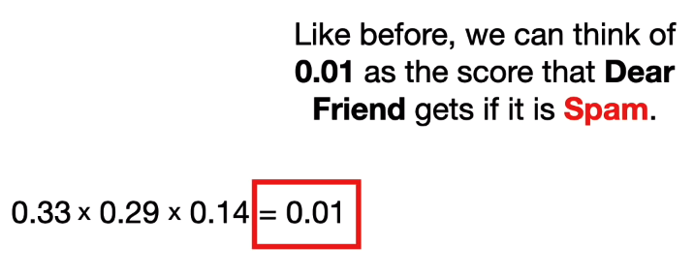
Intuition 1st Example
Same process for spam:

Slide 15
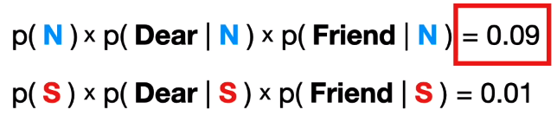
Intuition 1st Example
Compare both results :

Slide 16
Intuition 2nd Example
Now let’s try and classify :
Lunch Money

Slide 17
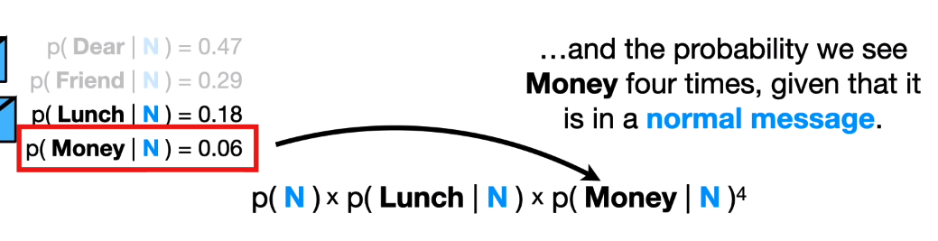
Intuition 2nd Example

Slide 18
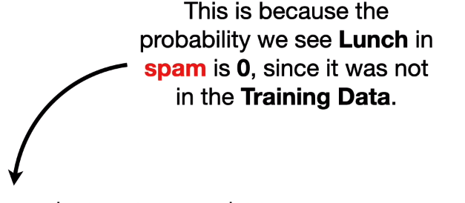
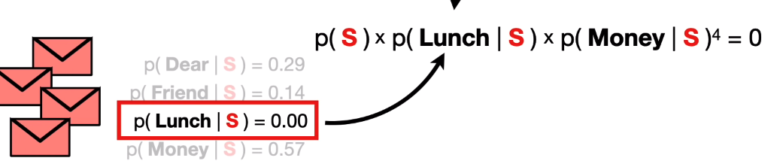
Intuition 2nd Example

Slide 19
Intuition 2nd Example
In other words, of a message contains lunch, it will not be classified as spam…
This is not satisfactory !
No matter how many times we see the word money, or any other word which has a high probability of being in spam, the end result will be 0 …

Slide 20
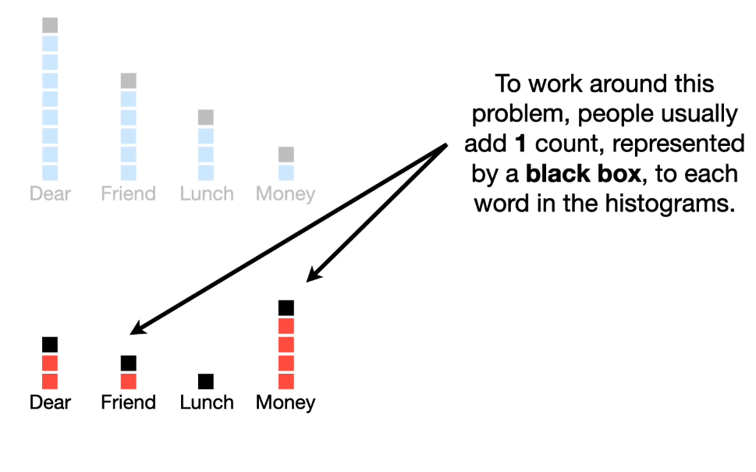
Pseudocounts
The pseudocount is referred to with the Greek letter ⍺ (1 here)

Slide 21
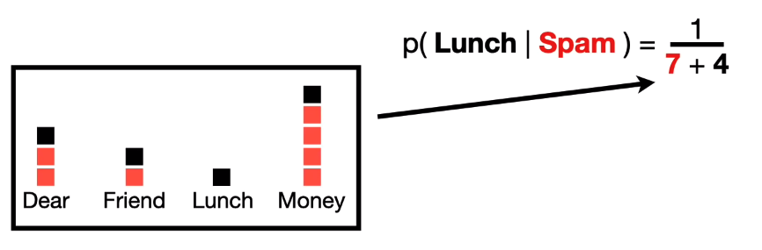
Now, when calculating the probas of observing each word, we never get 0.
Careful : we now need to add 4 (total counts added = our vocab length) to the denominator

Slide 22
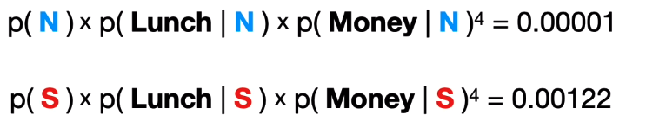
Our values for P(Normal) and P¨(Spam) do not change however.
We are ‘hallucinating’ data so our model will generalize better; meaning we’re taking into account seeing certain words that our data doesn’t account for so that if we do ever see this in the future, we have a probability estimate that we can use.

Slide 23
Why is this classifier called Naive Bayes ?
This classifier treats all word orders the same, there is no sequence info taken into account… only single word counts.
That said it tends to perform suprisingly well…

Slide 24
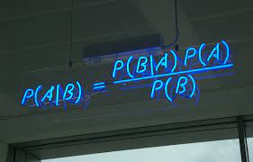
Putting things into perspective with the formula

Slide 25
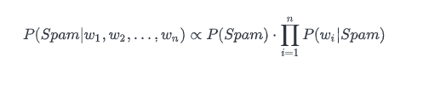
In the case of Spam Filtering
P(A|B) is proportional to our estimated probabilities
P_spam — the part/proportion of spam messages in our dataset
P_wi_spam — the probability of a word wi to be found in the spam messages.
Same logic for not spam (ham) :
P_not_spam — the part of non-spam messages in the dataset
P_wi_non_spam — the probability of a word to be found in the non-spam messages.

Slide 26
Why are we using proportinality vs equality ?
Where did the denominator from the formula P(B) go ?
P(B) = P(w1, w2, w3, …) will be the same when calculating the probabilities of both classes, spam and ham.
It can therefore be regarded as a constant :
We’re not interested in the exact result, only which class has higher probability.
So we can save a little computation by doing so.

Slide 27
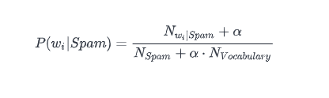
How de we measure the probability of a word given a class ? (same for ham)
N_vocabulary
the number of unique words in the whole dataset.
N_spam
the total number of words in the spam messages.
N_wi_spam
the number of times a word wi is repeated in all spam messages.
Alpha
the coefficient for the cases when a word in the message is absent in spam.

Slide 28
Implementation
Now we have all we need to know to implement the algorithm ☺

