Slide 1
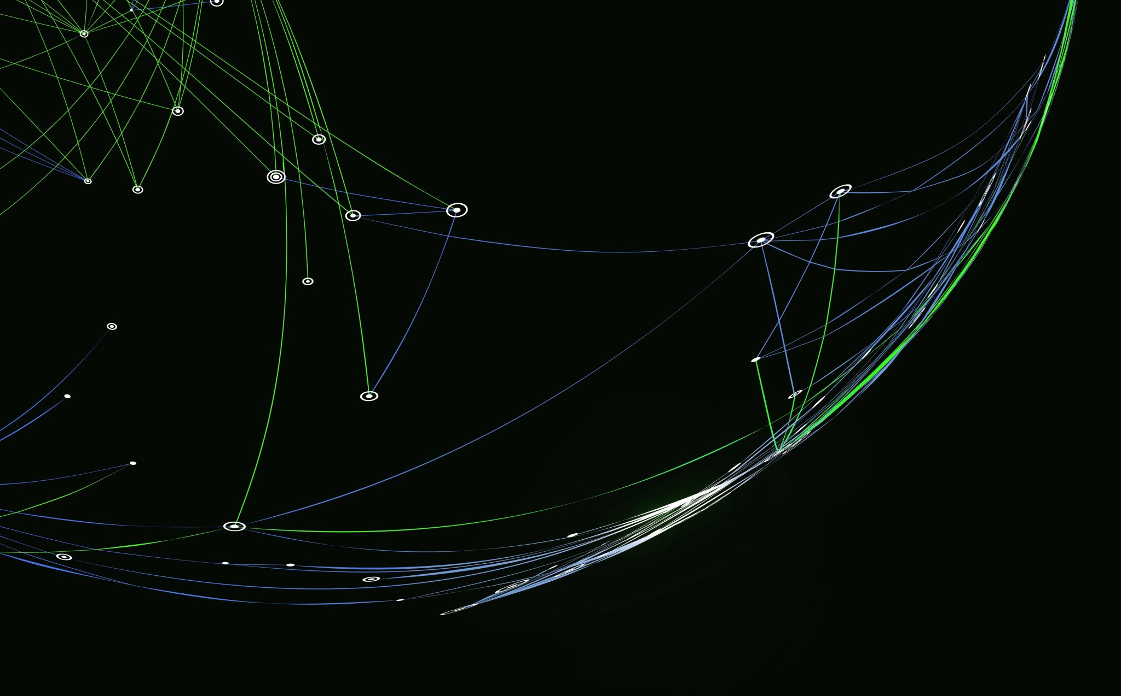
Extraction d’un lexique bilingue(manip python)

Slide 2
Objective
Create a bilingual lexicon using a corpus of English and French texts

Slide 3
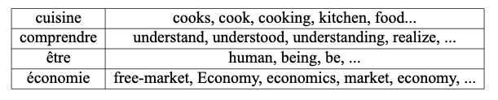
Definitionof a bilingual lexicon
A bilingual lexicon is a dictionary that associates a word of a source language with the list of its possible translations in a target language.

Slide 4
Methodology
The extraction will be unsupervised : the method used will take as input only a set of sentence pairs (a sentence in French and its translation in English).
Such a corpus is called a "parallel corpus" and sentences that are translations of each other are called "parallel".

Slide 5
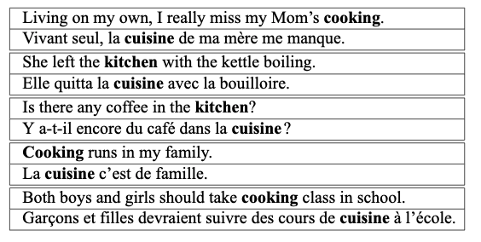
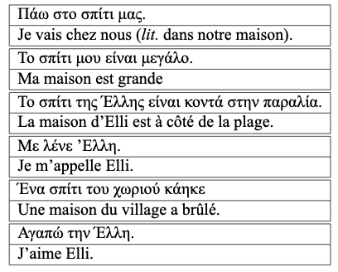
Examples of parallel corpora
French-English
French-Greek

Slide 6
« You shall know a word by the company it keeps » (Firth, J. R. 1957)
The proposed approach is based on a linguistic theory, the distributional hypothesis: the meaning of a word can be deduced directly from the context in which it appears.
The generalization of this hypothesis to the bilingual case can be formulated as follows:
a French word and an English word that frequently co-occur (appear in a pair of parallel sentences) have a high chance of being translations of each other.
Thus, in the example of the corpus on the previous slide, it is natural to assume that cuisine can be translated either by cooking or by kitchen because these are the only words that appear in all translations.

Slide 7
Mini exercise
Considering the French-Greek corpusin the previous slide, can you give the Greek translations of the words Elli, est and maison.

Slide 8
Naïve approach
You will find on the github two files containing the novel From the Earth to the Moon in English (english.corpus) and in French (french.corpus). The documents have been pre-processed to :
be aligned at the sentence level: the i^{th} line of the French file is the translation of the i^{th} line of the English file.
segmented into words: this segmentation consists of separating some signs (e.g. « à␣l'école. » is rewritten as « à␣l'␣école␣. ») and grouping others («100 000 » is rewritten as « 100000 »).

Slide 9
Naïve approach Co-occurrence table
The extraction of a lexicon from this parallel corpus relies on the construction of a co-occurrence table.
This table can be modeled by a python dictionary which associates to a French word (the 1st key), a second python dictionary whose keys are the set of English words co-occurring with the French word and whose values are the number of sentence pairs in which the French word and the English word both appear.

Slide 10
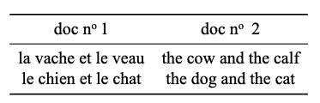
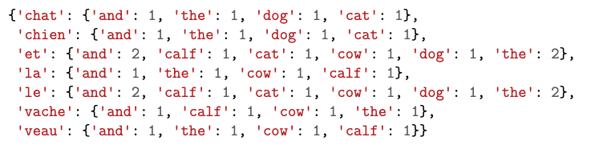
Naïve approach Co-occurrence table
For example, if the corpus consists of two sentences, this is what your python dictionary should look like :
cooc_table =

Slide 11
INstructions
Write a method build_cooc_table(filepath_fr, filepath_en) that takes two filenames describing a parallel corpus and returns the co-occurrence table of this corpus.
Beware: we want to determine the number of sentences in which a word appears, and even if a word appears several times in the same sentence, it must be counted only once.
=> Remember to remove duplicates within a sentence before performing the counts.

Slide 12
INstructions
Sort the cooc table by decreasing frequency and print it in an external file (1 pair of words per line).
To sort the table, you will first have to transform it into a list of tuples (French word, English word, frequency).
Finally, interpret the result obtained: does this method allow you to build a "good" lexicon?

