Slide 1

Independence + Joint, Marginal and Conditional Probability

Slide 2
The General Multiplication Rule (a.k.a. the Chain Rule)
When we calculate probabilities involving one event AND another event occurring, we multiply their probabilities.
In some cases, the first event happening impacts the probability of the second event. We call these dependent events.
In that case => P(A,B) = P(A) x P(B|A)
In other cases, the first event happening does not impact the probability of the seconds. We call these independent events.
In that case => P(A,B) = P(A) x P(B)

Slide 3
Independent Events: Flipping a coin twice
What is the probability of flipping a fair coin and getting "heads" twice in a row? That is, what is the probability of getting heads on the first flip AND heads on the second flip?
Imagine we had 100 people simulate this and flip a coin twice. On average, 50 people would get heads on the first flip, and then 25 of them would get heads again. So 25 out of the original 100 people — ¼ of them — would get heads twice in a row.
The number of people we start with doesn't really matter. Theoretically, 1/2 of the original group will get heads, and ½ of that group will get heads again. To find a fraction of a fraction, we multiply.

Slide 4
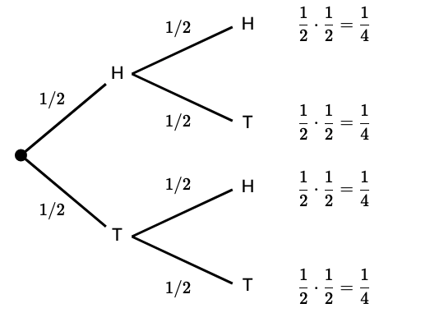
Independent Events
We can represent this concept with a tree diagram :

Slide 5
Independent Events
We multiply the probabilities along the branches to find the overall probability of one event AND the next even occurring.
For example, the probability of getting 2 "tails" in a row would be:
P(T and T) = ½ . ½ = 1/4

Slide 6
Practice Problem 1
Suppose that we are going to roll two fair 6-sided dice.
Find the probability that both dice show a 3.

Slide 7
Practice Problem 2
On a multiple choice test, problem 1 has 4 choices and problem 2 has 3 choices. Each problem has only 1 correct answer. What is the probabilty of randomly guessing the correct answer to both problems ?

Slide 8
Dependent events: Drawing cards
We can use a similar strategy even when we are dealing with dependent events.
Consider drawing two cards, without replacement, from a standard deck of 52 cards. That means we are drawing the first card, leaving it out, and then drawing the second card.
What is the probability that both cards selected are black?

Slide 9
Dependent events: Drawing cards
Half of the 52 cards are black, so the probability that the first card is black is 26/52.
But the probability of getting a black card changes on the next draw, since the number of black cards and the total number of cards have both been decreased by 1.

Slide 10
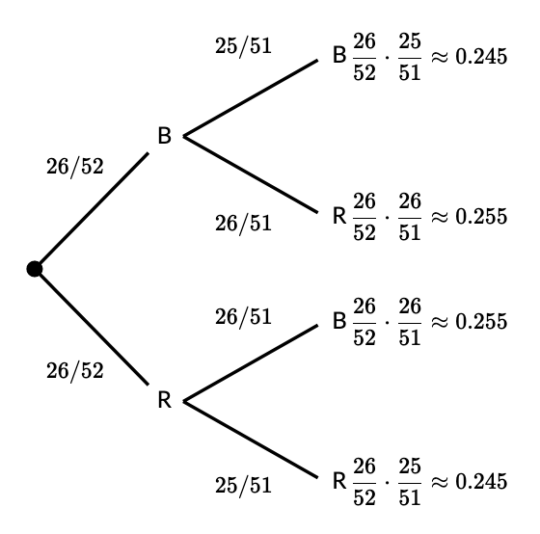
Dependent events: Drawing cards
Here's what the probabilities would look like in a tree diagram:

Slide 11
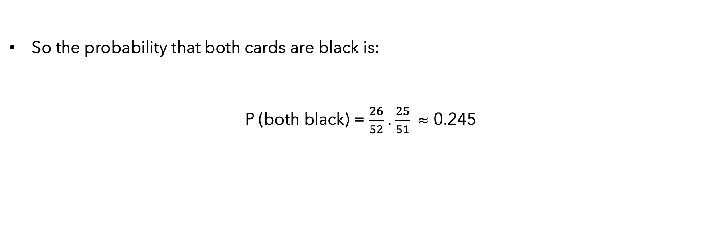
Dependent events: Drawing cards
So the probability that both cards are black is:
P (both black) = $\frac{26}{52}$ . $\frac{25}{51}$ ≈ 0.245

Slide 12
Practice Problem 1
A table of 5 students has 3 seniors and 2 juniors. The teacher is going to pick 2 students at random from this group to present homework solutions.
Find the probability that both students selected are juniors.

Slide 13
Practice Problem 2
The probability of winning the Nobel Prize if you have a PhD in Physics is 1 in a million [P(A|B = 0.000001]
Only 1 in 10,000 people have a PhD in Physics [P(B) = 0.0001]
What is the probability of a person both having a PhD in Physics and winning the Nobel Prize? 1. Smaller than 1 in a million 2. Greater than 1 in a million 3. Impossible to tell

Slide 14
Independence with regard to Conditional Probability
Two events A and B are independent if and only if :
P(A, B) = P(A)P(B)
Meaning :
P(A) = P(A|B)
P(B) = P(B|A)

Slide 15

General Definition
Given events A and B in Ω, with P (B) > 0 the conditional probability of A given B is
P (A and B) or P(A,B) is the joint probability of A and B.
The prob that a person is rich and famous –> joint The prob that a person is rich if they are famous –> conditional The prob that a person is famous if they are rich –> conditional

Slide 16
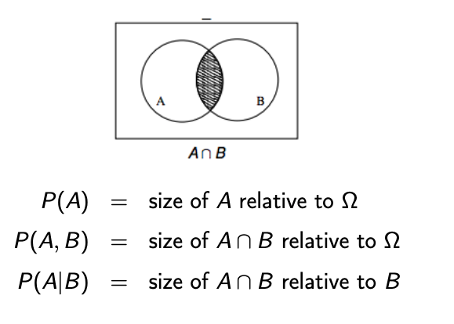
Conditional Probability with Venn Diagrams

Slide 17
NLP example
We sample word bigrams (pairs) from a large text T
Sample space and events:
Ω = {(w1, w2) ∈ T } => the set of bigrams in T
A = {(w1, w2) ∈ T | w1 = run } => bigrams starting with run
B = {(w1, w2) ∈ T | w2 = amok } => bigrams ending with amok
Probabilities :
P (A) = 10⁻³ => proba that a bigram starts with run
P (B) = 10⁻⁶ => proba that a bigram ends with amok
P (A, B) = 10⁻⁷ => proba of the bigram run amok
So what is the probability of amok following run? Of run preceding amok?

Slide 18
NLP example
So what is the probability of amok following run? Of run preceding amok?
P (amok following run) = P(B|A) = 10⁻⁷/ 10⁻³ = 0.0001
P (run preceding amok) = P (A|B) = 10⁻⁷/ 10⁻⁶ = 0.1

Slide 19
Marginal Probability
Marginalization, or the law of total probability
Best illustrated with an example

Slide 20
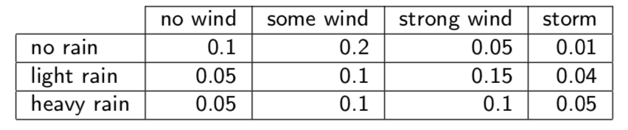
Marginal Probability
Joint probabilities for rain and wind :
P (no wind) = ?
P (light rain) = ?

Slide 21
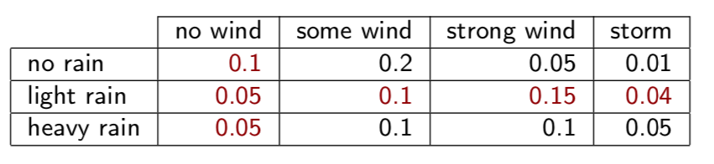
Marginal Probability
P(no wind) = 0.1+0.05+0.05 = 0.2
P(light rain) = 0.05 + 0.1 + 0.15 + 0.04 = 0.34
=> Marginal because we’re interested in the total probability, we’ve removed any dependence regarding the wind or the rain (depending on the case).

Slide 22
Marginal Probability
P(no wind) = 0.2
P(light rain) = 0.34
Combine to get conditional probabilities:
P (no wind | light rain) = 0.05/0.34 = 0.147
P (light rain | no wind) = 0.05/0.2 = 0.25

Slide 23
Practice Case: Airport Bags
An airport screens bags for forbidden items, and an alarm is supposed to be triggered when a forbidden item is detected.
Suppose that 5%, percent of bags contain forbidden items.
If a bag contains a forbidden item, there is a 98%, percent chance that it triggers the alarm.
If a bag doesn't contain a forbidden item, there is an 8%, percent chance that it triggers the alarm.
Given that a randomly chosen bag triggers the alarm, what is the probability that it contains a forbidden item?

Slide 24
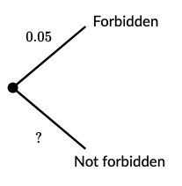
Practice Case: Airport Bags
The chance that the alarm is triggered depends on whether or not the bag contains a forbidden item, so we should first distinguish between bags that contain a forbidden item and those that don’t.

Slide 25
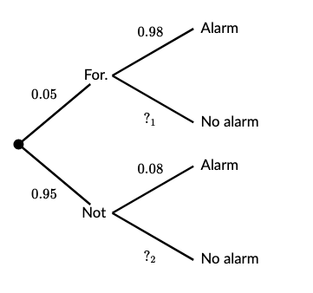
Practice Case: Airport Bags
"If a bag contains a forbidden item, there is a 98%, percent chance that it triggers the alarm."
"If a bag doesn't contain a forbidden item, there is an 8%, percent chance that it triggers the alarm. »

Slide 26
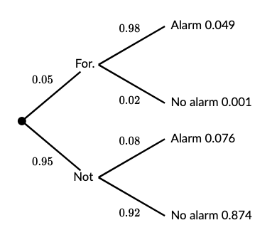
Practice Case: Airport Bags
We multiply the probabilities along the branches to complete the tree diagram.
Here's the completed diagram:

Slide 27
Practice Case: Airport Bags
"Given a randomly chosen bag triggers the alarm, what is the probability that it contains a forbidden item?"
Use the probabilities from the tree diagram and the conditional probability formula:
P (forbidden ∣ alarm) = P(F ∩ A) / P(A)

Slide 28
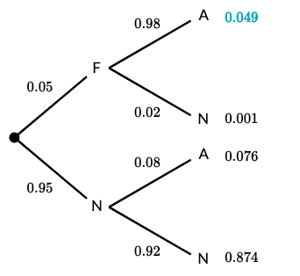
Practice Case: Airport Bags
P(F ∩ A) = 0.05 x 0.98 = 0.049

Slide 29
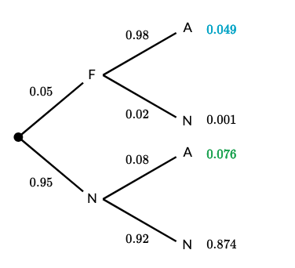
Practice Case: Airport Bags
There are two situations where bags can trigger the alarm, so we add those two probabilities together to get the marginal probability :
P(A)​ = P(F ∩ A)+ P(N ∩ A) = 0.125

Slide 30
Practice Case: Airport Bags
Finally : Given that a randomly chosen bag triggers the alarm, what is the probability that it contains a forbidden item?:
P(F∣A)​ = P(F ∩ A) / P(A)
= 0.049 / (0.076 + 0.049​)
= 0.049 / 0.125​
= 0.392​
Why does this make sense ? Why is it so low ?

Slide 31
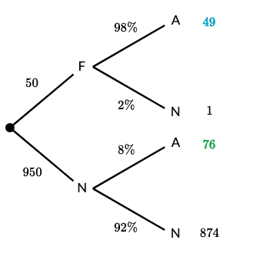
Practice Case: Airport Bags
In this problem, with a sample of 1000 bags, we can clearly see there are more bags without forbidden items that trigger the alarm…
So when all we know is that a random bag triggers the alarm, it's actually more likely to NOT contain a forbidden item.

Slide 32
Practice Case : Testing for a Disease
A hospital is testing patients for a certain disease. If a patient has the disease, the test is designed to return a "positive" result. If a patient does not have the disease, the test should return a "negative" result. No test is perfect though.
99% of patients who have the disease will test positive.
5% of patients who don't have the disease will also test positive.
10% of the population in question has the disease.
If a random patient tests positive, what is the probability that they have the disease?

Slide 33
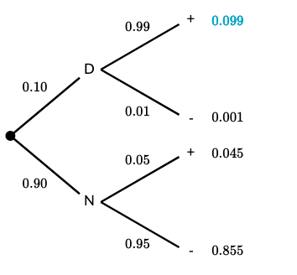
Practice Case : Testing for a Disease
Tree diagram :

Slide 34
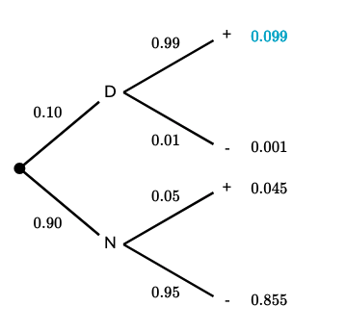
Practice Case : Testing for a Disease
Since 10% of patients have the disease, and 99% of those patients test positive, we can multiply those probabilities:
P(D ∩ +) = 0.10 x 0.99 = 0.099

Slide 35
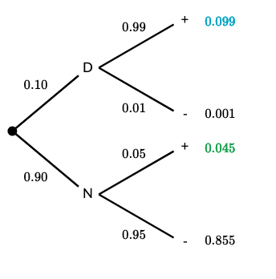
Practice Case : Testing for a Disease
There are two situations where patients can test positive, so we add those two probabilities together:
P(+)​ = P(D ∩ +) + P(N ∩ +)
=0.099 + 0.045
= 0.144​

Slide 36
Practice Case : Testing for a Disease
If a random patient tests positive, what is the probability that they have the disease?
P(D ∣ +)​ = P(+) P(D∩ +)​
= 0.099 / (0.099 + 0.045​)
= 0.099 / 0.144​
= 0.6875​

