Slide 1
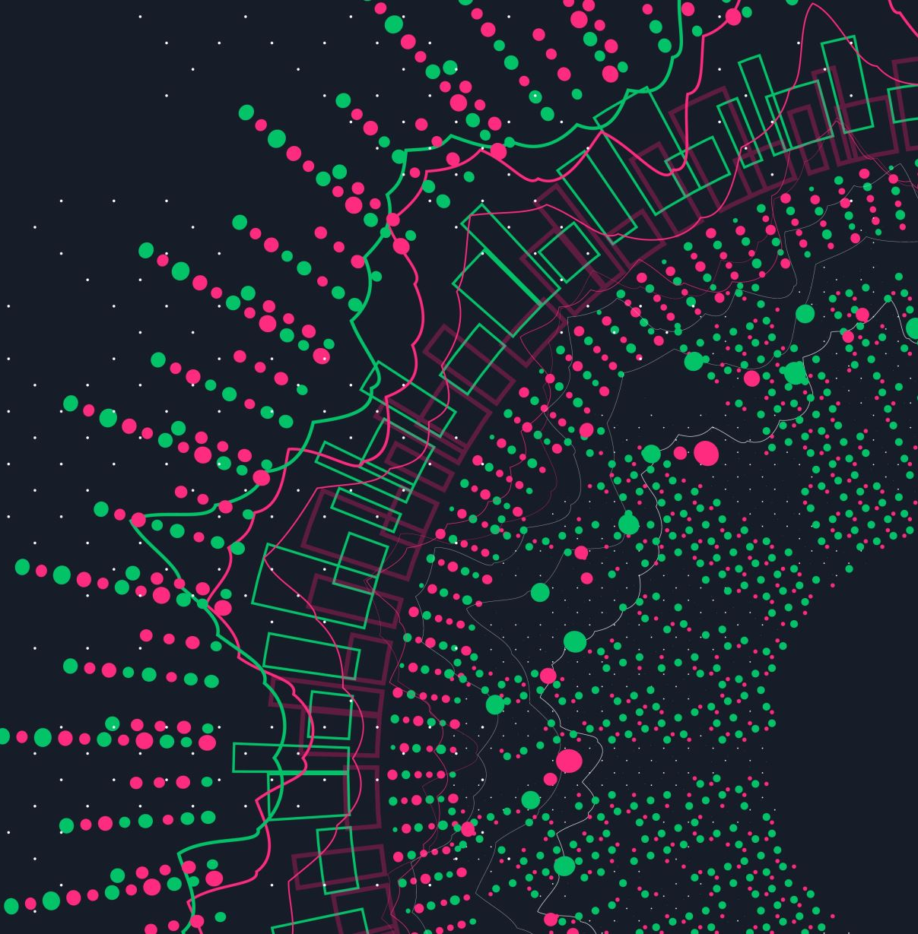
The Language Modeling Problem

Slide 2
The Language Modeling Problem
One of the oldest problem studied in statistical NLP because very useful
Used in many applications

Slide 3
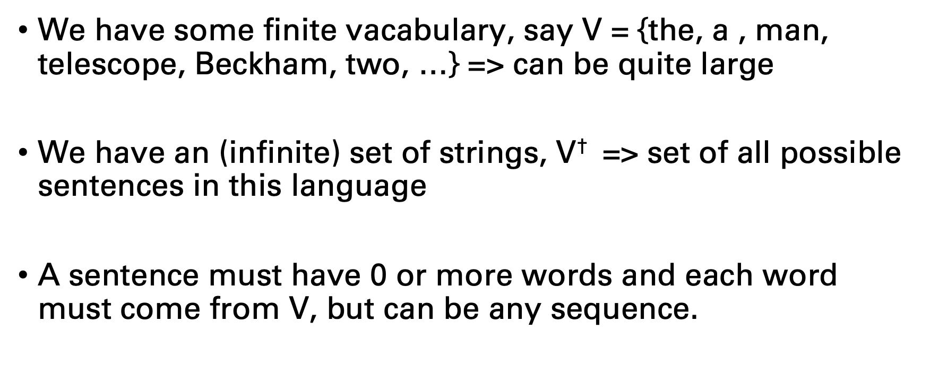
The Language Modeling Problem
We have some finite vacabulary, say V = {the, a , man, telescope, Beckham, two, …} => can be quite large
We have an (infinite) set of strings, $\text{V}$† => set of all possible sentences in this language
A sentence must have 0 or more words and each word must come from V, but can be any sequence.

Slide 4
The Language Modeling Problem
Possible sentences :
The STOP
A STOP
The fan STOP
The fan saw Beckham STOP
The fan saw saw STOP
The the the STOP
STOP

Slide 5
The Language Modeling Problem
We have a training sample of example sentences in English
Collection of sentences from the New York Times during the last ten years for example,
or large sample of sentences from the web
90s => 20 million words
2000s => 1 billion words
Nowadays => 100s billions words

Slide 6
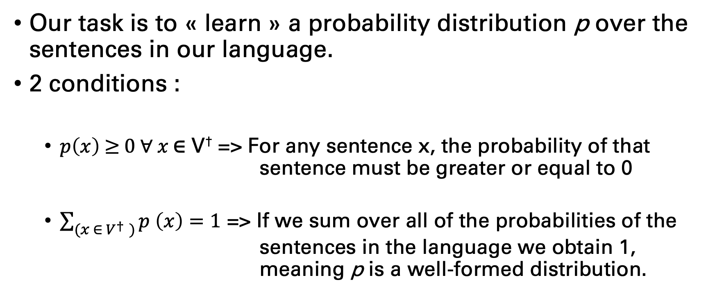
The Language Modeling Problem
Our task is to « learn » a probability distribution p over the sentences in our language.
2 conditions :
$p\left(x\right) \text{≥} 0 ∀ x \text{∈} \text{V}$†$\text{=>}$ For any sentence x, the probability of that sentence must be greater or equal to 0
$\sum_{(x ∈ V^{†} )}{p \left(x\right)=1}$ => If we sum over all of the probabilities of the sentences in the language we obtain 1, meaning p is a well-formed distribution.

Slide 7
The Language Modeling Problem
p is essentially a function which returns the probability for a sequence in a given language.
P (the STOP) = 10⁻¹²
P (the fan STOP) = 10⁻⁸
P (the fan saw Beckham STOP) = 2 x 10⁻⁸
P (the fan saw saw) = 10⁻¹⁵
… assign a probability to every sequence in the language

Slide 8
The Language Modeling Problem
We want to try and assign a high probability to likely sentences in English and low proba to unlikely sentences in English

Slide 9
Why would we want to do this ?!
Language models are useful in many applications:
Speech recognition: language models are criticla for modern speech recognizers (handwriting recognition also)
The estimaiton techniques used for this problem are useful for other NLP problems such as POS tagging or automatic translation.

Slide 10
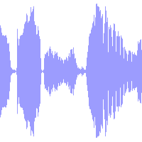
Language modeling for Speech Recognition
Quick sketch :
Input => an acoustic recording
Then map this input to the words which are actually spoken

Slide 11
Language modeling for Speech Recognition
Imagine the person says « recognize speech »
In practice, there are actually many alternative sentences which could have been spoken :
« wreck a nice beach »
….
….
Similar sentences from an acoustic point of view

Slide 12
Language modeling for Speech Recognition
A language model allows us to produce a probability for each sentence and estimate that « recognize speech » is more probable than another option.
=> Adds some very useful info to get rid of these kinds of cunfusions

Slide 13
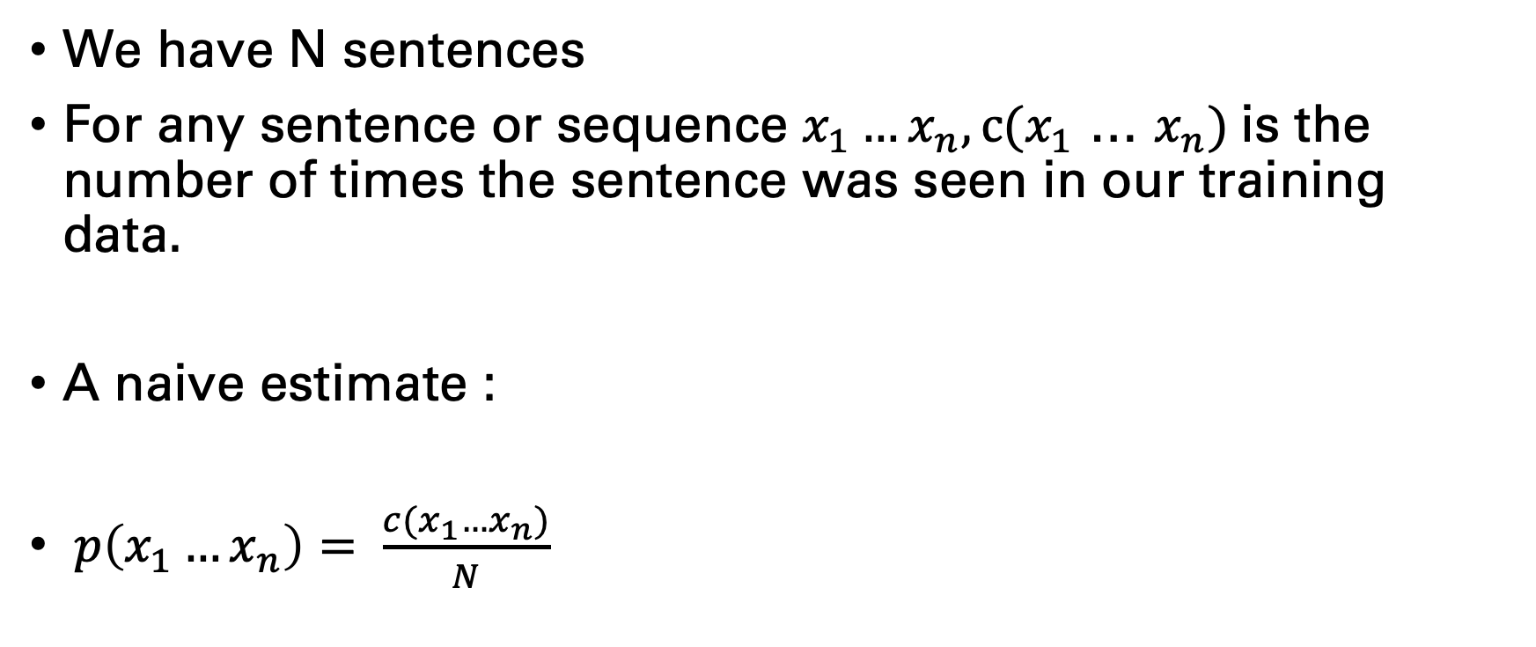
A naive method for Language Modeling
We have N sentences
For any sentence or sequence $x_{1}…x_{n}, c(x_{1}$ … $x_{n})$is the number of times the sentence was seen in our training data.
A naive estimate :
$p\left(x_{1}…x_{n}\right)= \frac{c(x_{1}…x_{n})}{N}$

Slide 14
A naive method for Language Modeling
Has some deficiencies, although it’s a well-formed language model:
Mainly it assigns proba 0 to any sentence not seen in our training sample…
Cannot generalize to new sentences

Slide 15
Trigram Models
Widely used language model
Build heavily on the idea of Markov processes…

Slide 16
Markov Processes
Consider a sequence of random variables X₁,…, X_{n}.
Each random variable can take any value in a finite set V (vocab).
We can assume the length n is fixed for now. (n=100 for ex.)
We want to model the joint probability
P (X₁ = x₁, …, X_{n} = x_{n})

Slide 17
Markov Processes
Huge number of possible values.
|V|^{n} possible sequences in our example

Slide 18
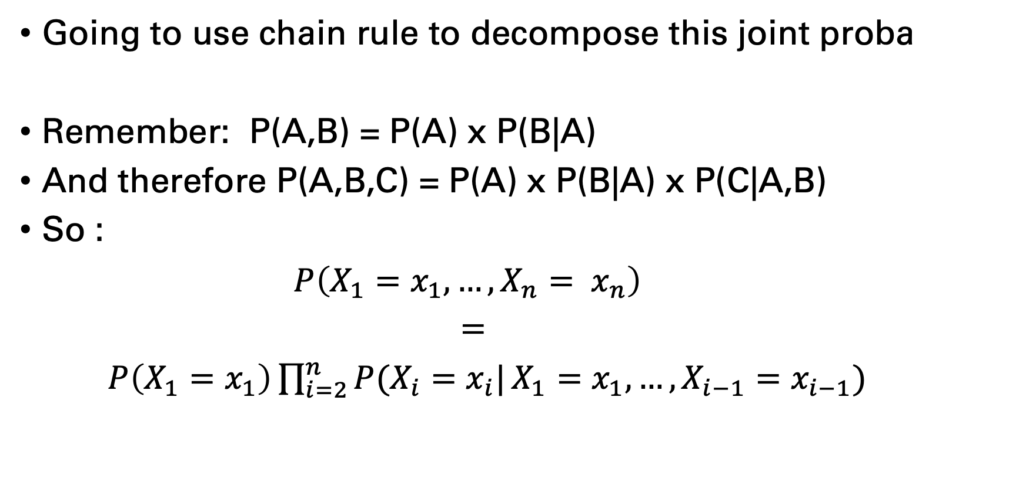
First-Order Markov Process
Going to use chain rule to decompose this joint proba
Remember: P(A,B) = P(A) x P(B|A)
And therefore P(A,B,C) = P(A) x P(B|A) x P(C|A,B)
So :
$P\left(X_{1}=x_{1}, …, X_{n}= x_{n}\right)$
=
$P\left(X_{1}=x_{1}\right)\prod_{i=2}^{n}{P(X_{i}=x_{i}|}X_{1}=x_{1}, …, X_{i−1}=x_{i−1})$

Slide 19
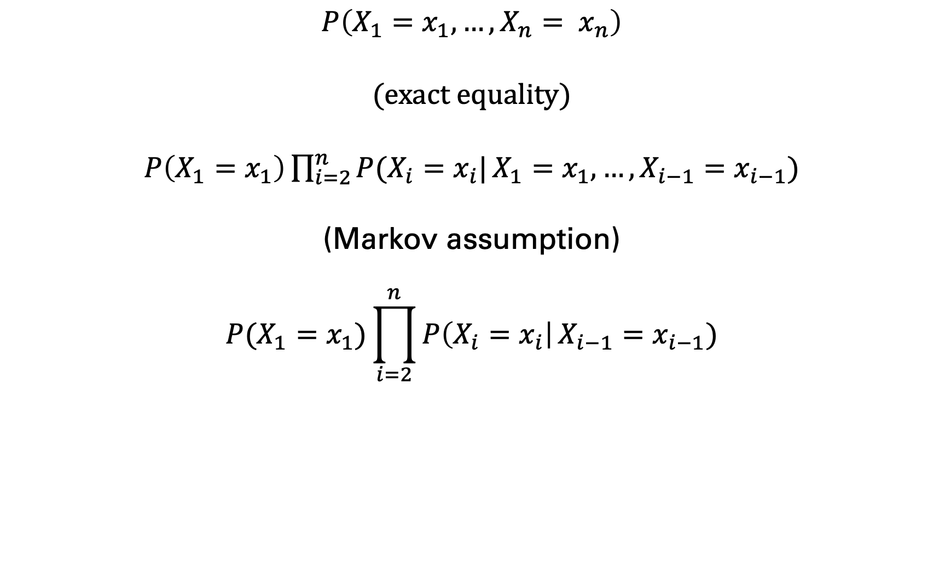
First-Order Markov Process
$$P\left(X_{1}=x_{1}, …, X_{n}= x_{n}\right)$$
(exact equality)
$P\left(X_{1}=x_{1}\right)\prod_{i=2}^{n}{P(X_{i}=x_{i}|}X_{1}=x_{1}, …, X_{i−1}=x_{i−1})$
(Markov assumption)
$$P(X_{1}=x_{1})\prod_{i=2}^{n}{P\left(X_{i}=x_{i}\right|}X_{i−1}=x_{i−1})$$

Slide 20
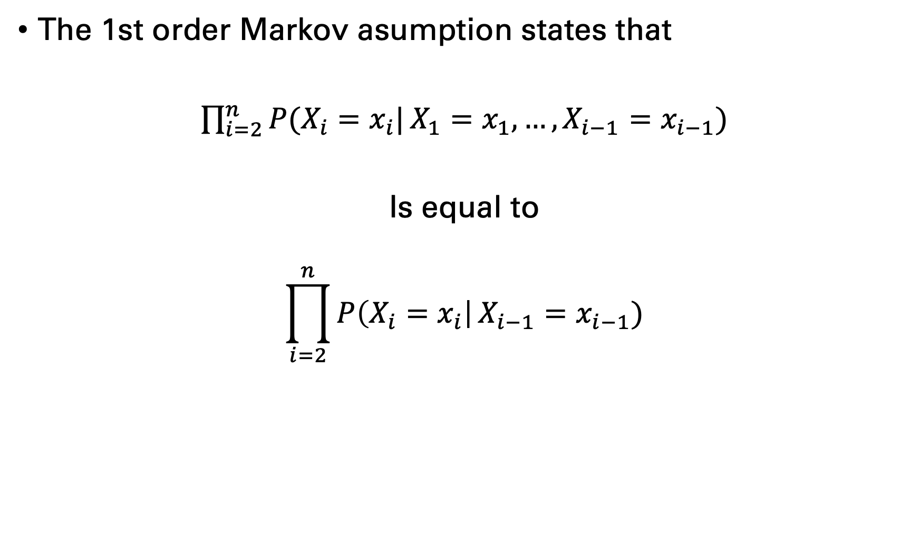
First-Order Markov Process
The 1st order Markov asumption states that
$\prod_{i=2}^{n}{P(X_{i}=x_{i}|}X_{1}=x_{1}, …, X_{i−1}=x_{i−1})$
Is equal to
$$\prod_{i=2}^{n}{P\left(X_{i}=x_{i}\right|}X_{i−1}=x_{i−1})$$

Slide 21
First-Order Markov Process
Huge assumption to state that the probabilty of a word here is only conditioned on the previous word…

Slide 22
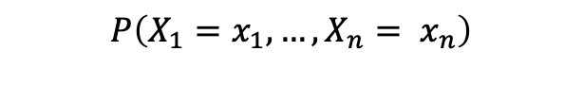
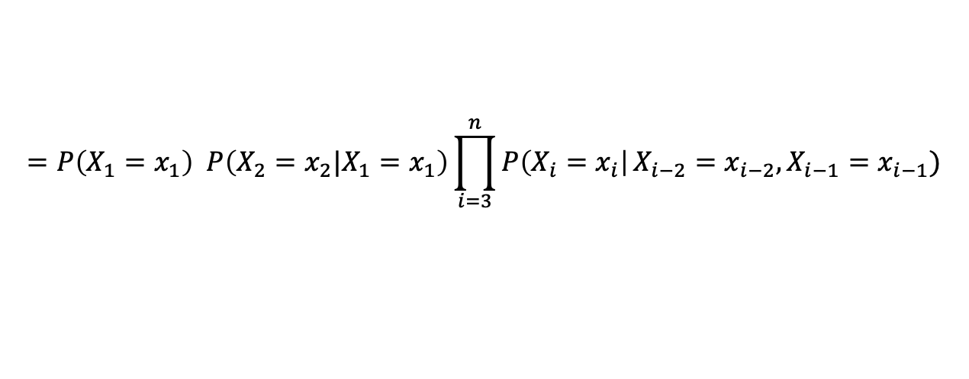
Second-Order Markov Precesses
Very similar model :
Condition on previous 2 elements vs only the previous element
$$P\left(X_{1}=x_{1}, …, X_{n}= x_{n}\right)$$
$$=P\left(X_{1}=x_{1}\right) P\left(X_{2}=x_{2}|X_{1}=x_{1}\right)\prod_{i=3}^{n}{P\left(X_{i}=x_{i}\right|}X_{i−2}=x_{i−2},X_{i−1}=x_{i−1})$$

Slide 23
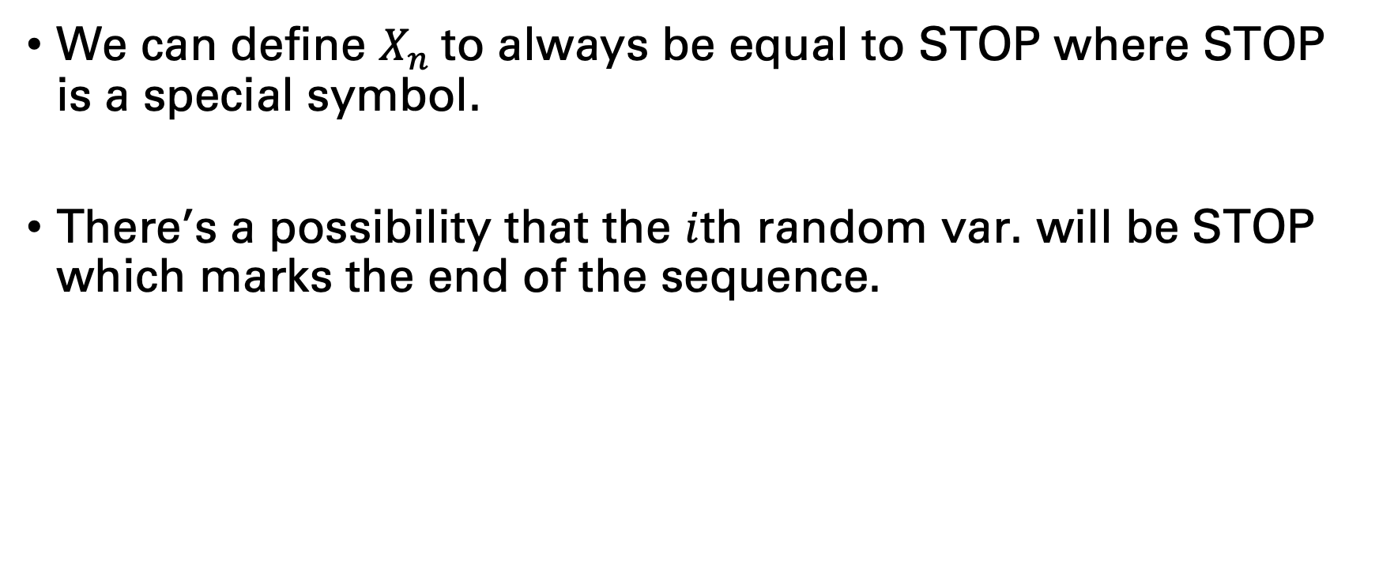
Second-Order Markov Precesses
We can define $X_{n}$to always be equal to STOP where STOP is a special symbol.
There’s a possibility that the $i$th random var. will be STOP which marks the end of the sequence.

Slide 24
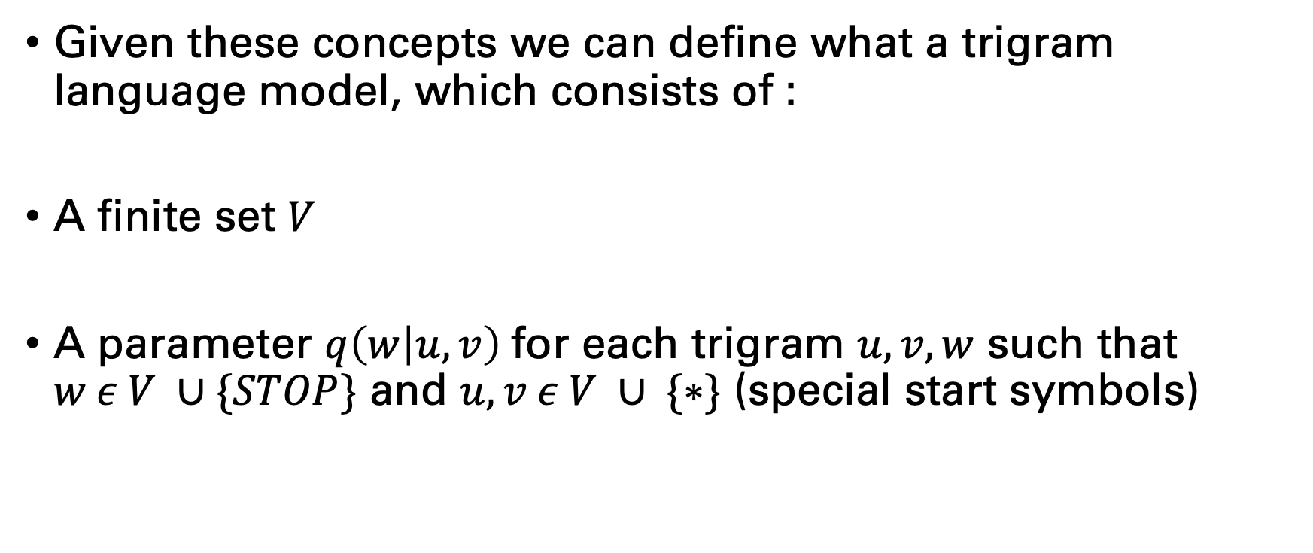
Trigram Language Model
Given these concepts we can define what a trigram language model, which consists of :
A finite set $V$
A parameter $q\left(w | u,v\right)$for each trigram $u, v, w$ such that $w ε V ∪\{STOP\}$ and $u, v ε V ∪ \{∗\}$ (special start symbols)

Slide 25
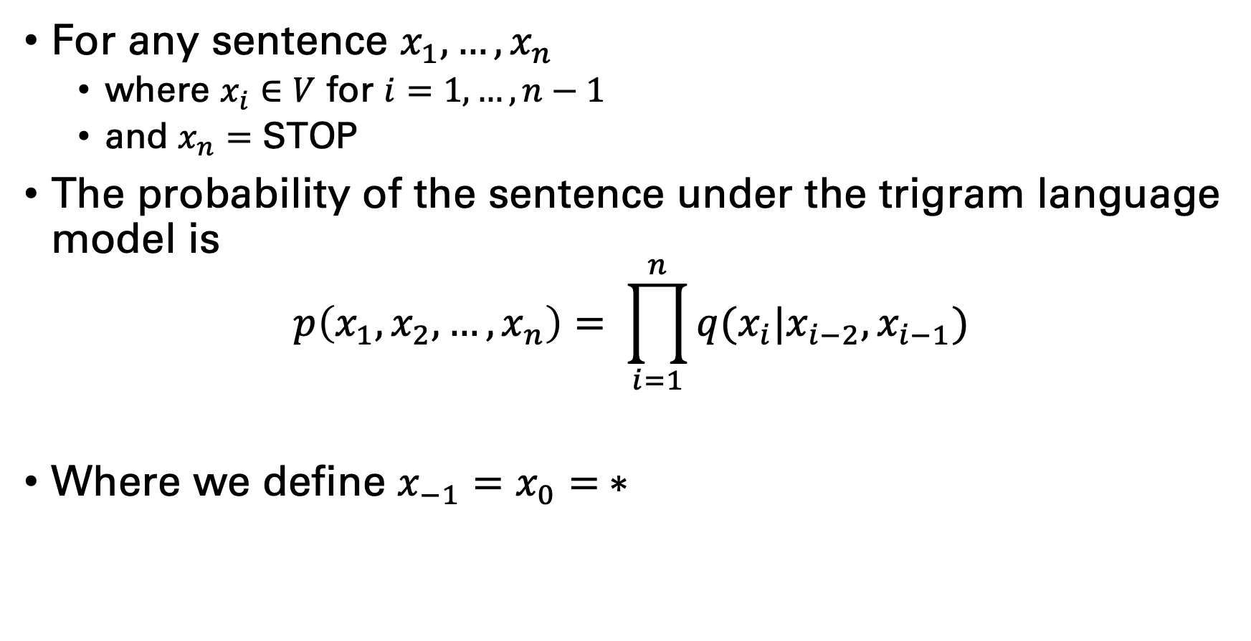
Trigram Language Model Formal Definition
For any sentence $x_{1}, …, x_{n}$
where $x_{i}∈V$ for $i=1, …, n−1$
and $x_{n}=$ STOP
The probability of the sentence under the trigram language model is
$$p\left(x_{1}, x_{2}, …, x_{n}\right)= \prod_{i=1}^{n}{q(x_{i}|x_{i−2}, x_{i−1})}$$
Where we define $x_{−1}=x_{0}= ∗$

Slide 26
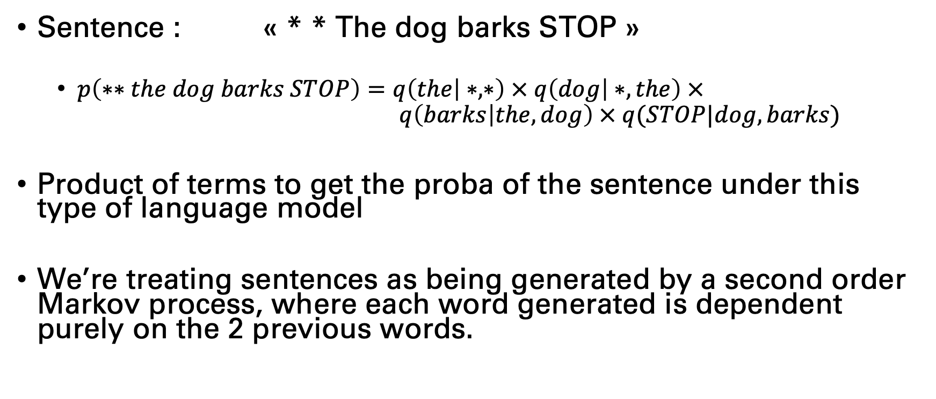
An example to make things clearer
Sentence : « * * The dog barks STOP »
$p\left(∗∗the dog barks STOP\right)=q\left(the | ∗,∗\right) × q\left(dog | ∗, the\right) × q\left(barks | the, dog\right) × q(STOP|dog, barks)$
Product of terms to get the proba of the sentence under this type of language model
We’re treating sentences as being generated by a second order Markov process, where each word generated is dependent purely on the 2 previous words.

Slide 27
Trigram Language Model
Advantages :
Simple, easy and cheap
useful for many applications
availablity of statistics over the internet
well understood math
Disadvantages:
Language: they do not capture non-local dependencies

Slide 28

Estimating the parameters
So we need to estimate $q(w_{i}|w_{i−2},w_{i−1})$
Remember, if we have two dependent events :
$p\left(A,B\right)=p\left(A\right)× p(B|A)$
Which is equivalent to
$p(B│A)=\frac{p(A,B) }{p(A)}$
Which can be generalized to 3 events
$$p\left(C | A,B\right)= \frac{p(A,B,C)}{p(A,B)}$$

Slide 29
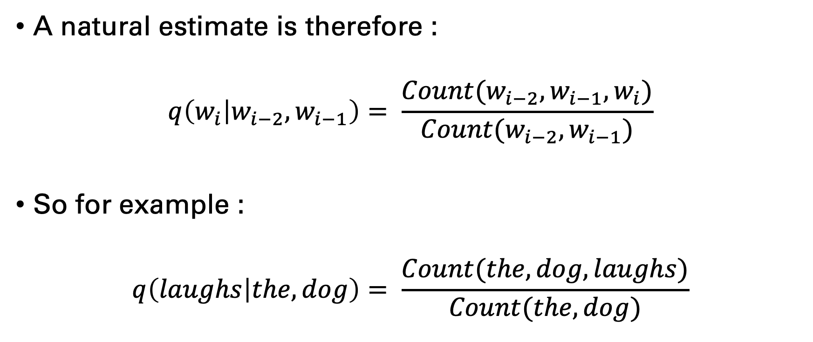
Estimating the parameters
A natural estimate is therefore :
$$q\left(w_{i} | w_{i−2},w_{i−1}\right)= \frac{Count(w_{i−2},w_{i−1},w_{i})}{Count(w_{i−2},w_{i−1})}$$
So for example :
$$q\left(laughs | the, dog\right)= \frac{Count(the, dog, laughs)}{Count(the, dog)}$$

Slide 30
Estimating the parameters from a toy corpus
An example corpus:
1. the cat saw the mouse. 2. the cat heard a mouse. 3. the mouse heard. 4. a mouse saw. 5. a cat saw. 6. a cat heard the mouse.
=> Using the corpus, give the parameter estimates for :
a bigram language model
a trigram language model
(the parameters for the first 2 sentences are enough)

Slide 31
Estimating the parameters
Bigram | Count | Unigram | Count | Relative frequency
* the | 3 | * | 6 | 3/6
the cat | 2 | the | 5 | 2/5
cat saw | 2 | cat | 4 | 2/4
saw the | 1 | saw | 3 | 1/3
the mouse | 2 | the | 5 | 2/5
mouse STOP | 3 | mouse | 5 | 3/5
cat heard | 2 | cat | 4 | 2/4
heard a | 1 | heard | 3 | 1/3
a mouse | 2 | a | 4 | 2/4
… | … | … | … | …

Slide 32
Estimating the parameters
Trigrams | Count | Bigram | Count | Relative frequency
* * the | 3 | ** | 6 | 3/6
* the cat | 2 | * the | 3 | 2/3
the cat saw | 1 | the cat | 2 | 1/2
cat saw the | 1 | cat saw | 2 | 1/2
saw the mouse | 1 | saw the | 1 | 1
the mouse STOP | 2 | the mouse | 3 | 2/3
the cat heard | 1 | the cat | 2 | 1/2
cat heard a | 1 | cat heard | 2 | 1/2
heard a mouse | 1 | heard a | 1 | 1
a mouse STOP | 1 | a mouse | 2 | 1/2
… | … | … | … | …

