Slide 1
Numpy Tutorial and Cosine Similarity

Slide 2
Numpy
Open notebook in github repo using google colab
Go to file ‘import notebook’ and pass in the github repo url
Or create a virtual env in which you install jupyter and numpy
Python3 –m venv __name__
Source __name__/bin/activate
Pip install jupyter numpy
Deactivate (to leave env)
You can also use the conda command but you need to install miniconda first
Then you can do :
Conda create --name __name__ python=3.9
Conda activate __name__
Conda install jupyter numpy
conda deactivate (to leave env)

Slide 3
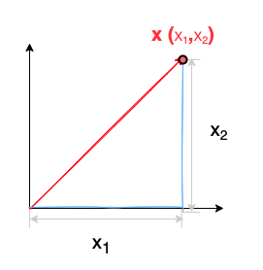
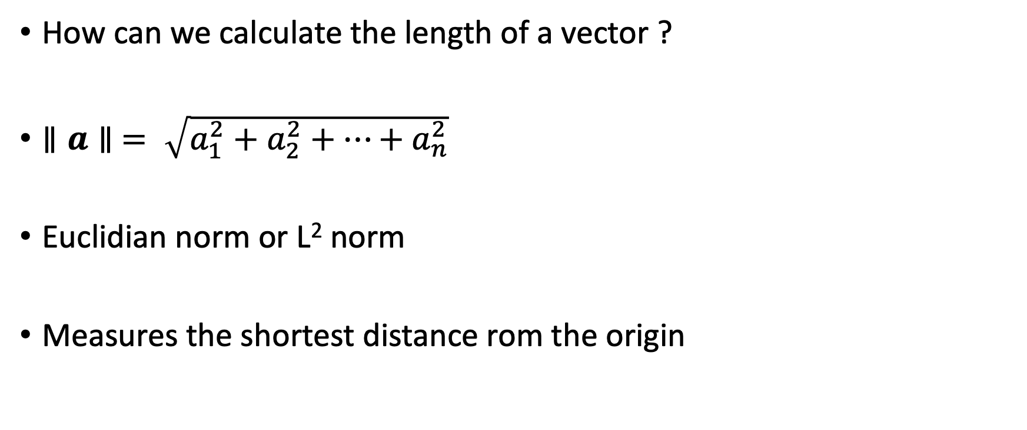
Vector Norm – Euclidian Norm
How can we calculate the length of a vector ?
$∥a∥ = \sqrt{a_{1}^{2}+a_{2}^{2}+…+a_{n}^{2}}$
Euclidian norm or L² norm
Measures the shortest distance rom the origin

Slide 4
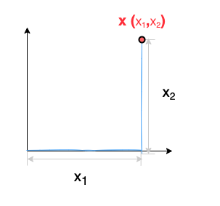

Manhattan Norm
$∥a∥ =\left|a_{1}\right|+\left|a_{2}\right|+…+|a_{n}|$
L₁ norm or Manhattan norm
Sum of the absolute values of the components of the vector

Slide 5
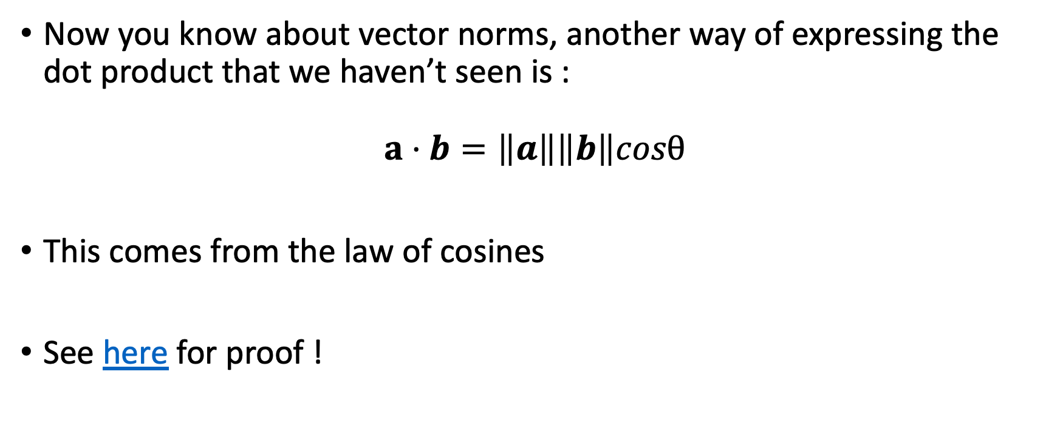
Law of Cosines and the Dot Product
Now you know about vector norms, another way of expressing the dot product that we haven’t seen is :
$$a⋅b=\left\|a\right\|\left\|b\right\|cosθ$$
This comes from the law of cosines
See here for proof !

Slide 6
New intuition about the dot product
The result of the dot product is therefore impacted by
the vectors’ magnitude
their direction/the angle between them
When θ < 90° dot product is positive
When θ = 90° dot product = 0
When 90° < θ < 180° dot product is negative

Slide 7
Cosine Similarity
Cosine similarity measures the similarity between two vectors.
It is measured by the cosine of the angle between two vectors and determines whether two vectors are pointing in roughly the same direction.
It is often used to measure document similarity in text analysis.
https://www.sciencedirect.com/topics/computer-science/cosine-similarity

Slide 8

Cosine Similarity
$$Similarity\left(a, b\right)=\cos{θ}=\frac{a ⋅b}{‖a‖‖b‖}$$
Remember
$$a⋅b=\left\|a\right\|\left\|b\right\|cosθ$$

Slide 9
Transfroming sentences into vectors
Now we’ve seen these fancy mathematical tools, we want to use them !
But how de we transform text into numerical data…?
One of the easiest ways to do this is to represent a sentence or document with attributes (or vector dimensions) which record the frequency of the words that appear in that particular sentence/doc !
Each document is then represented by an object called a term-frequency vector.

Slide 10
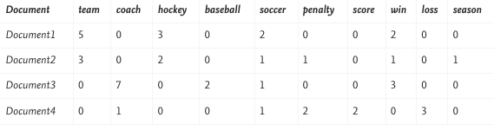
Term-Frequency Vector Example
Do you see any potential problems with such a representation ?
https://www.sciencedirect.com/topics/computer-science/cosine-similarity

Slide 11

These vectors are very sparse :
They are full of zeros !
And usually very long
In order for the dot product to work, the vector representations must have the same number of dimensions, which typically equals the number of words found in the vocab used…

Slide 12
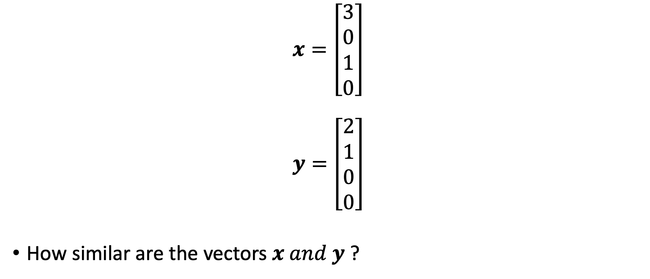
Calculating the cosine similarity between 2 term-frequency vectors by hand
$$x=\left[\begin{aligned}3 \\ 0 \\ 1 \\ 0\end{aligned}\right]$$
$$y=\left[\begin{aligned}2 \\ 1 \\ 0 \\ 0\end{aligned}\right]$$
How similar are the vectors $x and y$ ?

Slide 13
Implementing cosine similarity with numpy
See the github repo

