Slide 1

Manipulating Text with python and Spacy Introduction

Slide 2
Virtual Environments and how to install them
Conda : install miniconda3 on your own if you want to
https://www.youtube.com/watch?v=bbIG5d3bOmk for mac
https://www.youtube.com/watch?v=Avx_FYdFBcc for linux
Use Venv for now (should come preinstalled with python3) : appears as a directory within your project so it’s quite easy to manage
To create a venv => python3 –m venv env_name
To activate it => source env_name/bin/activate
To deactivate it => deactivate
To delete it => rm –r env_name

Slide 3
Install a particular version of python on linux (not necessary for this project normally)
Go to https://tecadmin.net/install-python-3-7-on-ubuntu-linuxmint/

Slide 4
Coding exercise using a jupyter notebook (ideally)
In your project directory, create a virtual environment called env_gutenberg
Download Pride And Prejudice from Gutenberg using the urllib.request.urlretrieve() method
This method saves the text to a file directly
Open the text file and dump the text into a variable
Divide the text into paragraphs
find what divider is used to seperate the paragraphs and use the split() method to obtain a list of all the paragraphs
Take a look at the text and write a function to identify the first paragraph

Slide 5
Coding exercise (suite)
Write a function to clean the first paragraph to prepare it for tokenization
Eliminate any extra whitespaces and special characters such as ‘\n’

Slide 6
Intro to Spacy
Install the spacy package and carry out a couple of NLP analyses of the first paragraph
Take a look at https://realpython.com/natural-language-processing-spacy-python/#using-spacy for a simplified tutorial or look at the Spacy documentation

Slide 7
What is Spacy ?
spaCy is a free, open-source library for NLP in Python. It’s written in Cython and is designed to build information extraction or natural language understanding systems. It’s built for production use and provides a concise and user-friendly API.

Slide 8
How to Download Models and Data
spaCy has different types of models. The default model for the English language is (usually) en_core_web_sm.
Download models and data for the English language:
python -m spacy download en_core_web_sm
Import spacy and load the model :
import spacy
nlp = spacy.load('en_core_web_sm’)
the nlp object here is a language model instance. In the spacy documentation, nlp refers to the language model loaded.

Slide 9
Wrap the model around your sentence
Wrap the text with the language model (object is usually called doc):
doc = nlp(sentence)
print ([token.text for token in doc])

Slide 10
Tokenization
Tokenization allows you to identify the basic units in your text.
These basic units are called tokens.
These units can then be used for further analysis, like part of speech tagging.

Slide 11
Lemmatization
Lemmatization is the process of reducing inflected forms of a word while still ensuring that the reduced form belongs to the language. This reduced form or root word is called a lemma.
For example, organizes, organized and organizing are all forms of organize. Here, organize is the lemma.
The inflection of a word allows you to express different grammatical categories like tense (organized vs organize), number (trains vs train), and so on.
Lemmatization is necessary because it helps you reduce the inflected forms of a word so that they can be analyzed as a single item.

Slide 12
POS (Part of Speech) Tagging
Part of speech or POS is a grammatical role that explains how a particular word is used in a sentence. There are eight parts of speech:
Noun
Pronoun
Adjective
Verb
Adverb
Preposition
Conjunction
Interjection
Part of speech tagging is the process of assigning a POS tag to each token depending on its usage in the sentence. POS tags are useful for assigning a syntactic category like noun or verb to each word.

Slide 13
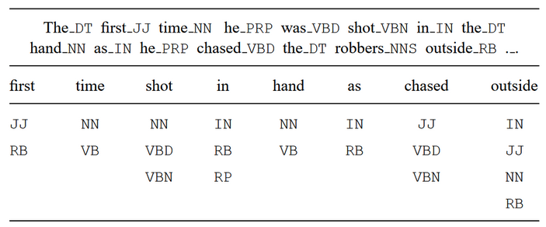
POS Tagging Ambiguity
Look at the word « shot » for example….

