Slide 1
What is Machine Learning ?
Slides inspired by Sebastian Raschka STAT451 Intro to ML

Slide 2
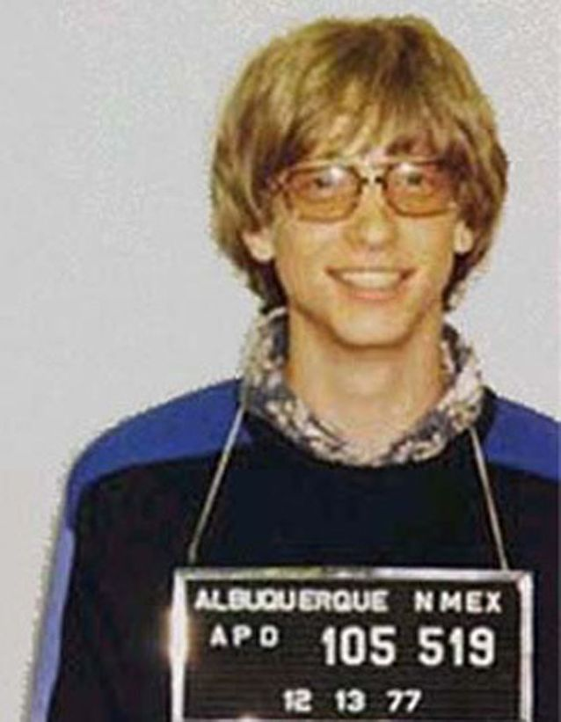
Comments and Definitions
"A breakthrough in machine learning would be worth ten Microsofts" —Bill Gates, Microsoft Co-founder

Slide 3
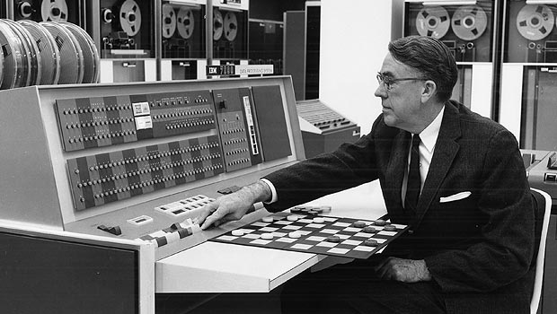
Machine learning is the field of study that gives computers the ability to learn without being explicitly programmed” — Arthur L. Samuel, AI pioneer, 1959

Slide 4
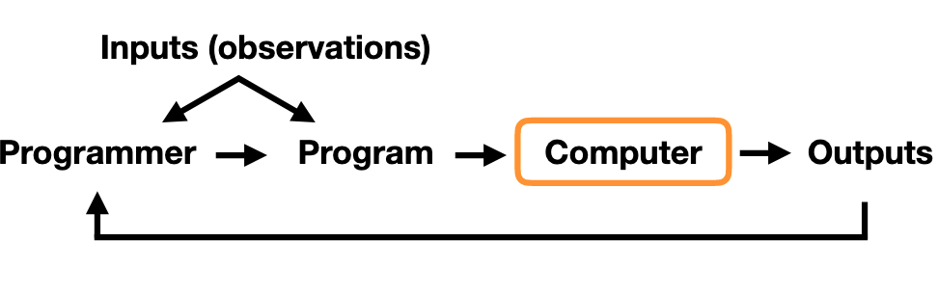
The traditional Programming Paradigm
Spam Filter with rules example

Slide 5
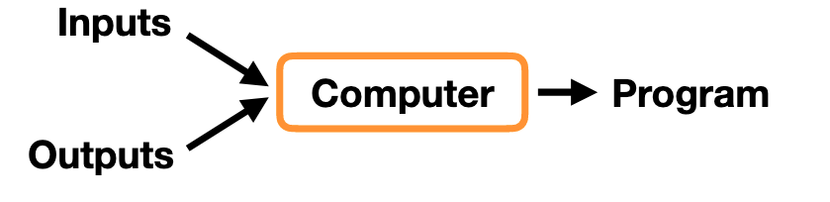
In machine learning, the programmer doesn’t develop the filter, we let the computer figure it out.
The outputs are on the left here, so the computer has examples of labeled emails

Slide 6
“A computer program is said to learn from experience E with respect to some class of tasks T and performance measure P , if its performance at tasks in T , as measured by P , improves with experience E.” — Tom Mitchell, Professor at Carnegie Mellon University

Slide 7
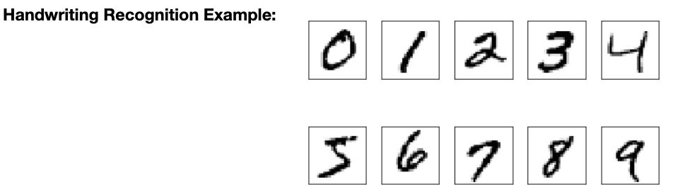
Example
Task T : ?
Performance Measure P : ?
Training Experience E : ?
MNIST Dataset
50K examples of handwritten digits, labeled

Slide 8
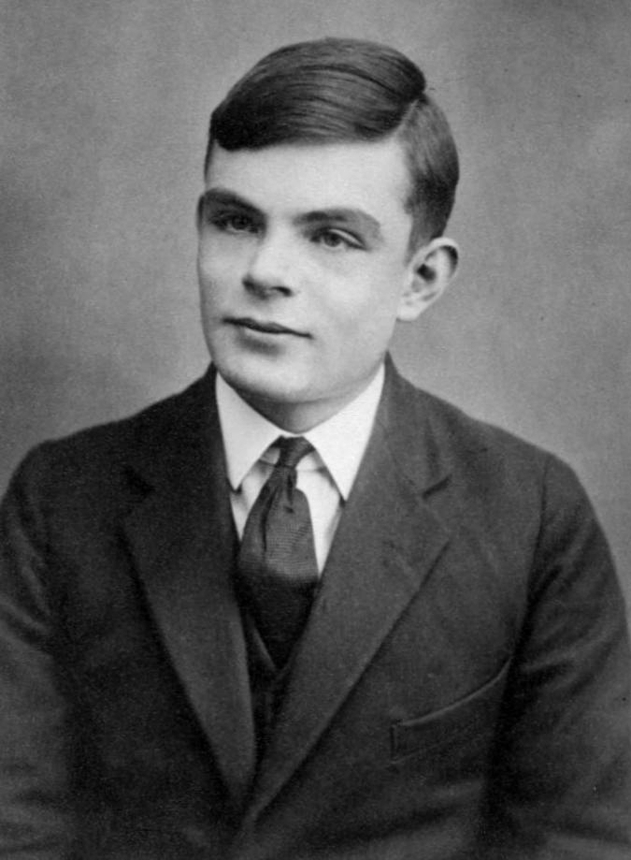
Alan Turing
Can machines think ? — Alan Turing (1912–1954)
« Can a machine do what we as thinking entities can do?
In other words, can a machine mimic or imitate a person? The answer to this question lies within The Imitation Game.
A. M. TURING, I.—COMPUTING MACHINERY AND INTELLIGENCE, Mind, Volume LIX, Issue 236, October 1950, Pages 433–460, https://doi.org/10.1093/mind/LIX.236.433

Slide 9
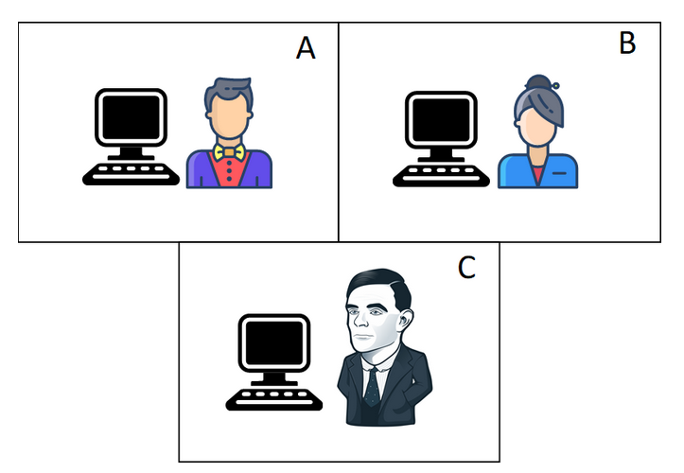
The Imitation Game
Man (A), Woman (B), Interrogator (C)
=> can only communicate using their computer
The goal of the game is for C to discover who is the male and who is the female.
The goal of A, in this case, is to make C fail => fool him into thinking that he is the female.
what will happen when a machine takes the role of A in this game?
This is the essence of the Turing Test: an interrogator has a conversation with a certain entity, which can either be a human or a machine.
If the interrogator is not able to tell if the entity it was interacting with is a machine or a human, then this machine is said to have passed the Turing Test.
https://howtolearnmachinelearning.com/articles/what-is-the-turing-test/

Slide 10
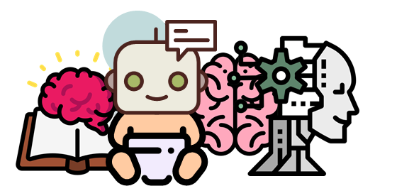
Learning Machines
If we want to imitate an adult human mind, we should somehow replicate the process that has taken place in such a mind, which he says, is made up of three components:
The initial state of the mind, at birth.
The education to which this mind has been subjected.
The experience (different from education, as that coming from the environment) to which the mind has been exposed.
The goal here is to create a program that replicates the mind of a child, and then educate it — make it learn — in order for it to reach the characteristics of the adult brain.
https://howtolearnmachinelearning.com/articles/what-is-the-turing-test/

Slide 11
Some Machine Learning Applications
Email Spam/Ham filter
Character/Digit recognition
Face recognition on your phone/computer for example
Self-driving cars
In NLP:
Language Translation
Social Media Monitoring
Chatbots/Dialogue Agents
Targeted advertizing
Hiring and Recruitment
Voice assistants
Grammar Checkers
https://www.analyticsvidhya.com/blog/2020/07/top-10-applications-of-natural-language-processing-nlp/

Slide 12
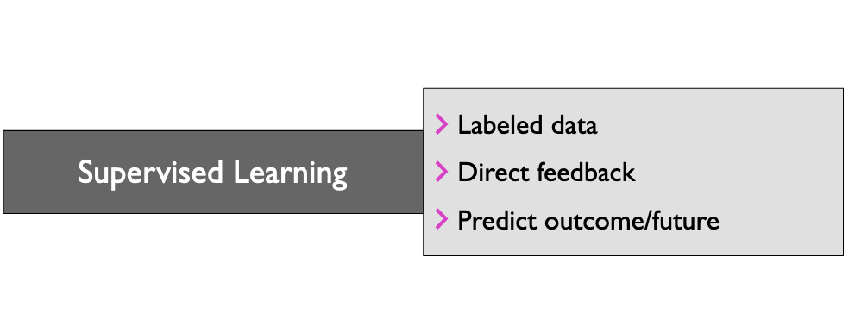
Categories of Machine Learning

Slide 13
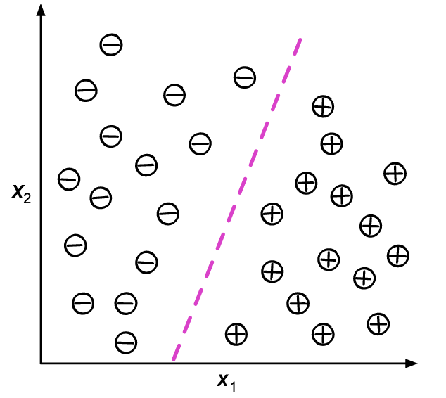
Supervised Learning Sub-category: Classification
Example : Sports car vs. Regular car
Sentiment
English vs. Another language
Spam vs. Ham…
Use boundary to predict the class of a new data point, axes are features : goal for the algorithm is to draw the boundary
such that it gets most data points in the correct class.

Slide 14
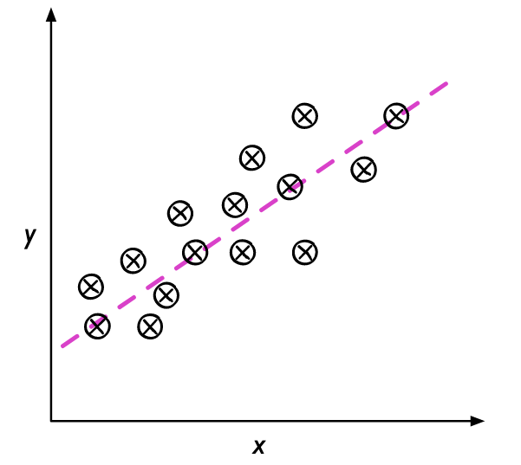
Supervised Learning Sub-class: Regression
Examples : Housing
Temperature
Sentence Similarity…
Predict targets which are continuous values. Given an input feature x, we want to predict the output y.

Slide 15
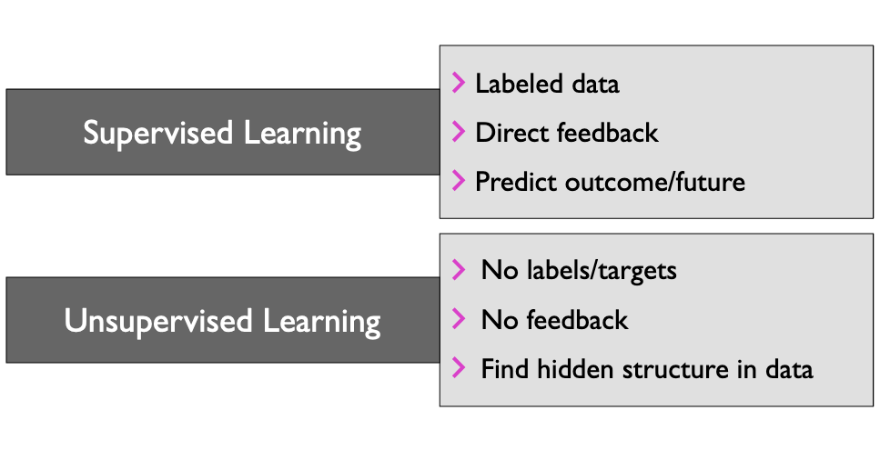
Categories of Machine Learning

Slide 16
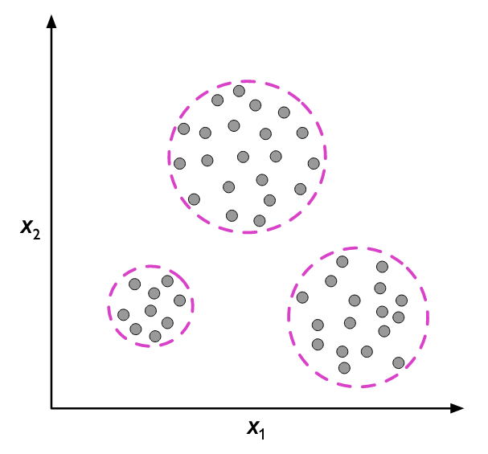
Unsupervised Learning Example : Clustering
Examples: finding clothes sizes
word-sense disambiguiation
finding similar users on youtube…
Different dots… Some appear to be grouped toegether (clusters), want our algorithm to
« make sense » of the data, find patterns in the data, when we don’t have any label info.

Slide 17
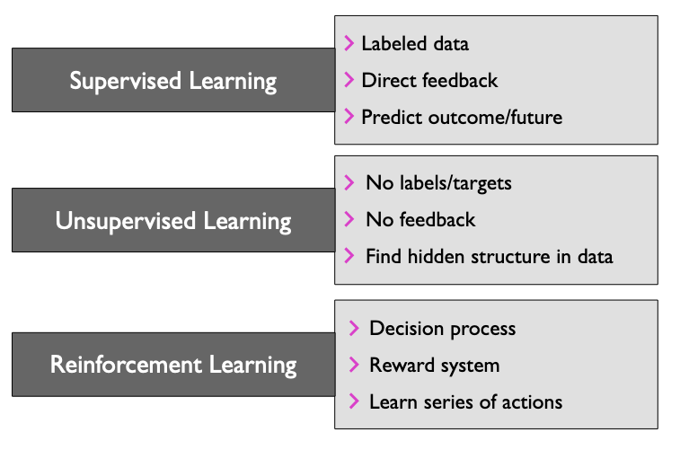
Categories of Machine Learning
Trying to learn something that looks more like a process, a series of actions to take

Slide 18
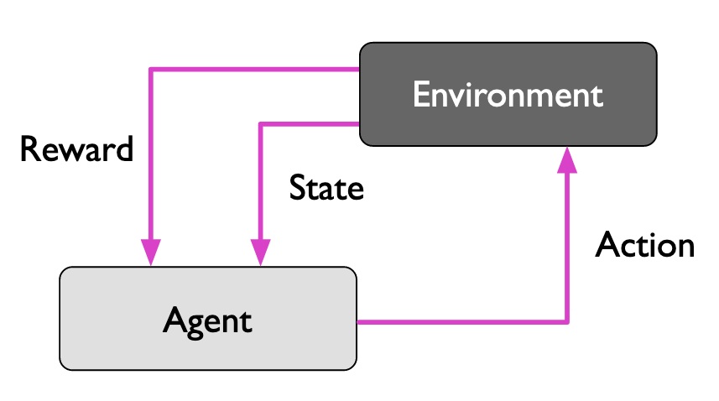
Reinforcement Learning Paradigm
GridWorld example, chess, video games (starcraft, atari games…), robotics etc…

Slide 19

RL Hide and Seek Demo OpenAI

Slide 20
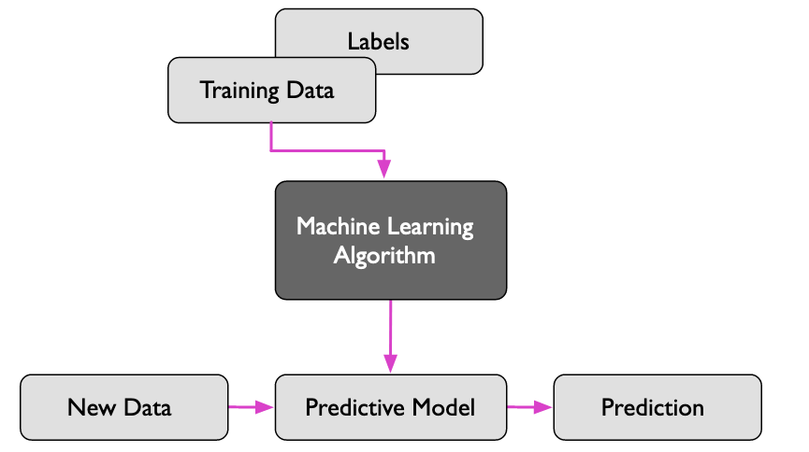
Supervised Learning Workflow Overview

Slide 21
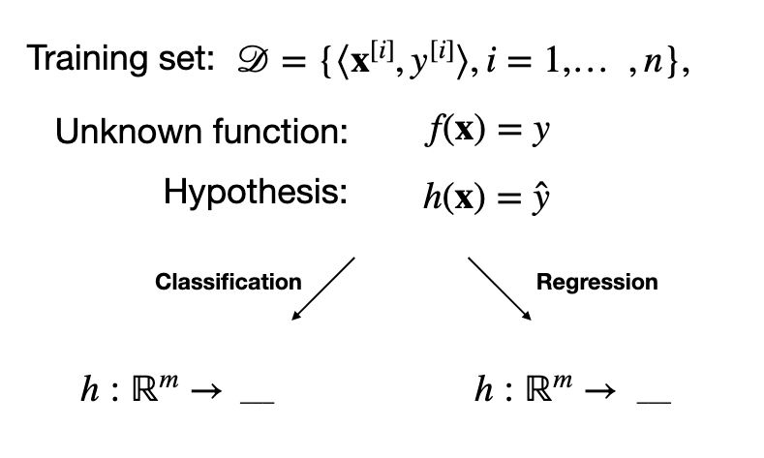
Supervised Learning Formal Notations
We want to map the input vectors of features to an output. The original mapping or function is unknown
and the predictive model serves as an estimate or hypothesis of that original function.

Slide 22
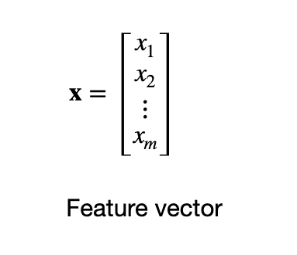
Data Representation

Slide 23
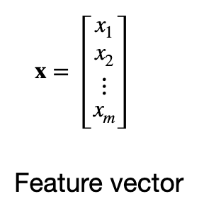
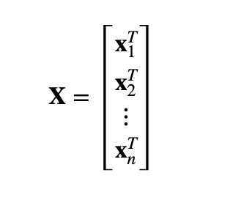
Data Representation
Design Matrix, each row represents 1 training example, i.e 1 feature vector transposed (what the T stands for). Common representation for datasets.
Pay attention to the bold font as well: bold => vector, vs.a single value variable when the font is normal.

Slide 24
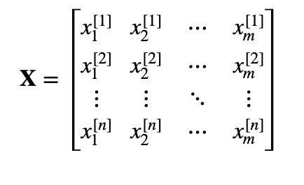
Data Representation Design Matrix Made Explicit

Slide 25
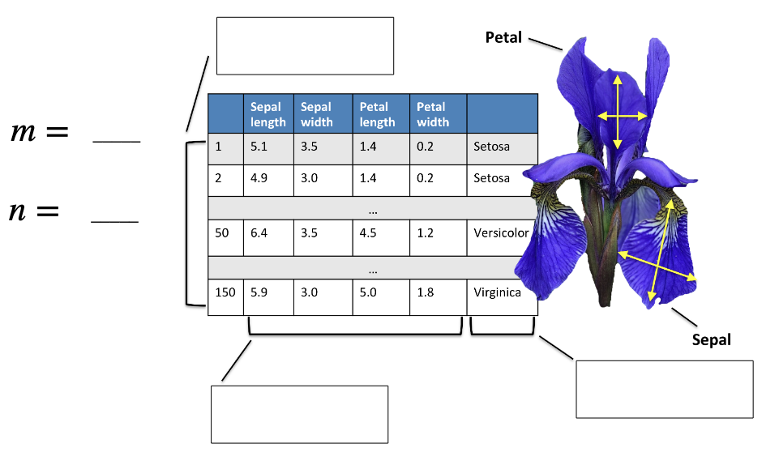
Extremely Popular Dataset Example: The Iris Dataset

Slide 26
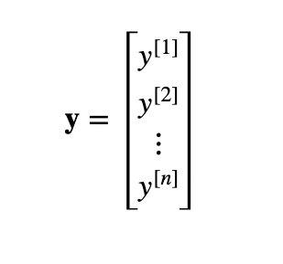
Data Representation: Labels
Can also use a vector to represent labels

Slide 27
ML Terminology
Training example: A row in the table representing the dataset. Synonymous to an observation, training record, training instance, training sample (in some contexts, sample refers to a collection of training examples).
Feature: a column in the table which represents a particular aspect of the dataset.
Targets: What we want to predict.
Output / prediction: use this to distinguish from targets; here, means output from the model.

Slide 28
Classes of Machine Learning Algorithms
Generalized linear models (e.g., logistic regression)
Support vector machines (e.g., linear SVM)
Artificial neural networks (e.g., multilayer perceptron)
Tree- or rule-based models (e.g., decision trees)
Ensembles (e.g., Random Forest)
Instance-based learners (e.g., k-nearest neighbors)

