Slide 1









COURIER-WALA
TABLE OF CONTENTS
An Efficient Courier Service
01
02
03
INTRODUCTION
OUR PROJECT
Database
Need, Requirements
Use Case Diagrams, UI design diagrams
ER Diagram

Slide 2
TABLE OF CONTENTS
SMILE-DOOT
01
02
03
An Efficient Courier Service
INTRODUCTION
OUR PROJECT
Database
Need, Requirements
Use Case Diagrams, UI design diagrams
ER Diagram

Slide 3








01
INTRODUCTION

Slide 4






OUR Team
WHO WE ARE?
Prashantkumar Dudhmal
Om Kharmate
Harshwardhan Rode
Sujay Gangan
Omkar Mane
WHAT WE DO?
We deliver you parcel across the globe.

Slide 5




02
OUR PROJECT
In our dynamic organization, we take great pride in the diverse array of projects we undertake. From innovative technological solutions to creative marketing campaigns, our projects span a wide range of industries and disciplines. Each project is approached with enthusiasm, dedication, and a commitment to excellence.

Slide 6

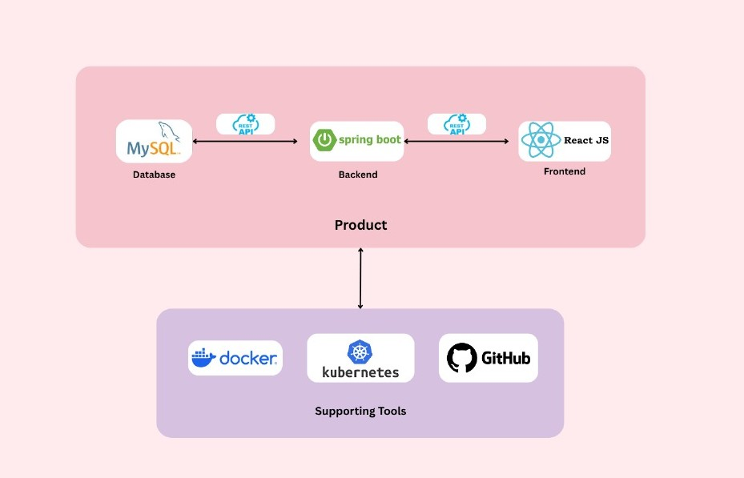








WHAT WE OFFER
Express Parcel
InCity Parcel
Elaborate on what you want to discuss.
Elaborate on what you want to discuss.
Domestic
WareHousing
Elaborate on what you want to discuss.
Elaborate on what you want to discuss.

Slide 7

TechStack
Express Parcel
Elaborate on what you want to discuss.
InCity Parcel
Elaborate on what you want to discuss.
WareHousing
Domestic
Elaborate on what you want to discuss.
Elaborate on what you want to discuss.

Slide 8
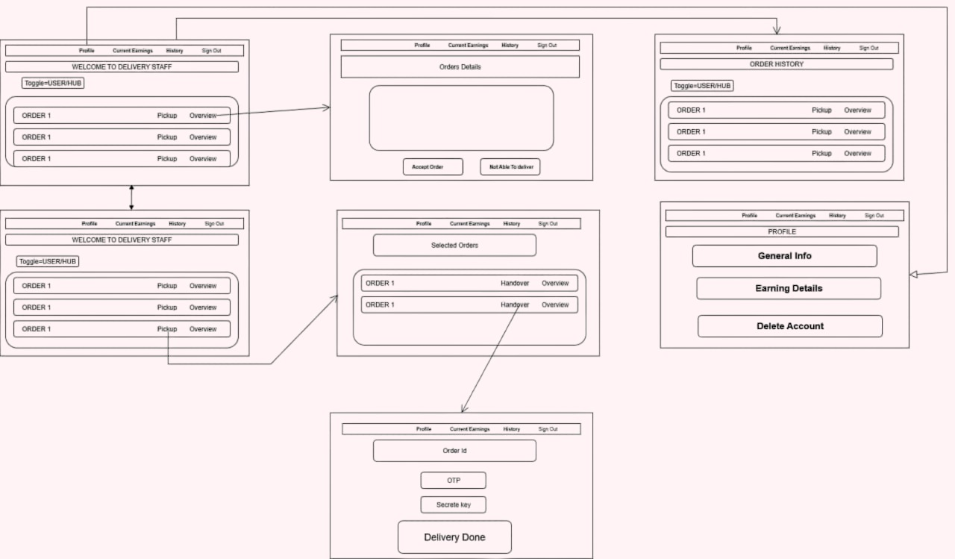
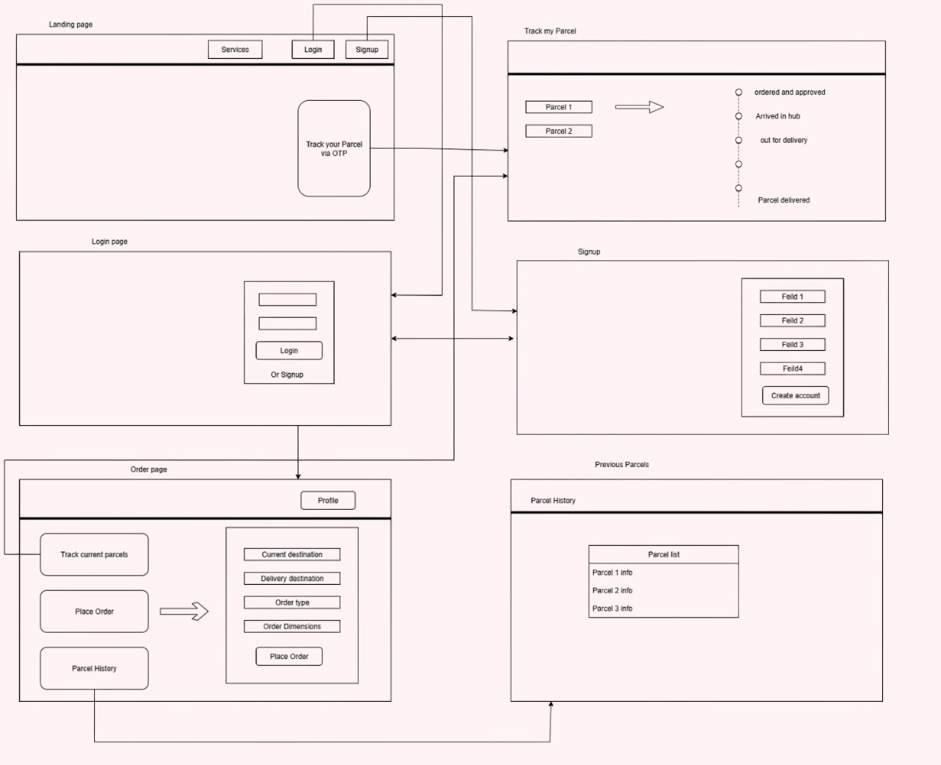
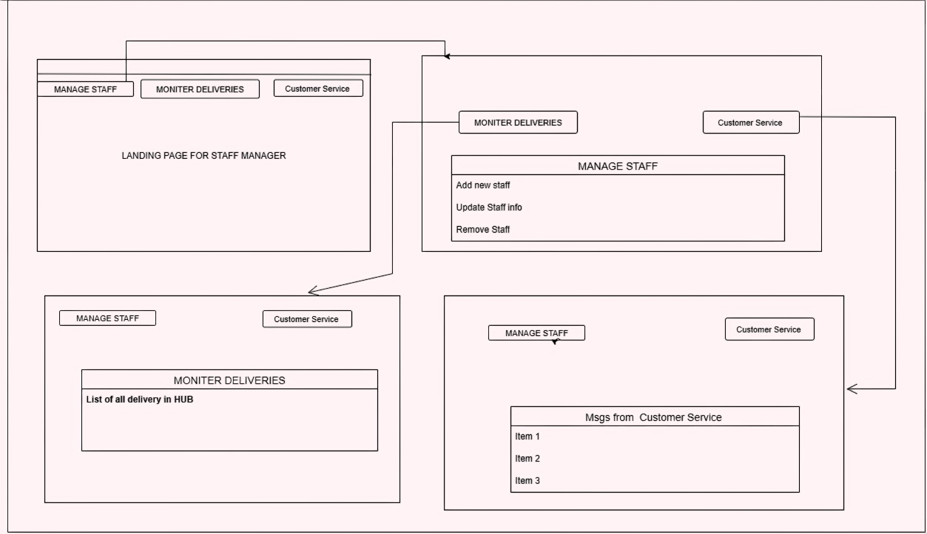
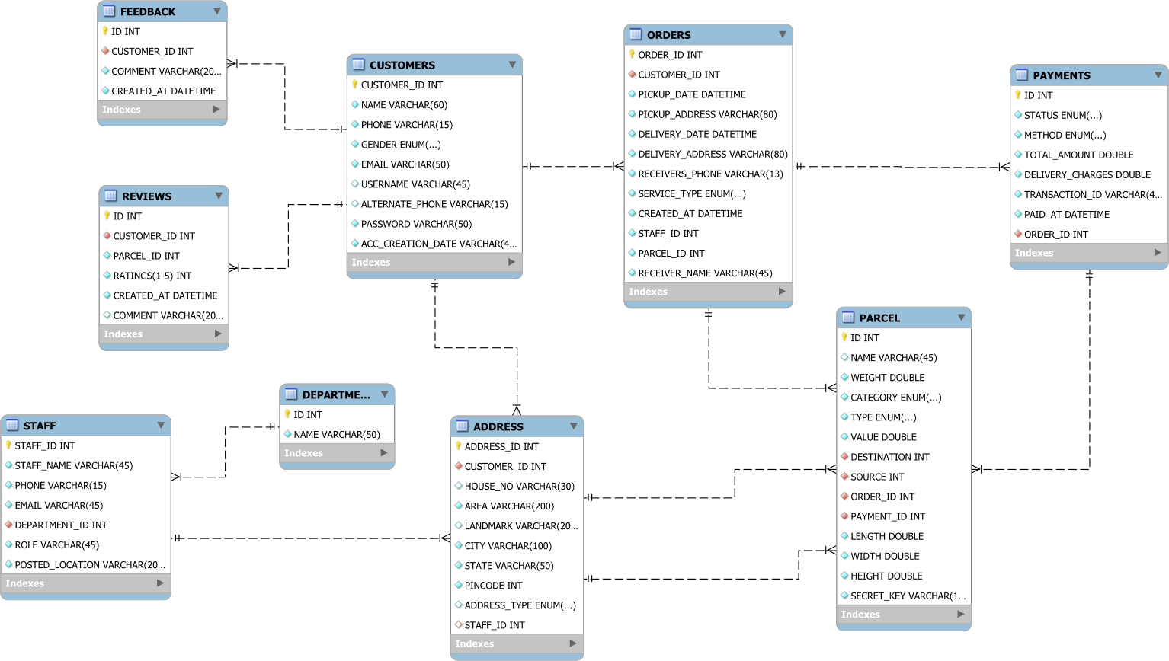
UI Design
Customer
ER Diagram

Slide 9
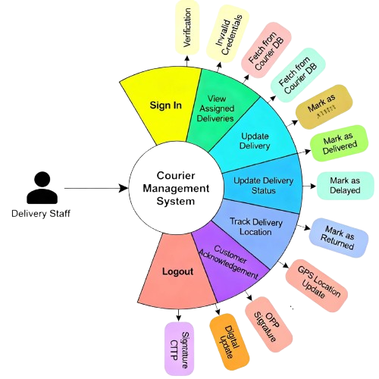
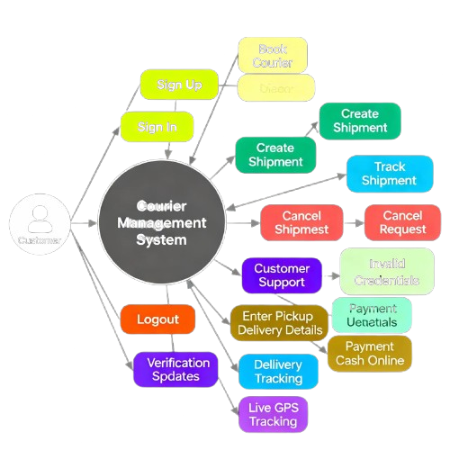
TechStack

Slide 10
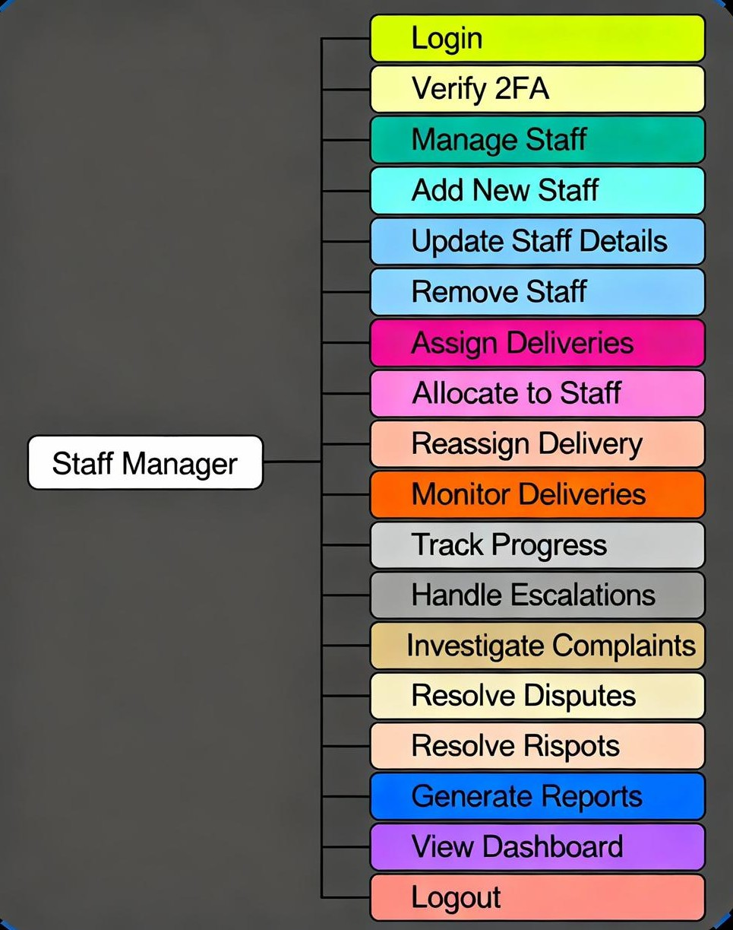
TechStack

Slide 11
ER Diagram
UI Design
Staff - Manager

Slide 12
TechStack

Slide 13
UI Design
ER Diagram
Delivery Guy

Slide 14
ER Diagram
THANK YOU!!

Slide 15
ER Diagram
THANK YOU!!

