Slide 1

ECEN689 – Project #3 RF Signal Strength Data Collection Tool
John Lusher II, P.E.
April 29, 2016
Notes:
This is an example of a notes page.
Please add as much info here to clearly communicate this slide to a non-engineering individual.
Go to ‘View’ and click on ‘Notes Page’

Slide 2

Purpose
Captures RSSI from XBee Pro radio interface with Teensy MCU.
Captures IMU orientation of phone
Communicate stored data to SQL Server
Integrates Goggle Map to show heat map of samples
Stores cell radio data set in database
Can support multiple COM ports (Xbee) devices
Be stable and easy to use

Slide 3
APIs, Technologies, and Main Classes
Google Map API
Googles’ API for interfacing their Google Map and integrate into an Android Application
MySQL Connector
Provides interface to connect to MySQL database and run SQL commands to insert new records and query records.
USB Serial Connector
Provides USB to Serial interface for Android Applications. Allows application to open port and create a listener to receive streaming input data, in this application the RSSI data.
Latitude and Longitude
Class to generate latitude and longitude based upon a starting location and given a distance and bearing. This is used for determine an area for the map viewer to pull data from the SQL database.
RF Field SQL Database
Class to provide simple interface to SQL database being provided functions to connect and add new data based upon the RF Data class.
RF Data Class
Simply the class in which all data for a record is stored, this includes the IMU data, RSSI, sample date, Lat/Long
Telephony Manger / Phone State
Provides the ability to get the RSSI of the various bands available to the cellular radio.
Location Manager
Provides the ability to get the geo-location of the device.
Sensor Manager
Provides the ability to get the sensor (IMU) information for the device. In this case we are interested in the Yaw, Pitch, and Roll.

Slide 4
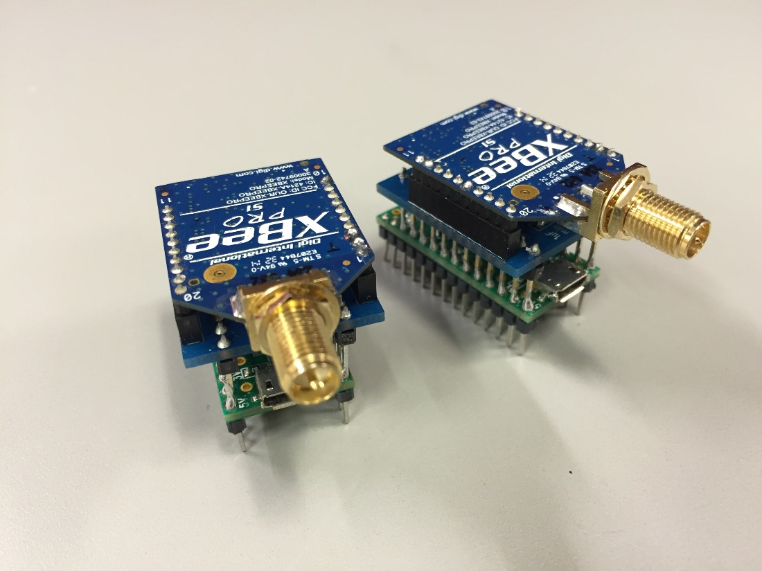
Teensy and Xbee Modules
Connects via USB port and the Teensy appears as a virtual COM port to the Android OS
Uses the usb-serial-for-android library to communications
Support for up to three devices is now supported.

Slide 5
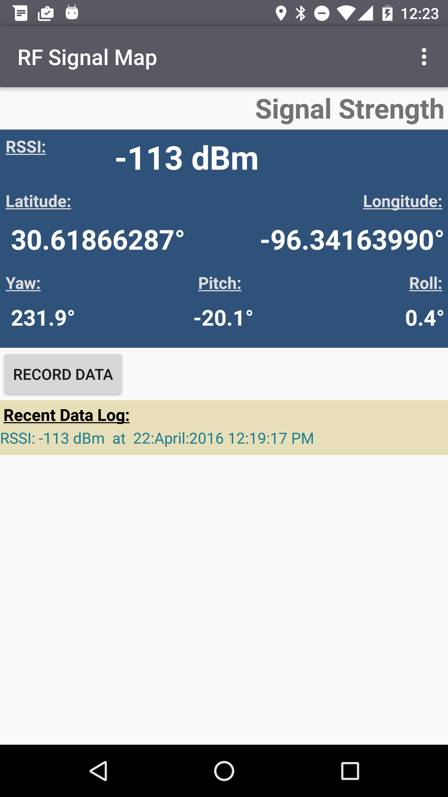
Functionality
Display Xbee RSSI, if available, else it will display the cell radio signal strength.
Display the following:
Latitude
Longitude
Yaw, Pitch, and Roll
Provide the ability for the user to log data to remote server via simple push button.
Display log of recent data pushed to the server.

Slide 6
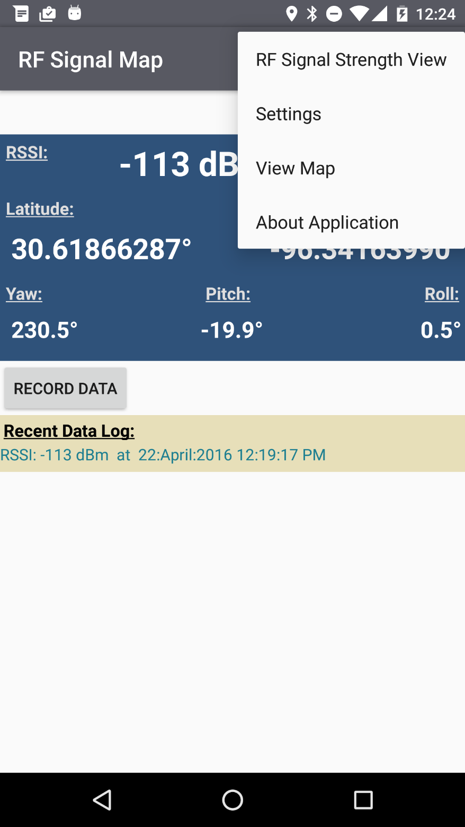
Functionality
Operational views that the user can select:
RF Signal View (Main Screen)
Settings
Map
About

Slide 7
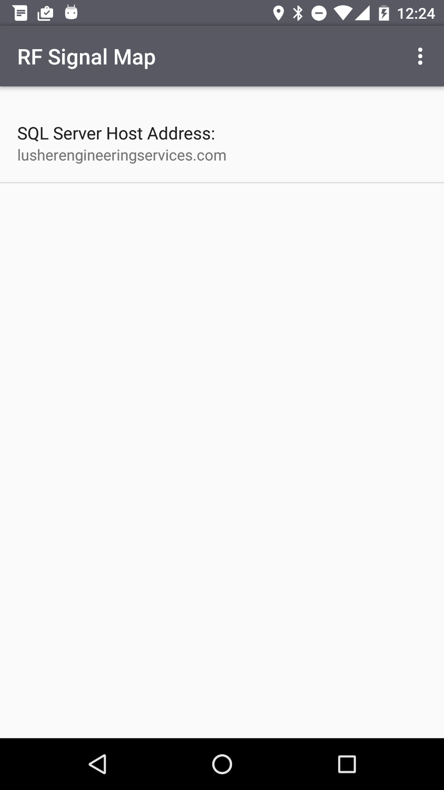
Functionality
Setting for this application are sparse. Mainly since the application was designed to be easy to use and not require many user settings.
Additional settings can easily be added if deemed necessary.

Slide 8
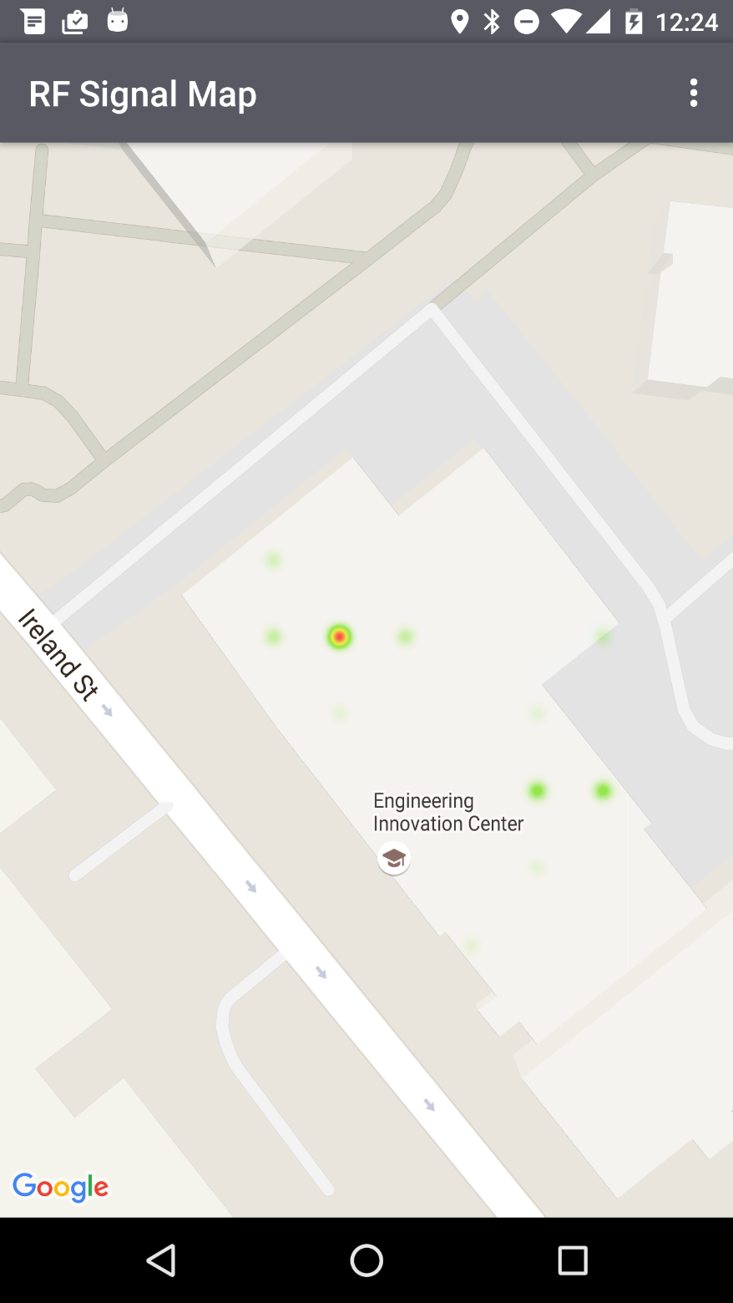
Functionality
Map simply displays the a heat map of the data in the area that the user “clicks”.
This uses the Google Map API and overlays a heat map from accessing records given the Lat/Long on the “clicked” position on the map and calling the data from the SQL server hosting the data.
Improvements and enhancements to this map can easily be done. Enhancements such as deselecting the device ID or RSSI range to display. API hooks for this are already in the SQL database interface API.

Slide 9
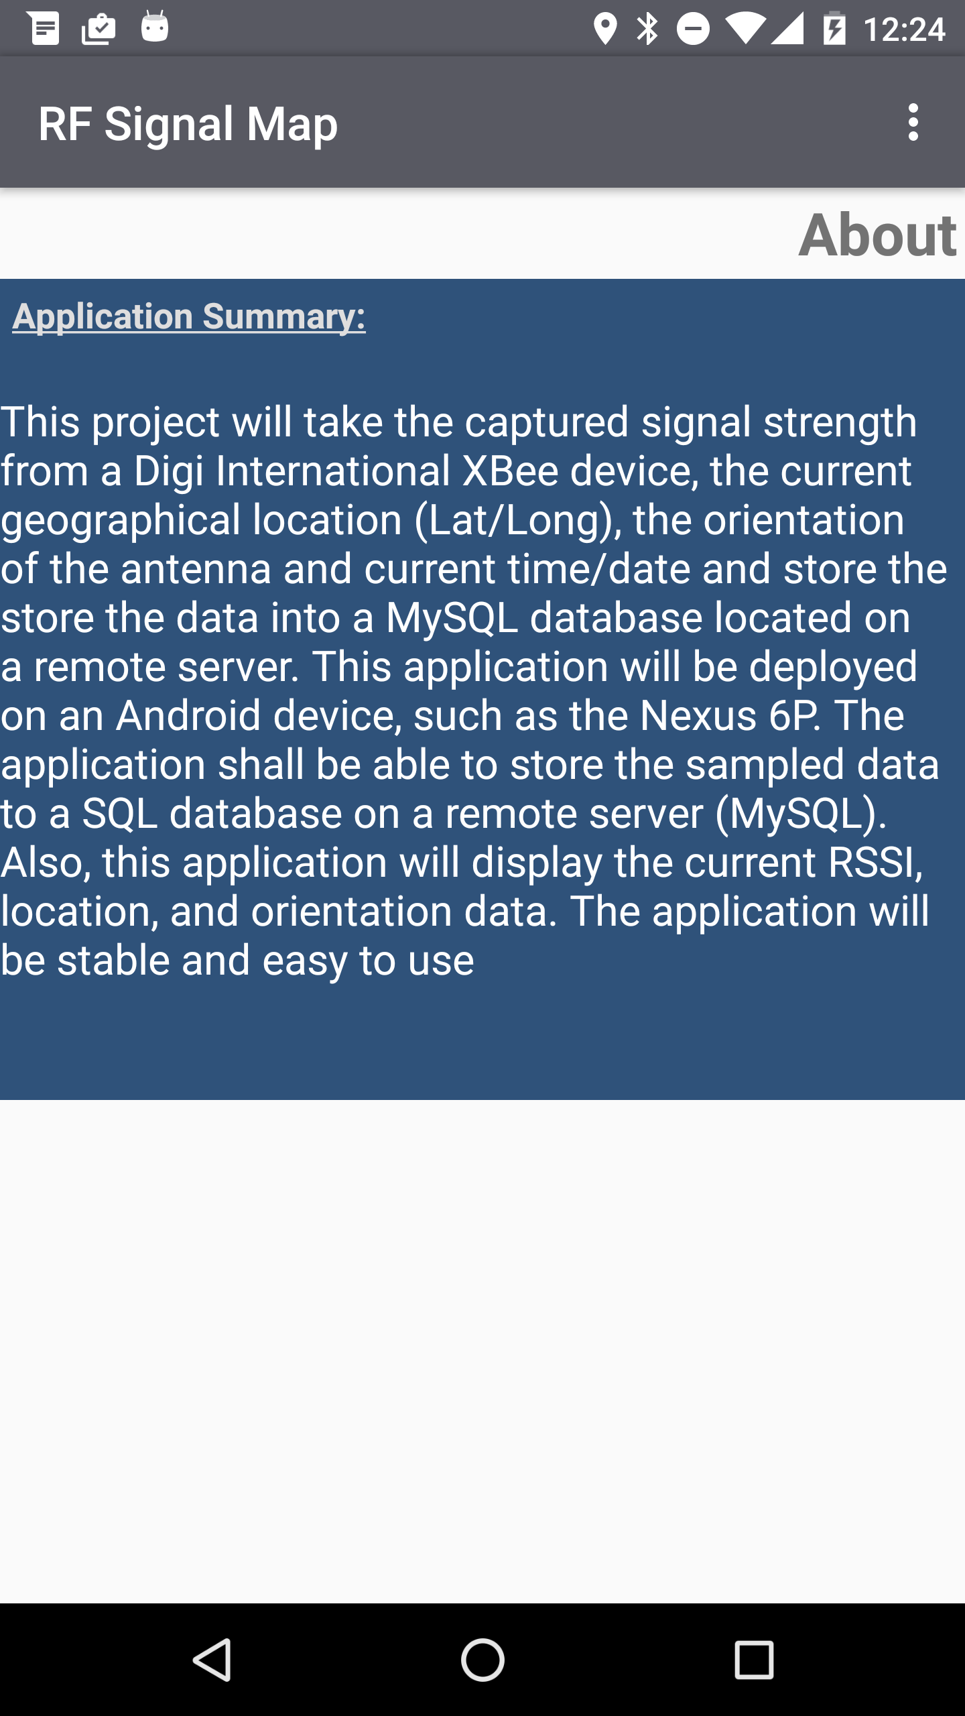
Functionality
Simply a quick “About” screen letting the user know the purpose of the application.

Slide 10
Google Maps Implementation
@Override protected void onCreate(Bundle savedInstanceState) { super.onCreate(savedInstanceState); setContentView(R.layout.activity_maps); // Obtain the SupportMapFragment and get notified when the map is ready to be used. SupportMapFragment mapFragment = (SupportMapFragment) getSupportFragmentManager() .findFragmentById(R.id.map); mapFragment.getMapAsync(this); }
@Override public void onMapReady(GoogleMap googleMap) { mMap = googleMap; /// Add a marker in EIC and move the camera /// We will need to hack this to work with other lat/long values to be displayed LatLng eic = new LatLng(30.618708, -96.341558); mMap.addMarker(new MarkerOptions().position(eic).title("EIC")); mMap.moveCamera(CameraUpdateFactory.newLatLngZoom(eic, 19)); mMap.setOnMapClickListener(this); // Calls function to update the map on the container UpdateMap((float) eic.latitude, (float) eic.longitude, 1000F); }

Slide 11
Serial Port Listener for Teensy LC on Android
//------------------------------------------------------------------------------------------------------------------ // SERIAL PORT LISTENER //------------------------------------------------------------------------------------------------------------------ private final SerialInputOutputManager.Listener mListener = new SerialInputOutputManager.Listener() { private final static String RXID = "Receive ID"; private final static String TXID = "Transmit ID"; private final static String RSSI = "RSSI"; @Override //------------------------------------------------------------------------------------------------------------------ /** * @fun SerialInputOutputManager.Listener:onRunError * @brief On Run Error */ public void onRunError(Exception e) { } @Override //------------------------------------------------------------------------------------------------------------------ /** * @fun SerialInputOutputManager.Listener:onNewData * @brief On New Data */ public void onNewData(final byte[] data) { try { // Append data to the incomming string buffer // Read data from Teensy device (based upon project by Paul Crouther) - JSON Object being streamed // to serial port at 9600 bps, includes IDs and RSSI, Note: RSSI is pos, actually is negative. String newrx = new String(data, "UTF-8"); JSONObject serialJSONObj = new JSONObject(newrx); CurrenSample.XbeeID = serialJSONObj.getInt(RXID); CurrenSample.DeviceID = serialJSONObj.getInt(TXID); XBeeRSSI = -1.0 * serialJSONObj.getDouble(RSSI); } catch (Exception e) { } } };

Slide 12
Parts Required From User
Android Phone/Device
Teensy LC and Xbee Pro – RX (connected to Android Device)
Teensy LC and Xbee Pro – TX (powered by USB)
MySQL Server
Currently for testing I pointed to my server (lusherengineeringservices.com), however, the “Norman” server/NUC is setup to operate this application as well. This can be setup next week in the lab.

Slide 13
References
Project #1 and Project #2 from ECEN489/689 Spring 2016 Class.
Google API
Example / test projects provided by Google (i.e. Google Maps, Hello World)

Slide 14
What is Next?
Integrate with final hardware and test in actual test setting
Integrate in HackRF One to use to collect data
Collect and process data!

