Slide 1
Motion Detection Project ECEN 489 – Paul Crouther
Making an app that detects motion (for security purposes) the determines the detection on a server.

Slide 2
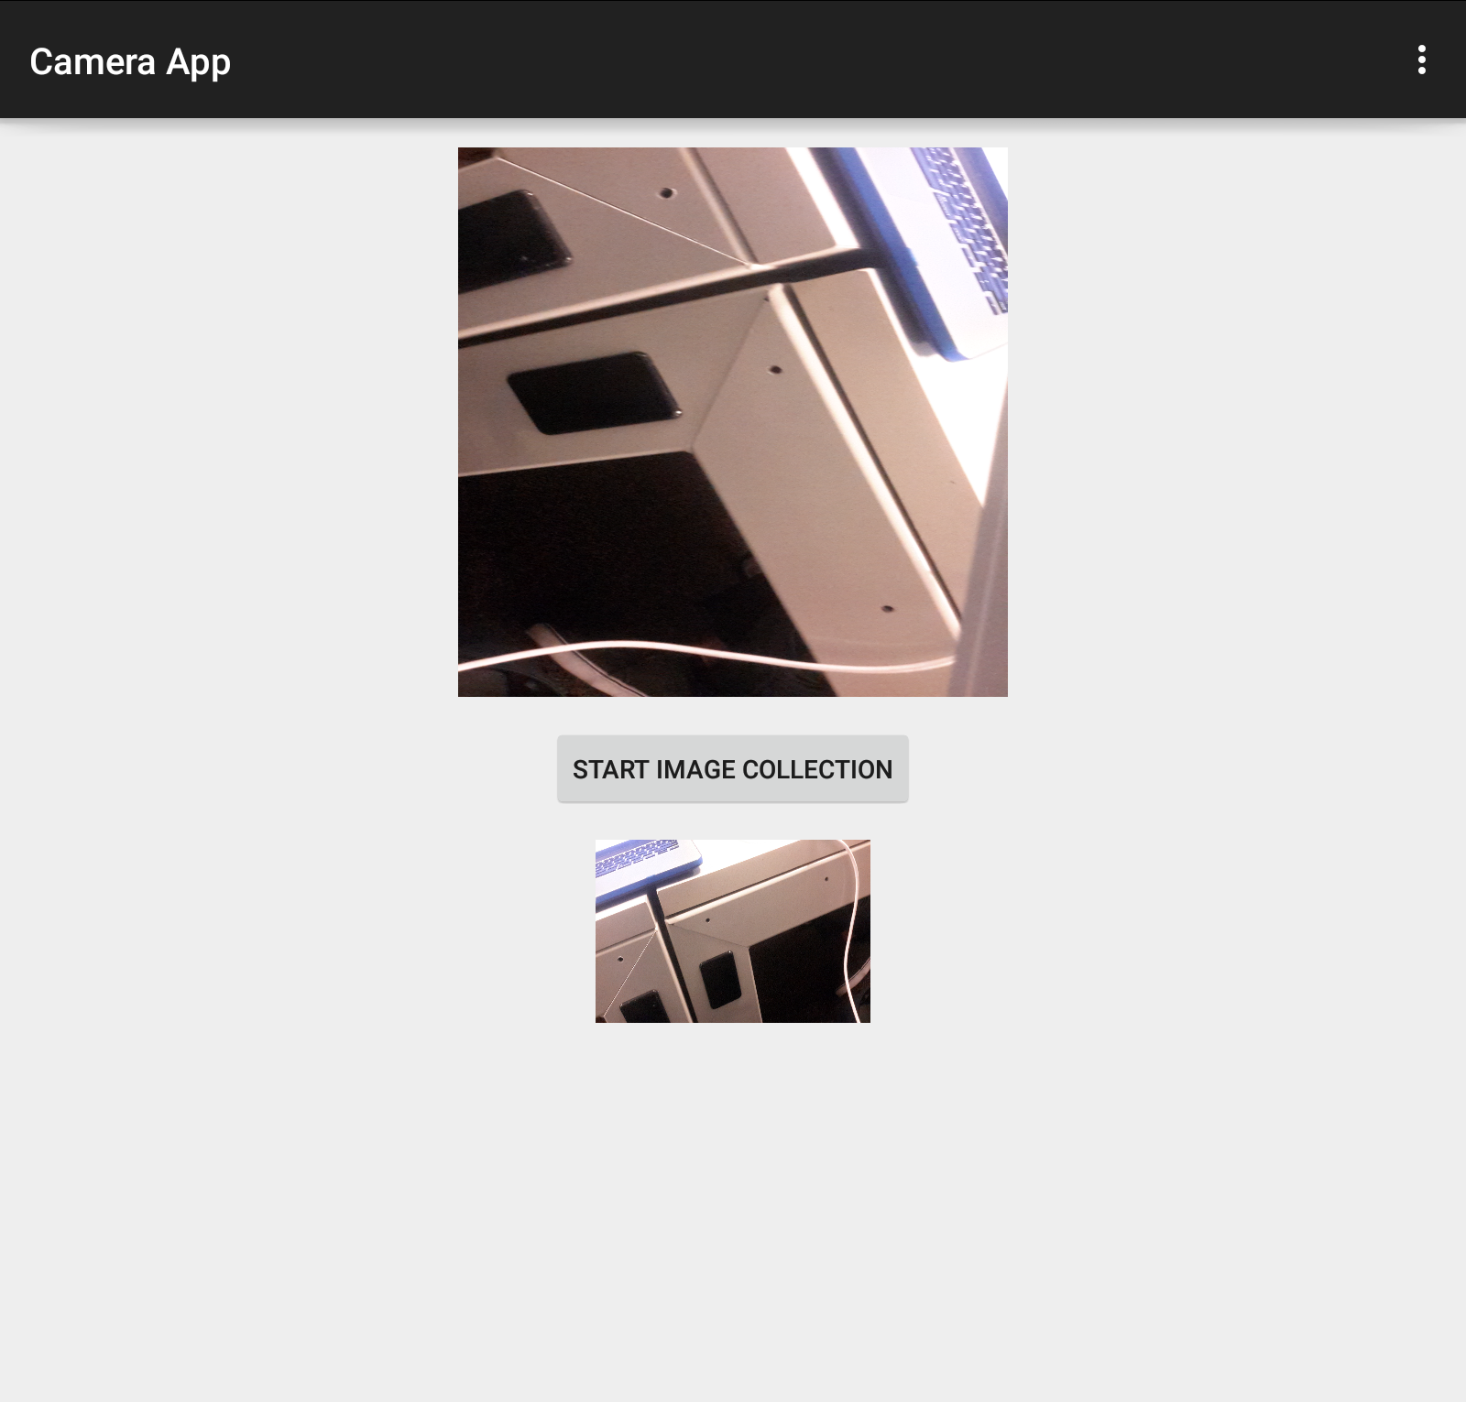
The Motion Detection App:
Detects motion in the direction of the camera

Slide 3
How it works:
Images are sampled at 1Hz from the preview frame. Taken in bitmap format.
Sent to a server in JPEG resized format.
Uses gray scale, compression, and image difference to determine whether there is motion or change between two images.
Android Phone
Python UDP Server
Preview frame
Image (Bitmap)
JPEG (Resize)
Grayscale
+
Image hash
Image diff +
Detection

Slide 4
Camera App:
Android Camera API Tutorial for layout and image capture from preview.
Used “Camera” API, supported on most phones.
Uses a separate thread for image capture to also send to UDP server every second.

Slide 5
Functionality (Camera App)
Press “Start Image Collection” to begin detecting motion after established UDP connection.
Camera preview
Thumbnail of the
current frame
(1 Hz refresh)

Slide 6
UDP Server (Python):
Dhash (Iconfinder tutorial) determining the difference between two images.
Used “Python Image Library” API, supported in Python by many image formats.
Opens a UDP socket and receives a 300x200px JPEG (from Bitmap).
Performs an image difference on the current and the previous image received.

Slide 7
UDP Server (Python):
Dhash (Iconfinder tutorial) determining the difference between two images.
Used “Python Image Library” API, supported in Python by many image formats.
Opens a UDP socket and receives a 300x200px JPEG (from Bitmap).
Performs an image difference on the current and the previous image received.
Images in a hash format, stored in a list “imageList[i]” indexed by when it is received. So that when a frame is received, it appends to the list.
Displays whether or not there is no motion detected, a little motion detected, or a lot of motion detected.

Slide 8
Sample output:
received: 8 (300, 200) JPEG ac3c3c5c5a5a9ada
count: 84 current image hash: 34328980e0e0e0e0
count: 83 previous image hash: 28339a84d090c8c0
Difference between the two hex values: 33055375299522464899136
Same image.
received: 8 (300, 200) JPEG 2c7c5c5c5c18d8d8
count: 85 current image hash: 243e9ac1c0f070f0
count: 84 previous image hash: 34328980e0e0e0e0
Difference between the two hex values: 37765059508436639907808
Same image.
received: 8 (300, 200) JPEG fc3c3c363a387873
count: 86 current image hash: c0d0f0f079b8f0f0
count: 85 previous image hash: 243e9ac1c0f070f0
Difference between the two hex values: 373419951145186056470528
Some motion detected

Slide 9
Wiki and references for tutorials
Image difference
http://blog.iconfinder.com/detecting-duplicate-images-using-python/
Android Camera API Tutorial
http://inducesmile.com/android/android-camera-api-tutorial/

