Slide 1
Project 3: Face Recognition App
Report 2

Slide 2
Overview
An app for face recognition from a finite set
Face Recognition in a photo, not video
Training mode and Running mode
On the android device:
1. UI (Done)
2. Data Storage (Done)
3. Face Detection&Recognition(In Progress)
On the server:
No Ideas Yet.

Slide 3
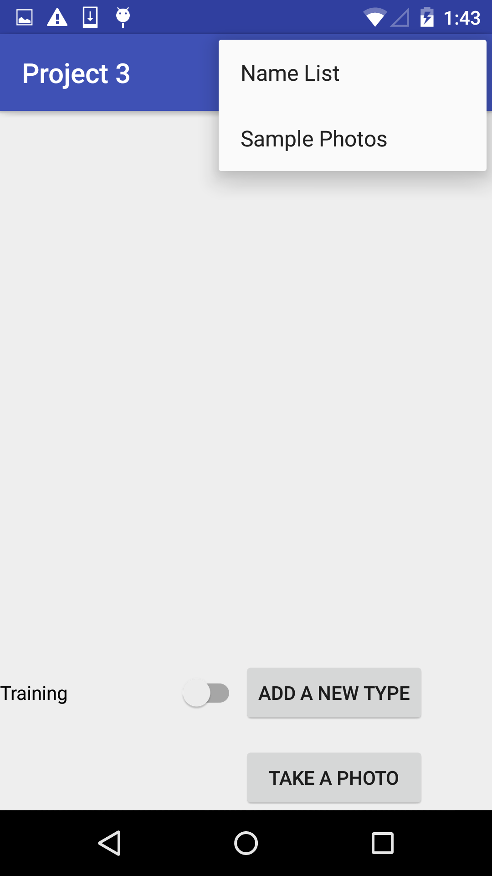
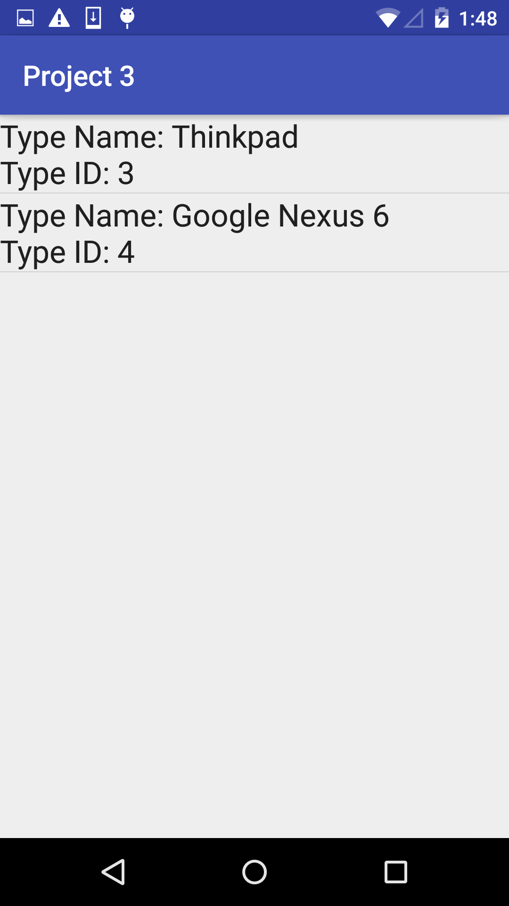
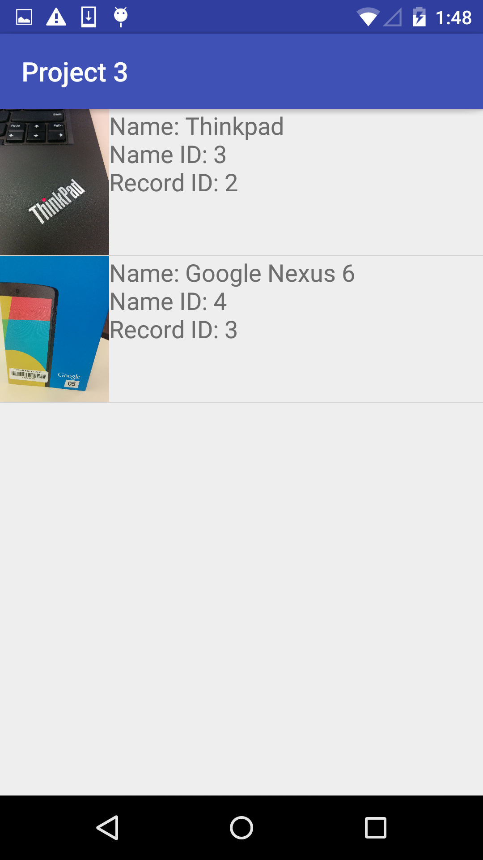
UI

Slide 4
On-device Data Storage
SQLite Database:
2 tables:
1. type_table:
TypeID, TypeName
2. record_table:
RecID, TypeName, TypeID, Photo_Dir, Thumbnail
External Storage:
Full-size Photos

Slide 5
Face Recognition API
On android: APIs for face detection.
In OpenCV 2.4, algorithms for face recognition are provided.
JavaCV: A Java wrapper for OpenCV developed by Google.

