Slide 1
Project 3: Face Recognition App
Report 4

Slide 2
UI
Main Fragment
- A TextView for displaying results
- An ImageView for displaying photos
- Two EditViews for entering Server IP and Server Port
- A switch
- Buttons for taking a new photo, and adding new names
- A TextView for displaying real-time light conditions

Slide 3
UI
Photo Fragment
A list of training samples, including the photo, name of the photo, name ID and photo ID
Name Fragment
A list of names and their IDs

Slide 4
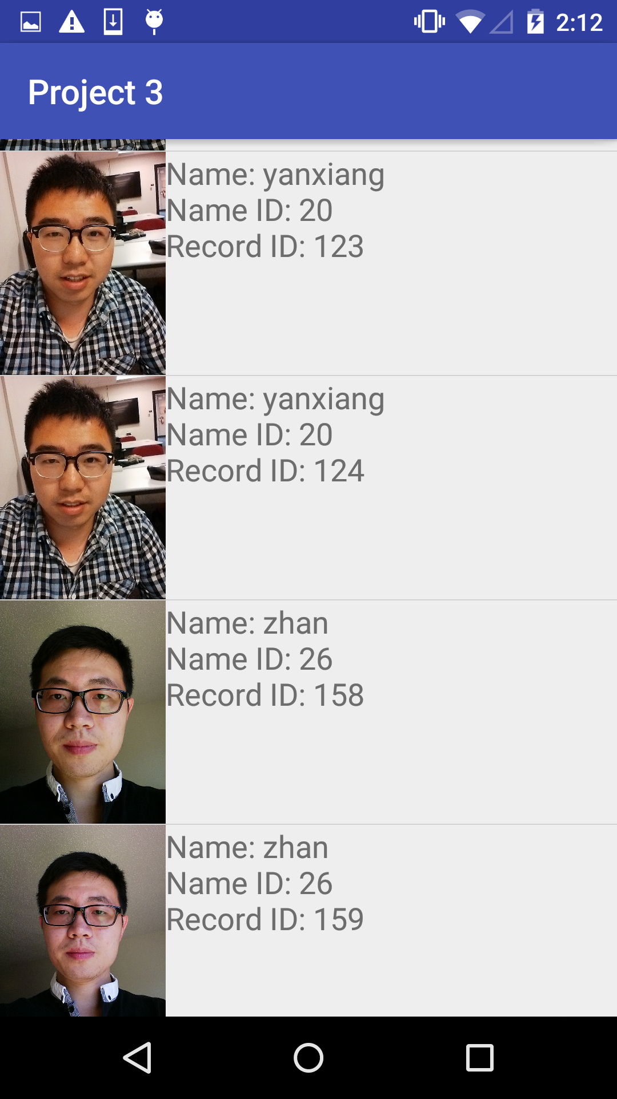
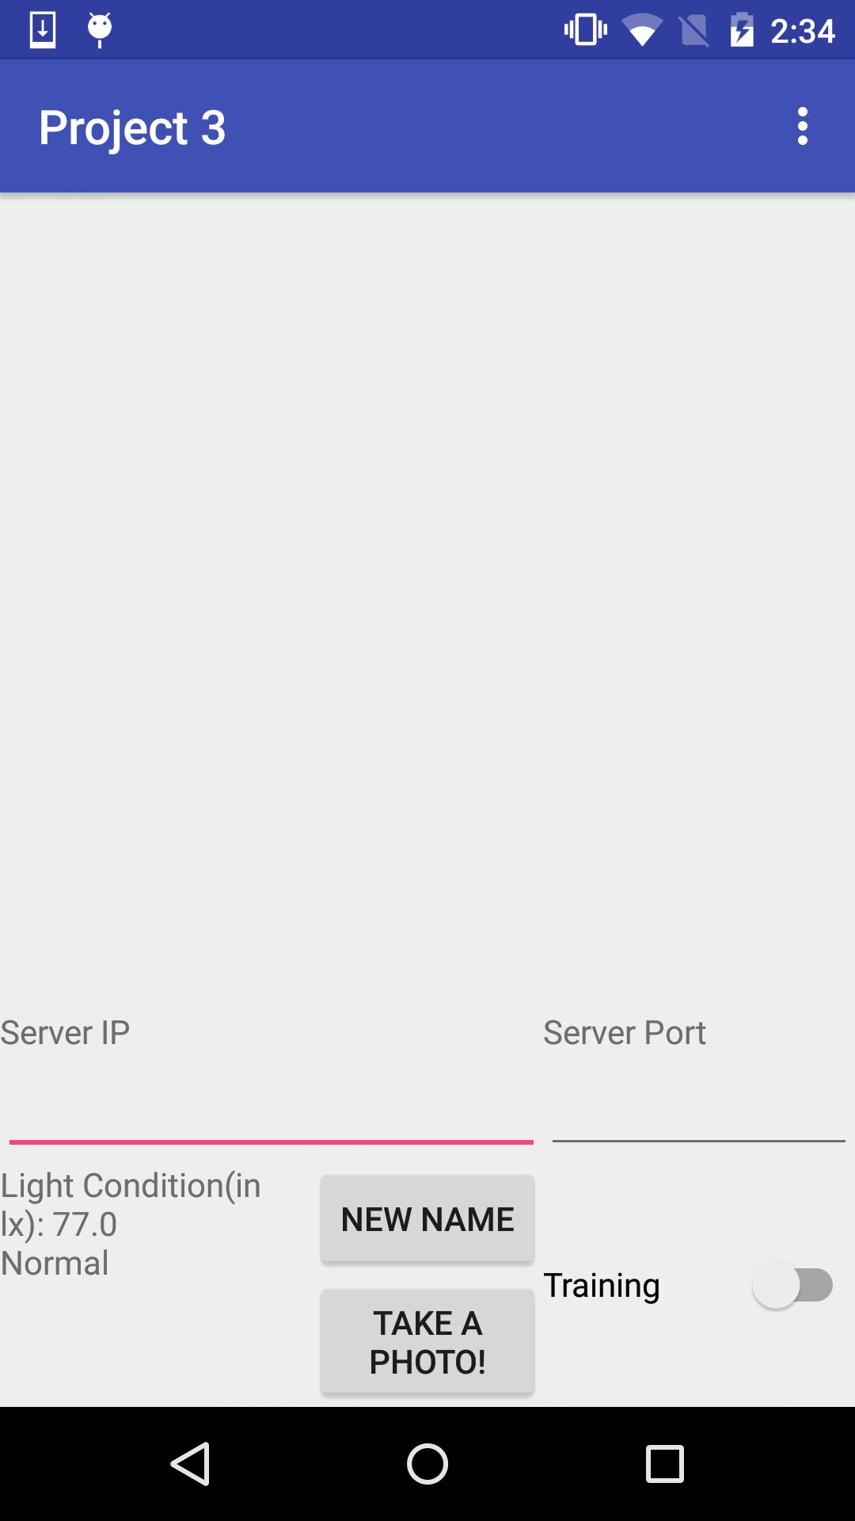
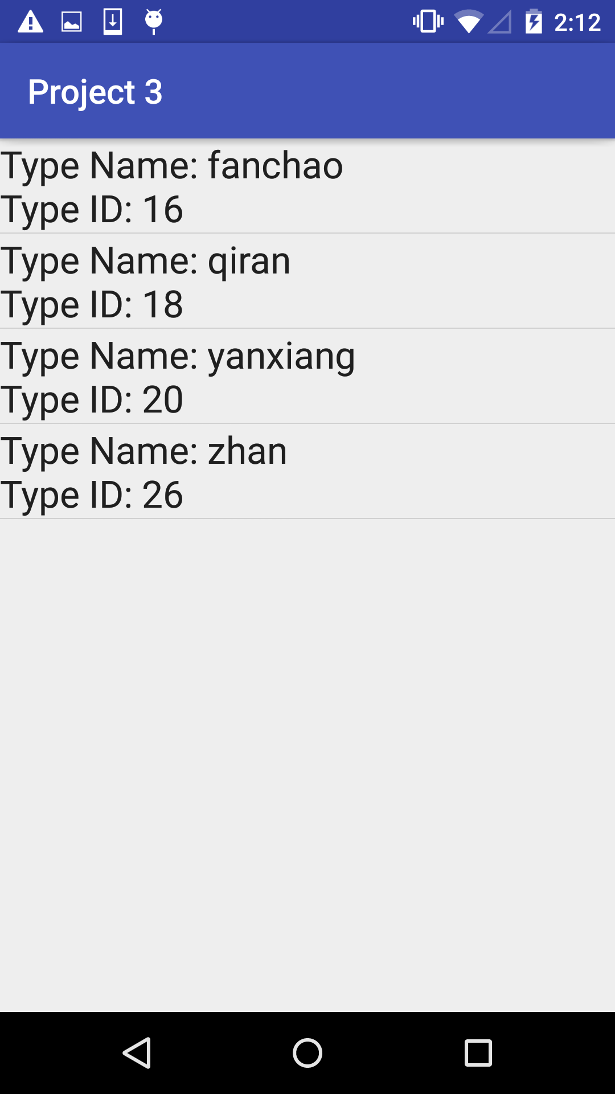
UI
Tree Hierarchy:

Slide 5
On-Device Data Storage
SQLite Database:
2 tables:
1. type_table:
TypeID, TypeName
2. record_table:
RecID, TypeName, TypeID, Photo_Dir, Thumbnail
External Storage:
Full-size Photos

Slide 6
Face Recognition API
On android: APIs for face detection.
In OpenCV 2.4, algorithms for face recognition are provided.
JavaCV: A Java wrapper for OpenCV developed by Google.
The app leverages LBP(Local Binary Pattern) to extract facial features
6-8 photos for each name
Training Time on Android: 4 people, 10+ sec in total

Slide 7

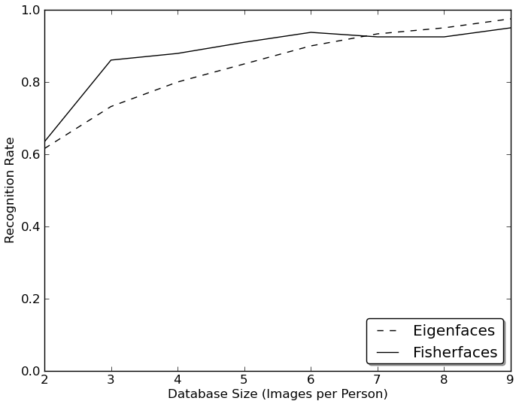
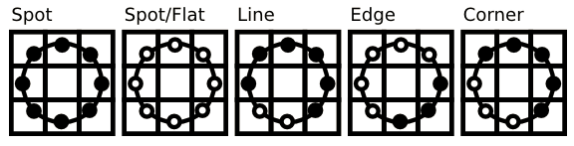
Face Recognition API
LBP(Local Binary Pattern):
GrayScale Images, all of the same size.
All the Formulas and Images are from the documentations on OpenCV official website[1]

Slide 8
Server
On android:
A photo is compressed and encoded into a string by Base 64. The photo and the result of it are sent to the server in a JSON string.

Slide 9
Server
Tomcat Server
- POST Method: The mobile device sends photos and names to the server by POST method
- GET Method: The server sends all the photos it has to a web browser by GET method
- The Tomcat server connects to a MySQL database to store and retrive info. about photos, and sends all
photos back to the browser
MySQL Database
- The database stores the name of the photo, and the file name of the photo.

Slide 10
References
[1] OpenCV Official Tutorials on Face Recognition API, http://docs.opencv.org/2.4/modules/contrib/doc/facerec/facerec_tutorial.html

