Slide 1
Introduction to Feature Engineering

Slide 2
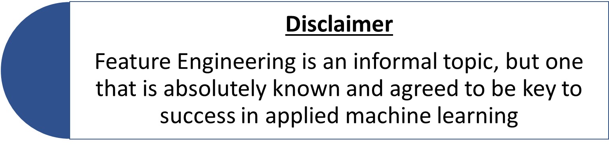

Slide 3


‘The better the features that I will prepare and choose, the better the results I will achieve’
True, but misleading statement !
In reality, the results you achieve depend on various factors:
Model, you choose
Objective Measures (accuracy, RMSE etc.)
Data, available to you
Features, you prepared

Slide 4
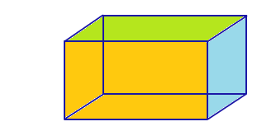
Importance of Feature Engineering
Better feature means flexibility
Less Complex Models
Easier to understand
Faster to run
Easier to maintain

Slide 5
Importance of Feature Engineering
Better feature means simpler models
‘Wrong parameters’, No Problem!! You may still get good results
No need to work as hard to pick the right models and the most optimized parameters
Better feature means better results
“The algorithms we used are very standard for Kagglers. We spent most of our efforts in Feature Engineering”
- Xavier Conort (current grandmaster and former 1st ranker on Kaggle)

Slide 6



What is Feature Engineering
Hahaha, are you kidding me! I calculated the feature importance scores for all features and selected the best subset of features, this is feature engineering!
Whoa! I extracted out features from raw data by reducing the dimensionality of observations into a much smaller set. I did feature engineering, today!
Shut up, you idiots! I manually created new features using the given raw data. You guys don’t even know what feature engineering is, do you!

Slide 7
What is Feature Engineering
Feature Engineering is the process of transforming raw data into features that better represent the underlying problem to the predictive models, resulting in improved model accuracy on resulting data.
Pre-processed
Raw Data
Engineered Features
Prediction Model
Desired accuracy
Feature engineering is a broad topic and there are many subproblems that come under feature engineering.

Slide 8

Feature Extraction: ‘automatic construction of new features from raw data’
Some observations, in their raw state are far too voluminous to be modelled by predictive modelling algorithms directly. Common examples include: image, audio, video, textual data.
Training ML model with 60000 samples
Image
(200x200)
Feature Extraction is a process of automatically reducing the dimensionality of these types of observations into a much smaller set that can be modelled. Methods include: Principal Component Analysis (PCA), clustering, line or edge detection.

Slide 9


Feature Selection: ‘from many features to few that are useful’
Hmm, this feature looks much more important than others to the model accuracy !
This feature seems redundant in context to other features !
Hey guys, those attributes that are irrelevant to the problem need to be removed, understood!
Building a Machine Learning/Data Science model is not a hard-step, defined process, rather it is an iterative process.

Slide 10
Building Machine Learning Model
Pre-process the data
Cleaning the data
Handling missing values
Play with features
Extract features from raw data
Select useful features or even create new features using domain knowledge
Choose the model
Based on their experience and their analysis of the data, they choose which model to test first and what hyperparameters to use with that model
Analyze the correlation among features and target model
Scaling the data

Slide 11
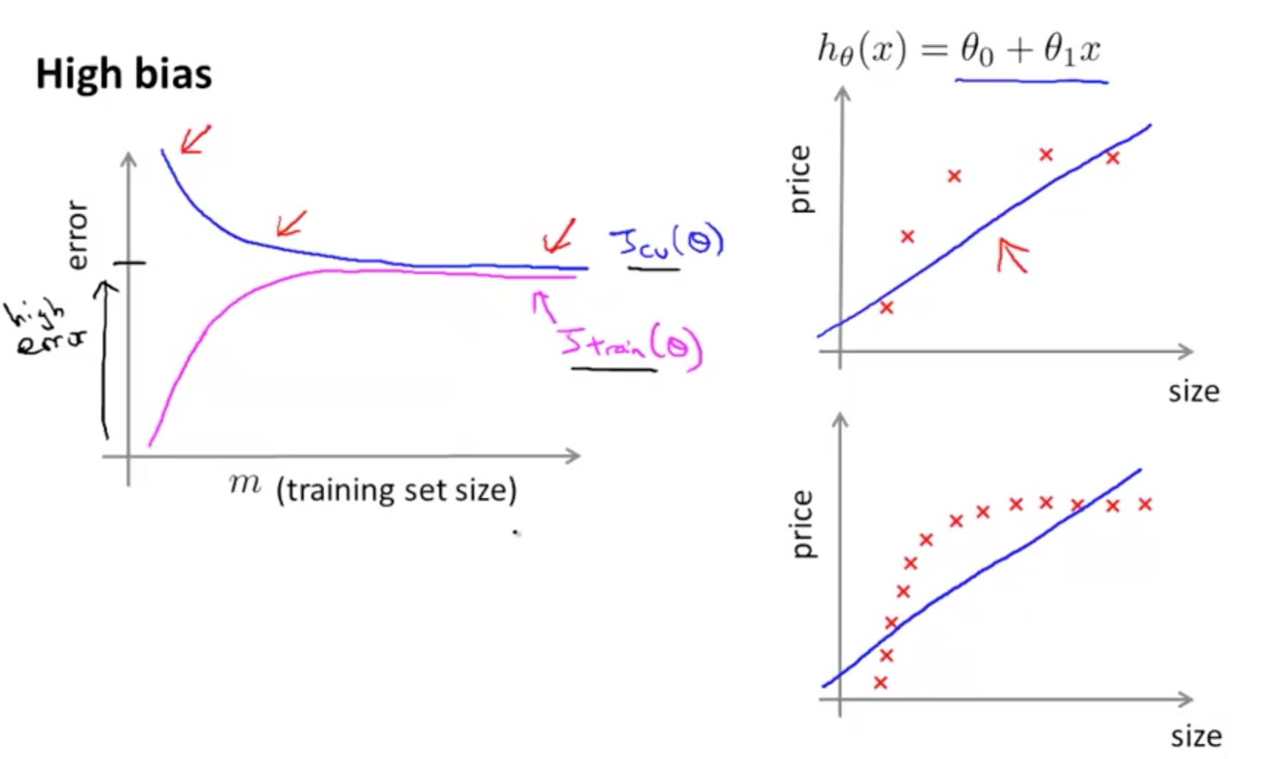
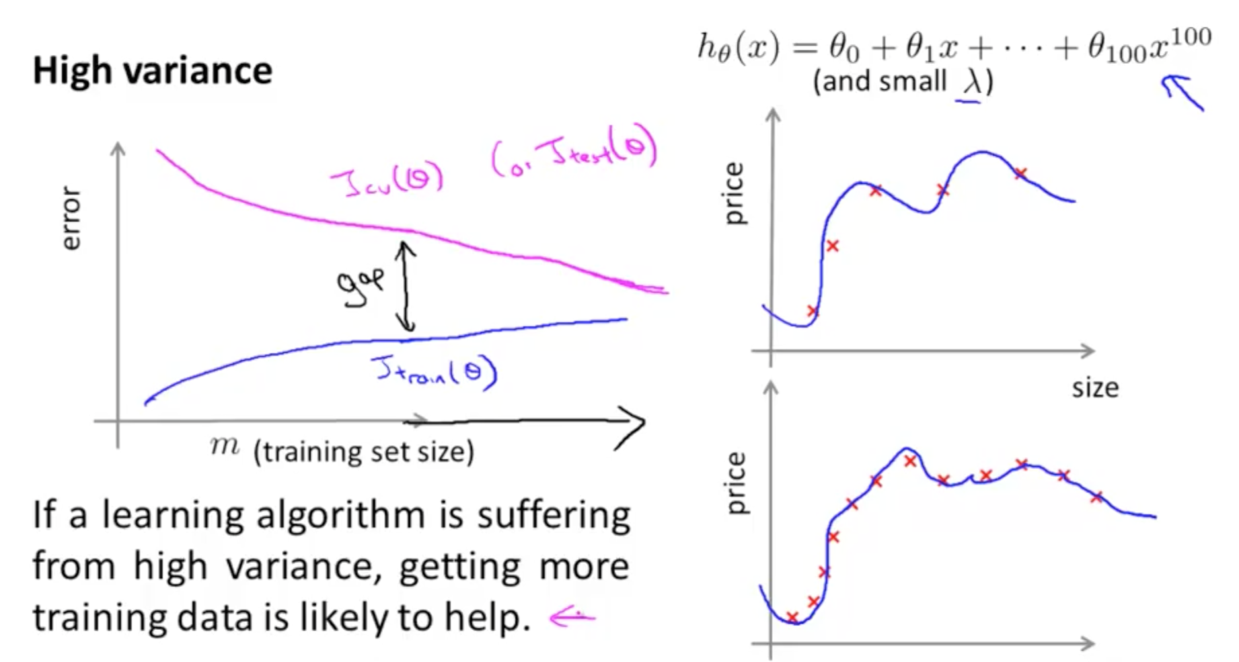
Building Machine Learning Model
Iterating Back using Learning Curves
- Pictures taken from Andrew Ng’s Machine Learning course on Coursera

Slide 12
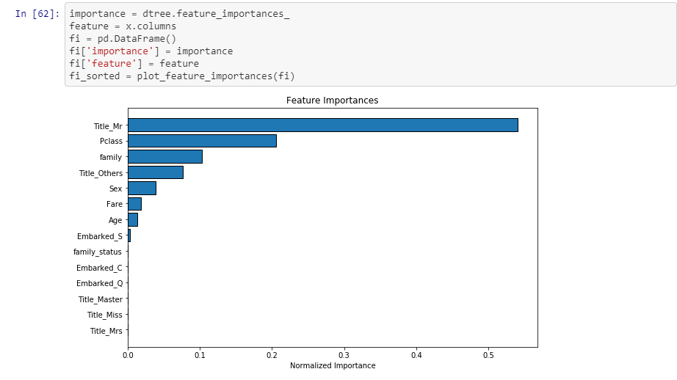
Feature Selection (Manually)

Slide 13
Feature Selection (Automation)
Recursive Feature Elimination
sklearn.feature_selection.RFE
Select features by recursively considering smaller and smaller sets of features
Regularization methods
LASSO, RIDGE
They actively seek to remove or discount the contribution of features as part of the model building process
the importance of each feature is obtained either through a coef_ attribute or through a feature_importances_ attribute
the least important features are pruned from current set of features
procedure is recursively repeated on the pruned set until the desired number of features to select is eventually reached.

Slide 14
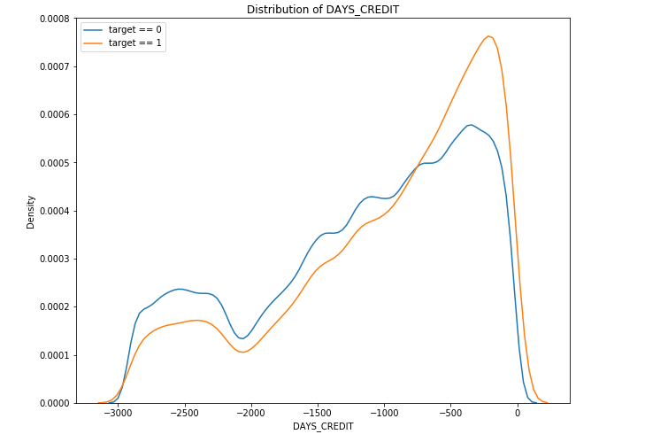
Feature Construction: ‘manual construction of new features from raw data’

Slide 15
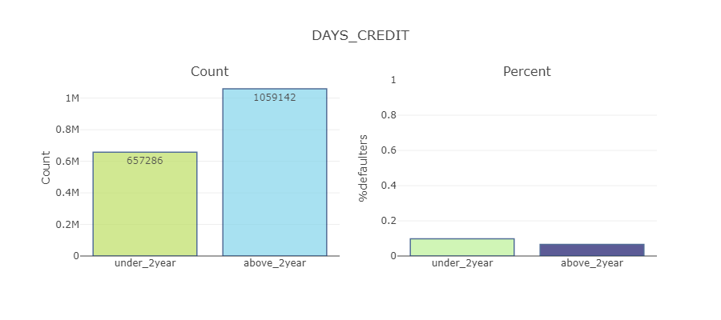
Feature Construction: ‘manual construction of new features from raw data’

Slide 16
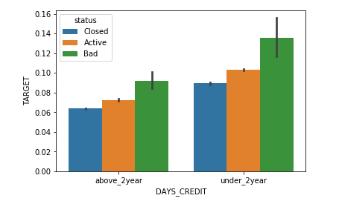
Feature Construction: ‘manual construction of new features from raw data’

Slide 17
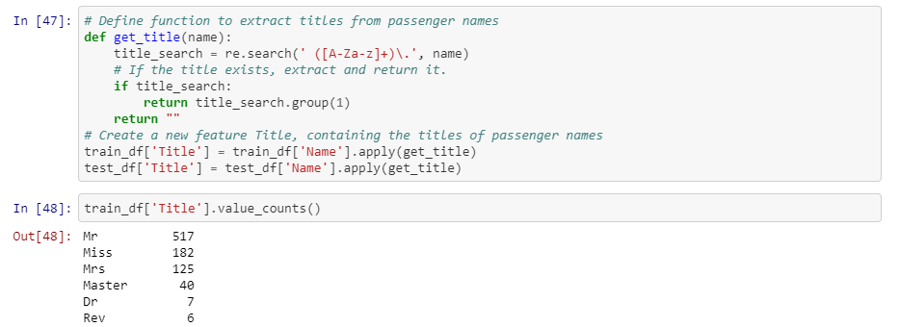
Feature Construction: ‘manual construction of new features from raw data’

Slide 18
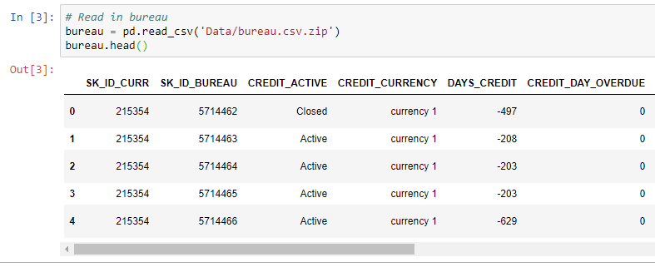
Feature Construction
Construction of new features requires spending a lot of time with actual sample data and thinking about the underlying form of the problem, structures in data and how best to expose them to predictive modelling algorithms
Feature creation requires great amount of domain knowledge

Slide 19
Feature Construction
This is the part of feature engineering that is often talked the most about as an artform, the part that is attributed the importance and signalled as the differentiation in competitive machine learning
It is manual, it is slow, it requires lots of human brain power, and it makes a big difference!

Slide 20
