Slide 1
Medicine and technology
Girish Tillu
Vinay Mahajan
Aswhini Mathur

Slide 2
Agenda
Milestones in medical technology
History of medical records
Modern medical records
Medical statistics
Data collection
History of computers in Medicine
IAIM Hospital database case study
Examples of “observation to analysis”

Slide 3
Milestones in medical technology From eyeglasses to the stethoscope to imaging the brain at work, a long list of inventions and innovations have changed medicine – not a full exhaustive list
1250 | Magnifying Glass
1752 | Eyeglasses, Flexible Catheter
1815 | Stethoscope
1841 | Anesthesia
1874 | Brain waves
1895 | X-ray
1903 | ECG
1910 | Laparoscopy
1924 | EEG
1935 | Lobotomy
1936 | Pacemaker
1937 | Electroconvulsive Therapy
1943 | Dialysis
1952 | Mechanical heart
1953 | Cochlear Prosthesis
1954 | Kidney transplant
1958 | Fetal ultrasound
1963 | Artificial heart, Liver transplant
1967 | Heart transplant
1971 | CT scanner
1978 | MRI
1989 | Synthetic blood
1992 | DNA sequencing
2000 | Human genome
2004 | Artificial knee
2005 | Artificial face transplant
2006 | Artificial liver
2007 | Artificial eye
2013 | Human liver from stem cell
2014 | 3D printer for skull transplant
2016 | Artificial pancreas
NY times: https://archive.nytimes.com/www.nytimes.com/interactive/2012/10/05/health/digital-doctor.html?ref=thedigitaldoctor#/#time15_375

Slide 4
History of medical records
Ancient Mesopotamia: including Iraq and parts of Iran, Syria and Turkey: clay tablets (baked in fire) written in cuneiform (one of the oldest writing styles, and you might be forgiven for thinking that some modern doctors still write in cuneiform!).
Egyptians: on scrolls of papyrus, a material that was made from a water plant, from surgery to general medicine and even dentistry, more than 4000 years ago
Greek and Roman medical records tend to overlap, medical records were transcribed on parchment, which is prone to disintegrating
https://synapsemedical.com.au/news/2017/08/01/history-medical-records-ancient-world/

Slide 5
Modern medical records
Initially developed for training / teaching medical students
Billing in hospitals
Governments trying to create national level course of care since 1800s
Private practitioners recording data since 1900s
1950s large observational studies e.g. Framingham study
WHO data collection
FDA databases
Registries
http://annals.org/aim/fullarticle/746446/evolving-medical-record

Slide 6
Medical statistics
The Bible’s Book of Daniel King Nebuchadnezzar of Babylon | 10 days diet: Diet of only meat and wine Daniel and other Jewish children wanted to eat a diet of legumes and water (considered healthier)
5th Century BCE The Hippocrates writers | One pioneering example of an environmental epidemiological study The treatise On Airs, Waters, and Places Relying on a view of disease as “imbalance in bodily fluids” known as humours The work emphasised how climatic changes throughout the seasons of the year contributed to the spread of diseases
18th Century The practice of smallpox inoculation | Inserting actual small pox pustules under skin in small quantity (vaccination) Belief of reducing odds of deaths from 1:10 to 1:100, London physician John Arburthnot (1665-1735)
1757, John Lind, (a ship’s surgeon) had to deal with an outbreak of scurvy | 12 sailors divided into six groups of twos. All were given the same diet – a key different ingredient for each of the distinct six groups. For the two sailors who received oranges and limes as supplement, there was one complete and one near recovery; None of the other five groups improved as much Regarded as the (modern) “father” of the controlled clinical trial
History of biostatistics -- J. Rosser Matthews University of Maryland, College Park, MD, USA, Sept 2016

Slide 7
Medical statistics
19th Century French Dr. Pierre-Charles Alexandre Louis (1835 paper) | Blood letting data collection for 47 hospitalised patients and Blodd letting was not performed for 36 patients 18 out of 47 died vs. 9 out of 36 died Producing a lower mortality rate of approximately 1:4
Louis’ work by French physician Jules Gavarret (1840 paper) | Louis had observed 140 cases of typhoid fever 52 deaths and 88 recoveries, or a mortality of 37%. Relying on probabilistic considerations: The results could vary by 11.55%, or (26% to 49%) in every 140 cases observed. In modern day analysis, Gavarret was reporting the “confidence interval” associated with Louis’ result
1890s onwards Pearson, Greenwood, Hill, Fisher | Modern statistics
1946 British Medical research council | First randomized clinical trial: use of streptomycin in treatment of TB
1954 American trial | Polio, salk vaccine, almost 2 million children participated (annual incidence was 1 in 2000 children)
History of biostatistics -- J. Rosser Matthews University of Maryland, College Park, MD, USA, Sept 2016,
History of statistical thinking in medicine – Tar Timothy Chen, Arlington, Texas, USA

Slide 8
Data collection
Paper based documents
Unstructured: case report forms, case series
Structured paper based Case Report forms
Electronic Report forms
Databases
Sensors
eHealth records

Slide 9
History of computers in Medicine
1950s: automated questionnaire
(Slack)
1984: Artificial intelligence (Clancey) – Hypthetico – deductive approach
1995 onwards: Internet medicine
1960’s Eliza (MIT)
1980s: PCs, IBM, Apple, Microsoft
2000s: Interoperability
Electronic Health records, large data bases
1966: MGH utility multi-programming system (Octo Barnett)
Programming + data structure [MUMPS]
1985 onwards: Clinical / Health information system
2010s: Medical devices for tracking and measuring parameters, Cloud technology, Artificial intelligence, Machine Learning
1970s - 80s: Medical Information defined (Cure, education, research)
http://www.cs.princeton.edu/courses/archive/spr02/cs495/History%20of%20Computing%20in%20Medicine.pdf, accessed on 1st Dec 2018

Slide 10
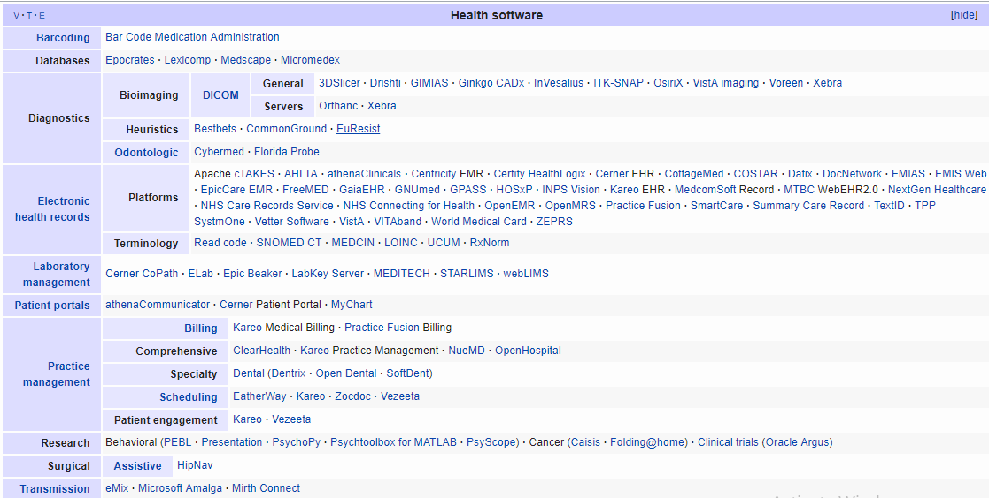
List of freeware health software
Source: Wikipedia, accessed 1st Dec 2018

Slide 11
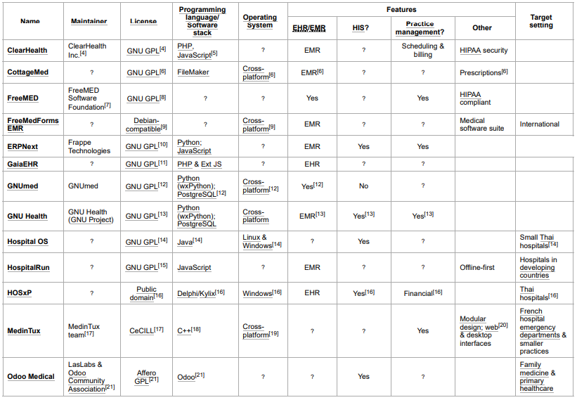
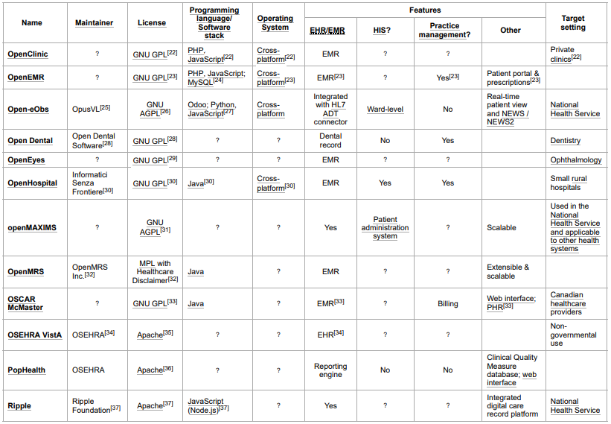
Electronic records and hospital management
Source: Wikipedia, accessed 1st Dec 2018

Slide 12
IAIM Hospital database Bengaluru
One of the largest Ayurvedic electronic databases operational since 2010
Total number of patients treated = ~50,000
Out patients = ~45,000
In patients = ~7,000 (* some patients are both Out patient / in patient)
~1,70,000 out patient visits
Patients from more than 50 countries
More than 900 disease conditions treated
Implementation of Ayurvedic Clinical Dictionary for diagnosis
Data as of June 2018

Slide 13
Data observations into summaries, stories
Generic algorithm and steps followed
Use R program to generate tabular or graphical analysis
Use source tables from the SQLserver
Use SQL queries to combine necessary tables
Use R program to create analysis data tables
Use Tableau to generate interactive visual analysis
Login on the SQL server using the credentials
Use the IAIM schema, access following tables to generate base table with
Demographics information, Patient Visit information and prescribed treatments
STATE_MASTER
COUNTRY_MASTER
CITY
STATE
PATIENT_DETAILS
PATIENT_REGISTRATION
MRD_DIAGNOSIS
PATIENT_PRESCRIPTION
PATIENT_MEDICINE_PRESCRIPTIONS
IP_PRESCRIPTION
SERVICES_PRESCRIBED
SERVICES
MEDICINE_SALES_VIEW
There are many CRF pages built to collect relevant Ayurvedic data, measurement data, Hospital visit data, food / exercise advice, etc.
This data is present in the following tables:
PATIENT_SECTION_DETAILS
PATIENT_SECTION_VALUES
SECTION_MASTER
SECTION_FIELD_OPTIONS
SECTION_FIELD_DESC
PATIENT_CONSULTATION_FIELD_VALUES
The datasets created in steps 2 and 3 are further processed using R programming language and the analysis ready datasets are created

Slide 14




Data observations into summaries, stories

Slide 15
Examples of analysis

Slide 16
Top 15 diseases treated, Data as of June 2016
Example 1
Disease | Grand Total | Female | Male
Vatavyadhi – Sandhigata vaata | 3577 | 2339 | 1238
Vatavyadhi | 2783 | 1507 | 1276
Vatavyadhi – Gridhrasee | 2034 | 1055 | 979
Vatavyadhi – Avabaahuka | 1482 | 865 | 617
Amlapitta | 1429 | 628 | 801
Prameha | 1375 | 585 | 790
Shvaasa | 1228 | 543 | 685
Netra Roga | 1120 | 516 | 604
Madhumeha | 1063 | 369 | 694
Staanabhedana Shoola – Katee Shoola | 978 | 494 | 484
Sthaulya | 831 | 487 | 344
Greeva Graha | 821 | 399 | 422
Kaasa | 814 | 410 | 404
Staanabhedana Graha – Katee Graha | 796 | 363 | 433
Kshudra Roga | 725 | 378 | 347

Slide 17
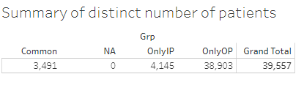
Text table generated using Tableau
Example 2

Slide 18
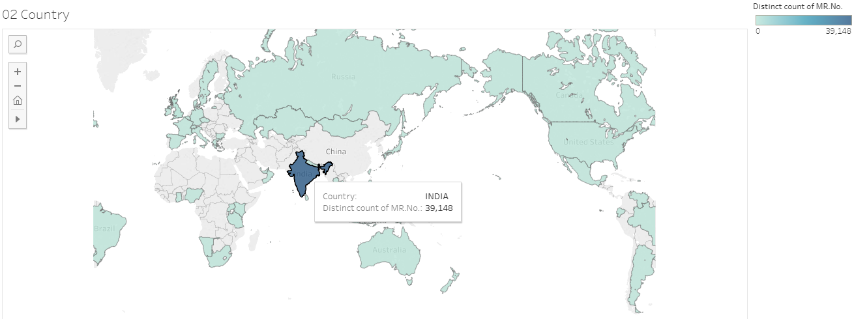
Country wise split, interactive tooltip showing count of unique patients
Example 3

Slide 19
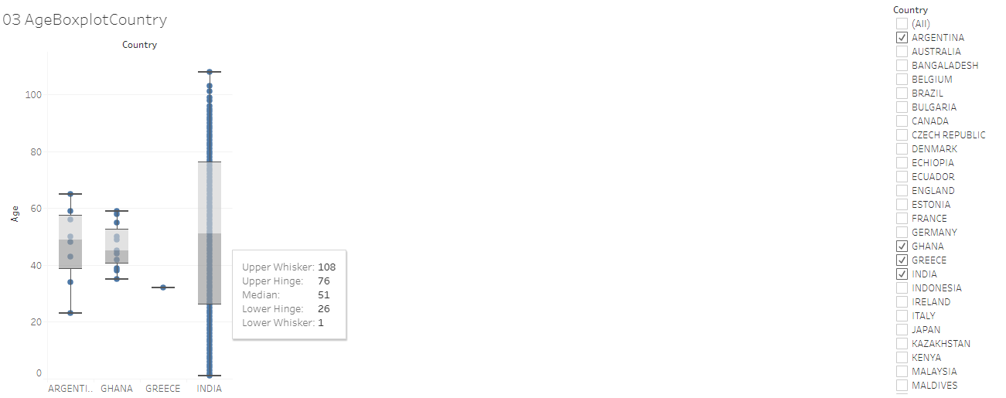
Box plot for age by country
Example 4
Ability to display or hide data for specific country (is), additional statistics are shown in the tooltip

Slide 20
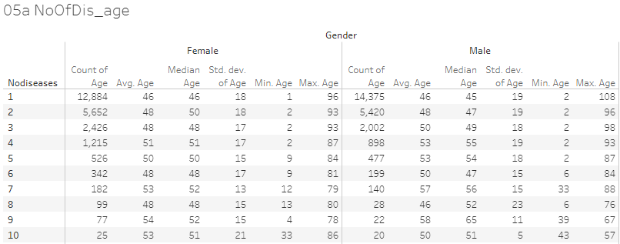
Descriptive statistics table generated using Tableau
Example 5

Slide 21
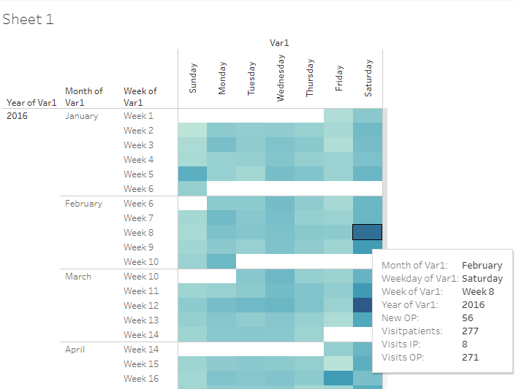
Operational view of number of patients
Example 6
Patients visiting on each day, details of visits displayed in the tooltip maximizing the usage of space

Slide 22
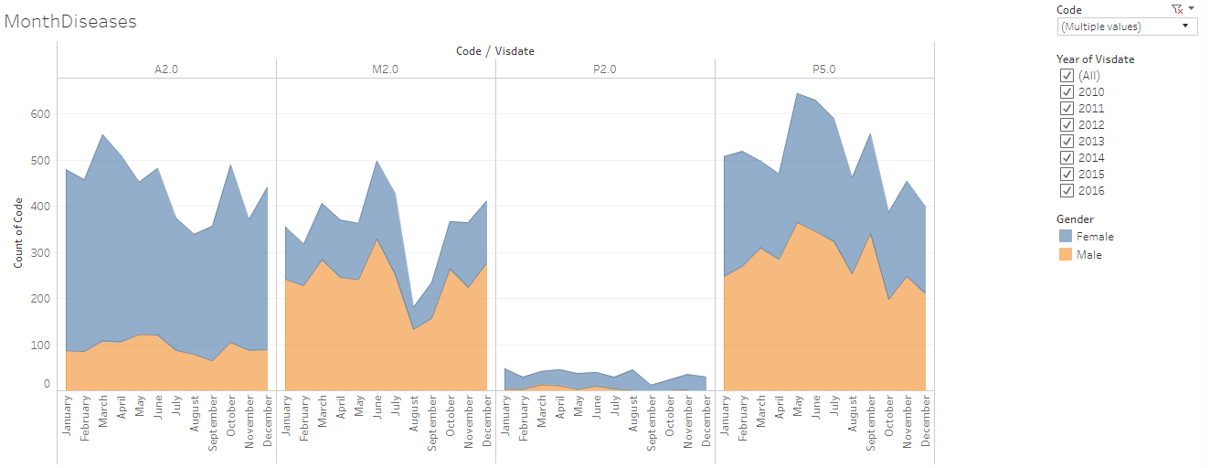

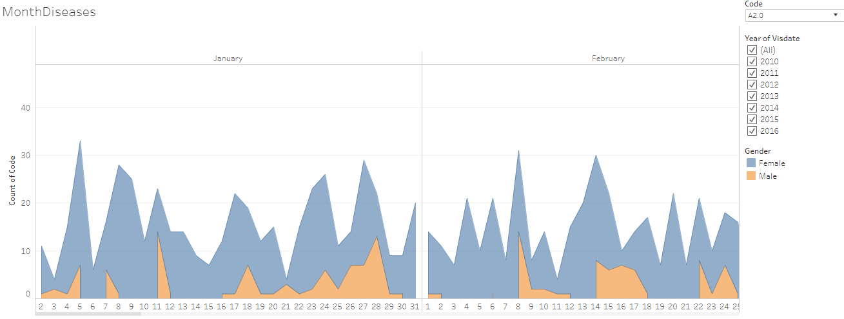
Frequency count of patients for each disease by month by gender
Example 7
This visual opens for each day, by clicking on “+” sign on the x-axis, showing the operational as well as scientific usefulness.

Slide 23
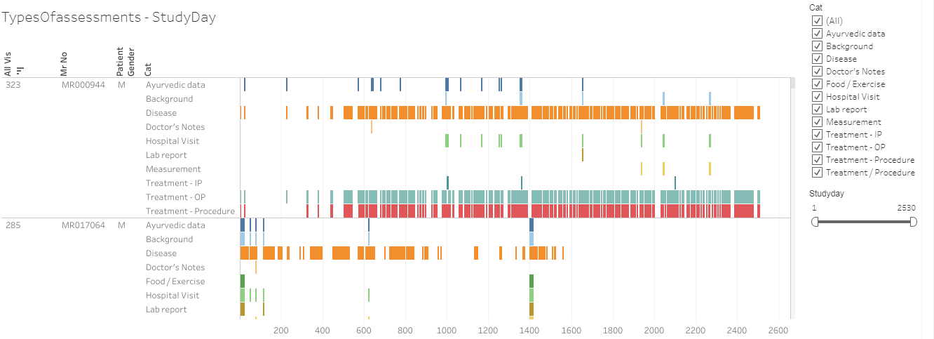
Types of assessment captured by CRFs for individual patients by visit day
Example 8
Data for individual patient displayed by visit day

Slide 24
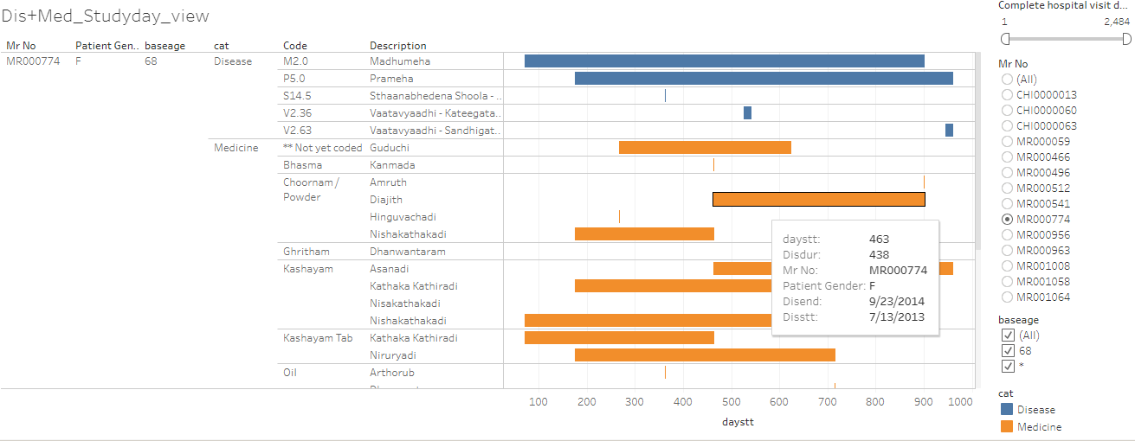
Patient profile view of individual patient by disease and medicine
Example 9

Slide 25
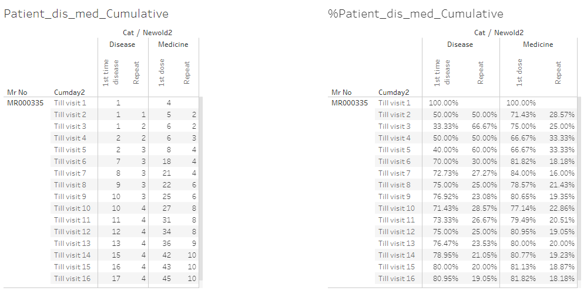
Number of reported diseases and prescribed medicines for each patient by visit
Example 10
Very good insights into disease and medicine combinations

Slide 26
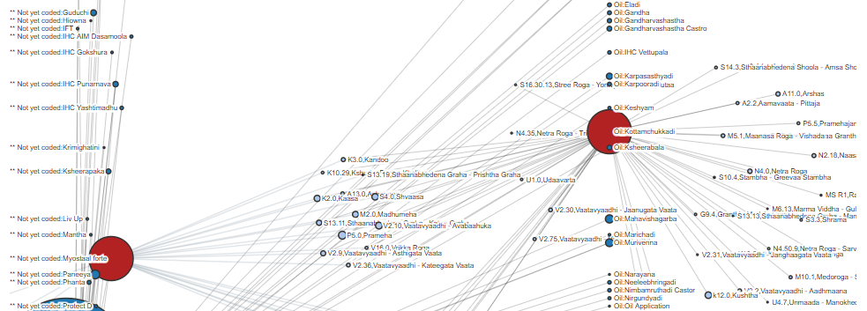
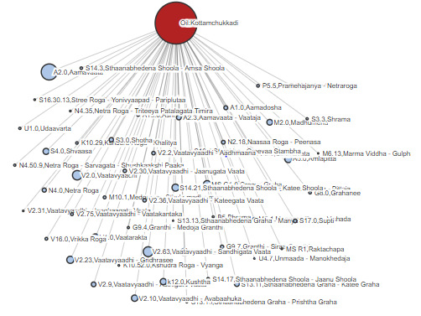
Medicine and diseases
Example 11
Relationship between diseases and medicines

Slide 27
How does it help?
Credible basis for medical decisions
Cause, diagnosis, prognosis, relationship
Trends
New
Hypotheses,
Questions / answers
Treatments, diseases
Validation of anecdotes, assumptions, beliefs

Slide 28
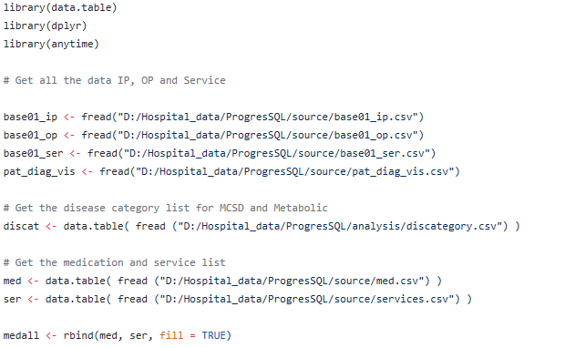
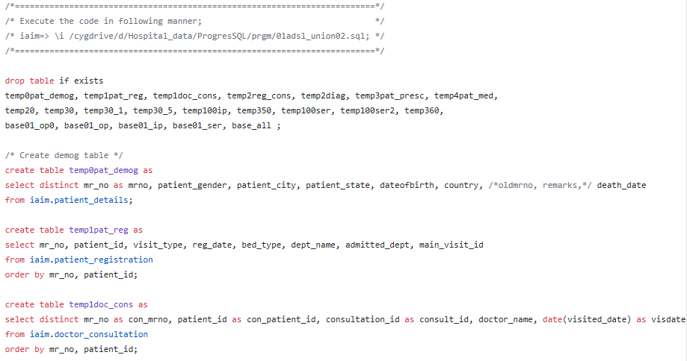
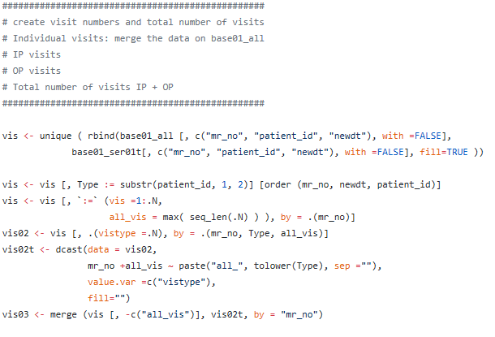
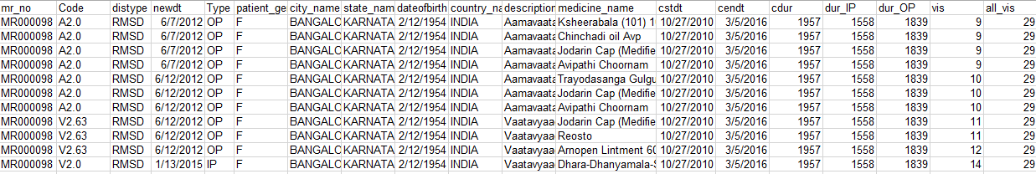
SQL script, R script, dataset
The snapshot shows following variables:
patient ID,
Disease code,
Disease type,
Date of visit,
visit type (IP, OP),
gender,
city,
state,
date of birth,
Country,
Description of disease,
Medicine name,
Start date,
End date,
Total duration,
In Patient duration,
Outpatient duration,
Visit number,
Total number of visits, etc.

Slide 29
Thank you !!!

