Slide 1

Insights generation using Health Management Information Systems
Vinay Mahajan, Girish Tillu, Ashwini Mathur, Darshan Shankar
The University of Trans-disciplinary Health Sciences and Technology (TDU)

Slide 2
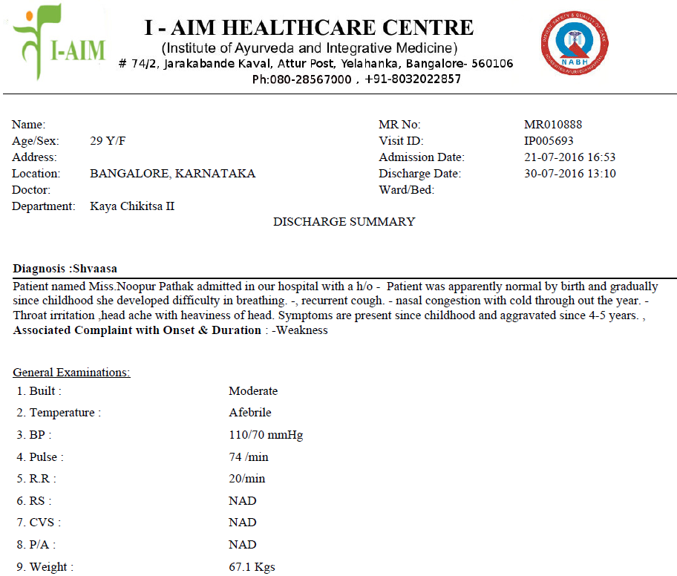
From a patient to ...
Operational insights
Clinical insights
New research ideas
Relationships between biomedical disease classification and ACD ..TRANS-DISCIPLINARY PERSPECTIVES

Slide 3
IAIM Hospital database Bengaluru
Reasonably Ayurvedic electronic databases operational since 2010
Total number of patients treated = ~50,000
Out patients = ~45,000
In patients = ~7,000 (* some patients are both Out patient / in patient)
~1,70,000 out patient visits
Patients from more than 50 countries
More than 900 disease conditions treated, > 3000 medicines recorded
Implementation of Ayurvedic Clinical Dictionary for diagnosis
Data as of June 2018

Slide 4
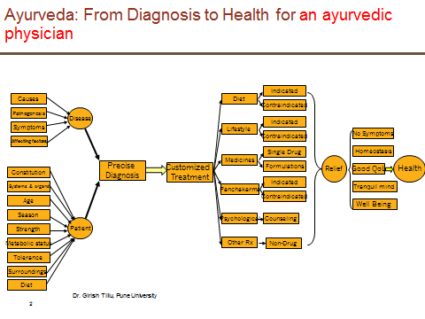
Theoretical flowchart based on texts

Slide 5
Pilot study based on I-AIM data
A few facts: Duration: 1st January 2011 to 5th June 2015
Total registered patients 31,826
14,188 (49.5%) patients only 1 visit data
~ 1290 (4.5%) patients with more than 10 visits
Based on Excel, only textual representation
Major disease areas treated: musculoskeletal and metabolic diseases
Total 2,29,011 therapies were administered to 8,364 patients
Out of 58,596 patient visits, details of 53,332 visits (91%) are documented as diagnostic codes of Ayurvedic Classification of Diseases (ACD)
Perhaps the largest electronically available ayurvedic treatment database.
Ref: Information based on analysis done by Girish Tillu – A snapshot of clinical records

Slide 6
After implementing the data science approaches
Modern programming methods
Interactive visualizations
What clinical, operational insights could be gained?
Let us see a few examples

Slide 7
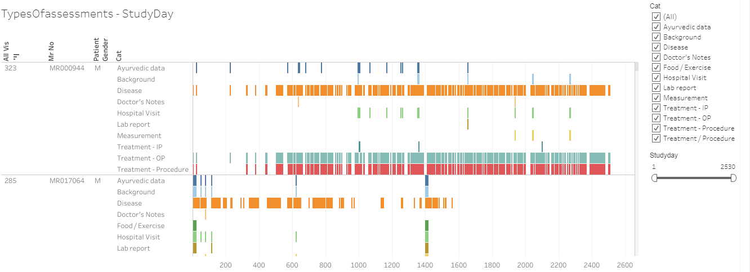
Case report
Example 1
Patient data visual

Slide 8
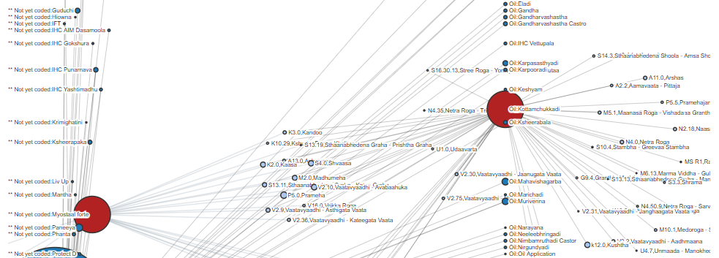
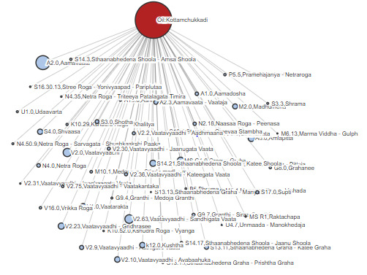
Example 2: Relationship between diseases and medicines

Slide 9
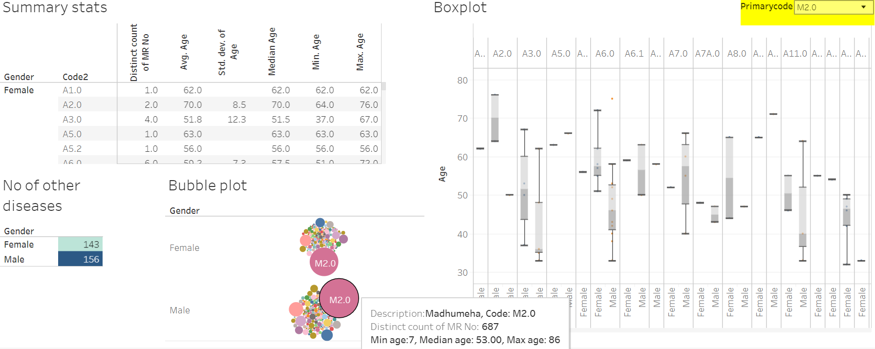
Example 3: Patients with Madhumeha and additional diseases reported

Slide 10
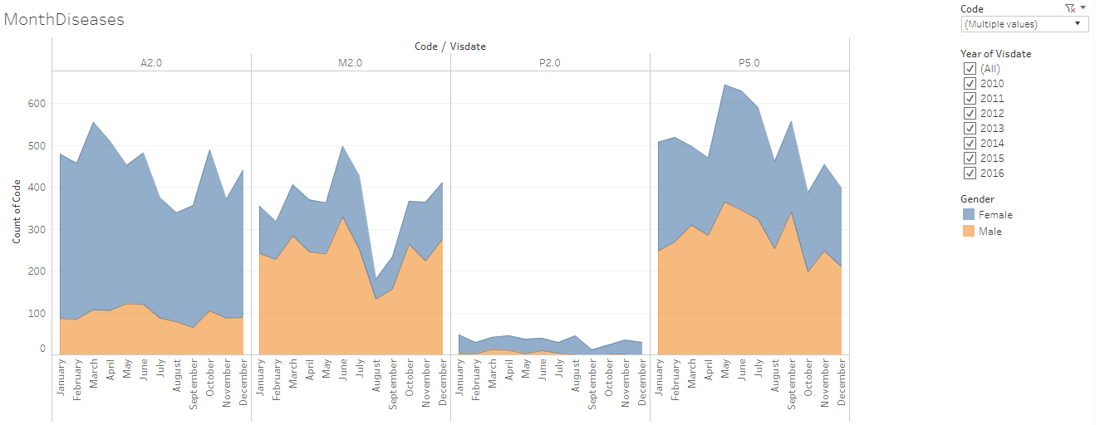

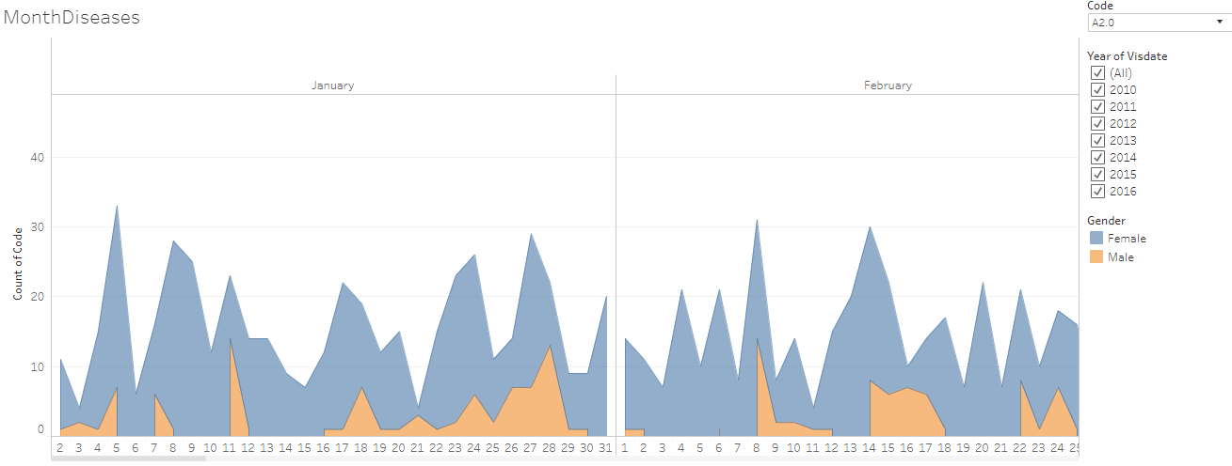
Example 4: Frequency count of patients for each disease by month by gender
This visual opens for each day, by clicking on “+” sign on the x-axis, showing the operational as well as scientific usefulness.
Seasonal variation,
Gender wise variation,
Disease variation

Slide 11
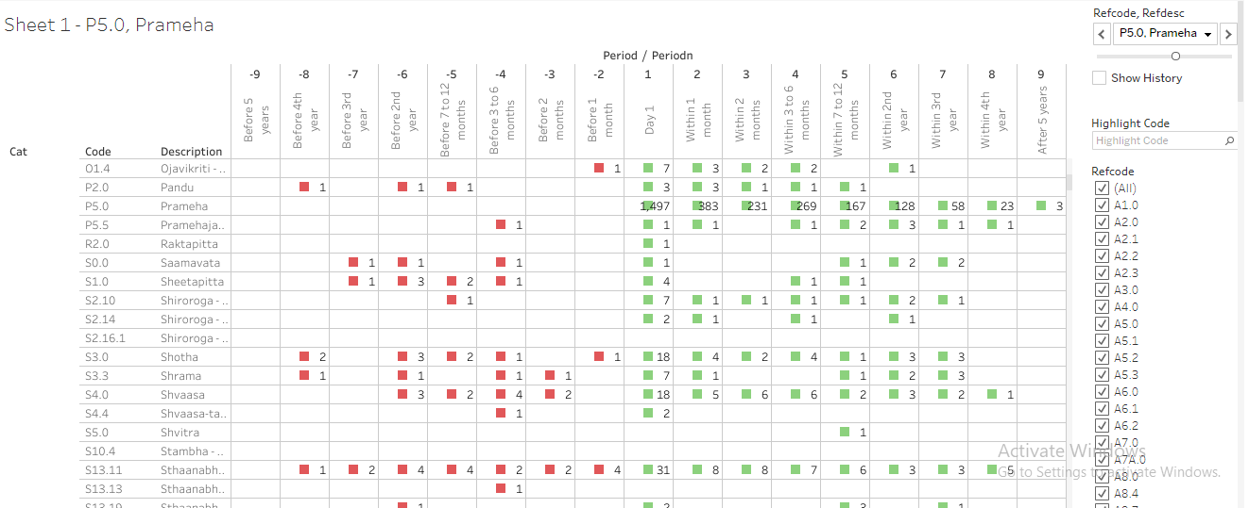
Example 5: pre and post co-morbidities for Prameha
Prameha has been reported by 1497 patients. Out of these 383 patients visit hospital within 1st month, 231, 269, 167, 128, etc are in the following time points.
Other lines in the table provide details about diseases reported by these 1497 patients.
Bottom section of the table provides information about the treatment details for these patients.

Slide 12
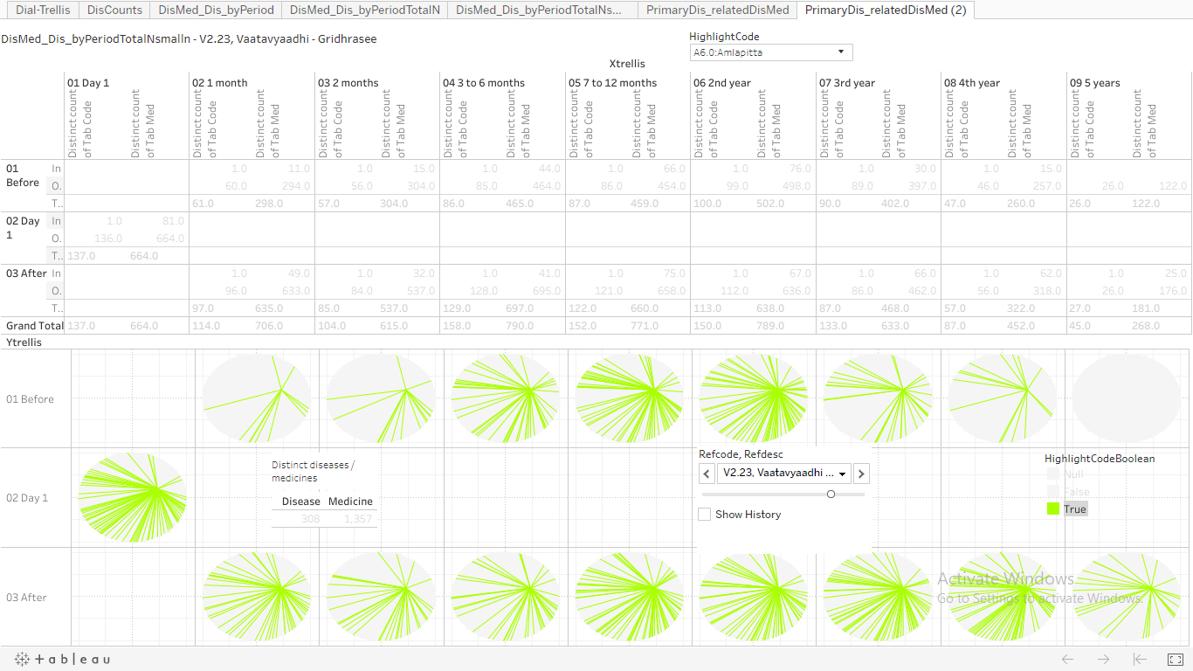
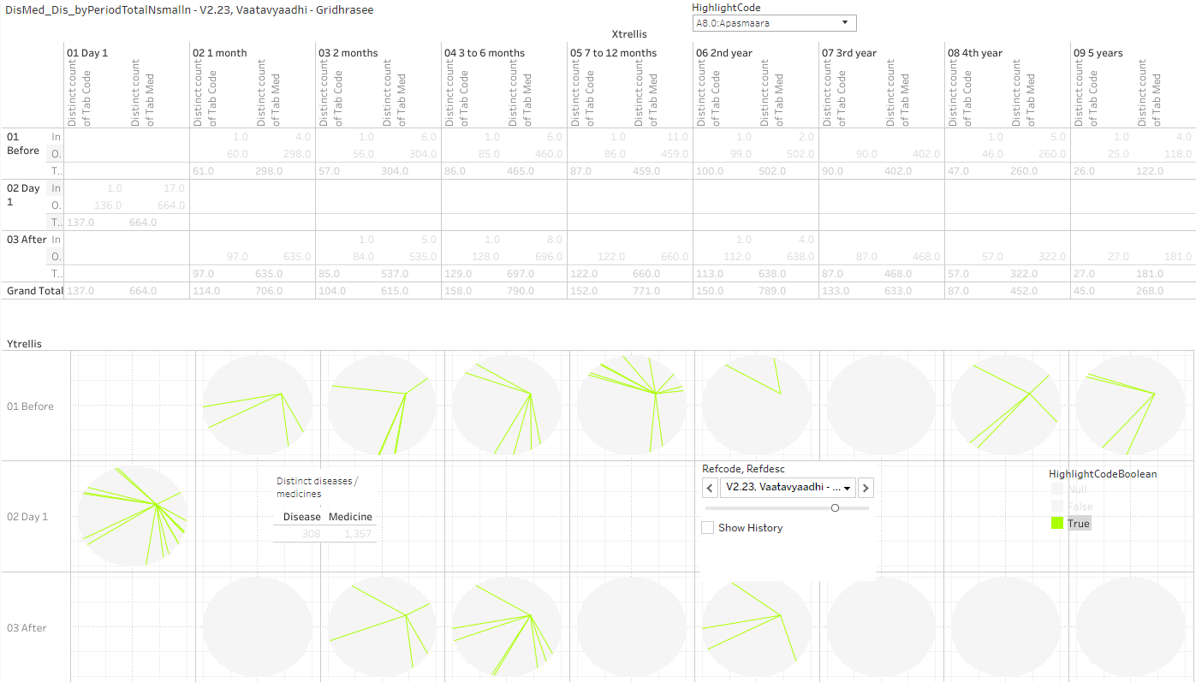
Example 6: circular view representation of disease and medicine co-occurrences, pre and post
Interpretation, Many green lines means:
There is a greater chance of diseases reported by patients
There is a greater chance of a medicine prescribed for a disease
Visualization of
Co-occurrences of disease and medicine
Co-occurrences of disease and disease

Slide 13
Value of insights?
Credible and robust basis for medical decisions
Cause, diagnosis, prognosis, relationship
Trends
New
Hypotheses,
Questions / answers
Treatments, diseases
Validation of anecdotes, assumptions, beliefs

Slide 14
Aspirational goal ...

Slide 15
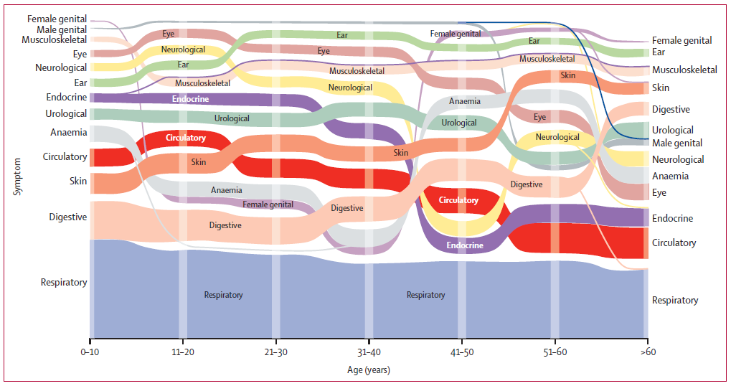
Disease or symptom prevalence across decades of life
Salvi S. Symptoms and medical conditions in 204 912 patients visiting primary health-care practitioners in India: a 1-day point prevalence study (the POSEIDON study). Lancet 2015 (3)

Slide 16
Aspirational goal
Ayurvedic vaidyas all over India
Collect data in “1 day prevalence study”
Prakriti
Disease
Medicines
Outcomes of the study
Importance of HMIS in day to day practice
Operational insights
Medical insights
Credible and robust estimates at India level for ayurvedic parameters
Data observations into summaries, stories

Slide 17
Thank you

Slide 18
Back-up

Slide 19
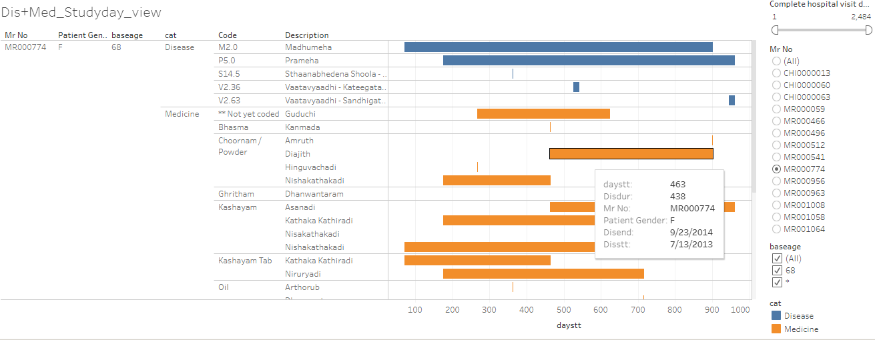
Case report
Example 2
Patient profile view of individual patient by disease and medicine

Slide 20
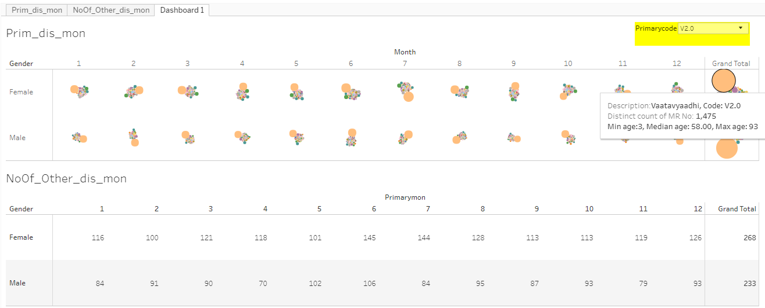
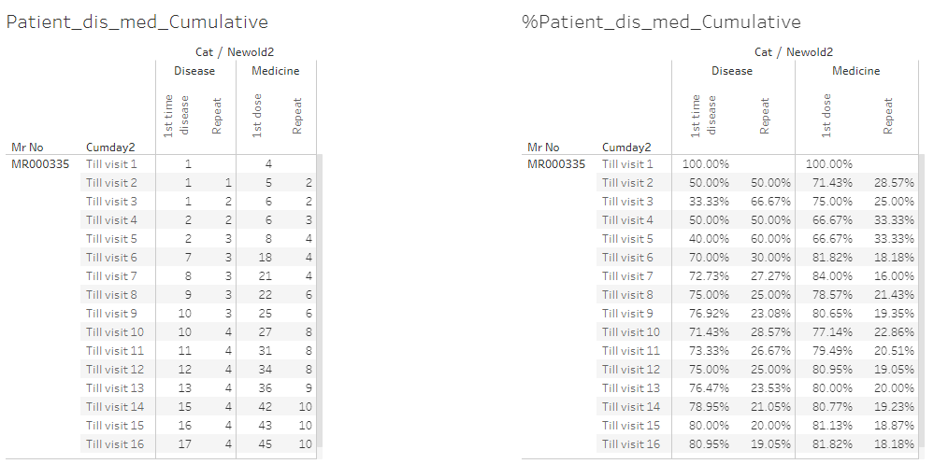
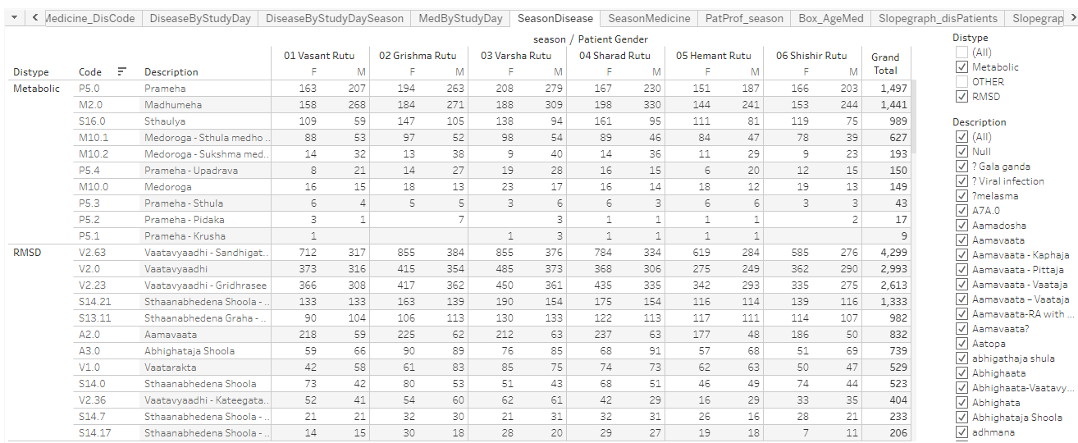
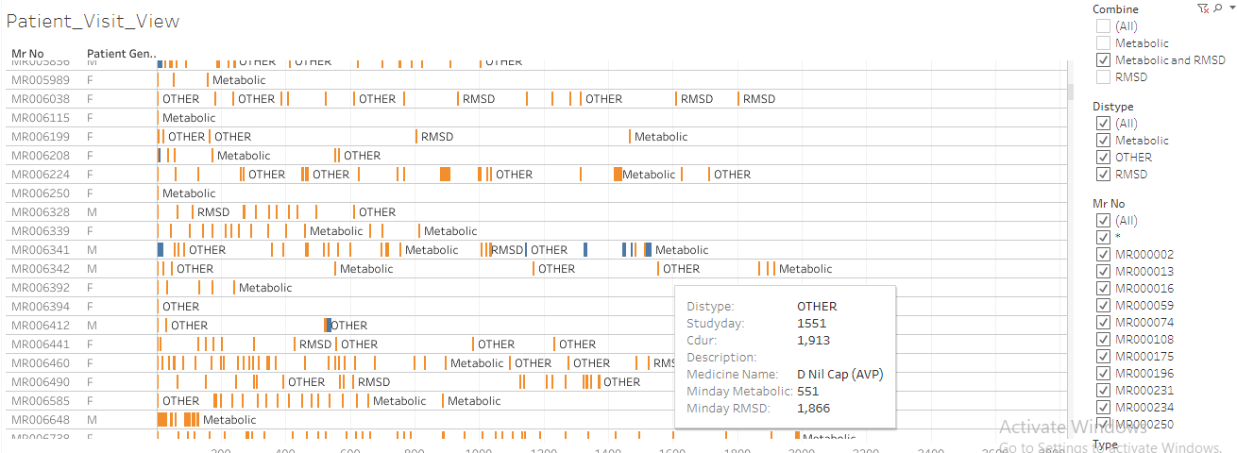
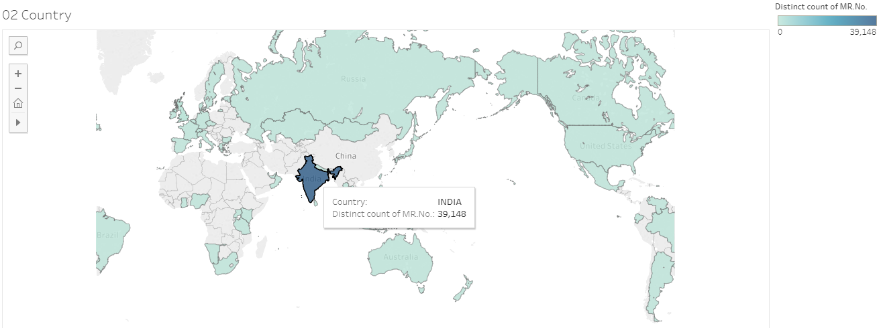
Many more examples

Slide 21
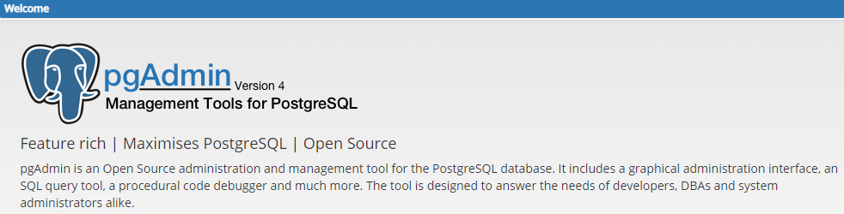
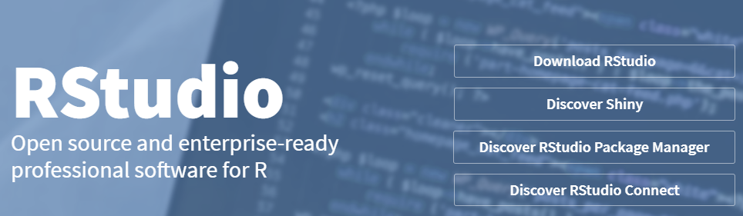
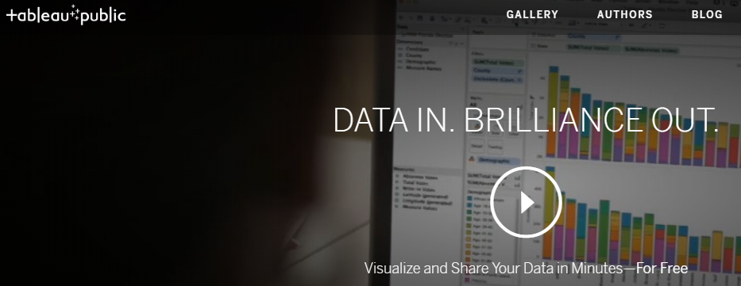
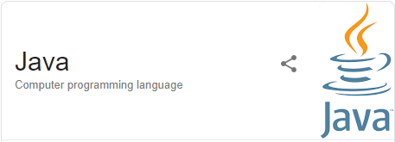
Data observations into summaries, stories

Slide 22
Data observations into summaries, stories
Generic algorithm and steps followed
Use R program to generate tabular or graphical analysis
Use source tables from the SQLserver
Use SQL queries to combine necessary tables
Use R program to create analysis data tables
Use Tableau to generate interactive visual analysis
Login on the SQL server using the credentials
Use the IAIM schema, access following tables to generate base table with
Demographics information, Patient Visit information and prescribed treatments
STATE_MASTER
COUNTRY_MASTER
CITY
STATE
PATIENT_DETAILS
PATIENT_REGISTRATION
MRD_DIAGNOSIS
PATIENT_PRESCRIPTION
PATIENT_MEDICINE_PRESCRIPTIONS
IP_PRESCRIPTION
SERVICES_PRESCRIBED
SERVICES
MEDICINE_SALES_VIEW
There are many CRF pages built to collect relevant Ayurvedic data, measurement data, Hospital visit data, food / exercise advice, etc.
This data is present in the following tables:
PATIENT_SECTION_DETAILS
PATIENT_SECTION_VALUES
SECTION_MASTER
SECTION_FIELD_OPTIONS
SECTION_FIELD_DESC
PATIENT_CONSULTATION_FIELD_VALUES
The datasets created in steps 2 and 3 are further processed using R programming language and the analysis ready datasets are created

