Slide 1
Case 01 Vrikka Roga

Slide 2
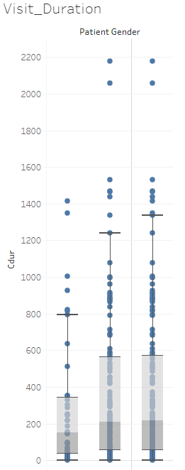
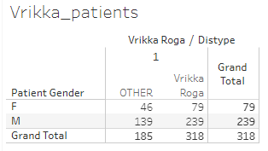
Basic understanding of data

Slide 3
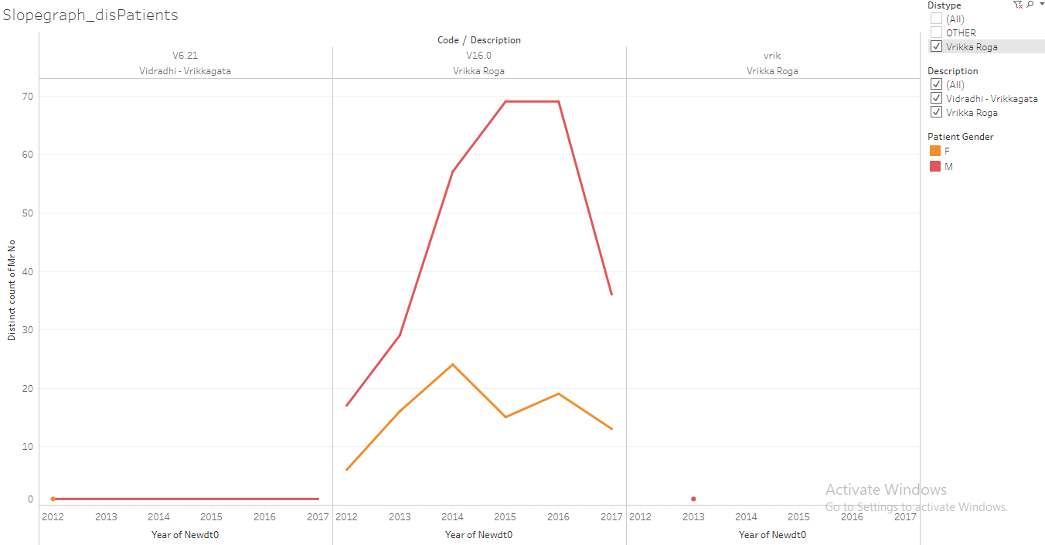

Slide 4
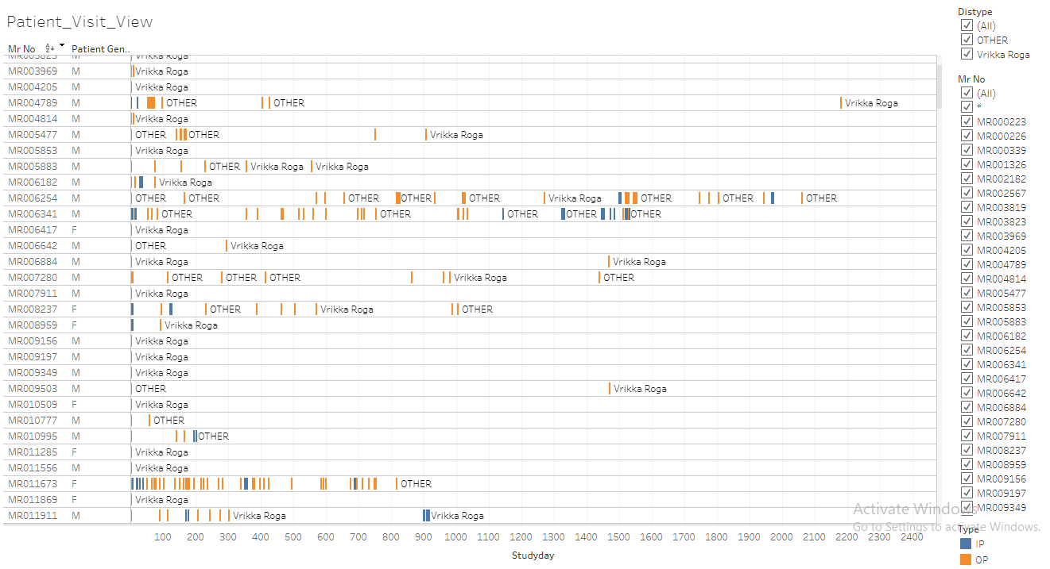

Slide 5
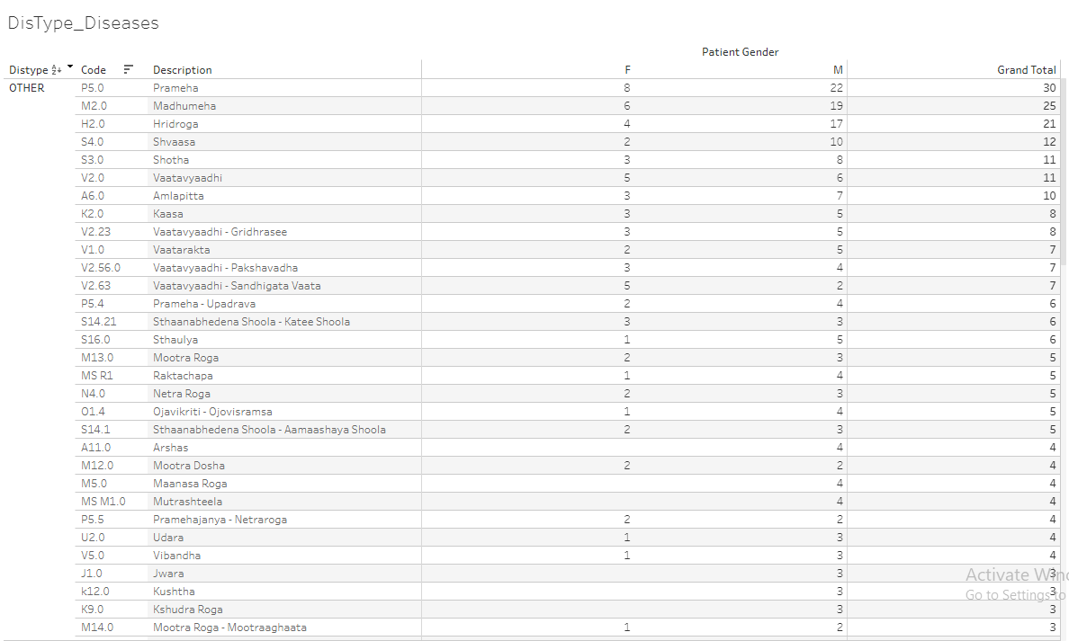

Slide 6
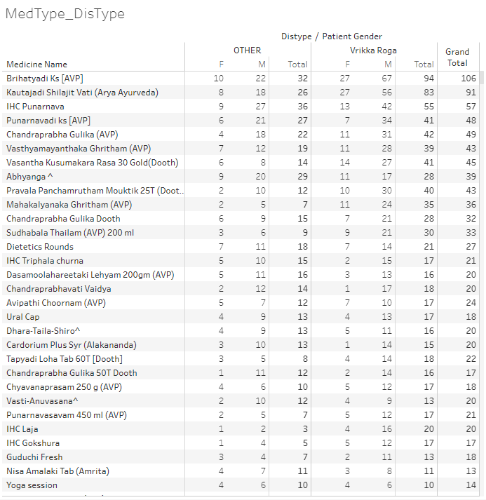

Slide 7
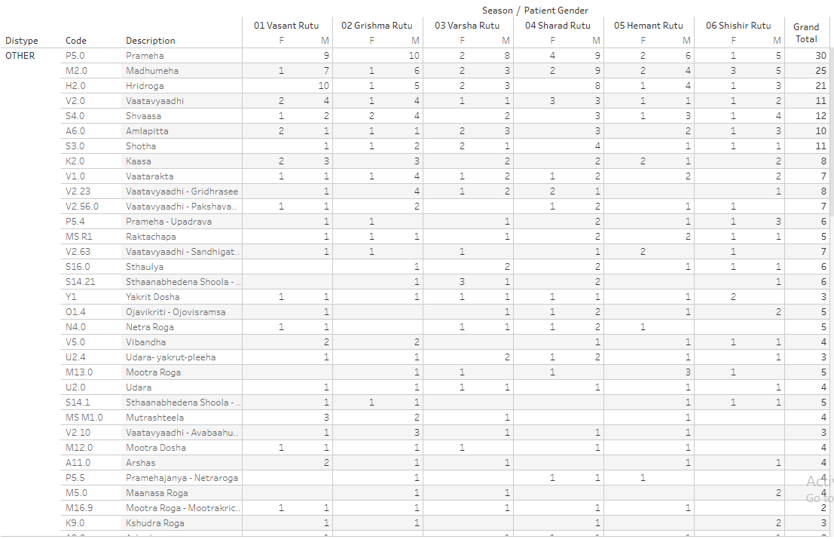

Slide 8
Disease & treatment view, listing + summary: Vrikka roga
There are 3 analysis views created for individual patient data.
1stpart of the analysis: Patients are treated as they come to hospital. This visual provides a patient level view of number of diseases reported for the first time and then repeated, similarly treatment prescribed for the first time vs. a repeat of treatment.
When a disease is reported very first time then that is considered “1st time disease reported”, any subsequent repetition is considered as “Repeat”.
When a treatment is prescribed very first time then that is considered “1st time treatment prescribed”, any subsequent repetition is considered as “Repeat”.
These 2 calculations are repeated through the data for each patient.

Slide 9
Disease & treatment view, listing + summary: Vrikka roga
2nd part of the analysis: This is a cumulative view for an individual patient. This provides a summary of what would have happened to a patient till a certain visit number. There are 2 tables created, first with absolute numbers and second with percentages.
3rd part of analysis: This is another version of display of diseases and treatments for individual patients “non-overlapping or non-cumulative” version.
Each line is a patient visit. 1st disease, Repeat disease, 1st treatment and Repeat treatment columns are displayed.
Study day column shows the visit day.

Slide 10
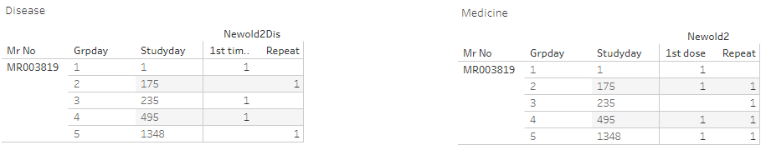
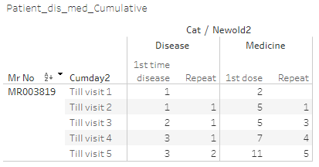
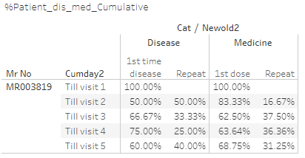
A specific patient – diseases and medicines

Slide 11
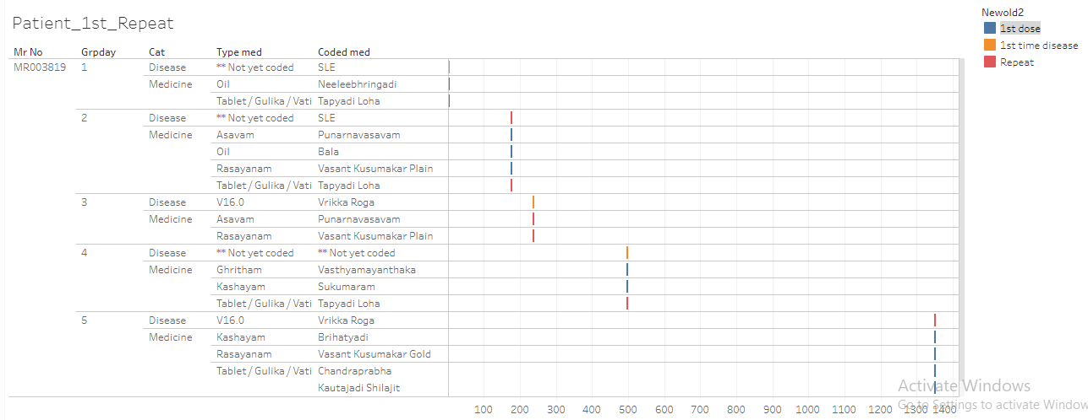

Slide 12
Before and after analysis

Slide 13
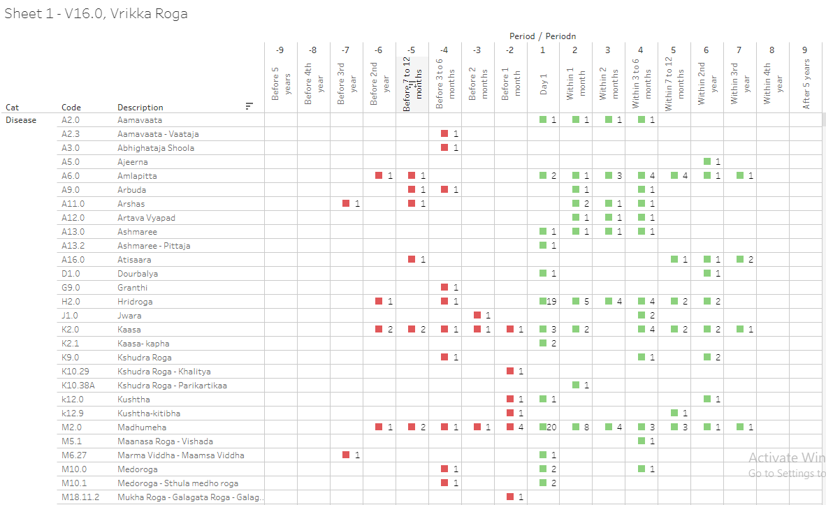

Slide 14
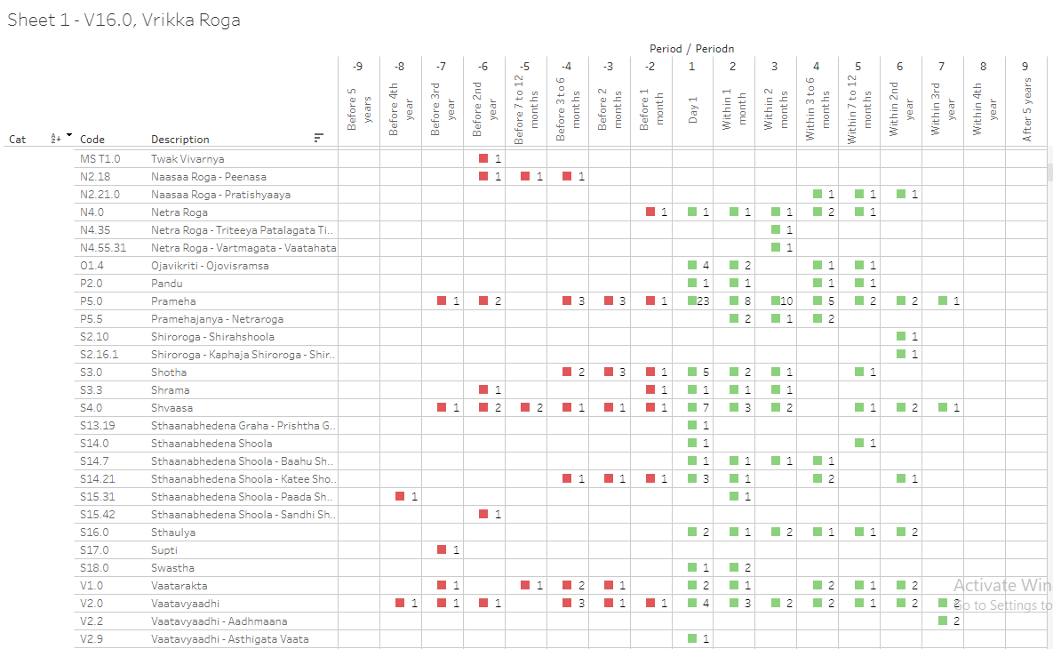

Slide 15
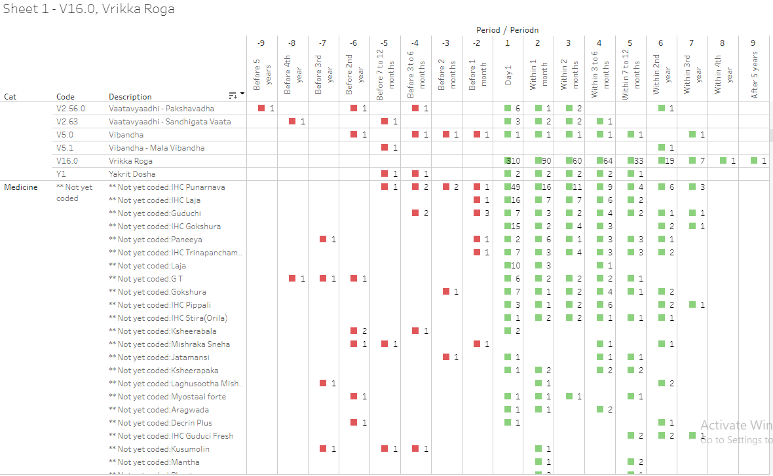

Slide 16
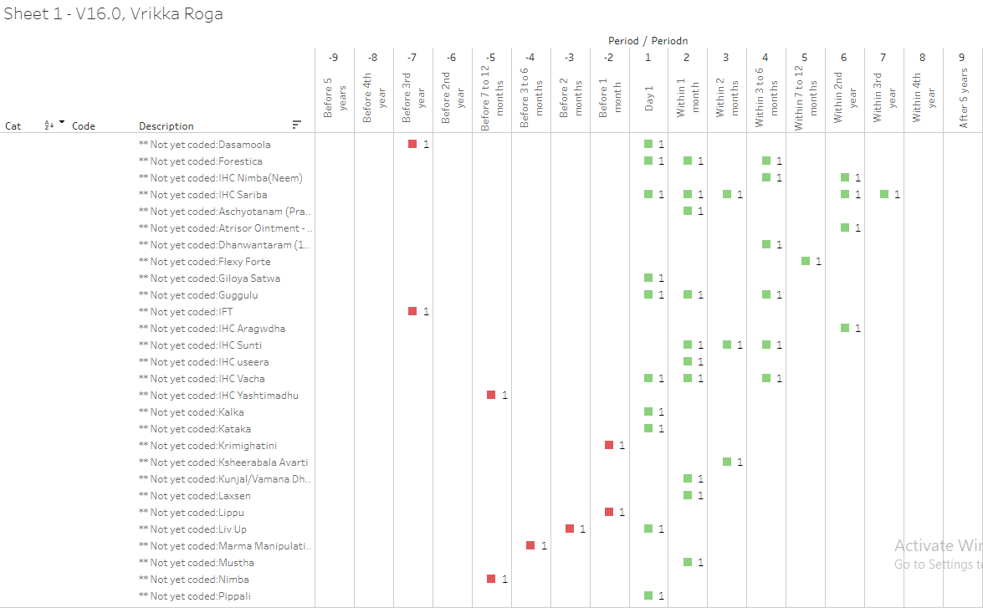

Slide 17
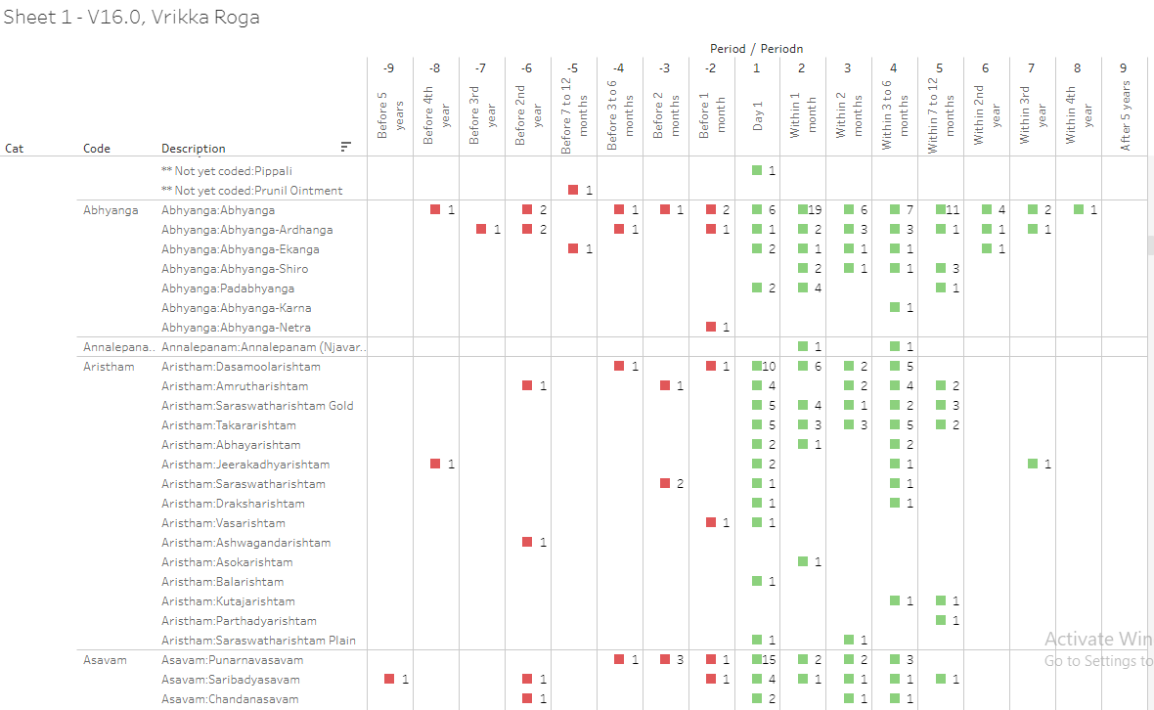

Slide 18
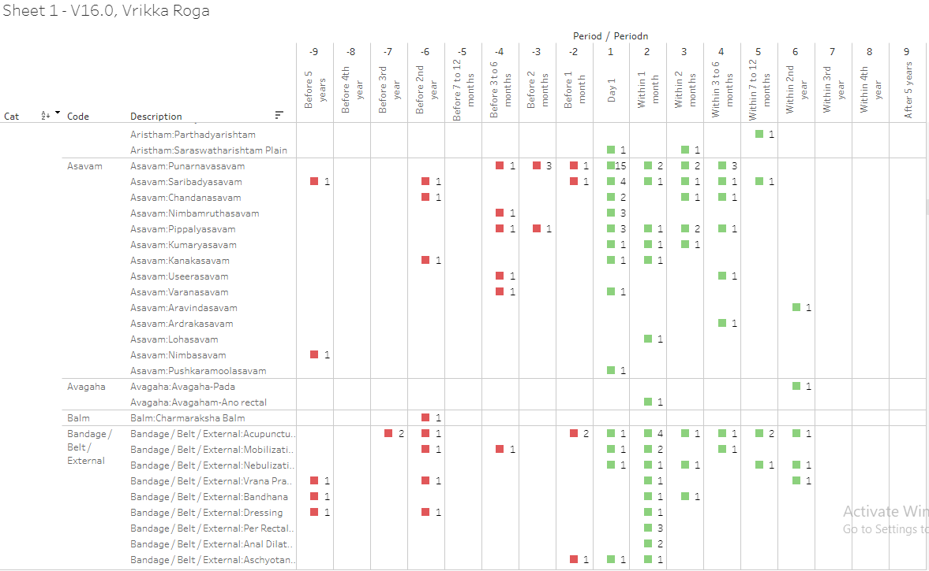

Slide 19
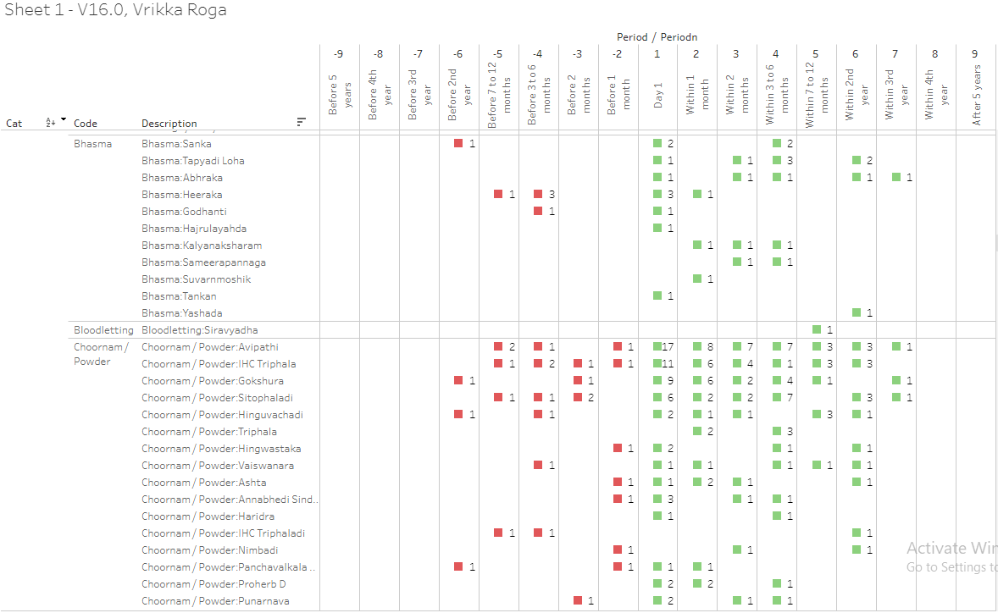

Slide 20
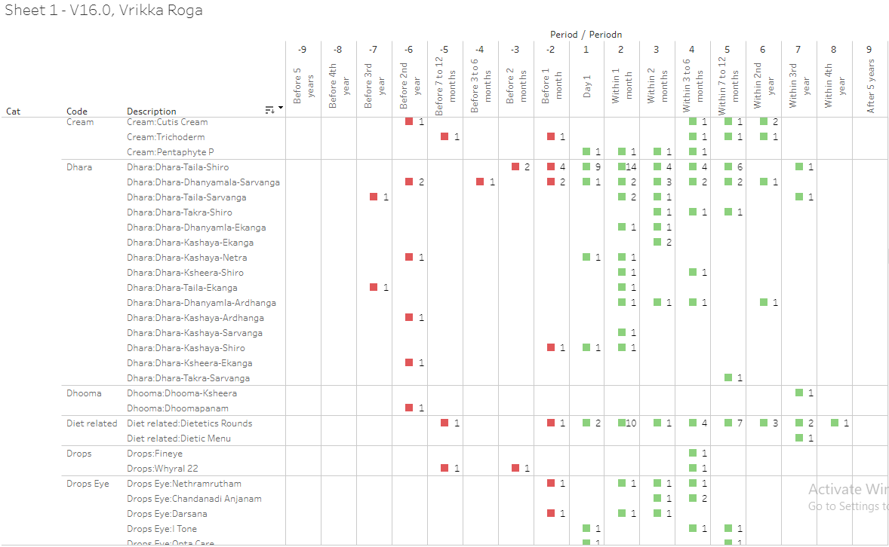

Slide 21
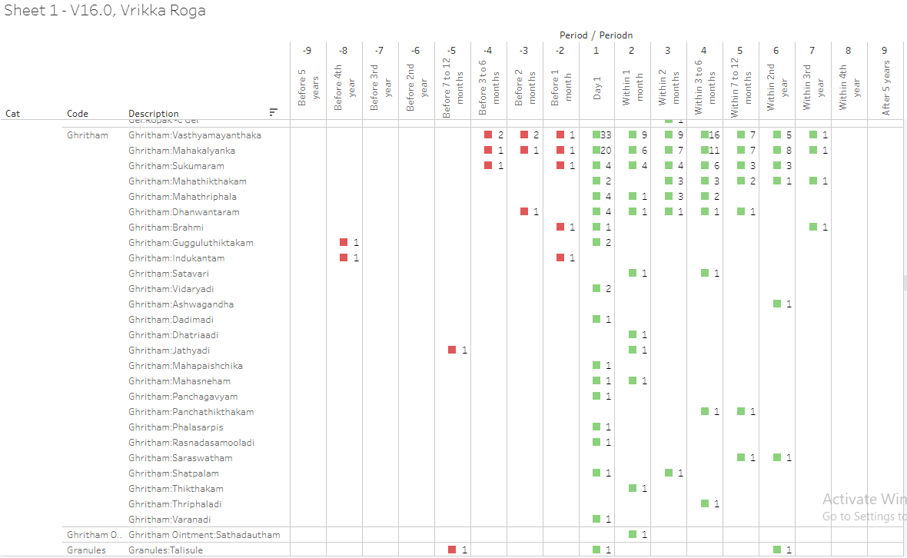

Slide 22
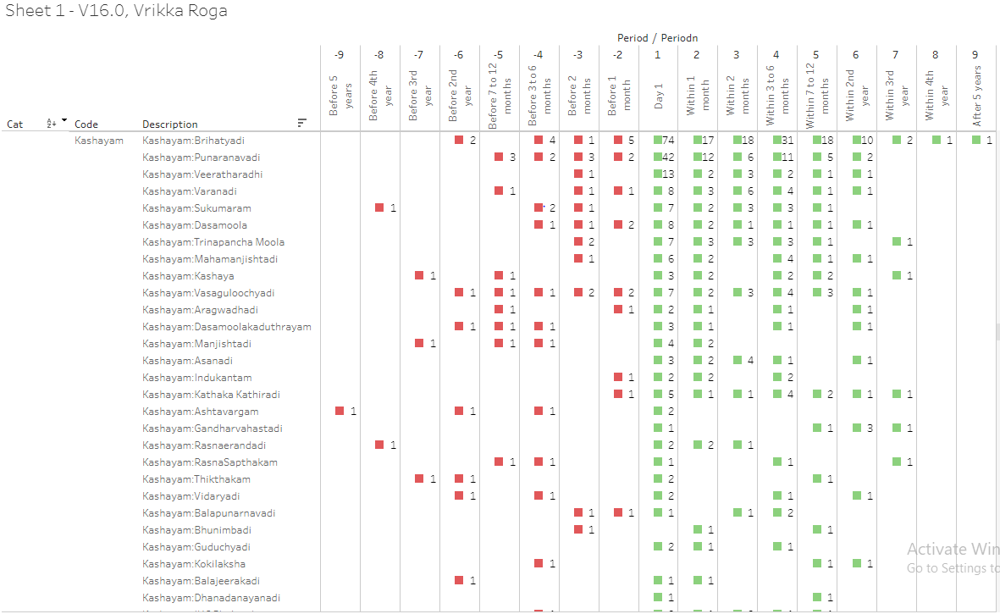

Slide 23
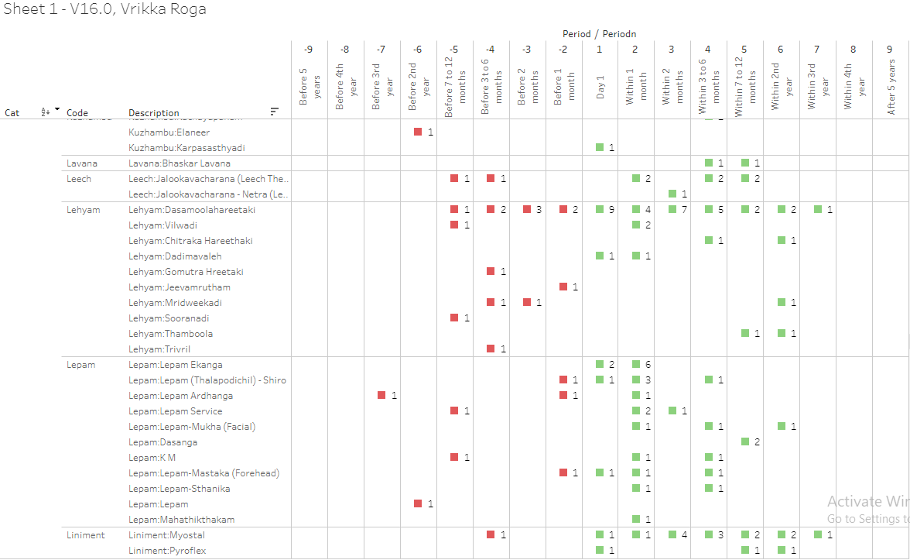

Slide 24
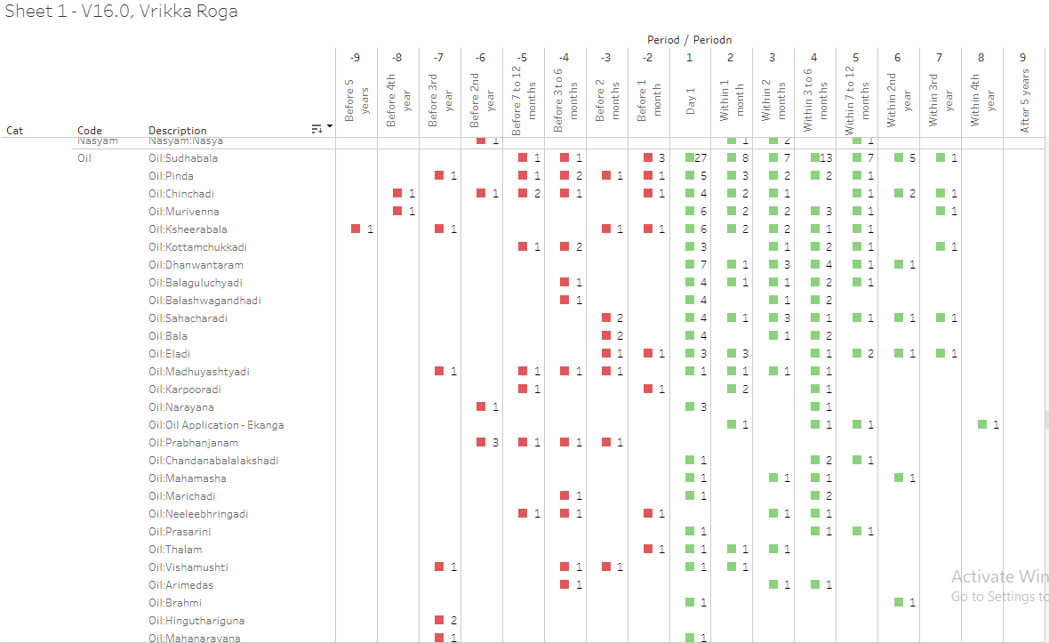

Slide 25
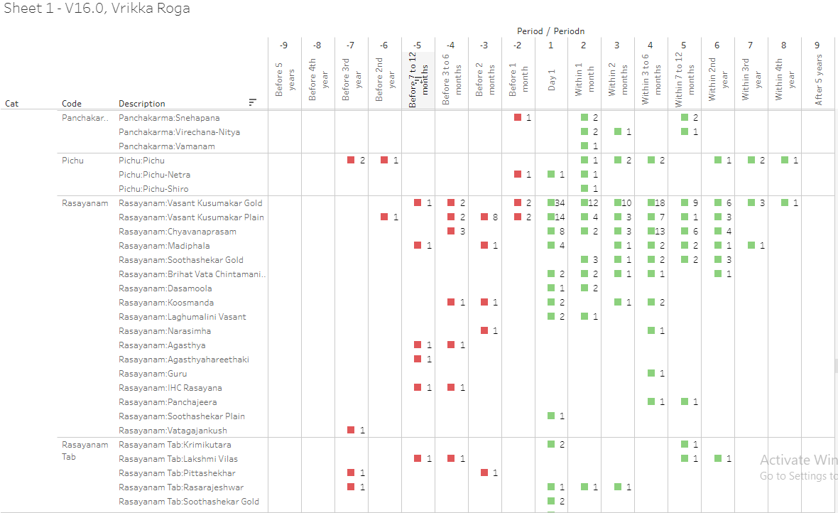

Slide 26
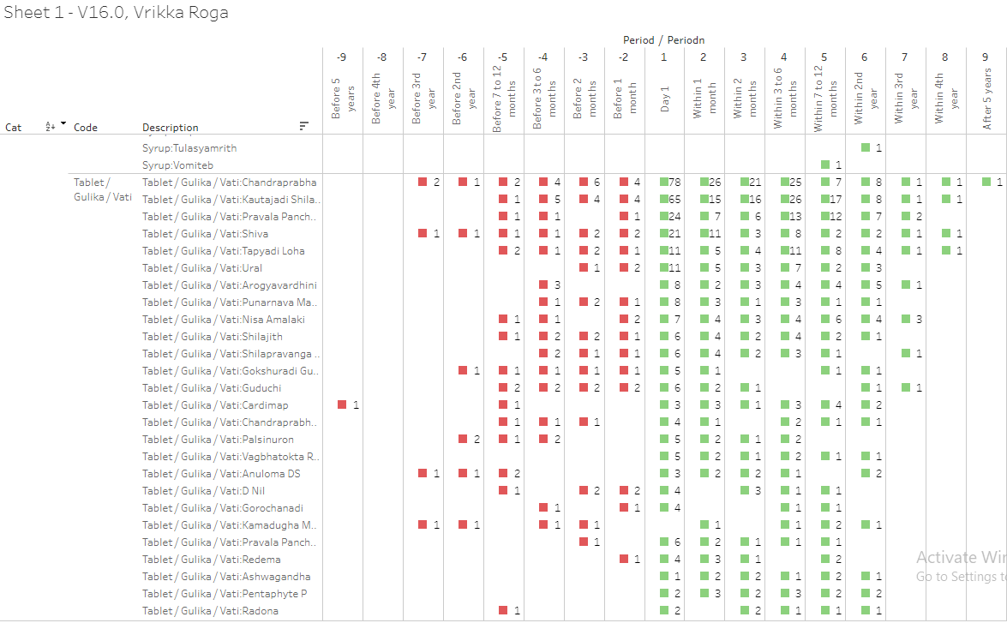

Slide 27
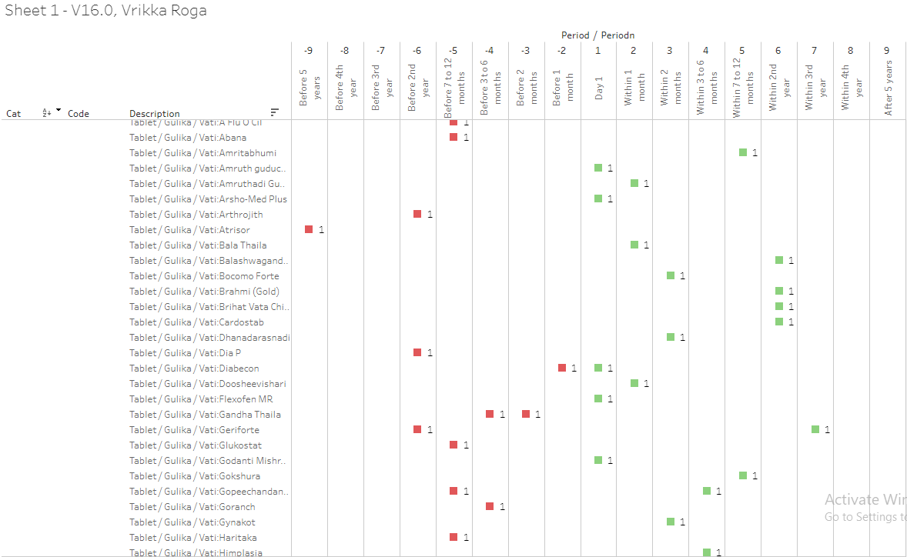

Slide 28
