Slide 1
The Prediction of Car Accidents Severity
IBM Applied Data Science Capstone
By: Mickael Aghajarian
September 2020

Slide 2
Car accidents have been resulted in many deaths and injuries in the world
Machine learning algorithms can be developed to predict the severity of car accidents before they would actually occur
Such intelligent systems can mitigate the number of deaths and injuries by warning drivers ahead of time
Governments/Hospitals/Car companies would be highly interested in such systems

Slide 3
Dataset:
The dataset of car accidents in the Seattle city (from 2004 to present)
The dependent variable is the accident severity in terms of 37 independent variables such as weather condition, read condition, and speeding
Five independent variables were selected:
Address type
Collision type
Weather condition
Road condition
Light condition

Slide 4
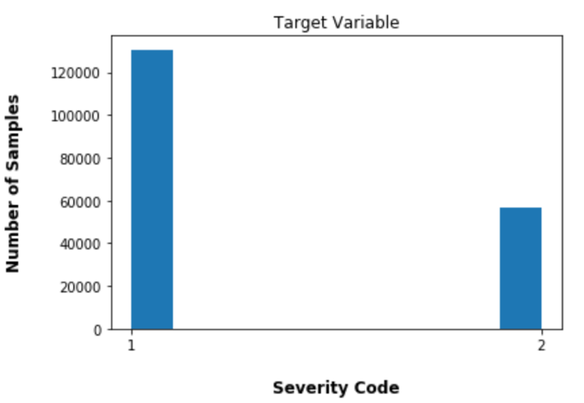
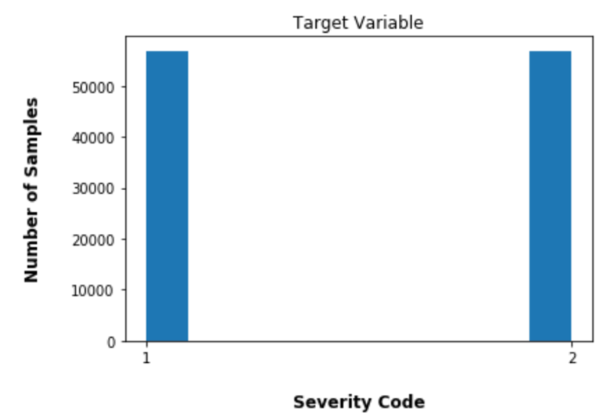
Data Preprocessing:
Remove the unnecessary/missing values
Convert the categorical variables to numerical
Balance the dataset by down-sampling
Normalize the data (zero mean and unit variance)
Imbalance dataset
balanced dataset

Slide 5
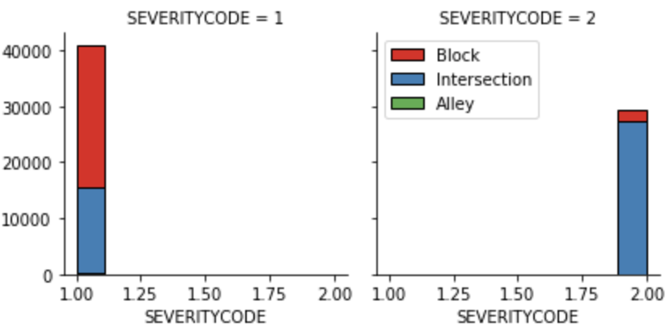
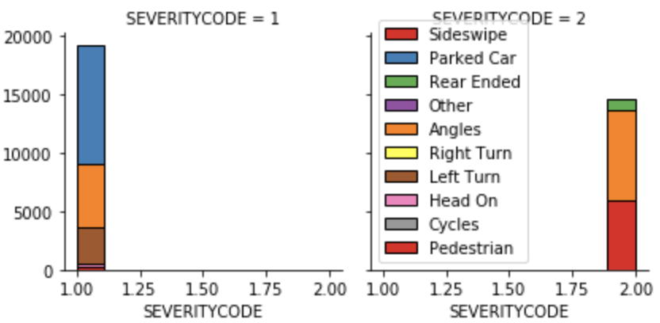
Exploratory Data Analysis:
Uncover relationships between independents variable and the target variable
Address type
Collision type

Slide 6
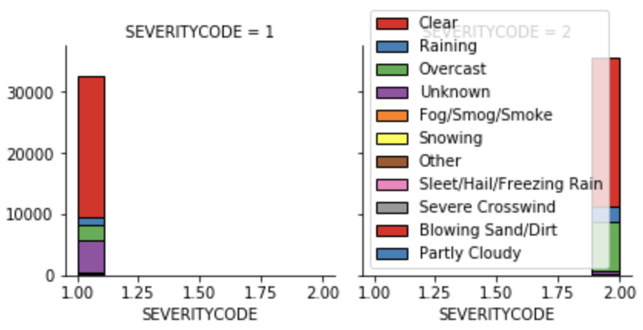
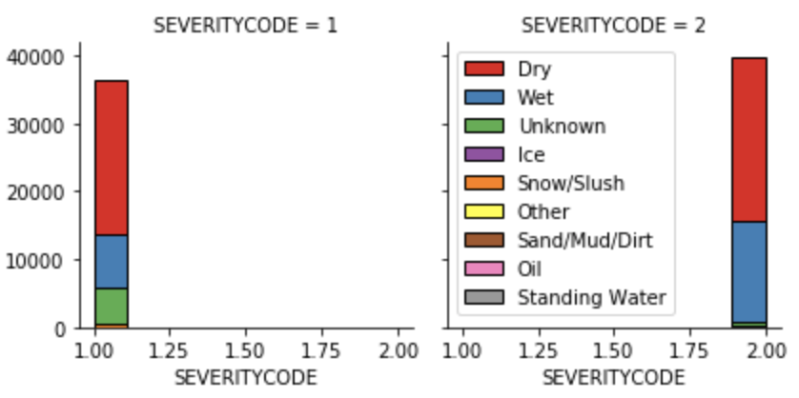
Exploratory Data Analysis
Uncover relationships between independents variable and the target variable
Weather condition
Road condition

Slide 7
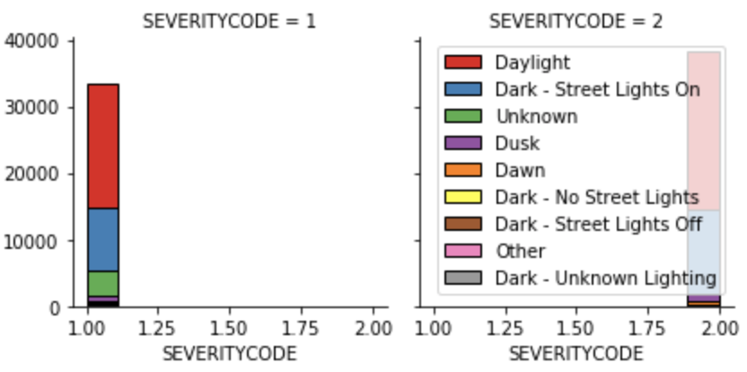
Exploratory Data Analysis
Uncover relationships between independents variable and the target variable
Light condition

Slide 8
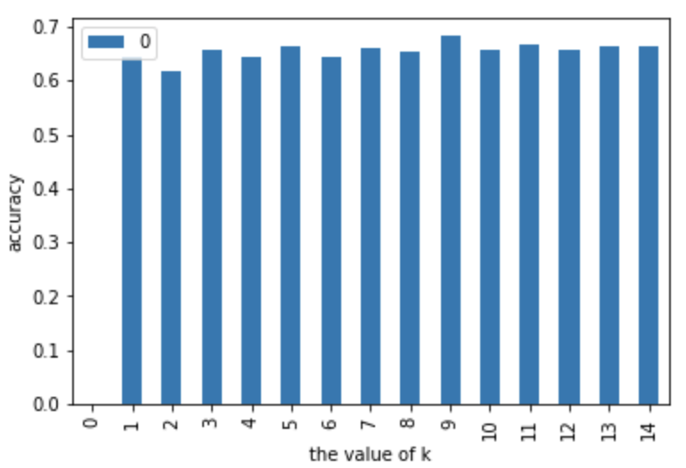
Model Development:
KNN (k = 9)
the classification accuracy for different values of k

Slide 9
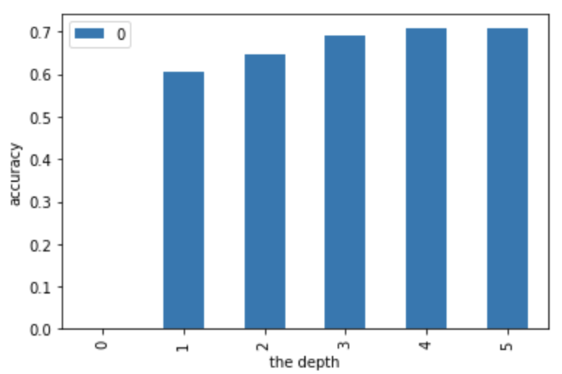
Model Development:
2) Decision tree (depth = 5)
the classification accuracy for different values of the depth

Slide 10
Model Development:
3) Logistic Regression
C = 0.01
Solver = “liblinear”

Slide 11
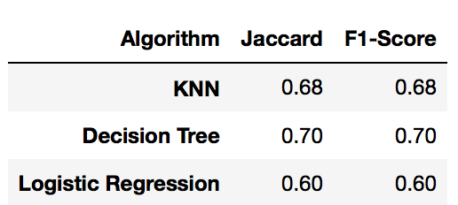
Results:
The test data was used to calculate two evaluation metrics:
The Jaccard index
F-1 score

Slide 12
Conclusion and future work:
Decision tree classifier achieved the highest F-1 score (70%)
There might be still room for improvement
Instead of removing the missing values, they could be replaced them with an average of similar data points
Use more independent features
Use k-fold method to use the data more effectively
Train other classifiers such as neural networks and support vector machine

