Slide 1
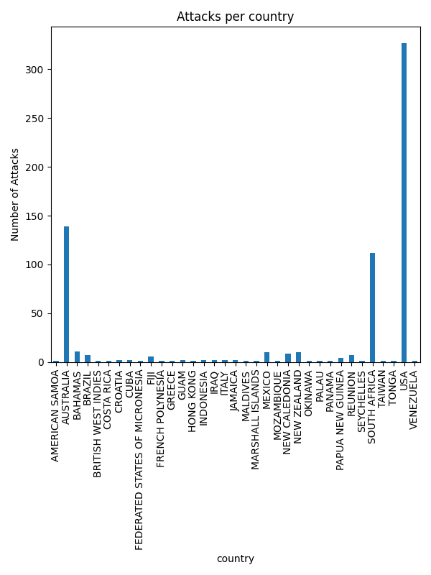
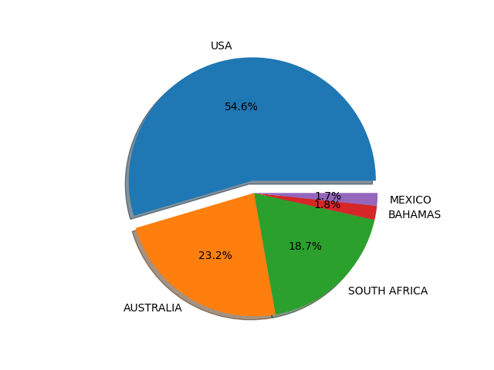

Slide 2
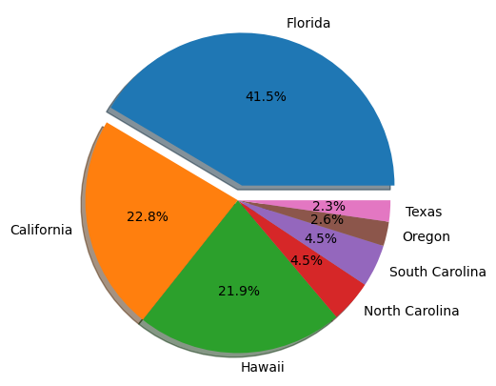
Top USA State and Shark Attack

Slide 3
Summary points
Based on this data, shark attack records were available from 35 countries with varying counts of attack incidences
More than half of the attacks were reported in the USA (54.6%) followed by Australia and South Africa at 23.2% and 18.7% respectively.
The high rate in USA could be associated with high population visiting beaches as well as efficient reporting system that captures all the incidences compared to other countries
In the USA, Florida had the highest cases of shark attack at 41.5% followed by California at 22.8% and Hawaii at 21.9%. The high rate in Florida could be associated with high number of beach goers particularly during spring breaks

