Slide 1
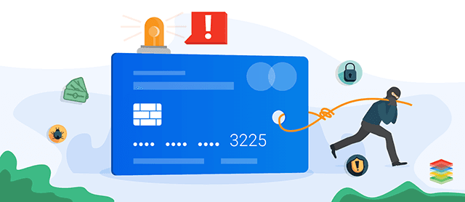
Credit card fraud detection
Capstone 2 Project by Courtney David.

Slide 2
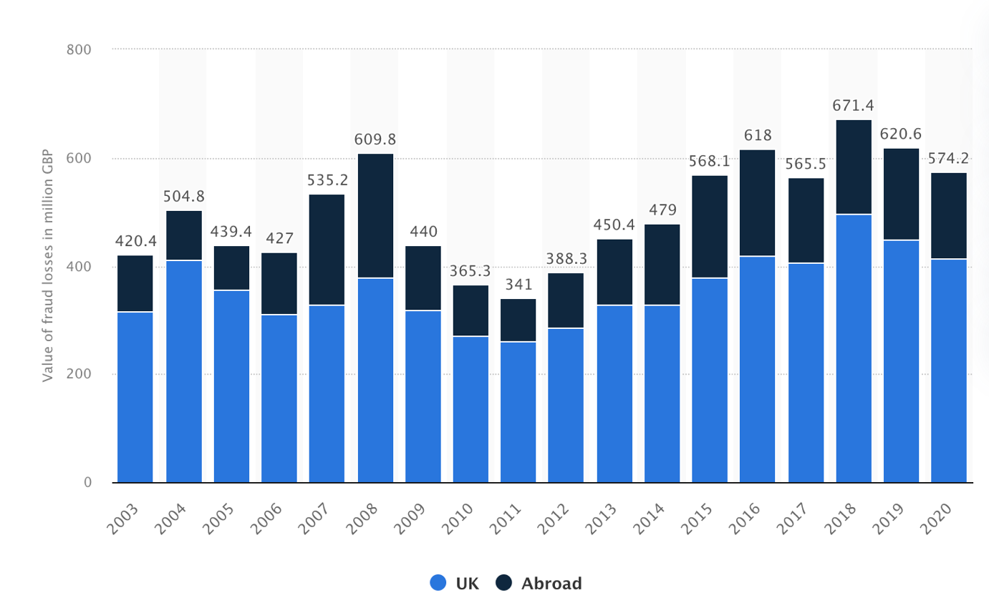
Context of the project
For any bank or financial organisation, credit card fraud detection is of utmost importance. Being able to spot potential fraud so that consumers are not billed for goods they haven’t purchased is extremely important.
The aim is, therefore, to create a classifier that indicates whether a requested transaction is a fraud or not.
Data on the total annual value of fraud losses on debit and credit cards issued in the United Kingdom (UK) from 2002 to 2020, abroad and in the United Kingdom (UK) shows that the total value of annual fraud losses on UK-issued debit and credit cards fluctuated overall during the period under observation, reaching a value of 574.2 million British pounds as of 2020.

Slide 3
Problem statement
Is it possible to spot potential fraud activity on credit cards so that consumers are not billed for goods that they haven’t purchased? Can it be spotted immediately when a purchase has been made?

Slide 4
Solution
My approach to solving the problem is building a classifier in the following steps:
Perform Exploratory Data Analysis (EDA) on the dataset
Apply different Machine Learning models to the dataset
Train and assess our models on the dataset and pick the best one.

Slide 5
The dataset
The dataset contains transactions made by credit cards in September 2013 by European cardholders. This dataset presents transactions that transpired in two days, where we have 492 frauds out of 284,807 transactions.
The dataset is highly unbalanced; the positive class (frauds) account for 0.172% of all transactions. It contains only numerical input variables, which are the result of a PCA transformation. This dataset was downloaded from Kaggle.
The dataset has been collected and analysed during a research collaboration between Worldline and the Machine Learning Group of ULB (Université Libre de Bruxelles) on big data mining and fraud detection.
This dataset has the following columns: Time: the time of the transaction. V1 to V28 : Features V1 to V28 are the principal components obtained with PCA. Class: is the response variable and it takes value 1 in case of fraud and 0 otherwise. Amount: The amount of the transaction made.

Slide 6
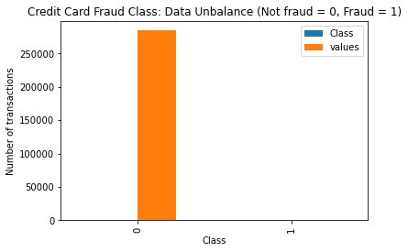
Data Wrangling
The data was read from a csv file and contains 284807 rows and 31 columns. This dataset has the following columns; Time: the time of the transaction; V1 to V28 : Features V1 to V28 are the principal components obtained with PCA; Class: is the response variable and it takes value 1 in case of fraud and 0 otherwise; and Amount: The amount of the transaction made.
I used statistical methods to describe the columns and found that the Time feature contains 284,807 transactions during 2 consecutive days (or 172792 seconds). The dataset was then checked for any missing values and non was found.
The dataset is unbalanced, I therefore wanted to check the target value which is Class. I used a bar chart to display the class value with 0 being not fraud and 1 being fraud. Only 492 (or 0.172%) of transaction are fraudulent. That means the data is highly unbalanced with respect with target variable Class.

Slide 7
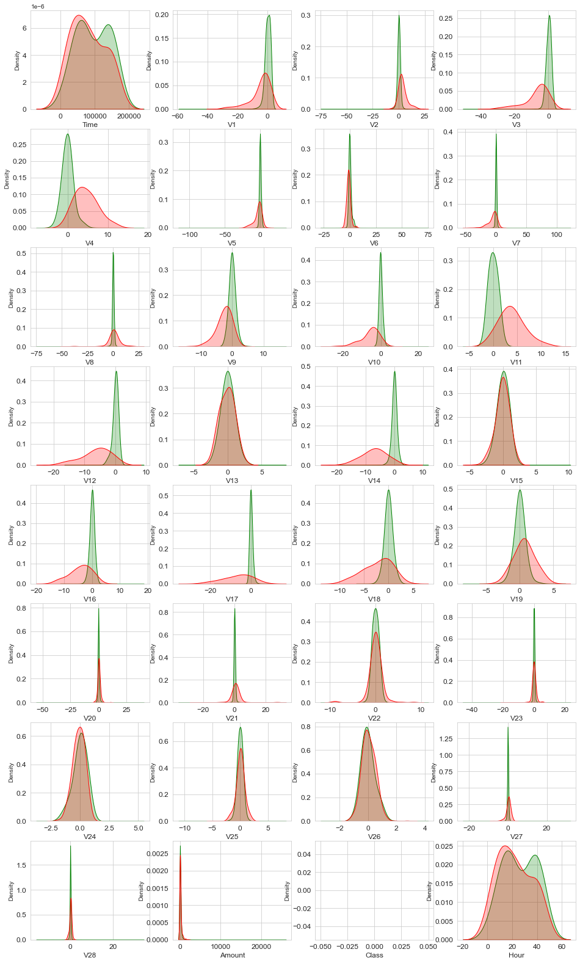
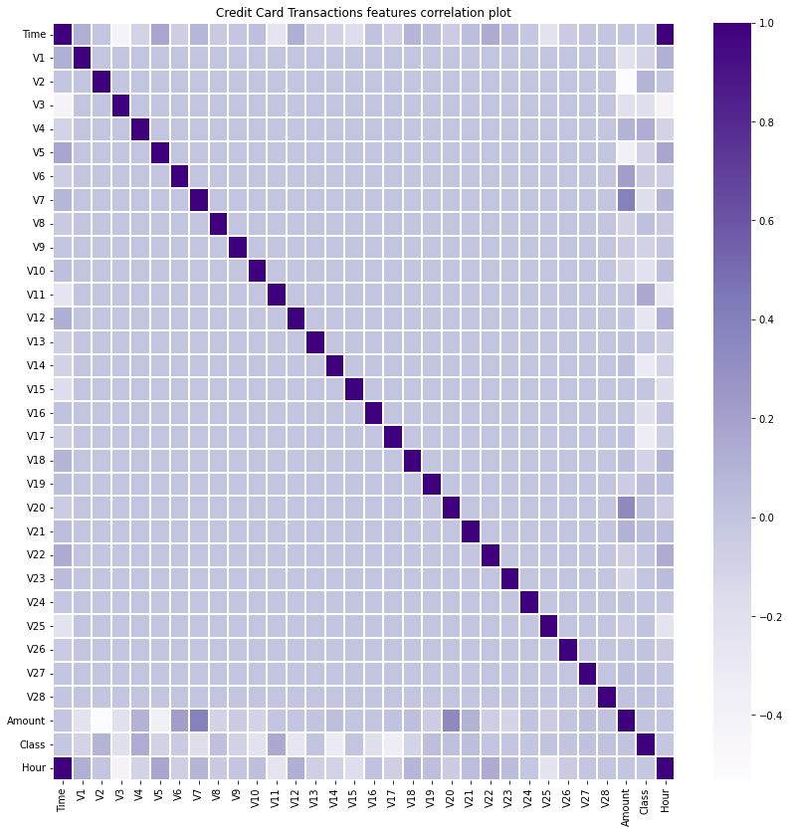
EDA on the Dataset
Feature density plots
Feature correlations

Slide 8
Creating Predictive Machine Learning Models
I used several machine learning models with a confusion matrix and ROC AUC for accuracy. Below are the summaries of the models.
Model | Accuracy
Decision Tree Classifier | ROC_AUC Score was 0.83
Random Forest Classifier | ROC_AUC Score was 0.85
AdaBoost Classifier | ROC_AUC Score was 0.83.
CatBoost Classifier | ROC_AUC Score was 0.85
XGBoost Model | ROC_AUC Score was 0.97.

Slide 9
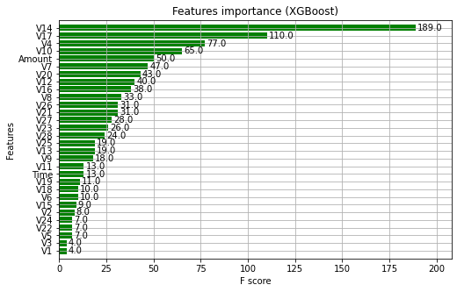
XGBoost model
I used the validation set for the validation of the training model. The validation score was 0.985. To predict the target value, I used the model with the best training step to predict the target value from the test data, and the AUC Score was 0.978.
From all the models used, it is clear that the XGBoost model has the best results.

Slide 10
recommendations
I recommend using the XGBoost Model to detect fraudulent credit card transactions, which is 97% accurate.
The machine learning models were run on a credit card dataset, and the model's accuracy was evaluated with the help of a confusion matrix and ROC AUC.

Slide 11
Further research
The finance and banking sector is vital in our present-day generation, where almost every human must do banking in person or online.
This topic of detecting fraudulent transactions inspired me to research more deeply in this field and how machine learning models can help predict other fraudulent activities.
I would dive deeper into understanding and researching other variables of data not included in this dataset that contribute to detecting fraudulent credit card activities using machine learning models.

Slide 12
Questions?

