Slide 1
The economy of Europe 2022
Courtney David
Data Story Telling
Non Technical Audience.

Slide 2
My story
Four and a half years ago, my husband and I decided to take the adventure of our lives and more to Europe, more precisely, the United Kingdom. From a South African perspective, Europe was always seen as a place of endless opportunities. Most South Africans see Europe as a group of countries run by governments that are not entirely corrupt and strive to create a better future for their people. This was something we never saw from our fellow government in South Africa. So, when the opportunity came, we took it and moved to the UK.
Now, in the year 2022, Europe seems to be in economic distress. With the prices of cost of living doubled in a few months, unemployment rates soared, and some of the highest inflation rates in decades. My concern is that most European countries my not be as financially stable in the future.
When I was searching for a dataset to analyze, I was intrigued by this dataset, with many exciting questions I wanted to answer through exploring it and finding possible trends.

Slide 3
The economic crisis in Europe right now
Inflation shows no signs of abating. On the contrary, the official flash estimate for October sees inflation in the Eurozone at another record high of 10.7%, after reaching 9.9% in September. This surge was once again driven by not only accelerating energy prices, which increased by 42%, but also food prices, which were up 13%.
Even without new energy supply disruptions, inflation could remain higher for longer. Most of the inflation surge so far is driven by high commodity prices—primarily energy, but also food, particularly in the Western Balkan countries. While these prices might remain elevated for some time, there is hope that they will stop increasing and thereby contribute to a steady decline in inflation throughout 2023.

Slide 4
About the dataset
This dataset includes economic records from 42 European countries. The perspective of the collection of this dataset is that it is important to note that important political and financial events in member countries are sensitive to, adjust to, separate, and affect GDP.
The foremost EMU adopters are Germany, France, and Italy, for which the financial statistics of these three countries are most applicable to the euro to broaden the EMU financial information as well.
This dataset was downloaded from Kaggel: https://www.kaggle.com/datasets/hanzlanawaz/economy-of-europe-2022

Slide 5
Possible questions that intrigued me from this dataset.
Is a healthy GDP linked to a smaller or larger population?
Does the jobless rate affect the GDP and /or government budget?
How does inflation affect the jobless rate in a country?
All of these questions I will be exploring these dataset to look for possible trends in the data.

Slide 6
Eda of the dataset
To answer my top three questions, I have to conduct an EDA of the dataset.
Exploratory Data Analysis (EDA) refers to the critical process of performing initial investigations on data to discover patterns, spot anomalies, test hypotheses, and check assumptions with the help of summary statistics and graphical representations.
Please refer to my GitHub repository for the full EDA of the dataset.

Slide 7
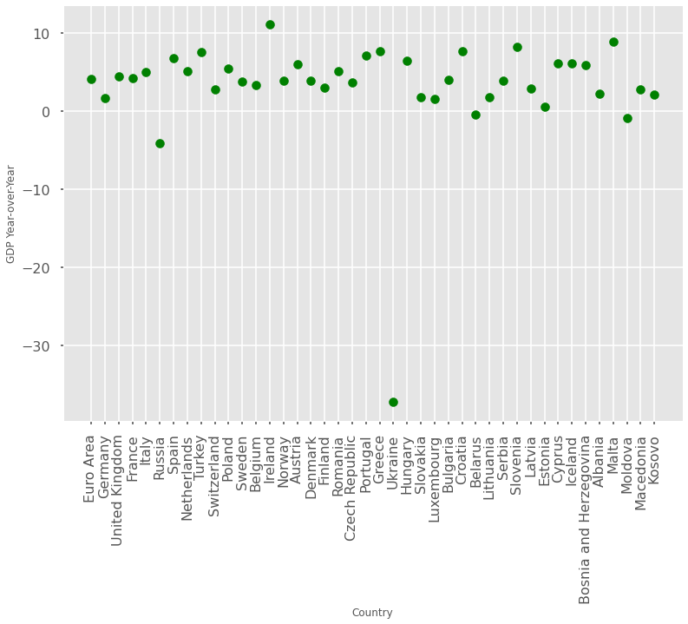
European countries and their GDPs
The ideal GDP growth rate is between 2% and 3%. The GDP growth rate measures how healthy the economy is.
When the number is positive, the economy grows. When the number is negative, the economy is contracting.

Slide 8
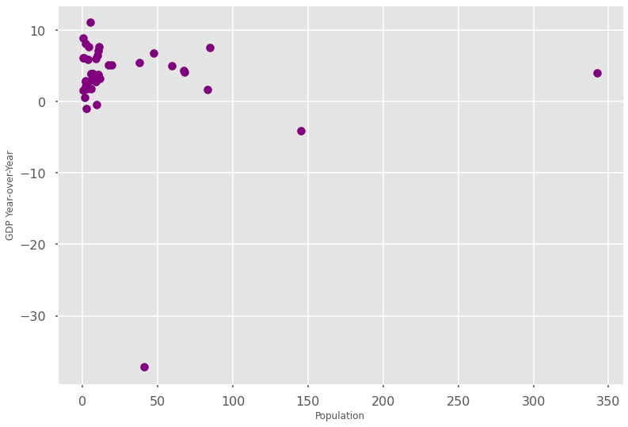
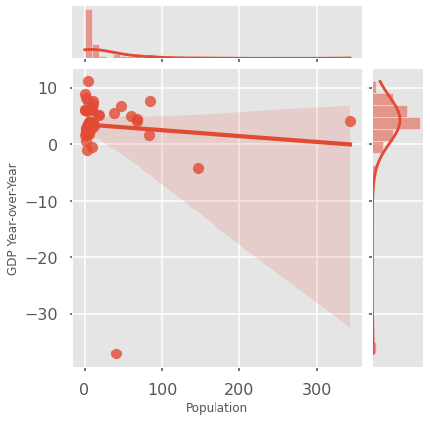
Trends in the data
Is a healthy GDP linked to a smaller or larger population?
In these plots, there is a link between smaller population size and a healthy GDP. The outliers are not considered because these countries are either at war or a collection of the Eurozone. I have used a scatter plot and a joint plot to display different possible views. Countries like Luxembourg are excellent examples of a healthy GDP but a small population.

Slide 9
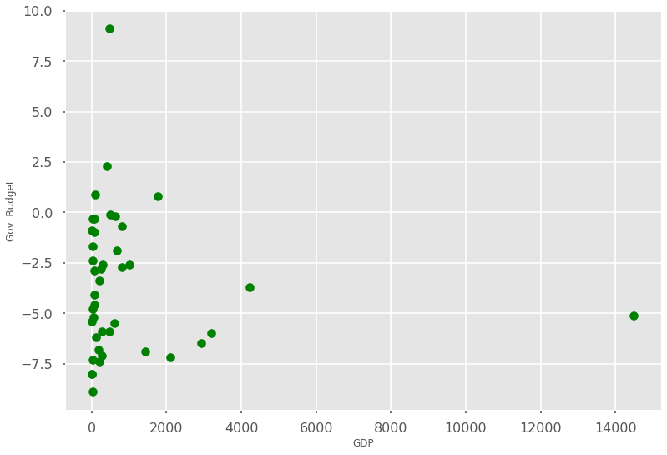
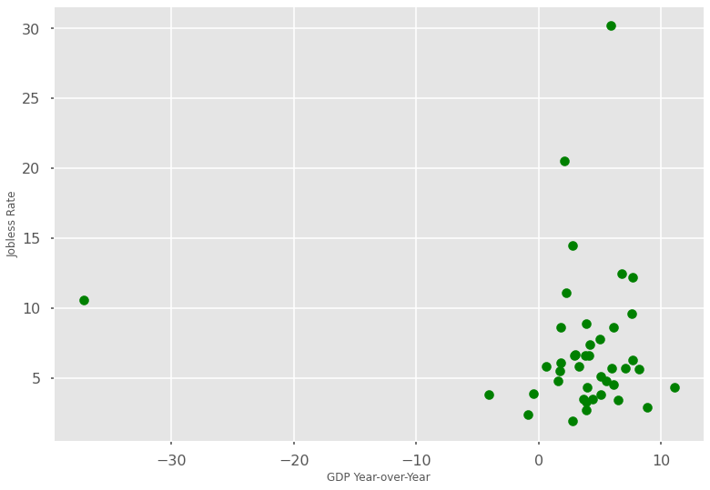
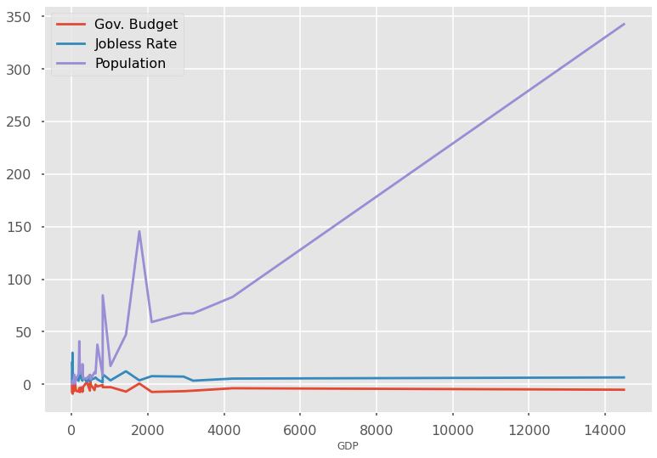
Trends in the data
Does the jobless rate affect the GDP and /or Government budget?
There seems to be a strong correlation between a healthy GDP and a low rate of joblessness.
A negative government budget is linked to a healthy GDP.
From this view of the line plot, it is evident that an increased population is linked to an unhealthy GDP. But there is no drastic correlation between the GDP, jobless rate and Government budget.

Slide 10
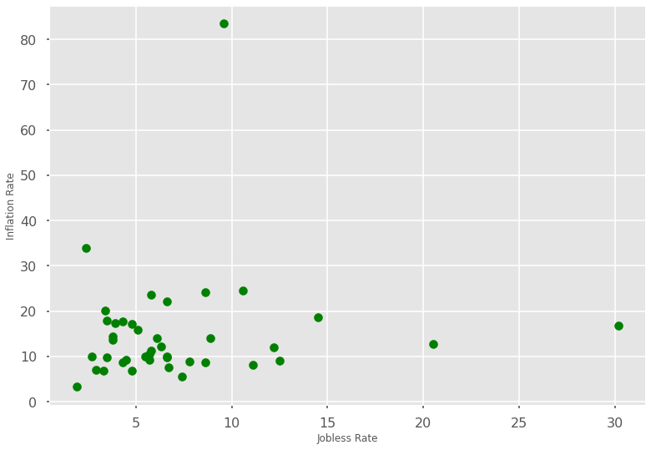
Trends in the data
How does the inflation rate affect the jobless rate?
In this scatter plot, there is a link between a low inflation rate and low jobless rate.

Slide 11
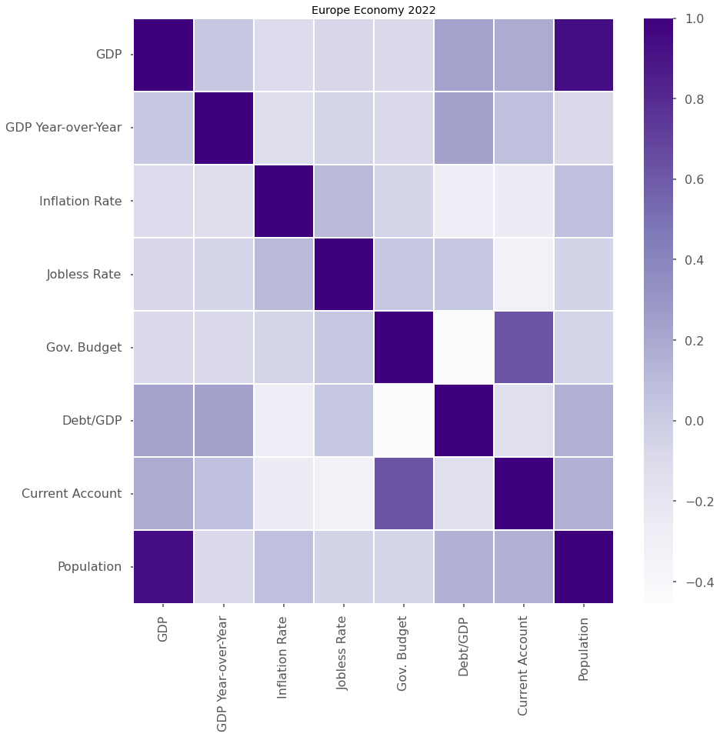
Feature Correlation
Feature Correlation of all data. Using a heatmap, I want to explore possible feature correlations between the different variables.
Some of the direct correlations are:
The GDP and Population
Current account and government budget. I will not explore this correlation because I need more data about this column from the dataset.
Some of the inverse correlations are:
Debt/GDP and Government budget.

Slide 12
conclusion
From my analysis exploring this dataset, I have concluded that there is a trend in the following pieces of data:
There is a link between smaller population sizes and a healthy GDP. The outliers are not considered because these countries are either at war or a collection of the Eurozone.
There is a strong correlation between a healthy GDP and a low rate of joblessness.
An increased population is linked to an unhealthy GDP. But there is no drastic correlation between the GDP, jobless rate and Government budget.
Lastly, there is a link between a low inflation rate and a low jobless rate.

