Slide 1
Ticket Price Modeling for Big Mountain Resort
Courtney David
Springboard Guided Capstone Project

Slide 2
Problem statement
Recommend a strategy to Big Mountain Resort on recouping the increased operating cost of $1.54MM for installing a new chair list this season and capitalising on their facilities by changing their ticket price.

Slide 3
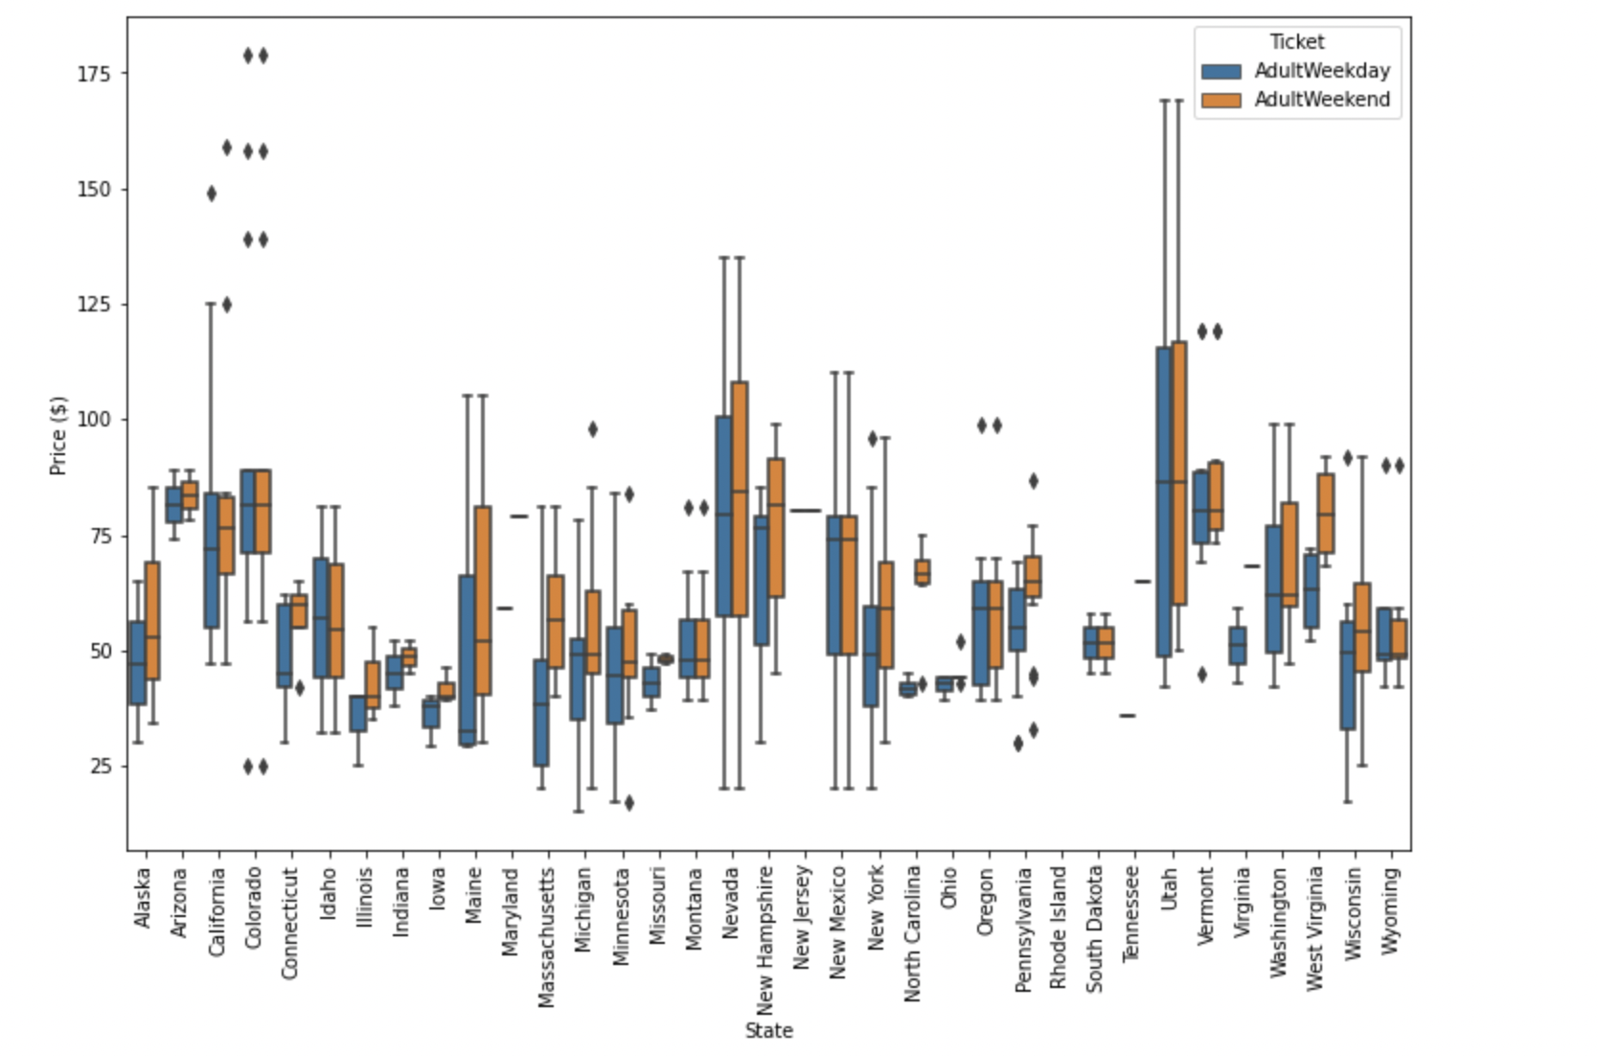
Ticket prices in the context
Big Mountain Resort
Current Ticket Price = $81.00
Relative to the nationwide market, Big Mountain Resort is 81st percentile for weekend pricing.
What is our suggested ticket price?
Mean: $95.87 (92nd percentile)
Range (+/- MAE):
$85.48 - $106.26
85th - 95th percentile
Big Mountain

Slide 4
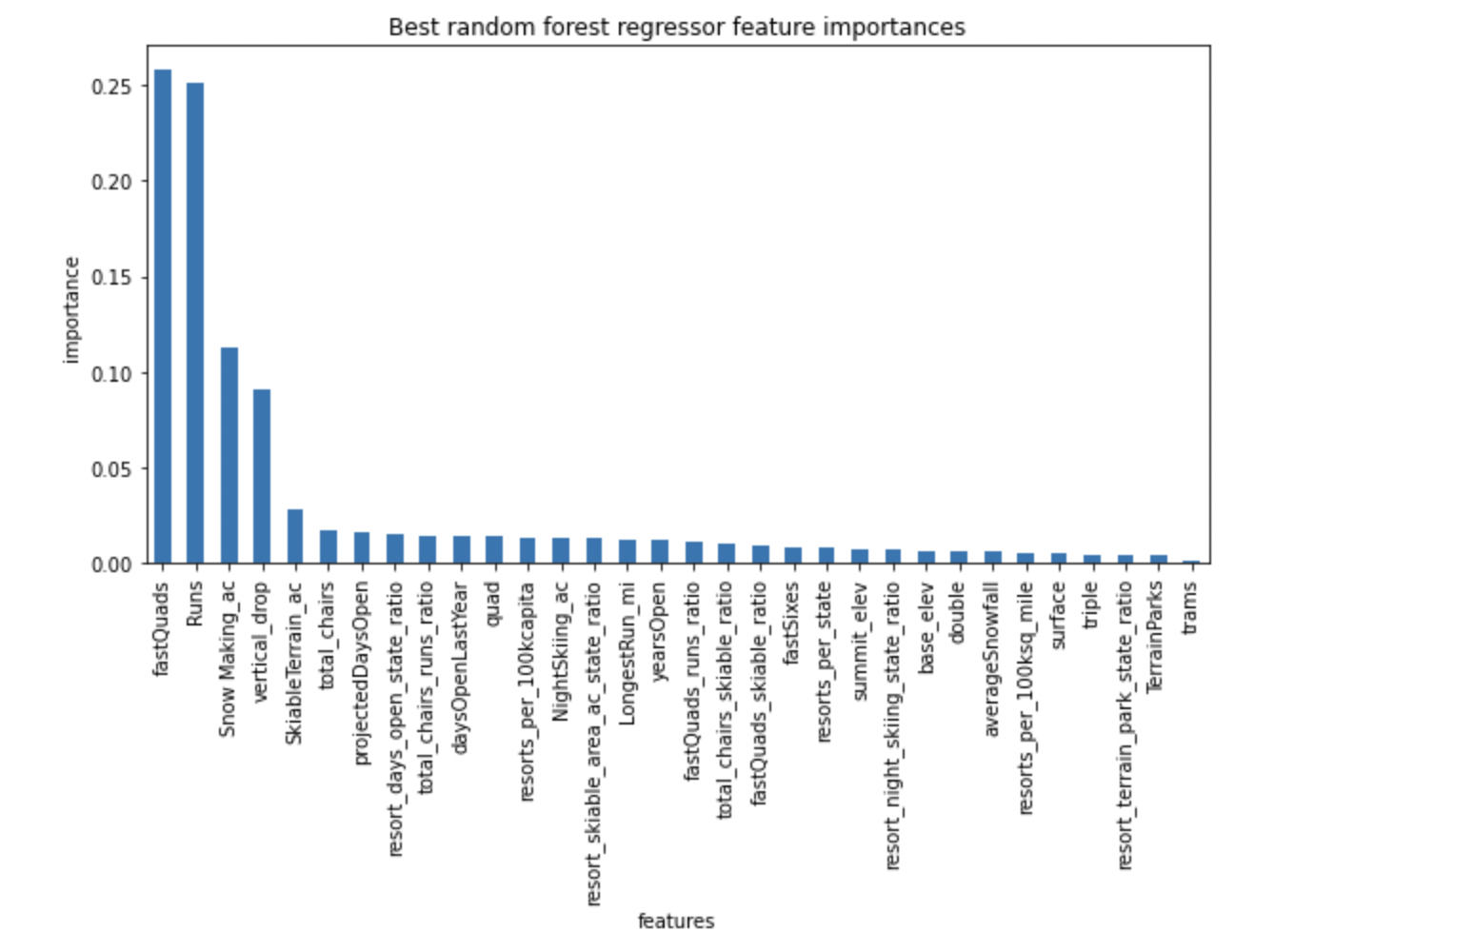
Price-predictive features
1. Most reliable model was a random forest model.
2. Using 32 total features to predict ‘AdultWeekend’ price, including resort data and state-level data
Best predictors of price:
Number of Fast Quad chairlifts
Number of Runs
Acres of snow-making
Vertical drop distance
Skiable acres
Total chairs

Slide 5
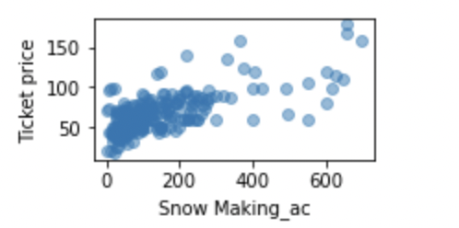
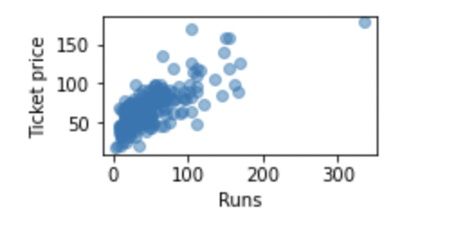
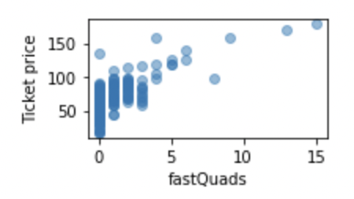
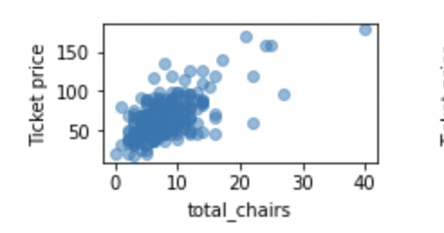
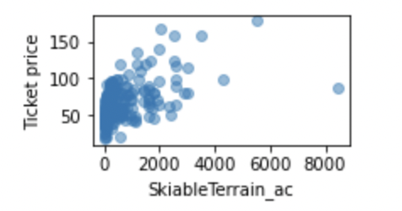
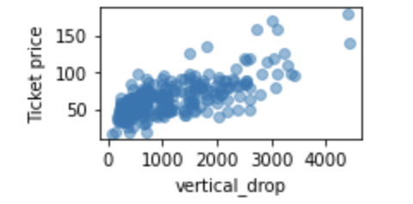
Big Mountain is strong on key features
What is our suggested ticket price?
Mean: $95.87 (92nd percentile)
Range (+/- MAE):
$85.48 - $106.26
85th - 95th percentile
Variable | Big Mountain Resort’s value | Percent of ski resorts less than or equal to Big Mountain Resort
AdultWeekend ticket price | $81.00 | 81st percentile
Fast Quads | 3 | 95th percentile
Runs | 105 | 93rd percentile
Snow-making acreage | 600 | 98th percentile
Vertical drop (feet) | 2353 | 90th percentile
Skiable acreage | 3000 | 99th percentile
Total chairs | 14 | 95th percentile

Slide 6
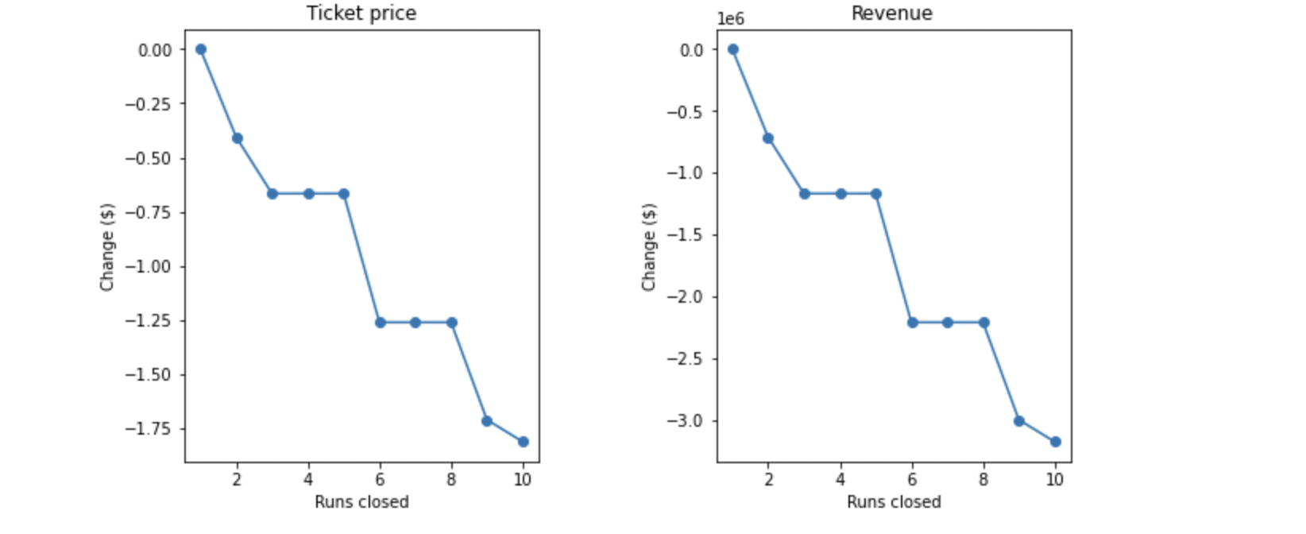
Scenario 1 – Close up to 10 runs
Loss of up to -$1.81 per ticket and -$3.17 Million in annual revenue.
One run could probably be closed without undermining price

Slide 7
More scenarios
Scenario 2 – Add a run and a chair lift to extend vertical drop by 150 ft
Estimated gain of $1.99 per ticket and $3.47 Million in annual revenue.
Scenario 3 – As above plus 2 acres of snow-making to cover new run.
Same gain as Scenario 2. No added benefit of snow-making.
Scenario 4 – Increase longest run by 0.2 miles and add 4 acres snow-making.
No gain.

Slide 8
conclusions
Current price of $81.00 is underestimating the true value when compared with ski resorts nationwide.
We recommend a ticket price of $95.87 (Range: $85.48 - $106.26)
Of the short-listed improvement scenarios, scenario 2 (extending the vertical drop) is the best option for supporting a higher ticket price.

