Slide 1
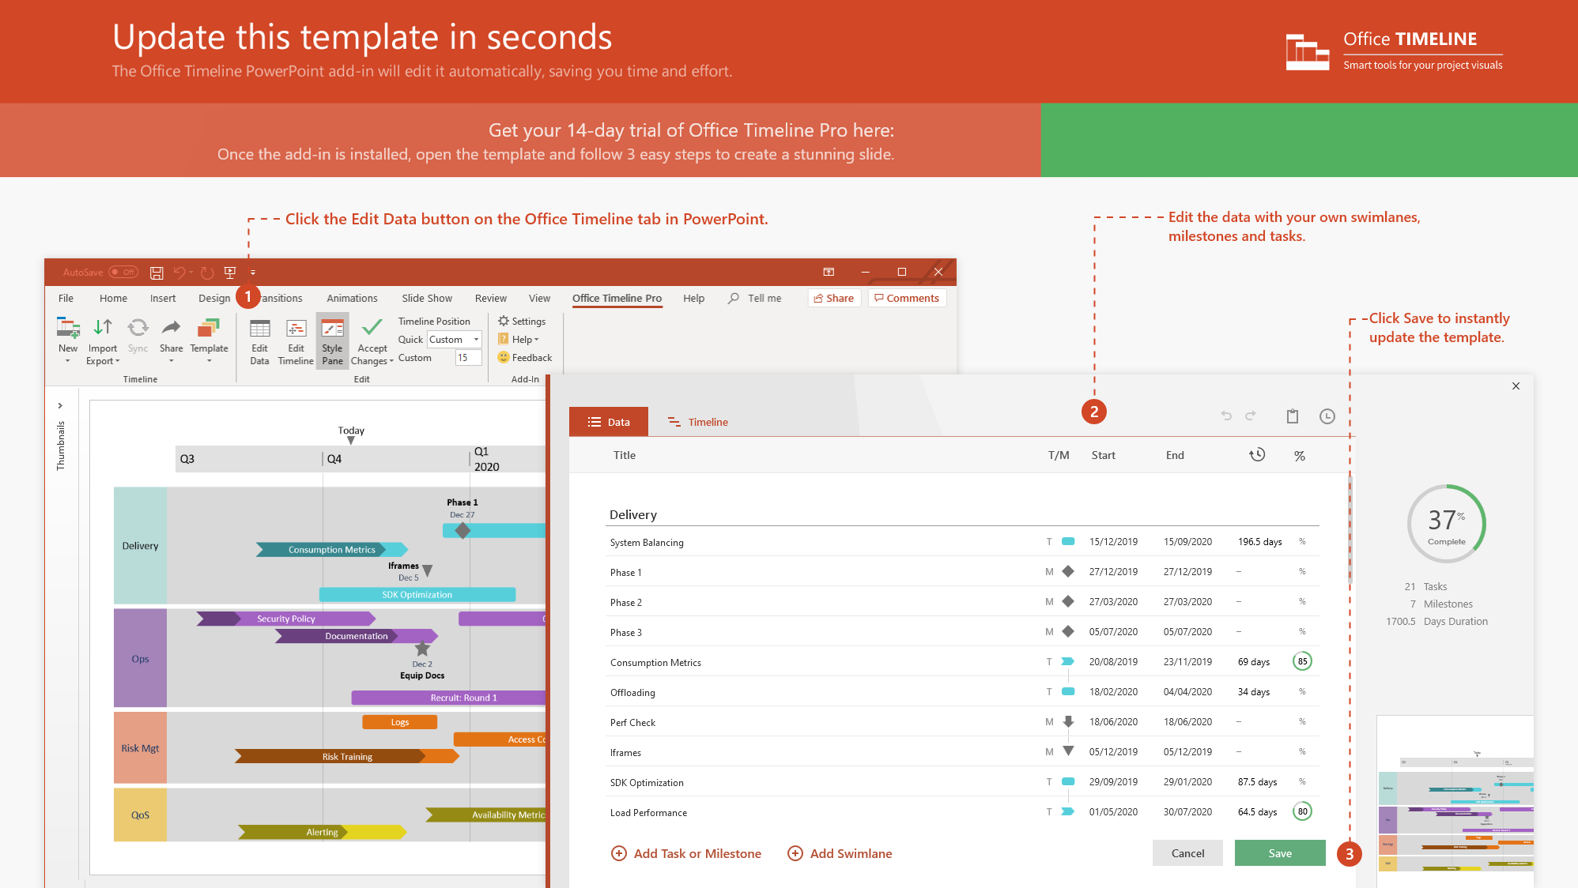
https://www.officetimeline.com/14-days-trial

Slide 2
Jul 26
Migration Plan
Migration Plan
Notification
Notification
Aug 20 - Sep 23
Jul 29 - Aug 30
Sep 21 - Oct 11
Aug 21 - Sep 18
Jun 3 - Jul 15
Jun 3 - Jun 24
Jun 30 - Aug 1
Oct 1 - Oct 15
Awareness
15.8 days
23.9 days
10.6 days
22.9 days
20 days
22.1 days
14.9 days
31 days
Blank
Blank
Blank
Blank
Blank
Blank
Blank
Sep 13
Jul 17
Jul 31
Jun 26
Jul 31
Jun 30
Aug 26
Jul 19
Aug 13
Jul 17
Jul 21
Aug 15
Aug 11
Sep 25
Aug 18
Sep 18
Oct 13
Sep 20
Oct 17
Sep 28
2021
Aug 4
Aug 8
Aug 4
Aug 8
Sep 7
Sep 5
Sep 9
Aug 2
Sep 1
M5
2021
Stock Project Chart
Today
Week 5
Week 6
Week 7
Week 8
Week 9
Milestones
Model checkpoint
Data ingestion checkpoint
Models
Mean reversion
Ensemble model
Testing
Testing 接口
Testing ensemble
Back-testing
Final Demo
preparation
Demo practice

