Slide 1
While you wait
Start Kali/Parrot
Install pwndbg
git clone https://github.com/pwndbg/pwndbg
cd pwndbg
./setup.sh

Slide 2


Assembly & Shellcode
Part 1 of Linux Binary Exploitation
Ben Roxbee Cox

Slide 3
What is Binary Exploitation?
Also known as pwning
Taking advantage of a bug or misconfiguration in an executable
Competitions like pwn2own, DefCon qualifiers
Some binary exploitation concepts change depending on system architecture
Knowledge required for (basic) binary exploitation
Assembly
Some knowledge of memory
Scripting
Tools required
gdb (preferable with GEF/Pwn-dbg)
Python3
Pwntools
Reverse engineering framework

Slide 4
4 Week Plan
Week 1: Assembly & Shellcoding
Writing our own assembly, writing some shellcode. Getting used to debugging tools
Week 2: Reverse Engineering
Learning some basic reversing techniques, getting used to reversing frameworks
Week 3: Stack smashing
Basic program exploitation. How to exploit programs that have little/no protections
Week 4: Return Oriented Programming
Exploiting programs with some modern protections enabled

Slide 5
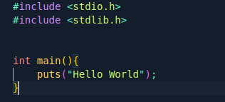
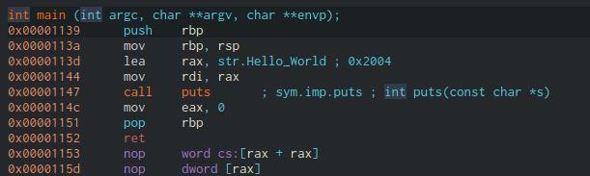
Session Plan
Intro to assembly
Intro to Memory
Assembly Activity
Intro to system calls
Shellcoding Activity

Slide 6
What is assembly & shellcode
We usually program in high level languages
Python
C
PHP
Assembly is a low level language
In binary exploitation it is sometimes possible to write malicious assembly (shellcode) and get the program to execute it
Notes:
Python, C, Golang, PHP are all high(ish) level programming languages. They allow us to quickly code benaviour we want the computer to do. The computer does not understand this high level language. Compilers compile compiled programming languages. Python and interpreted languages interpret each line ata time (well, batches of line actually). Assembly intrsruction are about as close as we can get to seeing what happens on a physical level.

Slide 7
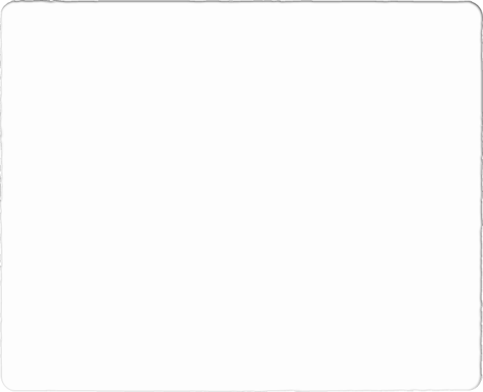
Registers
Registers Store data
Registers have slightly different names depending on architecture of the system
Registers store different amounts of data depending on architecture
Important Registers
Instruction Pointer (IP)
Registers used for general operations, such as passing data to function calls.
AX
BX
CX
DX
R8-R15 (General Registers for 64 Bit Processors)
Registers used for Stream (or string) operations
SI (Source Index) Pointer to start of data input location
DI (Destination Index) Pointer to data output location
Registers used for Managing the Stack
BP: (Base pointer) Points to the current base of the stack
SP: (Stack Pointer) Points to the current top of the stack
8 bit (byte)
16 bit (word)
32 bit (dword)
64 bit (qword)
0xFFFFFFFFFFFFFFFF
Notes:
The architecture will add a prefix to the register we are addressing, to let us know how large it is.
32bit E (Extended)
64bit R (Register)
Thus: - in a 32Bit system our Instruction pointer becomes EIP - in a 64Bit system our Instruction pointer becomes RIP
Even in 64 bit architecture, we can move data in just the lower parts of the register by specifying the other arch term
Explain a little about architecture's here. From 8-64 bit

Slide 8
Some Assembly
# Move data into register (mov dest, src)
mov rdi, 10
# Add/Sub/Multiply data to register (add/sub/multiple dest, src)
add rdi, 10
sub rdi, 10
imul rdi, 10
# Division (integer math) the result is stored in rax
mov rax, rdi
div rsi
# https://www.felixcloutier.com/x86/

Slide 9
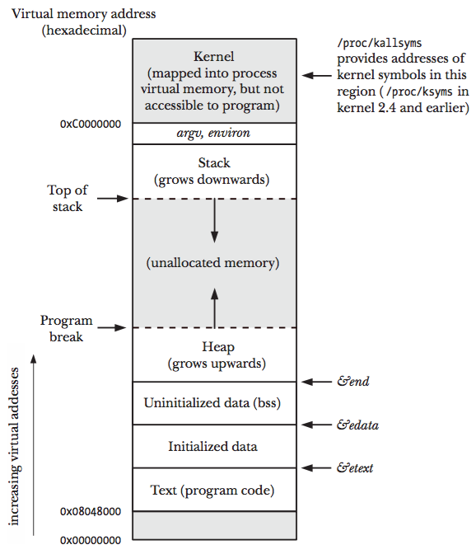
Memory (The Stack)
In programming, the stack is a logical data structure that obeys LIFO (Last in First Out) principle
In processes, the stack is a region of memory where data is stored
Each new function of a process gets it own stack frame
The stack starts at a high memory location and grows down

Slide 10
Stack Frames
When a function is called, the data associated with it is stored in the stack frame
1. First any arguments from the calling function are pushed onto the stack.
NOTE: There is a subtle difference between 32 and 64 bit architectures here:
A 32 Bit system will push the arguments via the stack
In 64 Bit systems registers are used to pass the first 6 arguments.
2. The address of the Current instruction (the Instruction Pointer) is pushed
This acts as a Return Address and tells the program what address it needs to go back to once the function finishes.
3. The Current Base pointer is also pushed
4. Finally the space required for any local Variables for the function is calculated and allocated in the new stack frame

Slide 11
First Assembly Program
.global _start
.intel_syntax noprefix
_start:
push 60
push 1337
pop rdi
pop rax
syscall
$ gcc write.s -o write.elf -nostdlib -static
Notes:
Does anyone know what this does
What else could I have done

Slide 12
Assembly Activity
Program the following and watch them in a debugger:
Calculate (x * y) / z + a
Calculate X ^ 3
Try to build a loop for this
Program the logic for:
Calculate y = x/z
If y is odd then exit
If y is even, divide again, loop until odd
$ gcc write.s -o write.elf -nostdlib -static

Slide 13
Shellcode
Part 1 of Linux Binary Exploitation
Ben Roxbee Cox

Slide 14
Shellcoding
Shellcode is a small piece of code used as the payload in the exploitation of a software vulnerability.
It is called "shellcode" because it typically starts a command shell from which the attacker can control the compromised machine, but any piece of code that performs a similar task can be called shellcode.

Slide 15
Hello World
.global _start
.intel_syntax noprefix
_start:
mov rdi, 1
lea rsi, [rip+hello]
mov rdx, 15
mov rax, 1
syscall
hello:
.ascii "Hello World"
> gcc write.s -o write.elf -nostdlib -static && objcopy --dump-section .text=flag.bin write.elf
Notes:
What did I change here?
Stored everything in the text section
Used a different compiler
Referenced string in a different way

Slide 16
System Calls and File Descriptors
System calls are how we make our assembly code interact with the outside world.
Common system calls are: read, write, open, execve, exit
In Linux, everything is a file. As such, file descriptors are how we direct the result of our syscalls
x64
read(0,rsp, 100)
write(2, rsp, 50)
sendfile(1, 3, 0, 200)
https://github.com/Cov-ComSec/HelpfulResources/tree/main/buffer/syscalls
https://syscall.sh/
Notes:
Read 100 bytes of memory onto the stack from stdin
Write 60 bytes of data from the stack to stderr
Sendfile 200 bytes of data, starting at offset 0, from file descriptor 3 to stdout

Slide 17
Example Shellcode 2
open:
lea rdi, [rip+flag]
xor rsi, rsi
xor rdx, rdx
mov rax, 2
syscall
sendfile:
mov rdi, 1
mov rsi, 3
mov rdx, 0
mov r10, 60
mov rax, 40
syscall
exit:
mov rax, 60
mov rsi, 42
syscall
flag:
.ascii "flag\0"
Open
file “/flag”
flags 0
mode 0
Sendfile
To stdin
From fd opened by previous syscall
With offset 0
60 bytes of data

Slide 18
Example Shellcode 1
open:
mov rdi, [rip+flag]
xor rsi, rsi
xor rdx, rdx
mov rax, 2
syscall
read:
mov rdi, rax
mov rsi, rsp
mov rdx, 60
mov rax, 0
Syscall
write:
mov rdi, 1
mov rsi, rsp
mov rdx, 60
mov rax, 1
syscall
flag:
.ascii "/flag"
Open
file “/flag”
flags 0
mode 0
Read
From fd opened by open
From to the stack
60 bytes of data
Write
To stdout
From the stack
60 bytes of data

Slide 19
Shellcode Activity
Program the following and watch them in a debugger:
3 docker containers available at:
Python script available too
Put your shellcode in the shellcode variable
Run it

