Slide 1
THIS IS A PROJECT BASED ON HOW WEATHER INFLUENCES NUMBER OF CARS AT FREMONT.

Slide 2
PURPOSE
The basis of the project is to
Analyze, Visualize And Predict How Weather Influences number Of Cars

Slide 3
WHAT WE WERE ABLE TO DETECT
Daylight Influence On The Outcome.
Dry Day Influence.
PRCP Influence On The Outcome .
Temperature Influence.

Slide 4
1.
Number Of Cars against Weekdays

Slide 5
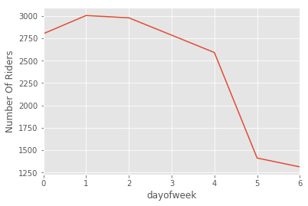

Slide 6
L
2.
Total Number Of Cars at both Point against Month.
.

Slide 7
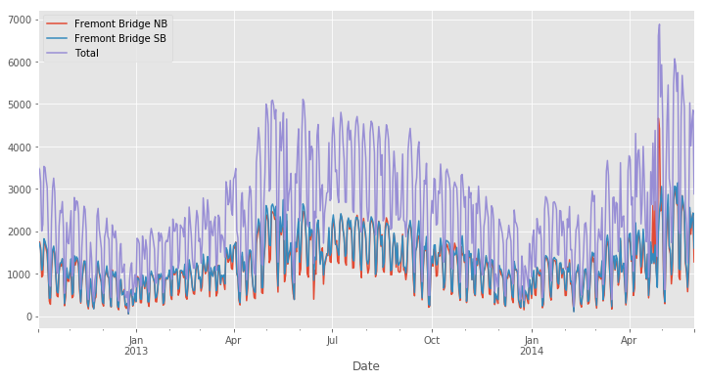

Slide 8
4.
Daylight Hours Against
Month.

Slide 9
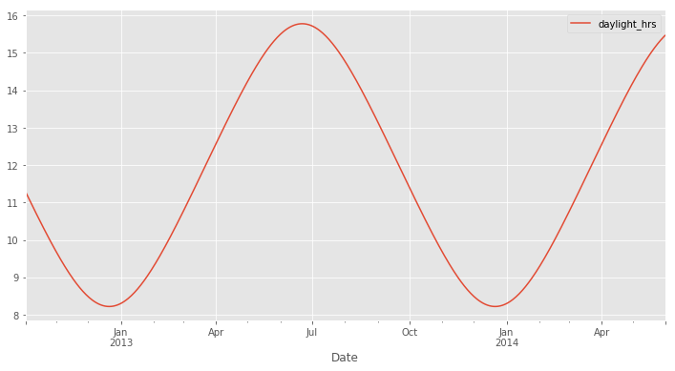

Slide 10
4.
Daily Number Of Cars At Both Point Against Months.

Slide 11
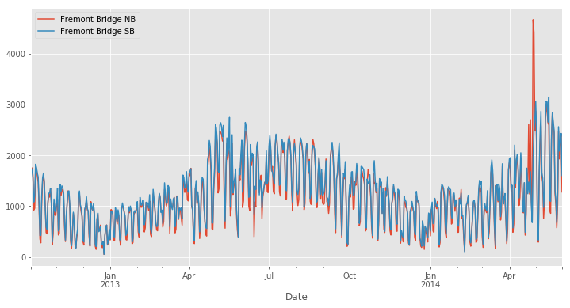

Slide 12
CONCLUSION
With this in mind, the marketing department would inform the department to create a prototype.

Slide 13
Based on Snow
Our model shows that once all other factors are accounted for, every inch of Snow translates, on average, to about 600 Cars staying home. Not a surprising result, but it's interesting to see it quantified!
Based on Temp
We see that for every increase of one degree, we add around 65 crossings on the Fremont bridge!
Based on Dry day
for every dry day i.e a day with no Rain We have over 562 Cars on road

Slide 14
Based On Daylight
We see that, once the effects of rain and temperature are removed, each hour of daylight results in about 76 more crossings at the Fremont Bridge. this is because our first model did not include precipitation and temperature: apparently the weather is far more important than the darkness in affecting ridership!

Slide 15
THANK YOU

