Slide 1
EU CoVis-19 VISUAL ANALYSYS
Covid-19 effects in Europe

Slide 2



OUR TEAM
VALERIO CORETTI
FABIO CAPUTO
WEIHAO PENG
Engineering in Computer Science
Sapienza University of Rome coretti.1635747@studenti.uniroma1.it
Engineering in Computer Science
Sapienza University of Rome
caputo.1695402@studenti.uniroma1.it
Engineering in Computer Science
Sapienza University of Rome peng.1713518@studenti.uniroma1.it

Slide 3
INTRODUCTION
01
Why EU CoVis-19?

Slide 4
Introduction
BACKGROUND
BIG DATA
TARGET
In the last two years one of the biggest pandemics in history: The Coronavirus or Covid-19.
Covid-19 provide a huge amount of data to analyze
Knowledge discovered helps: researchers, epidemiologists, and policymakers
MAIN ASPECTS
OBJECTIVES
Three main aspects: Cases, Deaths, and Vaccinations
Two main objectives:
Comparisons between different European countries
Interactive Visualizations
Analyze not only factors caused by COVID-19

Slide 5
RELATED WORKS
02
Literature

Slide 6
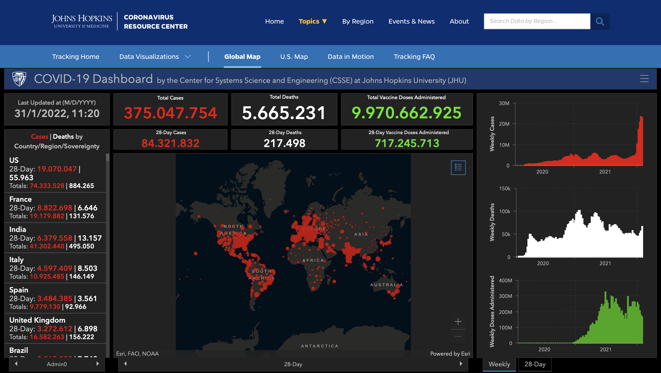
Related Works
Due to the COVID-19 pandemic, many viewers and dashboards have been developed in the past year.
Some of them viewed literature related to COVID-19 research and others viewed the economic impact
Most of them focused on actual COVID-19 cases.
However none of them deals with visual analytics but only with information visualization

Slide 7
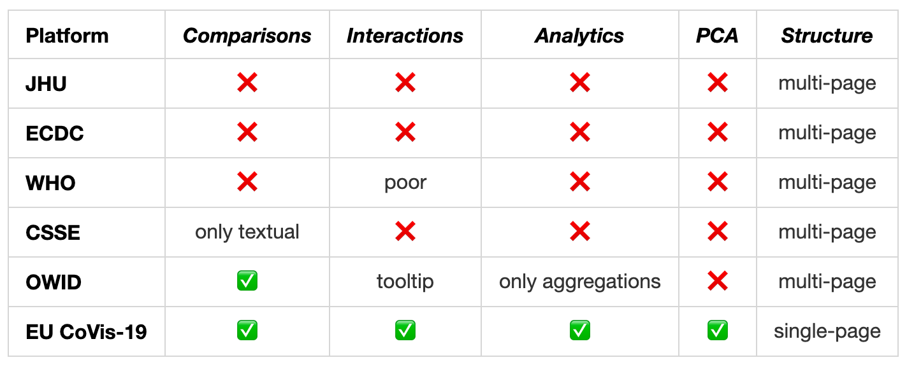
Related Works
We analyze the related works with the goal to start from those ideas and then build our system.

Slide 8
DATASET
03
Data management

Slide 9
Dataset
SOURCES
We took the dataset by Our World in Data. It is very huge (AS index greater than 6 million), it contains the collected data for all the world.
Different sources:
COVID-19 Data Repository by the Center for Systems Science and Engineering (CSSE) at Johns Hopkins University (JHU)
European Centre for Disease Prevention and Control
Government sources
DATA MANAGEMENT
Because we have to manage a very huge amount of data, we have chosen to store them inside a non-relational DataBase, making the accessibility easier.

Slide 10
Preprocessing
Very huge dataset:
Only European countries
Discarded countries: Guernsey, Jersey, Vatican, Andorra, Faeroe Islands, Gibraltar, Isle of Man, Kosovo, Liechtenstein, Monaco, San Marino, North Macedonia
We select only a part of the features, the ones related to vaccinations, deaths, cases, and static factors

Slide 11
TECHNOLOGIES
04
What’s inside EU CoVis-19

Slide 12


Scalable
Back End
Fast
Supports both vertical and horizontal scaling, it’s well-suited for microservices due to a node based approach.
Built upon Google V8 Javascript runtime has a non-blocking I/O philosophy.
DB
Community
Node.js best suites with MongoDB, a NoSQL distributed database which allows ad-hoc quesries and real-time integrations.
There are plenty of interactive courses, tutorials, libraries and examples on GitHub.

Slide 13



D3.JS
Front End
REACT.JS
A JavaScript library used to create interactive visualizations in the browser.
D3.js allows us to manipulate the elements on the DOM, making possibile to build interactive charts with smooth transitions and interactions.
Opensource JavaScript library that allows users to build user interfaces through a component-based approach. Flexible, Reusable, Independent and Integrable. Those are the primary feature of this incredible library.

Slide 14
VISUALIZATIONS
05
And interactions of our project

Slide 15
OUR VIEWS
DEATHS
VACCINATIONS
CASES
~1.7M
336M at least 1 doses 317M at least 2 doses
~125M

Slide 16
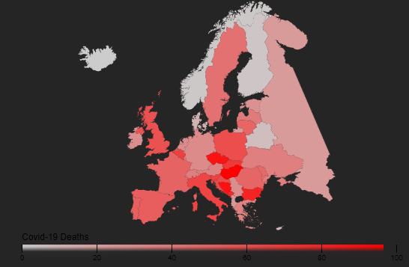
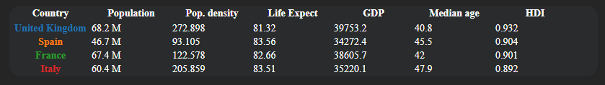
Navbar
Table Chart
In our case table chart has been used as an interactive legend for the current view
Each nation have a specific color constant for all the graphs.
On click changes the focus of the environment on the selected country.
Choropleth Map
Simple but effective view that allows to visualize at first glance how covid affects counties in Europe.
Colors in the map respect how much high is the percentage of deaths/cases/vaccination related to the population (an appropriate legend has been placed for reference).
On click select/remove focus on the country.
Zoom when select a country with a projection of data.
Time selector
Flag button
Country search bar

Slide 17
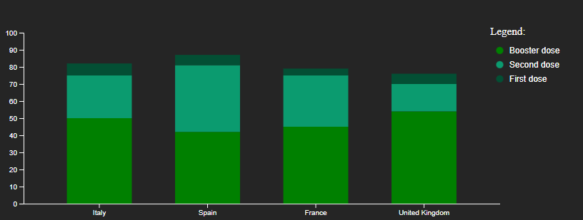
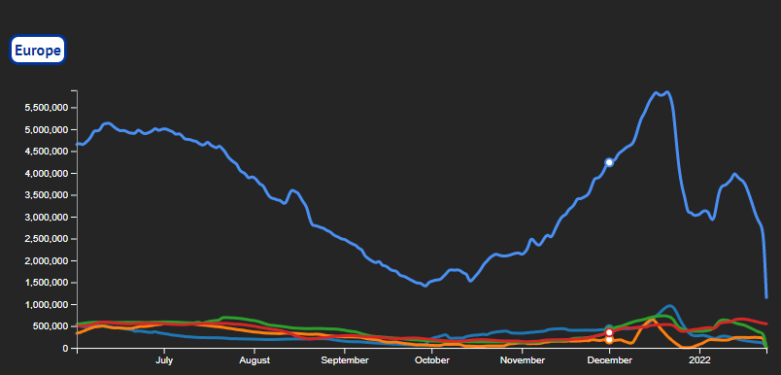
Line Chart
Bar Chart
Displays information as a series of data points connected by straight line segments.
Great visualization to display temporal information about the presented data.
Immediate comparison between countries and Europe.
Color encoded among all the charts.
On mouse over shows a tooltip with data about selected countries.
In this kind of views vertical bars has length proportional to the values represented.
Stacked bar chart to compare different countries.
Vaccination -> percentage of vaccinated related to doses status.
Deaths -> percentage of deaths compared with positive over population.
Cases -> percentage of positives over population compared with deaths and stringency index
On click select/remove focus on the country.
On mouse over shows a tooltip with the displayed data.

Slide 18
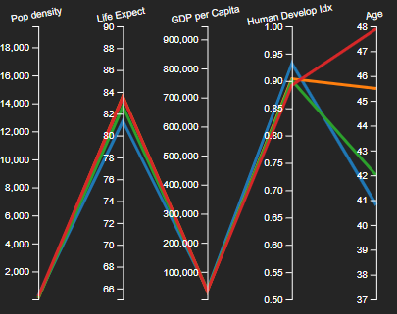
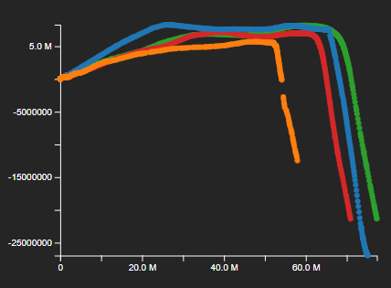
PCA Chart
Scatterplot to display pairs of data into Cartesian coordinates.
2D visualization of the two principal components for each selected countries.
Highlight the differences between countries, it’s easy to see which of them have provided a small amount of data.
Changes based on selected countries and interval of time.
Different visualization in base of the views (Death and Cases shares the same graph).
Parallel Coordinates Chart
Computes the feature of several observations about a set of numeric variables.
Each bar represents a variable with its related scale.
Values displayed as series of lines connected across axis.
Different feature, that better describes the healthiness and wealth of a country, for each visualizations.

Slide 19
ANALYTICS
06
Simple and Complex

Slide 20
Simple
Make the comparison as simple as possible:
The aggregation of the data are based on countries and period selected, computed at the selection
Very high number of possible combination
About:
Parallel coordinates and TableChart are simple aggregation
LineChart is aggregation plus summation
All the percentage shown in the BarChart are the result of a computation
European data are computed at the selection

Slide 21
Complex
PCA:
Not used only for dimensionality reduction, but also making the data shown by PCA useful for comparison
Applied to different data to help to understand how much data we have of each country
some countries provide much more data than others
Analytics because the computation is done at each selection and is not precomputed

Slide 22
CASE OF STUDY
07
An example of use

Slide 23
Italy, Russia and Romania
At first look:
Russia: most affected nation for both infections and deaths
Romania: one of the least affected countries even having vaccinated people
Italy: almost affected as Russia being much smaller and having a very high percentage of vaccinated people
Overall: Italy takes excessive measures that are not effective, Romania is healthy while not taking measures and Russia is in catastrophe

Slide 24
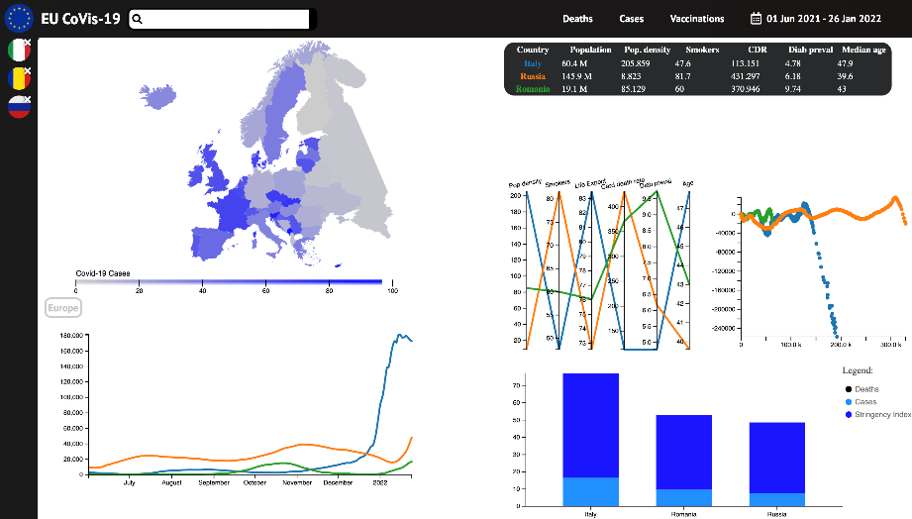
Italy, Russia and Romania
Let’s analyze with EU CoVis-19:
MapChart: Italy has the highest percentage of cases and vaccination relatives to the population, but the percentage of deaths in Romania and Russia is higher
BarChart: Italy is the one that maintains the highest stringency index, which together with the vaccinations influence the saturation of intensive care
Table and Parallel coordinates: Italy has the most
population density, longest life expectancy and
is oldest country faster infection
PCA chart: few data of Romania undisclosed
data that would influence the percentage of cases,
deaths and vaccinations

Slide 25
CONCLUSION AND FUTURE WORK
08
What we can do more

Slide 26
Conclusion
Different from other views, we take into account all the possible factors that can affect the pandemic
We made the view in one-page structure make the comparison as efficient as possible
By incorporating PCA we provide also a tool that helps to ideally understand how different country data is and how much data is being provided
Future work
Our tool can be applied to other real-world applications, by changing the data in the dataset
We explore the possibility of incorporating other tools into the project to make prediction of trends or help better understanding of the data

Slide 27

THANKS!
GitHub: https://github.com/EU- CoVis-19
Do you have any questions?

