Slide 1
EU CoVis-19 VISUAL ANALYSYS
Covid-19 effects in Europe

Slide 2
INTRODUCTION
01
Why EU CoVis-19?

Slide 3
Introduction
BACKGROUND
BIG DATA
TARGET
In the last two years one of the biggest pandemics in history: The Coronavirus or Covid-19.
Covid-19 provide a huge amount of data to analyze
Knowledge discovered helps: researchers, epidemiologists, and policymakers
MAIN ASPECTS
OBJECTIVES
Three main aspects: Cases, Deaths, and Vaccinations
Two main objectives:
Comparisons between different European countries
Interactive Visualizations
Analyze not only factors caused by COVID-19

Slide 4
RELATED WORKS
02
Literature

Slide 5
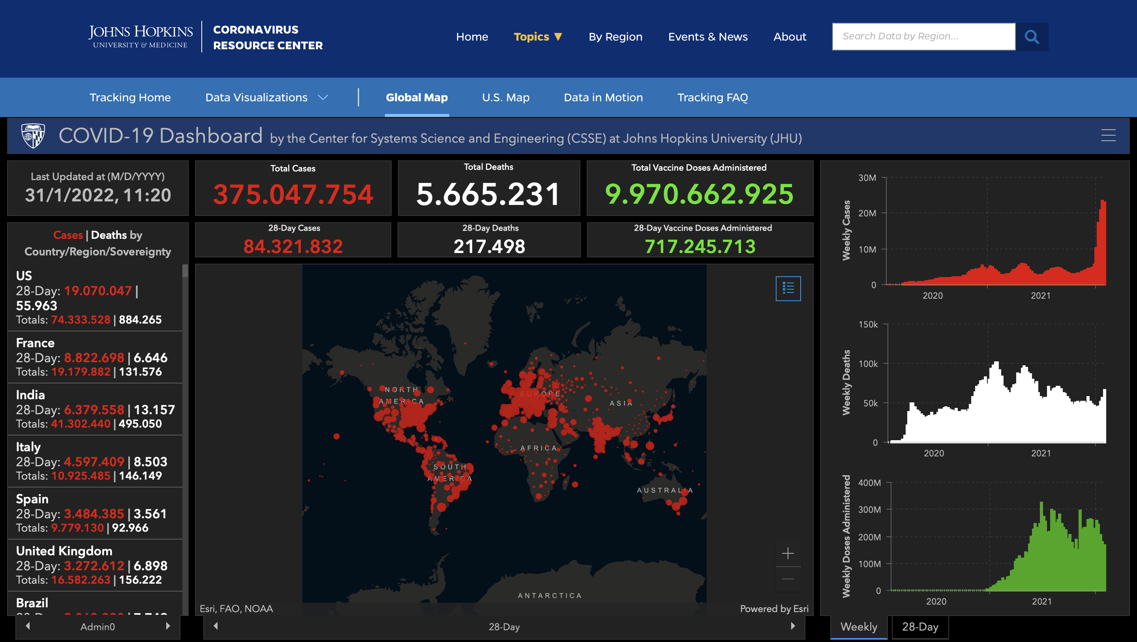
Related Works
Due to the COVID-19 pandemic, many viewers and dashboards have been developed in the past year.
Some of them viewed literature related to COVID-19 research and others viewed the economic impact
Most of them focused on actual COVID-19 cases.
However none of them deals with visual analytics but only with information visualization

Slide 6
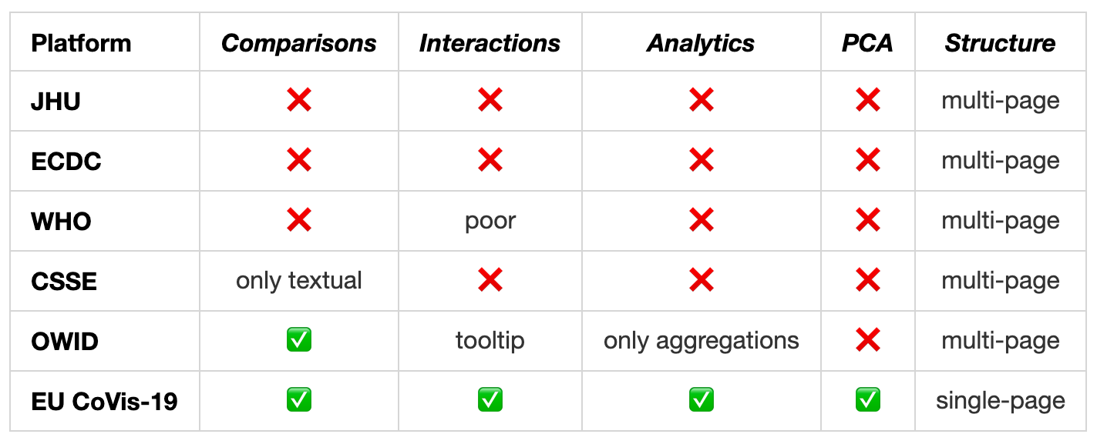
Related Works
We analyze the related works with the goal to start from those ideas and then build our system.

Slide 7
DATASET
03
Data management

Slide 8
Dataset
SOURCES
We took the dataset by Our World in Data. It is very huge (AS index greater than 6 million), it contains the collected data for all the world.
Different sources:
COVID-19 Data Repository by the Center for Systems Science and Engineering (CSSE) at Johns Hopkins University (JHU)
European Centre for Disease Prevention and Control
Government sources
DATA MANAGEMENT
Because we have to manage a very huge amount of data, we have chosen to store them inside a non-relational DataBase, making the accessibility easier.

Slide 9
Preprocessing
Very huge dataset:
Only European countries
Discarded countries: Guernsey, Jersey, Vatican, Andorra, Faeroe Islands, Gibraltar, Isle of Man, Kosovo, Liechtenstein, Monaco, San Marino, North Macedonia
We select only a part of the features, the ones related to vaccinations, deaths, cases, and static factors

Slide 10
TECHNOLOGIES
04
What’s inside EU CoVis-19

Slide 11


Scalable
Back End
Fast
Supports both vertical and horizontal scaling, it’s well-suited for microservices due to a node based approach.
Built upon Google V8 Javascript runtime has a non-blocking I/O philosophy.
DB
Community
Node.js best suites with MongoDB, a NoSQL distributed database which allows ad-hoc quesries and real-time integrations.
There are plenty of interactive courses, tutorials, libraries and examples on GitHub.

Slide 12



D3.JS
Front End
REACT.JS
A JavaScript library used to create interactive visualizations in the browser.
D3.js allows us to manipulate the elements on the DOM, making possibile to build interactive charts with smooth transitions and interactions.
Opensource JavaScript library that allows users to build user interfaces through a component-based approach. Flexible, Reusable, Independent and Integrable. Those are the primary feature of this incredible library.

Slide 13
VISUALIZATIONS
05
And interactions of our project

Slide 14
OUR VIEWS
DEATHS
VACCINATIONS
CASES
~1.7M
336M at least 1 doses 317M at least 2 doses
~125M

Slide 15
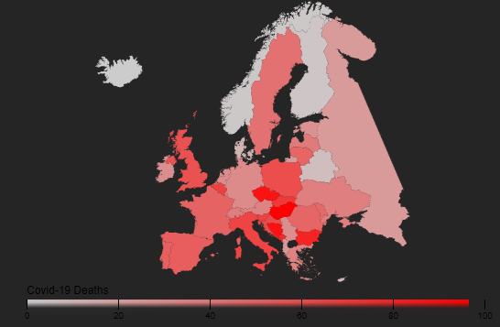
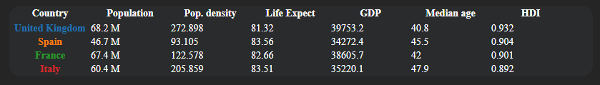
Navbar
Table Chart
In our case table chart has been used as an interactive legend for the current view
Each nation have a specific color constant for all the graphs.
On click changes the focus of the environment on the selected country.
Choropleth Map
Simple but effective view that allows to visualize at first glance how covid affects counties in Europe.
Colors in the map respect how much high is the percentage of deaths/cases/vaccination related to the population (an appropriate legend has been placed for reference).
On click select/remove focus on the country.
Zoom when select a country with a projection of data.
Time selector
Flag button
Country search bar

Slide 16
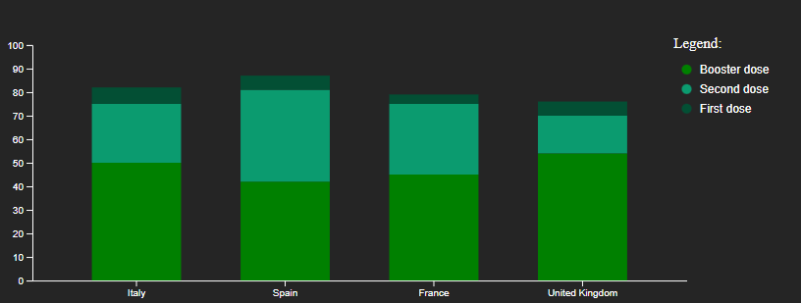
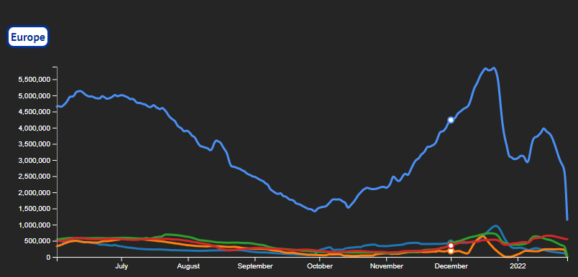
Line Chart
Bar Chart
Displays information as a series of data points connected by straight line segments.
Great visualization to display temporal information about the presented data.
Immediate comparison between countries and Europe.
Color encoded among all the charts.
On mouse over shows a tooltip with data about selected countries.
In this kind of views vertical bars has length proportional to the values represented.
Stacked bar chart to compare different countries.
Vaccination -> percentage of vaccinated related to doses status.
Deaths -> percentage of deaths compared with positive over population.
Cases -> percentage of positives over population compared with deaths and stringency index
On click select/remove focus on the country.
On mouse over shows a tooltip with the displayed data.

Slide 17
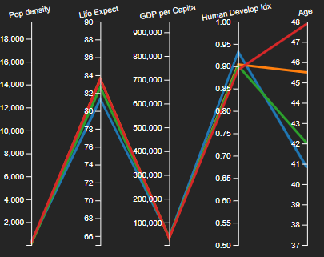
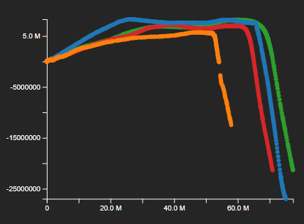
PCA Chart
Scatterplot to display pairs of data into Cartesian coordinates.
2D visualization of the two principal components for each selected countries.
Highlight the differences between countries, it’s easy to see which of them have provided a small amount of data.
Changes based on selected countries and interval of time.
Different visualization in base of the views (Death and Cases shares the same graph).
Parallel Coordinates Chart
Computes the feature of several observations about a set of numeric variables.
Each bar represents a variable with its related scale.
Values displayed as series of lines connected across axis.
Different feature, that better describes the healthiness and wealth of a country, for each visualizations.

