Slide 1
SAE-J1939 Transport Layer Vulnerabilities
Subhojeet Mukherjee, Jeremy Daily

Slide 2
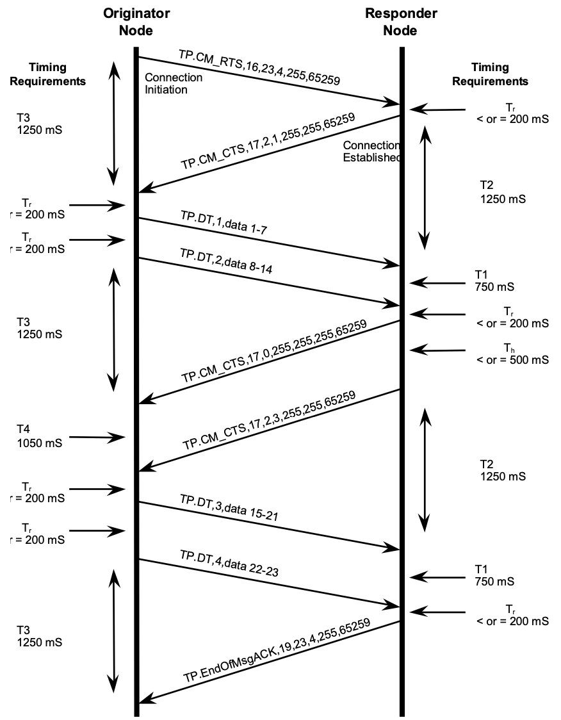
The Transport Protocol SAE International, ‘Data Link Layer’, SAE International, Standard J1939-21, 2015.

Slide 3
Possible Attack Graph
DoS
Connection limit reached
Open connections
Keep alive
Send periodic CTS
Send request and RTS with spoofed SRC
Assuming timers are implemented

Slide 4
Possible Attack Graph
DoS
OR
Memory over usage
Connection limit reached
Half-open connections
Open connections
Keep alive
Send fast requests
Connection opens on CTS
Send periodic CTS
Send request and RTS with spoofed SRC
Assuming timers are implemented

Slide 5
Possible Attack Graph
DoS
OR
CPU over usage
Memory over usage
Connection limit reached
Unbounded requests
Half-open connections
Open connections
Keep alive
Send fast requests
Connection opens on CTS
Send periodic CTS
Send request and RTS with spoofed SRC
Assuming timers are implemented

Slide 6
Possible Attack Graph
DoS
OR
Buffer overflow
CPU over usage
Memory over usage
Connection limit reached
Buffer size < input data size
Unbounded requests
Half-open connections
Open connections
Keep alive
Send fast requests
Connection opens on CTS
Send periodic CTS
Send request and RTS with spoofed SRC
Assuming timers are implemented

Slide 7
Buffer size < input data size == crafted RTS
Single RTS
Num bytes << num packets
Recipient buffers till num packets have arrived or EoMA
Second RTS
Reduced num bytes
Recipient buffers till num packets have arrived or EoMA
Reduced num packets
Recipient buffers till num bytes have arrived or EoMA
Realloc

Slide 8
https://github.com/SystemsCyber/J1939_21_Transport_Vuln_POC.git
Implements DoS via
Memory over usage
Buffer overflow via Second RTS.Reduced num bytes
Connection limit reached
Incomplete

