Slide 1
OS调查问卷
https://www.wjx.cn/jq/99849545.aspx

Slide 2
考试及答疑安排
考试时间、地点：
12月23日（周三）08:00-10:00
教四楼402, 402
答疑安排
  地点： 教三楼 918
  12月22日（周二），14:30点—18:00点
注意考场纪律
  禁止：
  1. 夹带纸制品；
  2. 使用手机、PAD等

Slide 3
CHAPTER 1
OS definition, functionalities
Classification of computer systems and operating systems:
multiprogramming,
batch systems, time-sharing/interactive systems,
(hard, soft) real time systems,
distributed systems, parallel systems
Parallel vs. Concurrent, degree of multiple programming
当前主流OS？！

Slide 4
CHAPTER 1
interrupt vs. trap (陷阱、内部中断)
Storage structure and hierarchy
caching, Fig.1.4
Dual mode operation and privileged instructions (1.5)
System call, API

Slide 5
CHAPTER 2
Services provided by OS (2.1)，见下图
Interfaces between OS and Users (2.2)
System calls as API (概念、原理, 2.3)
（略——Types of system calls ，2.4了解)
(2.7) System structure:
simple, layered, microkernel, module,
各自结构特点、每类结构的代表性OS
（略——2.8 the concepts of virtual machine，容器Docker）
(2.9) system booting, bootstrap (概念、过程)

Slide 6
Services: what functions does the OS provide for OS users, or supporting programs executing , viewpoints of OS users components: how to provide these services, viewpoints of OS designers/developers
accounting
protection and
security
User
interfaces
file system
manipulation
services
program
Execution
(dynamic)
resource
allocation
I/O
operations
error
detection
communication
(§2.1)
OS components/functions
Command-interpreter system
networking
file
management
process
management
main memory
management
I/O system
management
Secondary
storage
management
hardware
device controllers
I/O devices
memory controllers
secondary memory
(disk, tape)
CPU
main
memory
(§1.2)
Fig. 2.0.1

Slide 7
Fig. 2.0.2
Persons
Application programs
Users
Other system software,
i.e. DBMS, MS Office2000
Compilers, Assemblers
Loader, linkage, debuger
Text
editors
communication
System software
Command Statements:
process, I/O, memory, file,
protection, networking
(GUI, MMI)
System
libraries
System
Programs(§2.5)
Operating system
Command-interpreter
system( or Shell, §2.2.1 )
system calls (or API, §2.3/2.4 )
OS kernels (parts of OS components
, §2.7)
drivers (chapter13)
Hardware
device controllers
I/O devices
memory controllers
secondary memory
(disk, tape)
CPU
main
memory

Slide 8
summary
OS | features
DOS | simple/ill-structure
Unix | （宏）kernel
Mach | micro-kernel
OS2 | layered
Solaris/Linux | module
Windows NT/XP， Mac OS X | (micro-)kernel + layered

Slide 9
例题
3. When we power up or reset a PC computer, the booting procedure starts, and the CPU will sequentially executes the following codes, including
I. boot block on disk II. bootstrap in BIOS
III. OS kernel
IV. application programs V. system programs
The correct order of code execution is D :
A. I, II, III, IV, V B. II, I, III, IV, V
C. I, II, III, V, VI D. II, I, III, V, VI

Slide 10
CHAPTER 3
(3.1) Process concept
process vs. program
Process states and state transitions
— 哪些状态转换不可能发生？ e.g. waiting → running
CPU switch, PCB, components of processes
(3.2) Process Scheduling: scheduling queues,
long-term, medium-term, short-term, 各自作用
Context of the process and context switch
Process creation and termination

Slide 11
外存交换区
作业提交
就绪
等待
I/O管
理系统
交换调度
主存
完成
状态
提交
状态
后备
状态
就绪
等待
进程或线程
disk 输入井
运行
作业结果
输出
作业运行态
进程/线程调度
作业调度

Slide 12
independent process vs cooperating process
I/O bound process vs CPU bound process
Inter-process Communication :
message-passing system
memory-sharing/shared
(结合实验，了解概念：pipe, signal，socket）

Slide 13
CHAPTER 4
thread definition, benefits of thread,
process vs thread
  process, 资源分配单位 vs CPU调度单位
  TCB，线程执行轨迹
user-level threads (ULT) and kernel-level threads (KLT)
  KLT
  在支持线程的操作系统中，由OS直接管理、调度和分配CPU的对象，来自于OS、系统软件、应用软件程序模块
  ULT
  用户编程空间中的编程、管理、调度对象
协程/纤程coroutine: 用户级线程

Slide 14
用户空间
进程1
进程2
进程3
进程4
进程5
u
u
u
u
u
u
u
u
u
u
u
u
线程库
线程 库
线程库
线程库
线程 库
L
L
L
L
L
L
L
L
L
内核空间
k
k
k
k
k
k
k
k
k
线程调度程序
CPU
CPU
CPU
CPU
CPU
硬
件
例。 Window XP + Java/C++/C#

Slide 15
Multithreading models
  ULT-to-KLT Mapping，通过编译
  many-to-one, one-to-one, many-to-many
    各自优点、缺点

Slide 16
CHAPTER 5
Concepts on CPU scheduling§5.1
  CPU burst, I/O bursts
  scheduling: select-allocate-enabling
scheduler vs dispatcher,
  when CPU scheduling occurs——5.1.4节，4种情况!
Scheduling Criteria (§5.2)
CPU利用率，response time的概念
Several scheduling algorithms (§5.3，做题)
  FIFO, SJF, priority(抢占/非抢占), RR, 多级（反馈）队列
preemptive SJF：最短剩余时间优先
  Bladey异常
  preemptive: SJFS, priority, RR，多级（反馈）队列
nonpreemptive: FIFO

Slide 17
CHAPTER 6
synchronization vs mutual exclusion
  race condition
synchronization in producer-consumer problem (Bounded-Buffer)
(6.2) Critical-Section Problem
  three requirements for solutions to critical-section problem（P194，互斥、进展、有限等待）
General structure of the process (Fig.6.1)
  enter section, critical section, exit section, remain section
Synchronizing mechanisms on four levels
  hardware: TestAndSet, Swap
  OS: 信号量
  high-level construct/programing environment: monitor
  application software: Peterson/Bakery algorithms
特点：semaphore、monitor可以避免busy-waiting

Slide 18
Semaphores
  definitions, wait/signal operators, P/V
  physical implications for semaphores, maximum/minimum values，信号量值与阻塞/等待进程的对应关系
Semaphore implementation
  busy-waiting, non-busy-waiting
Concepts of deadlock and starvation
信号量四种应用场合
  进程间同步, 二元sync
  进程间互斥, 二元mutex
  资源信号量, 多元, empty/full
  ! 当需要对信号量所代表的资源进行复杂的逻辑判断时，引入用户空间变量对信号量的备份/镜像
    readcount + mutex，睡眠理发师waiting-customer数目

Slide 19
信号量方式 | 管程方式
互斥访问的资源/变量, e.g.1 buffer, e.g.2 shared data; readcount e.g.3 餐桌; state[i] | monitor; shared variables 说明：管程自动实现对管程所代表的资源或管程内shared variables的互斥访问，因此不需要单独定义类似于binary semaphores mutex角色的结构
binary semaphores: 对临界资源/变量互斥访问 e.g.1 mutex e.g.2 wrt, mutex e.g.3 mutex
counting semaphores e.g.1 empty, full; e.g.2 self[i]; | conditional variables
wait(), signal() on counting信号量 | x.wait(), x.signal() on conditional variables
concurrent processes的各个业务逻辑步骤 | concurrent procedures
shared variables, binary semaphores, counting semaphores初始化 | initialization code: 对shared variables，conditional variables 初始化 说明：无binary semaphores

Slide 20
操作系统概念（英文）——6- 例题-作业及答案-20-v1
例题类型
  同步
  生产者-消费者问题及其扩展：资源互斥使用
  读写者问题及其扩展： 资源互斥使用
  哲学家就餐问题及其扩展： 同时申请多类资源
  睡眠理发师问题： 资源互斥使用+同步(不考！)
注意事项
  应用问题抽象归结为经典问题及其扩展，特别是生产者-消费者、读写者问题
  对信号量的操作只能通过系统调用wait/signal，不允许应用程序在用户空间内对信号量直接操作
  同步用sync，互斥用mutex，多元信号量取名反映其物理含义

Slide 21
注意：
不允许用户应用程序直接对信号量操作！
信号量是OS提供的一种内核空间进程同步互斥机制
在用户态下运行的用户应用程序只能通过wait()、signal()等系统调用，间接地操纵修改信号量
不允许用户应用程序直接在用户态下修改信号亮
反例。 Semaphore S
…
S := S – 1
if S > 0 then …
else …
  当需要对信号量所代表的资源进行复杂的逻辑判断时，引入用户空间变量对信号量的备份/镜像
    readcount+mutex，
    睡眠理发师waiting-customer数目

Slide 22
CHAPTER 7
Resource-allocation and Deadlock
  deadlock concept, 饿死starvation
  resource-allocation model (§7.1)，resource-allocation graph
Necessary conditions for deadlock (§7.2)

Slide 23
Principles of deadlock handling
  if deadlock occurs
then { (mutual exclusion)
and (hold and wait )
and (no preemption)
and (circular wait )
}
  /* 等价逆否命题：
if { not (mutual exclusion)
or not (hold and wait )
or not (no preemption)
or not (circular wait ) }
then deadlock will not occur
deadlock handling原理：
破坏四个条件之一，防止死锁发生

Slide 24
Three methods for deadlock handling (§7.3, 原理)
  prevention, avoidance, detect-and-recovery
Deadlock prevention (§7.4)
  no preemption based
  circular wait based
    有序资源使用法
主要破坏的条件：hold-and-wait, circular wait

Slide 25

Deadlock avoidance (§7.5)
  特点：根据进程预先的资源申明max，将系统控制在安全状态下
  resource-allocation state, safe sequence;
    safe state vs nondeadlock state,
方法
  Banker algorithm, 资源有多个资源实例
  Resource-Allocation Graph Algorithm，每类资源只有一个实例
  注意：
    安全状态、安全序列是针对死锁避免、不是针对死锁检测、死锁预防的
    死锁检测/预防中无安全状态、安全序列的概念，只有死锁、非死锁状态

Slide 26
Deadlock detection-and-recovery (§7.6)
Detection
  资源只有一个资源实例，waiting graph
  当资源可有多个资源实例时，deadlock detecting algorithm
    判断有无死锁、哪些进程处于死锁?
Recovery
  挑选victim process
  e.g. transaction rollback，回滚至事务开始前、回滚至save point

Slide 27
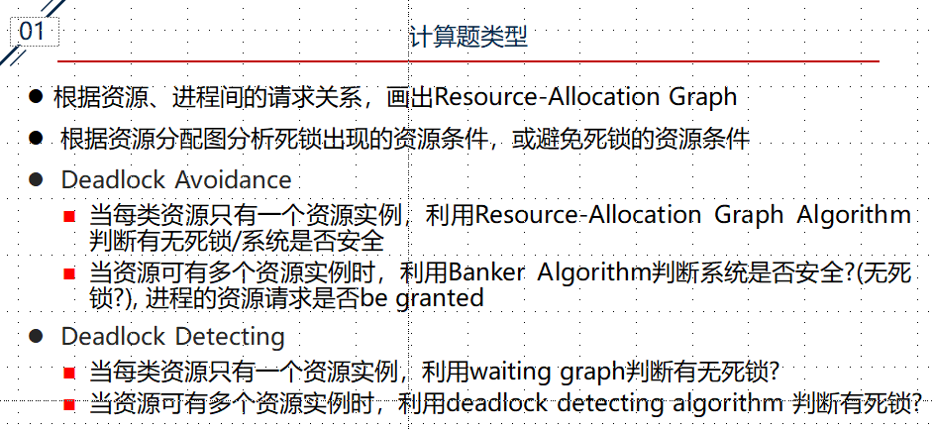
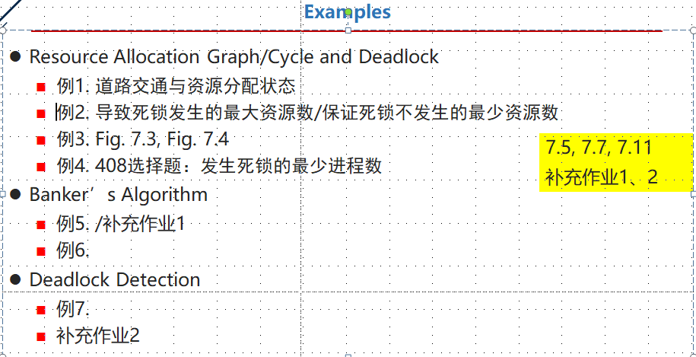
操作系统概念（英文）——7- 例题与作业-20-v1

Slide 28
Example 2 Resources and Deadlock
  某系统有K台互斥使用的同类设备，n=3个并发进程分别需要使用2、3、4台设备，可确保系统发生死锁的最大设备数目K为多少?
  答案
  资源种类数m=1，K个资源实例
  导致发生死锁的
  K = 所有进程的设备资源总需求L — 进程总数n
  = (2 + 3 + 4) – 3 = 6
  确保不发生死锁的最少资源实例总数为：
  K+1 = 所有进程的设备资源总需求L — （进程总数n-1）
  = (2 + 3 + 4) – （3-2） = 7

Slide 29
  L=9，K=9， n=3个进程的设备需求完全满足，进程无等待

Slide 30
  L=9，K=6， n=3个进程的需求不满足，每个进程缺少1个资源，形成循环等待

Slide 31
CHAPTER 8
Logical vs Physical Address Space
Address binding (address mapping among three address spaces, 地址变换与重定位)\
  compile-assembly-linkage-load-executing过程(Fig.8.3)
  binding时机：编译时，加载时，执行时
    静态bingding: 编译时，加载时
    动态bingding：执行时
动态binding，逻辑地址不同于物理地址
MMU: base register, limit register
  address translation and protection
swapping (了解概念)
逻辑地址：
address generated by CPU,
CPU译码时从指令中取出的地址，
e.g. LOAD A, X

Slide 32
Fig.8.0.0 Address mapping among three address spaces
0
70000
Logical/Relocatable address in object module
,
e.g., 14 bytes from the beginning of this module
Absolute
address in executing codes ,
e.g., 70014# byte in main memory
Symbolic
address in
source programs,
e.g.,
Integer count
compiler
, assembly
linkage
, loader
Symbolic
Address space
符号地址空间
Logical / Relocatable/
Virtual Address space
逻辑地址空间/
虚拟/相对/可重定位地址空间
Absolute/Physical Address space
绝对地址空间/
物理地址空间

Slide 33
ADD A, x
物理地址空间
0起始
地址
main routine
MMU: 200, 500
起始
地址
系统进程
200
0
进程1
的逻辑
地址
空间
相对
地址1，i.e., 200
200
x
main routine
的物理
地址
空间
链接、装载
物理
地址1，200+200
x
500
500
地址变换与重定位
subroutine
700
起始
地址 0
subroutine
的物理
地址
空间
进程2
的逻辑
地址
空间
物理
地址2, 300+700
y
y
600
相对
地址2, i.e., 300
600+700
600
Fig. 8.0.1
Address binding/translation/relocation/mapping

Slide 34
(8.3) Contiguous memory Allocation
  principle，allocation method
    全部加载进内存，存放在连续内存区域
    fixed-sized partitions，外部碎片，内部碎片
    可变分区法：外部碎片
  memory protection
  algorithms for selecting available hole for the incoming process
    first-fit, best-fit, worst-fit

Slide 35
(8.4) Paging
  principles, page, frame(页框)
  address mapping, page tables
    multi-level/hierarchical, inverted, hash
    多级页表目标：解决过长页表对连续存储空间的需求，不是为了提高页表访问速度和基于页表的地址变换
  frame table
    bit vector/map
  internal fragmentation
  memory protection (read-write or read-only, valid-invalid bit )
  page sharing (了解)

Slide 36
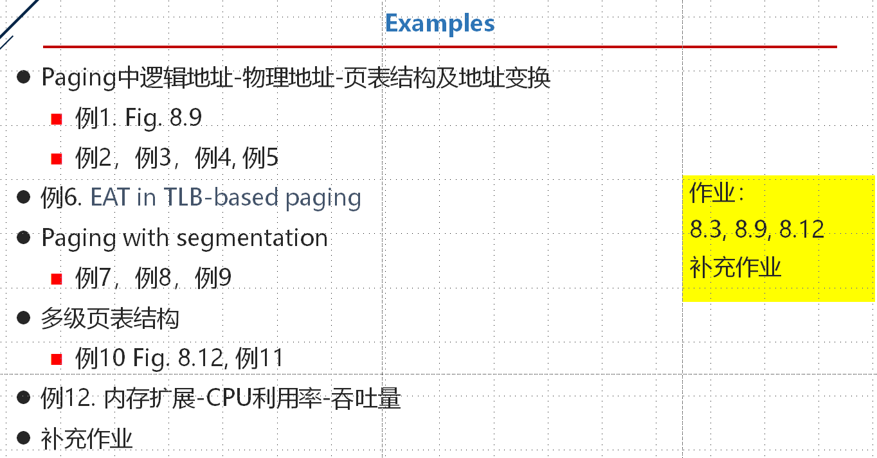
操作系统概念（英文）——8- 例题与作业-20-v1.1

Slide 37
Logical Address Space
page number
page/frame offset
18
10
9
0
v
15 high bits of physical address
frame#
concatenate
512
=2⁹
entries
….
Page
Table
15
14
0
15 high bits
10 low bits
Physical Address Space

Slide 38

Fig.8.11 Paging hardware with TLB

Slide 39
Segmentation
  principle,
    logical address space (二维)，segments, 见下图
  segmentation table/segmentation structure, address mapping
  memory allocation for segmentation
  external fragmentation

Slide 40
进程逻辑地址空间由编程者根据程序的结构 (子程序/模块/数据区等) 划分为多个段segment，逻辑地址由段号 + 段内地址构成：(s , w)
0
0
0
CALL [X] | <Y>
.
LOAD 1, [A] | 6
.
STORE 2, [B]|<C>
.
.
6：1A4E
Y：1020
C：35CD
600
200
500
segment X
(subroutine)
segment A
(array)
segment B
(working area)
segment n
( main program)
  Fig. 8.17.1 A process with 4 segments in the logical space

Slide 41
逻辑段号
长度 段地址
操作系统
0
.
操作系统
0
M
.
1000
K
0
K 3200
.
X
0
1
P 1500
1
X
.
2
L 6000
3200
P
3
.
M
N 8000
0
2
Y
4
S 5000
L
5000
B
段表
0
3
A
6000
N
Y
0
8000
4
B
A
S
进程逻辑地址空间
  Fig. 8.17.2
主存

Slide 42

Fig.8.19 Address mapping and protecting via segmentation hardware
protecting
binding

Slide 43
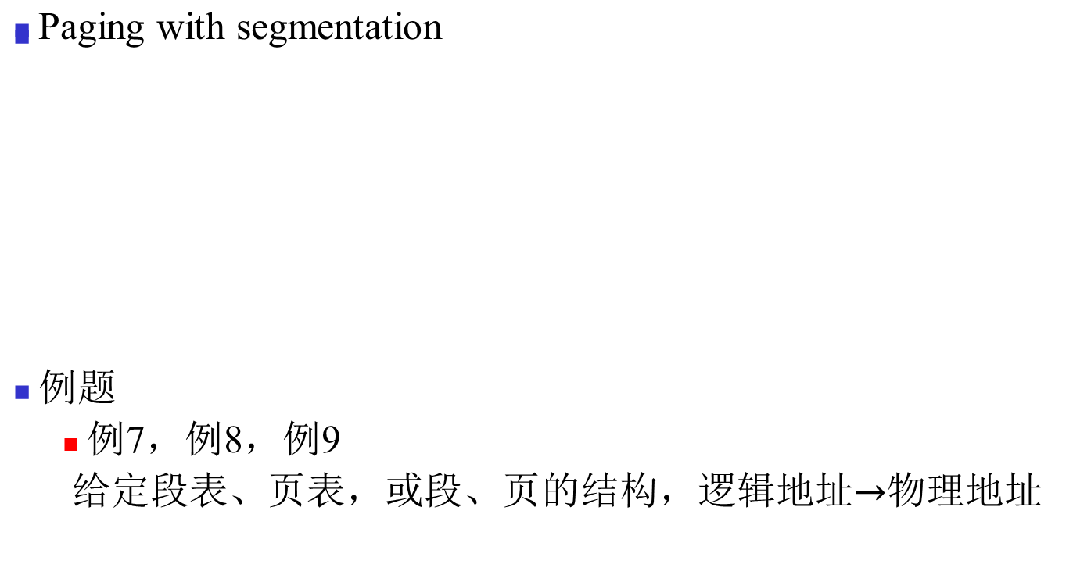
操作系统概念（英文）——8- 例题与作业-20-v1.1
segment
number
offset in segment
page
number
offset
in page

Slide 44
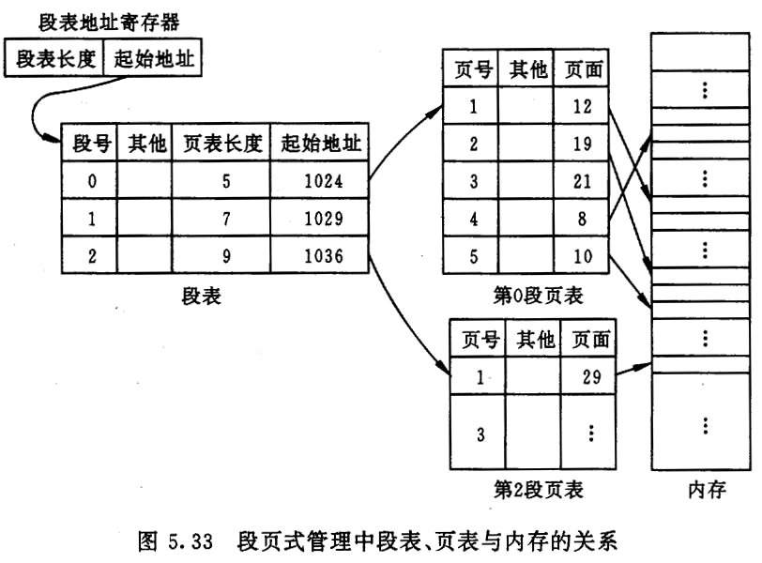
Operating System Concepts - Chapter9 Virtual Memory -

Slide 45
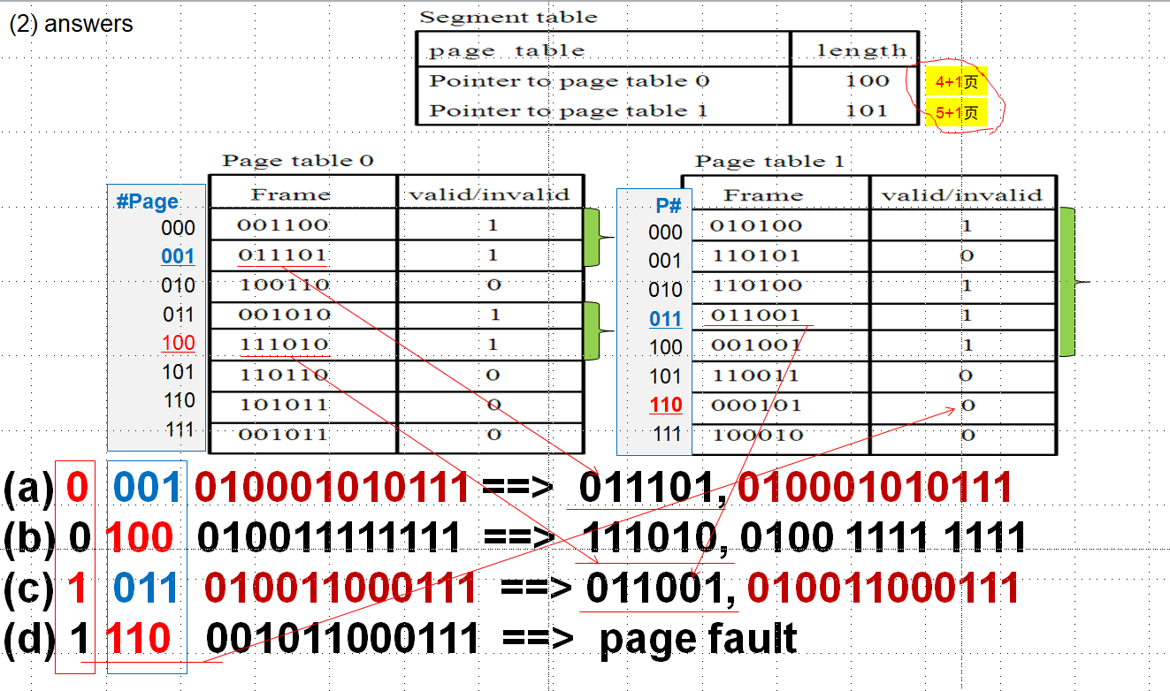
例9

Slide 46
CHAPTER 9 Virtual Memory
Concepts
Implementation of virtual memory
  demand paging, demand segmentation
(9.2) Demand paging
  principle, valid–invalid bits in page table
  Process executing and page fault handling (Fig.9.6)
  Hardware support ( page table, swap space)
Memory mapped file, COW (了解概念)

Slide 47
ADD X, Y
(indirect addressing)
ADD
X
pages
in memory
Y
logical
address
space
X
pages
not in
memory
Y

Slide 48

Fig. 9.6 Steps in handling a page fault

Slide 49
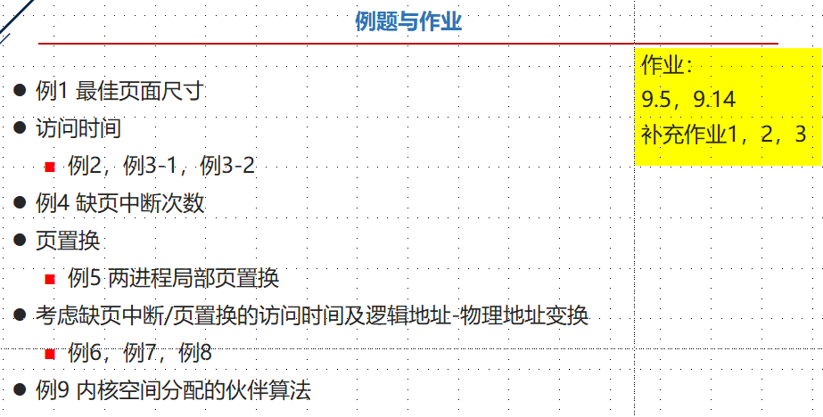
操作系统概念（英文）——9- 例题与作业-20-v3
计算题
  EAT 计算
  memory access time plus page fault handling time
    给定TLB命中率、缺页中断概率，计算：
“基于TLB的地址变换 + 缺页中断处理”时的EAT
  根据页表中的有效无效位，判断访问虚拟地址是否会导致缺页中断
  例4 缺页中断次数

Slide 50

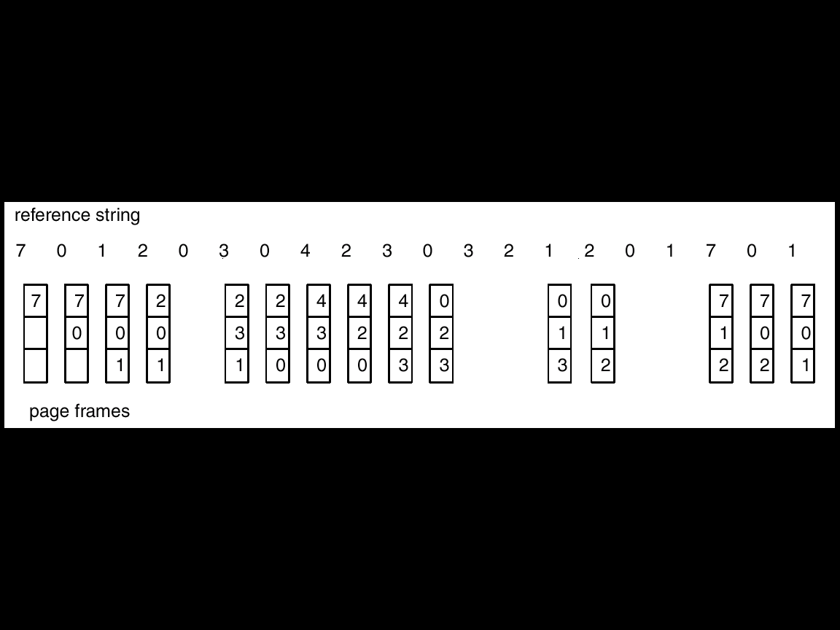
(9.4) Page replacement
  page replacement procedure and algorithms
    FIFO, OPR, LRU
    LRU近似算法：
      二次机会算法/second chance algorithm掌握
  global replacement, local replacement
Operating System Concepts-

Slide 51
10.4.5.2 Second-chance algorithms
FIFO + reference bit
  check the first page (i.e., the oldest page) in FIFO queue
  if the reference bit of the oldest page is 0, then this page is replaced.
  otherwise , the oldest page is moved onto the tail of FIFO queue. And the next page in FIFO queue will be checked
  Enhanced second-chance algorithms (10.4.5.3)
  reference bit + modify bit

Slide 52

Fig.10.14 Second-Chance (clock) Page-Replacement Algorithm

Slide 53
按照页面进入内存时间，将内存中页面组织成FIFO队列
  先进入内存的页面排在队列前部，后进入内存页面排在队列后部
  队列首页为较早进入内存的页面
对每页设置“引用”位，初始时，引用位为0，当页面被访问时，引用位置1
根据页面进入系统的时间（在FIFO队列中的位置），并结合页表中各页的”引用位”，选择被替换页
  检查FIFO中的队首页面(最早进入主存的页面)
    如果其引用位=0, 该页既老又最近没有访问，选择淘汰该页面
    如果引用位=1, 说明进入内存较早，且最近仍使用。引用位清0, 并将该页移到队尾，看作是一个新调入的页
算法含义
  最先进入内存的页，如果最近还在被使用，仍可作为新访问/进入的页，留在内存中

Slide 54
(9.5) Allocation of frames
  【略】minimum number of frames for process executing
e.g. MVC X, Y
X, Y均为直接寻址
跨页，最少需要6个frames，才能保证指令正常执行
principles of global vs. local allocation

Slide 55
(9.6了解概念) Thrashing
  definition, cause;
  (略): locality assumption，working-set model and strateg

Slide 56
CHAPTER 10
(10.1) Concepts: file, file system=file + 目录 + software component
  why file system needed
File system structure (Fig.11.1):
  logical file system, basic file system, organization module
    各层功能/职责
File logical structures
  stream-based structure (byte-oriented, logical-block-oriented);
  record-based structure
  index-based file，索引顺序文件
[例题：文件逻辑记录与逻辑字节，e.g. 10th byte in the file]
(Logical) Access Methods
  sequential, direct/random, indexed
[例题： 不同文件组织方式下需要读取的文件块数目]

Slide 57

Fig.11.1 Layered File System
(§10)
read record_{m}
file system
mapping
retrieve block n
mapping
I/O instruction operating on device controllers

Slide 58
Why file system needed?
access through
data base system
(DBS)
direct access
through
disk controller
access through
file system
(III)
(II)
access programs
(III)
(I)
access programs
(II)
DBS API
access programs
(I) (e.g. drivers)
DBMS: relational tables’ logical
structures and access methods
system calls related
to file management
file system:
file’s logical structures and access methods
I/O system : drivers
memory controllers (i.e. disk controller),
on the basis of secondary storage’s physical structures,
such as storage structures, access method
secondary storage (e.g. disk, tape)
and data on it (address: cylinder, track, sector)

Slide 59
file system = file + directory
  directory entry
文件操作
  open, close, read, write
    了解各个操作的内容
Directory Structure (了解)
  FCB/inode：
文件名+ 地址（直接索引，1级/2级/3级间接索引）,
  directory, directory entry;
  operations on directory
  directory structures
    单层，多层，树，图

Slide 60
CHAPTER 11
(11.1) File system structure
  各层功能/职责
11.2 Data structures for file-system implementation[了解]
  on-disk structure
    FCB
  in-memory structure
    system-wide open file table, process-level/ open file table
Partition/volume/logical disk, mounting;
VFS
  why needed?
(11.3) Directory implementation
  linear list, hash table

Slide 61
(11.4) Storage allocation for files(文件物理结构)
  contiguous (extent-based), linked, indexed
Free space management
  bit vector/map, linked list, grouping, counting

Slide 62
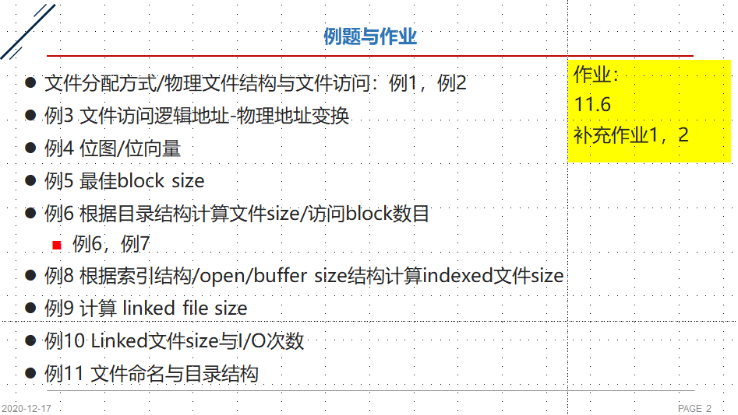
操作系统概念（英文）——10-11- 例题与作业-20-v2

Slide 63
CHAPTER 12
(12.1, 12.2) Mass-storage structure
  structure, principle
  寻道时间+旋转延迟
  addressing of the disk, Fig.12.1;
Disk scheduling (原理，特点, 算法)
  FCFS, SSTF, SCAN, C-SCAN, Look
  例题/习题

Slide 64

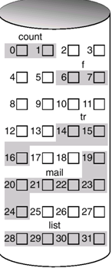
Fig. Moving-head disk mechanism
s_{k}
: sector_{k}
block/record-based file:
0
1
2
3
4
5
6
7
8
parallel access to the record n, n+1, n+2 by the three r/w heads
track 0
block array
s₀
s₁
s₂
platter
s_{n+1}
0
s_{n}
s_{n-1}
seeking
1
rotation
磁柱
2
<cylinder, track, sector>

Slide 65
操作系统概念（英文）——13 - 例题-v2.0

Slide 66
CHAPTER 13
Concepts
  device, device controller（通过bus与CPU连接）
  I/O system(software + hardware)
  I/O subsystem(software),
  kernel I/O subsystem(software in kernel);
  drivers;
  I/O system structure, Fig.13.6
(13.2) I/O Hardware (略)
  I/O ports, registers in device controller;
  direct I/O instructions vs memory-mapped I/O;
  I/O modes (了解) ：polling, interrupt, DMA

Slide 67
Application I/O Interface
  two types of interfaces: system calls, drivers
  characteristics of devices: Fig.13.7
  block and character-stream devices
  clocks and timers: programmable interval timer
(略)：blocking and nonblocking I/O, asynchronous I/O system call;

Slide 68
(13.4) Kernel I/O Subsystem:
  functions of I/O subsystem: P517;
scheduling, buffering, caching: cache, cache vs. buffer;
I/O protection and error handling
Spooling
  principle, spool
(13.5) Transforming I/O requests to hardware（略）
  two types of methods for device naming, device file
  I/O procedure for a blocking read request (Fig.13.13).

