Slide 1
数据库习题课
2018年4月3日

Slide 2
习题1
数据库如下：
  Member（memb_no, name, age)
  Book(isbn, title, authors, publisher)
  Borrowed(memb_no, isbn, date)
  打印借阅了任意由“McGraw-Hill”出版的书的会员名字
  打印借阅了所有由“McGraw_Hill”出版的书的会员名

Slide 3
习题1
对于每个出版商，打印借阅了多于五本由该出版商出版的书的会员名字
打印每位会员借阅书籍数量的平均值(若某会员没有借阅任何书籍，那么该会员根本不会出现在borrowed关系中)

Slide 4
答案1
select name from member m, book b, borrowed l where m.memb_no = l.memb_no and l.isbn = b.isbn and b.publisher = ’McGrawHill’
select distinct m.name from member m
where not exists ((select isbn from book where publisher = ’McGrawHill’) except (select isbn from borrowed l where l.memb_no = m.memb_no))
select publisher, name
from (select publisher, name, count (isbn)
from member m, book b, borrowed l
where m.memb_no = l.memb_no and l.isbn = b.isbn group by publisher, name)
as membpub(publisher, name, count books) where count books > 5

Slide 5
答案1
with memcount as (select count(*) from member) select count(*)/memcount from borrowed

Slide 6
习题2
Employee(employee_name, street, city)
works(employee_name, company_name, salary)
Company(company_name, city)
Managers(employee_name, manager_name)
找出数据库中所有不为”First Bank Corporation”工作的雇员
找出雇员最多的公司
找出平均工资高于“First Bank Corporation”平均工资的公司

Slide 7
答案2
Select employee name from works where company name ≠ ’First Bank Corporation’
select company name
from works
group by company_name
having count (distinct employee name) >= all
(select count (distinct employee name)
from works
group by company name)

Slide 8
答案2
select company name
from works
group by company name
having avg (salary) > (select avg (salary)
from works
where company name = ’First Bank Corporation’)

Slide 9
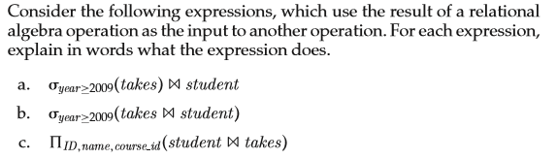
习题3

Slide 10
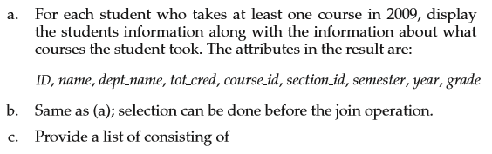

答案3

Slide 11

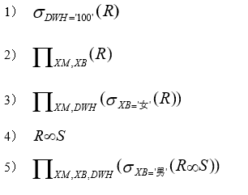
习题4
有如右所示的关系表R，S，T。写出下面关系代数对应的SQL语句

Slide 12
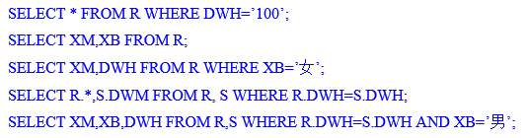
答案4

Slide 13
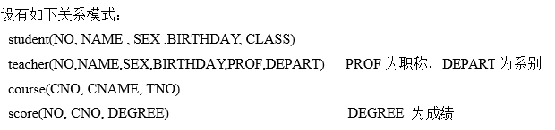

习题5

Slide 14

答案5

Slide 15
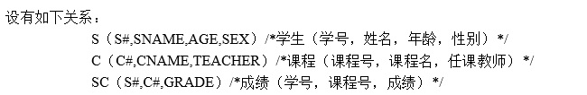
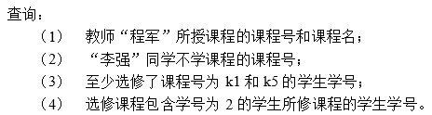
习题6

Slide 16
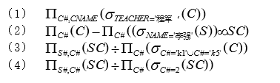
答案6

Slide 17
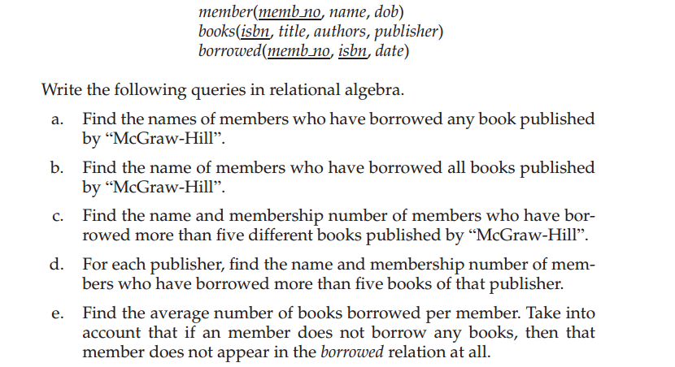
习题7

Slide 18
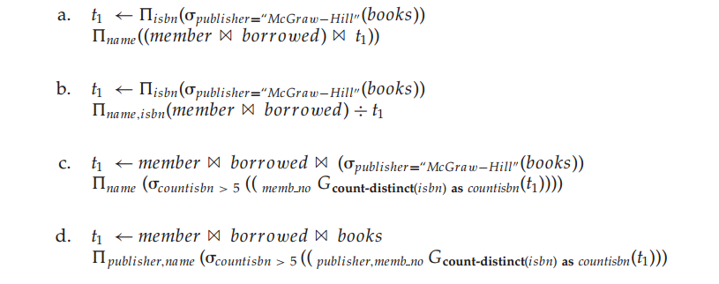
答案7

Slide 19
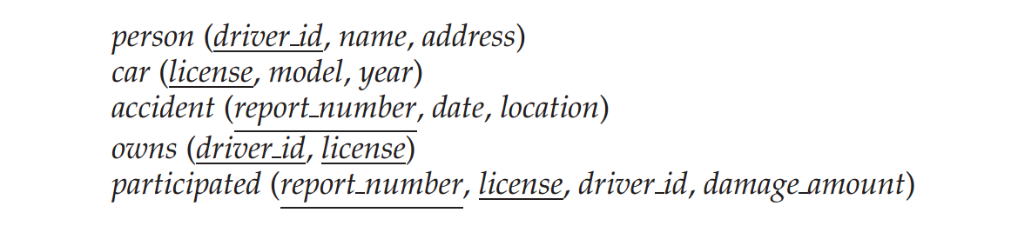
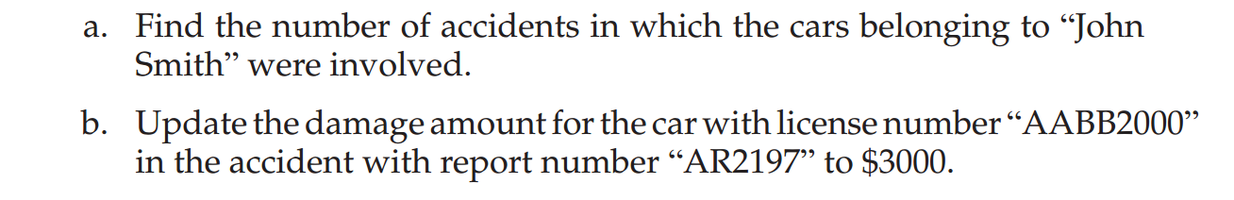
习题8

Slide 20
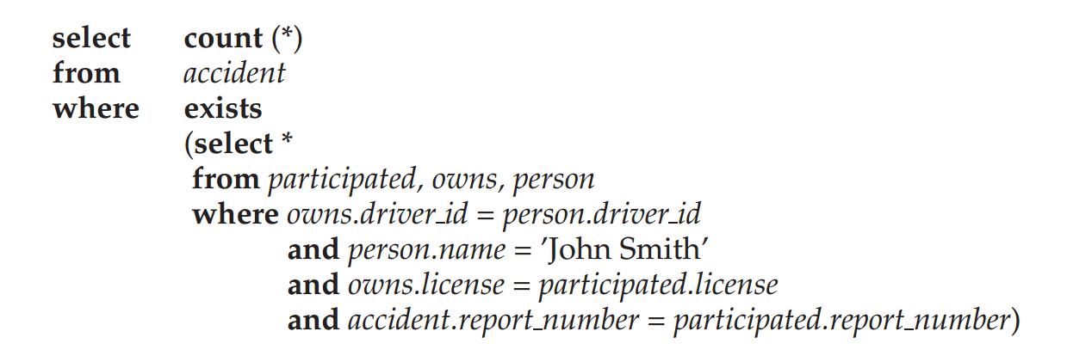

答案8

Slide 21
习题9

Slide 22
答案9

Slide 23
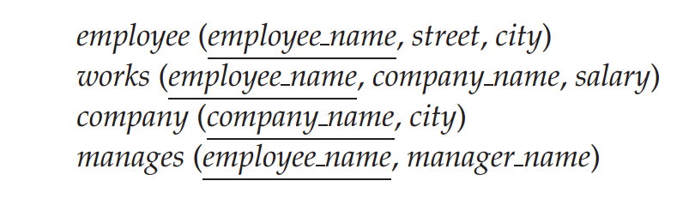
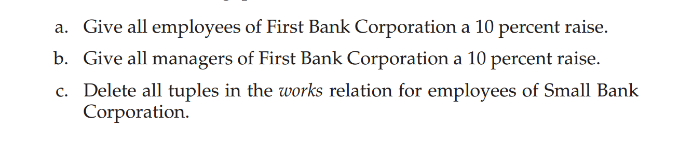
习题10

Slide 24

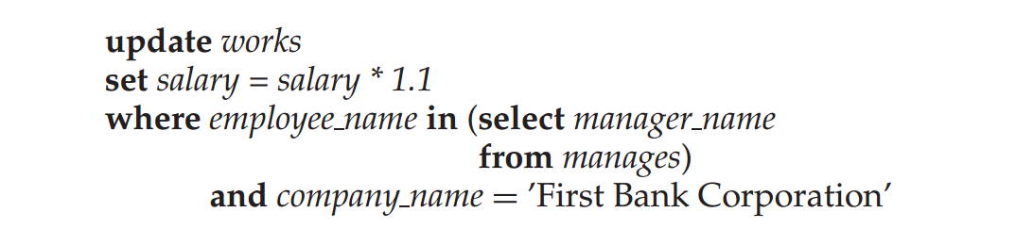
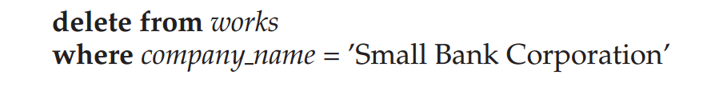
答案10

