Slide 1
<TODO name of conference>
Global Data Consistency in Microservice Architechtures
Copyright 2015 (c) Ant Kutschera

Slide 2
Agenda
The Problem
Traditional Solutions
An Open Source Solution based on JTA
Introduction to 2PC
Contracts
Eventual Consistency
Patterns

Slide 3


Facebook bug?
Middle link shows Karens comment at the bottom. Other link does not. Inconsistent data between nodes => increased scalability but only eventually consistent. Who wants to build their own framework code to ensure this consistency? It comes for free in NoSQL DBs. Why not in Microservice environments?

Slide 4
Selling Tickets
TODO talk about how we integrated fremdsysteme and how you dont want to purchase something on their side but not have it noted on your side and be financially responsible without reselling it to the end customer.
You cannot dictate the signature of the service you are integrating
Complex solution involving async batches
Getting it wrong costs 3m CHF in a month!

Slide 5
Adding a contract to a sale
Abo Management done in SAP
SAP is a “microservice” (http://martinfowler.com/articles/microservices.html)
It does one thing well (contract management)
Language Agnostic – SOAP + ABAP
Decentralised gonvernance
Decentralised data management
Product (contract management)
Split around Business Capability? (contracts department/CRM)
Evolutionary design (in this case because it was custom)

Slide 6
Adding a contract to a sale
TODO Services:
Customer DB – allows compensation only
SAP – execute/commit/rollback (contract managment)
SAP – compensation only (financials, which run async)
Ticket Backend – reserve/complete purchase/freigabe
Order Management – standard JTA/JDBC, but XA since multiple DB connections
Solution
Custom made asynchronous framework consisting of orchestrated commands
No BPEL because no centralised support for product :-(
Cost: up to 1 Man Year

Slide 7
Case Management
TODO talk about workflow where each claims case is also added into the workflow management product.
Because of wrong design, claim “container” is saved, WF case is created, and then validation logic is run. => invalid claim causes an error – schadenfall not saved, but webservice to WF already called.
One Solution
Fix design
Better Solution
Still need to consider compensation if something else goes wrong. If the schaden DB fails, you will get lots of created cases in WF which all need cleaning up manually!

Slide 8
Membership in Wiki
Small system built for an assocation
Membership Applications are made
When approved, application leads to:
Member creation in Wiki (REST, membership management done there)
Consists of lots of seperate calls! (create user, update properties)
No control over interface
Create account in Billing System (local DB or separate microservice)
What happens if first call to Wiki works, but subsequent calls fail due to validation?
Don't want to duplicate validation rules in front end!
What happens if there is a failure down the line, after the wiki account is created?

Slide 9
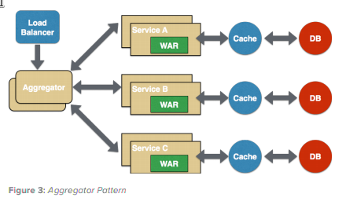
Common Problem
Composite Service
(see https://dzone.com/servlet/storage/?file=293353)
TODO when is it used? Entry point
of Client – Application Service
How do we make data consistent?
Either make data initially only visible to transaction (isolation level; via e.g. states)
Or compensate if something goes wrong
Eventually Consistent is OK here
Two Phase Commit / XA are only eventually consistent!

Slide 10
Possible Asynchronous Solutions
Write Job to DB in XA Transaction
Use JMS
=> Async means on instant feedback :-(

Slide 11
Possible One-Shot Solutions
CDI Events
Context, but no Recovery
Enlist XA Resource into JTA Transaction
No Recovery
Register Transaction Callbacks
No Context, No Recovery
=> Synchronous, but only one shot :-(

Slide 12
Possible Other Solutions
Custom Solution
Expensive; likely to be buggy; everyone on project will hate it
WS-AT
Do you have control over Interfaces?; locking?
Business Process Engine
Not a microservice, but yeah, why not?
Remote EJB
Old School; Locking

Slide 13
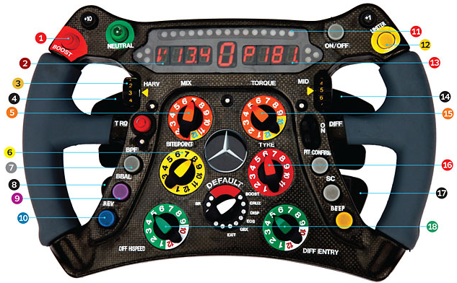
Best Choices
Anything that uses an existing transaction manager
Don't reinvent that very complex wheel!
JTA 1.1 => Ability to manage transaction over multiple resources

Slide 14
Refresher – Two Phase Commit
mysql> XA START 'someTxId';
mysql> insert into person values (null, 'ant');
mysql> XA END 'someTxId';
mysql> XA PREPARE 'someTxId';
mysql> XA COMMIT 'someTxId';
mysql> select * from person;
+-----+-------------------------------+
| id | name |
+-----+-------------------------------+
| 771 | ant |
+-----+-------------------------------+

Slide 15
Refresher – Two Phase Commit
mysql> XA RECOVER ;
+----------+--------------+--------------+----------+
| formatID | gtrid_length | bqual_length | data |
+----------+--------------+--------------+----------+
| 1 | 8 | 0 | someTxId |
+----------+--------------+--------------+----------+

Slide 16
Refresher – Two Phase Commit
Why is 2PC so bad?
Relatively slow because it is synchronous
All nodes in Oracle cluster are updated?
Compare to Apache Cassandra (NoSQL) – only one node is updated
No upper limit on how long to lock resources
3 PC => timeout
Databases tend to lock data
But locking data might make sense from a business point of view – e.g. a seat in a plane

Slide 17
Important Stages
Execution
Make sure execution is bound into transaction
Commit
Handled automatically
Rollback
Handled automatically
Timeout
Don't block resources forever
Recovery
Automatically retry commit/rollback until it works

Slide 18
“Contract” for Microservices that we can coordinate
Microservice should make three operations available: execution, commit and rollback (although commit is actually optional 1),
Microservice may let non-committed and non-rolledback executions timeout after which any reserved resources may be used in other transactions (à la 3PC),
A successful execution guarantees that the transaction manager is allowed to commit or rollback the reserved resources, as long as no timeout has occurred 2,
A call to commit or rollback the reservation can be done multiple times without side effects (think about idempotency here), so that the transaction manager may finish the transaction if an initial attempt failed.

Slide 19
MysqlXADataSource mysql = new MysqlXADataSource();
mysql.setUser("root"); //url, password, etc...
JdbcTransactionalResource mysqlResource = new JdbcTransactionalResource("jdbc/mysql", mysql);
UserTransactionServiceImp utsi = new UserTransactionServiceImp();
utsi.registerResource(mysqlResource); //registered for recovery purposes
UserTransactionManager utm = new UserTransactionManager();
utm.begin();
Transaction tx = utm.getTransaction();
XAConnection xamysql = mysql.getXAConnection();
XAResource db = xamysql.getXAResource();
tx.enlistResource(db);
try(Connection connection = xamysql.getConnaection()){
PreparedStatement stmt = connection.prepareStatement("insert into person(id, name)…");
stmt.setString(1, username);
stmt.executeUpdate();
}
tx.delistResource(db, XAResource.TMSUCCESS);
utm.commit();
Example Code

Slide 20
@Resource DataSource mysql;
@TransactionAttribute(REQUIRES_NEW)
public void doSomething(){
try(Connection connection = xamysql.getConnection()){
PreparedStatement stmt = connection.prepareStatement("insert into person(id, name)…");
stmt.setString(1, username);
stmt.executeUpdate();
}
}
Example Code

Slide 21
JCA Example in Java EE Container
@Resource(lookup = "java:/maxant/BookingSystem")
TransactionAssistanceFactory bookingFactory; //like a DataSource
//web service client (REST, SOAP, whatever)
BookingSystem bookingSystem = new BookingSystemWebServiceService().getBookingSystemPort();
@TransactionAttribute(REQUIRES_NEW)
public void doSomething(){
try(TransactionAssistant bookingTransactionAssistant = bookingFactory.getTransactionAssistant()){
String bookingResponse = bookingTransactionAssistant.executeInActiveTransaction(txid -> {
return bookingSystem.reserveTickets(txid, refNumber);
});
} catch (...) {...}
}

Slide 22
JCA Example in Java EE Container
@Startup @Singleton
public class TransactionAssistanceSetup {
@Resource(lookup = "java:/maxant/BookingSystem") TransactionAssistanceFactory bookingFactory;
@PostConstruct public void init() {
bookingFactory
.registerCommitRollbackRecovery(new Builder()
.withCommit( txid -> {
new BookingSystemWebServiceService().getBookingSystemPort().bookTickets(txid);
})
.withRollback( txid -> {
new BookingSystemWebServiceService().getBookingSystemPort().cancelTickets(txid);
})
.build()
);
}

Slide 23
Spring Boot Example
@Service
@Transactional
public class AppService {
@Autowired BaseicTransactionAssistanceFactory microserviceFactory;
public String doSomethingWithAGlobalTransactionAndARemoteMicroservice(String username) ... {
String msResponse = null;
try(TransactionAssistant transactionAssistant = microserviceFactory.getTransactionAssistant()){
msResponse = transactionAssistant.executeInActiveTransaction(txid->{
final LetterWriter service = new LetterWebServiceService().getLetterWriterPort();
return service.writeLetter(txid, username);
});
}
return msResponse;
}

Slide 24
Spring Boot Example
final LetterWriter service = new LetterWebServiceService().getLetterWriterPort();
CommitRollbackHandler commitRollbackCallback = new CommitRollbackHandler() {
@Override
public void rollback(String txid) throws Exception {
//compensate by cancelling the letter
service.cancelLetter(txid);
}
@Override
public void commit(String txid) throws Exception {
//nothing to do, this service autocommits.
}
};
BitronixTransactionConfigurator.setup("xa/ms1", commitRollbackCallback, 30000L, new File("."));

Slide 25
Supported Stacks
Standalone Java
Bitronix or Atomikos
Tomcat / Jetty
Plain Java + Bitronix or Atomikos
Spring + Bitronix or Atomikos
Spring Boot + Bitronix or Atomikos
Java EE
JBoss EAP + Wildfly
Websphere – not yet – need support please!
Other App Servers – not yet – need support please!

Slide 26
Contextual Information for Commit/Rollback
Look back at other code. The transaction ID – a String – is the key which you can use to lookup data from the execution stage.
Execution Stage MUST write data in an inner transaction before calling the microservice, to ensure it is available during commit / rollback.
Use File, DB or persistent key/value storage like MemCached or any NoSQL storage
No solution provided by library, because there are so many options!

Slide 27
(Non-)Issues
I'm integrating a service which doesn't have a “commit” method
No Problem. The data in that system might look consumed, altho a rollback / compensation is pending. But it's still eventually consistent
It takes a long time for a service to come back online after a crash
And Facebook has never lost a photo temporarily? Eventually, everything will be consistent.

Slide 28
(Non-)Issues
Isn't WS-AT better
If you are integrating SOAP services which support it and your systems are compatible, give it a try
TODO?

Slide 29
More Info
TODO
Links to blog articles
Original
Integrating non-tx
Spring boot
https://github.com/maxant/genericconnector
Lots of demo code
Create Forum?
Contacting Ant:
ant@maxant.co.uk @maxant_ch

