Slide 1
Figures

Slide 2
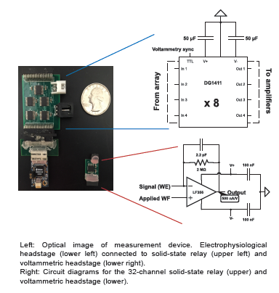
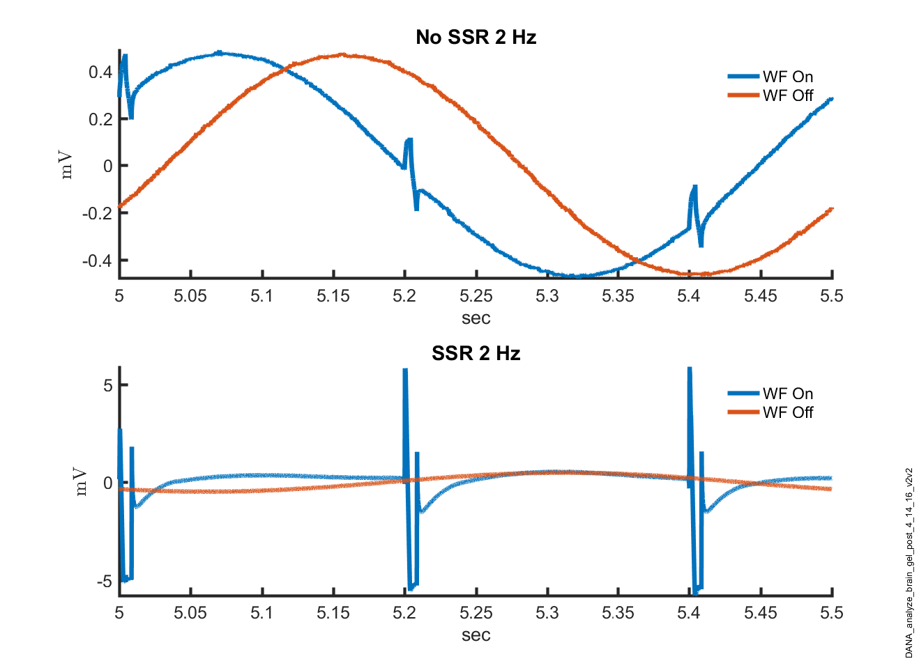
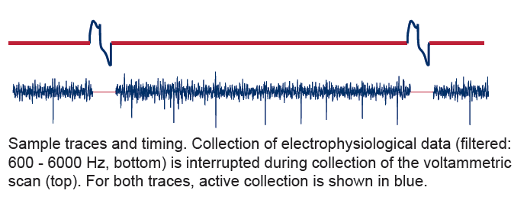
Figure1:
A
A) Setup, circuit diagram AND (to do ) add an illustration of how this setup was connected to the brain gel. Show the SSR but also put a box around it and indicate that in one experiment we used the SSR but in other conditions we did not have the SSR. Also have a brain diagram that shows where the electrodes and grounds were going (essentially replace the picture on the right with this diagram.
B) Real spike data/ timing diagram. Only one color. No data manipulated. Use a figure with a gorgeous cell on it. (not the one to the right that was from brain gel). Make shaded boxes around scan pulses to indicate where we are probably losing data. Also include a row with the pulses either above or below the spike data.
B

Slide 3
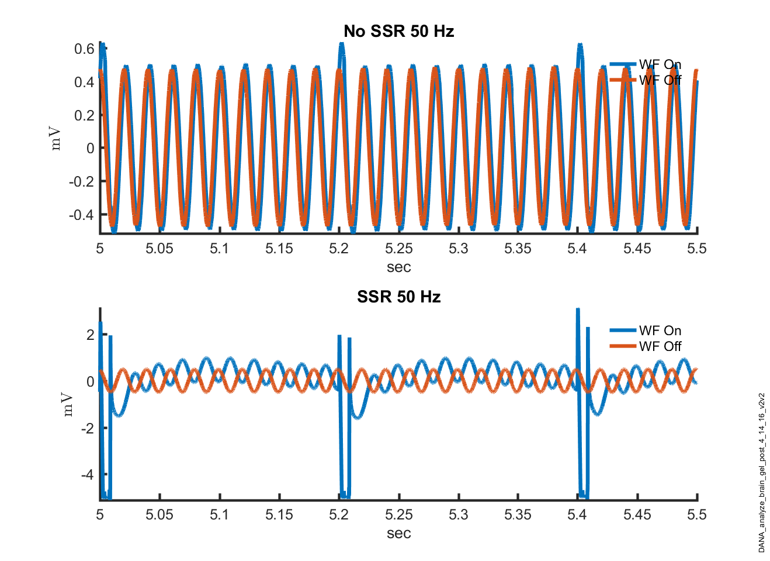
Brain Gel:
Something like the plot on the right. BUT, also we should overlay the SSR with the no SSR on the same plot. Red mark indicates the target frequency.
Put an INSET in each PSD that shows the raw signal.
Color is free!!!.
Restrict to these frequencies: 1, 5 , 10, 50, 100, 1000.
In text, provide numbers for the noise with intan alone, new headstage, and intan with SSR.
Regenerate the waveform figures as .fig files and .eps files. Kate will then work with these and put them as either separate plots or as insets. (don’t know if we need the pre at all. ). No pre.

Slide 4
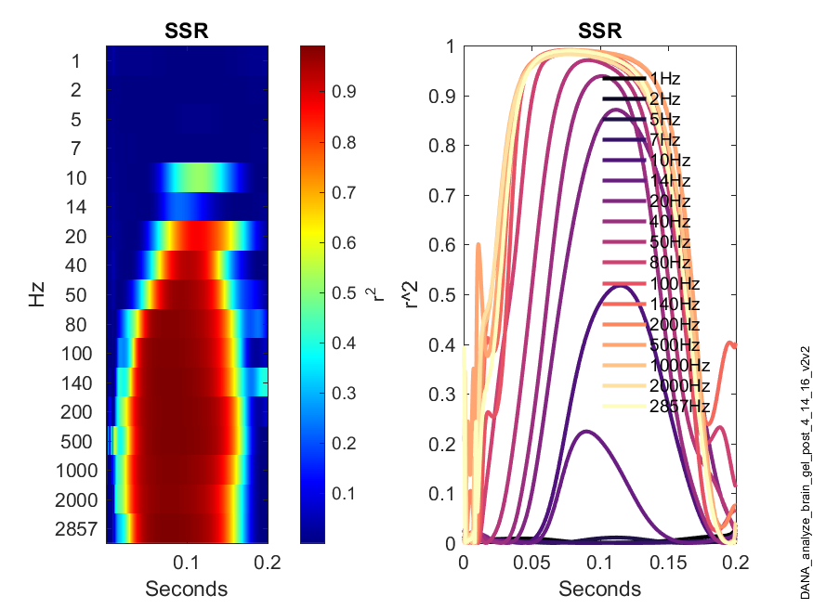
Figure 3 – template mathc recovery. 1) Get rid of the 5 Hz as this is indistinguishable from the Scan Fq 2) Just use the color plot. 3) Look at the SSR data – why is there a deflection right before the next scan pulse? Fix this.
Flip this axis. Stop at 200 ms
Create a plot like this for the template matching but use an r squared threshold of 0.7.
Do it for with and without SSR. Overlay the two.

Slide 5
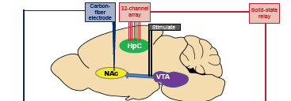
Figure – anesthesia - Biology:
Add a pie chart that indicates the portion of hippocampal cells that were uppers downers or no-effectors.
TO DO: add the waveform of the single unit to this
Average the colorplot and the [da] vs time plot.
This is with SSR – may be much nicer stuff without SSSR.

Slide 6
Behaving animals:
Just show the with SSR figure
Also include the dopamine trace I vs t and CV.
For the HFO data, get a say 50 ms interval showing pre-injection LFP and post-injection –at the peak HFO and put them side by side – to illustrate – JP can do this.

Slide 7
Supplementary Figures

Slide 8
With SSR electrophysiology anesthetized
Show spikes and data, but only show the without SSR data in the main document. We can refer to this supplementary figure in the main text.

Slide 9
More sexy pictures of single unit + dopamine responses with/without SSR. Up vs. down.

Slide 10
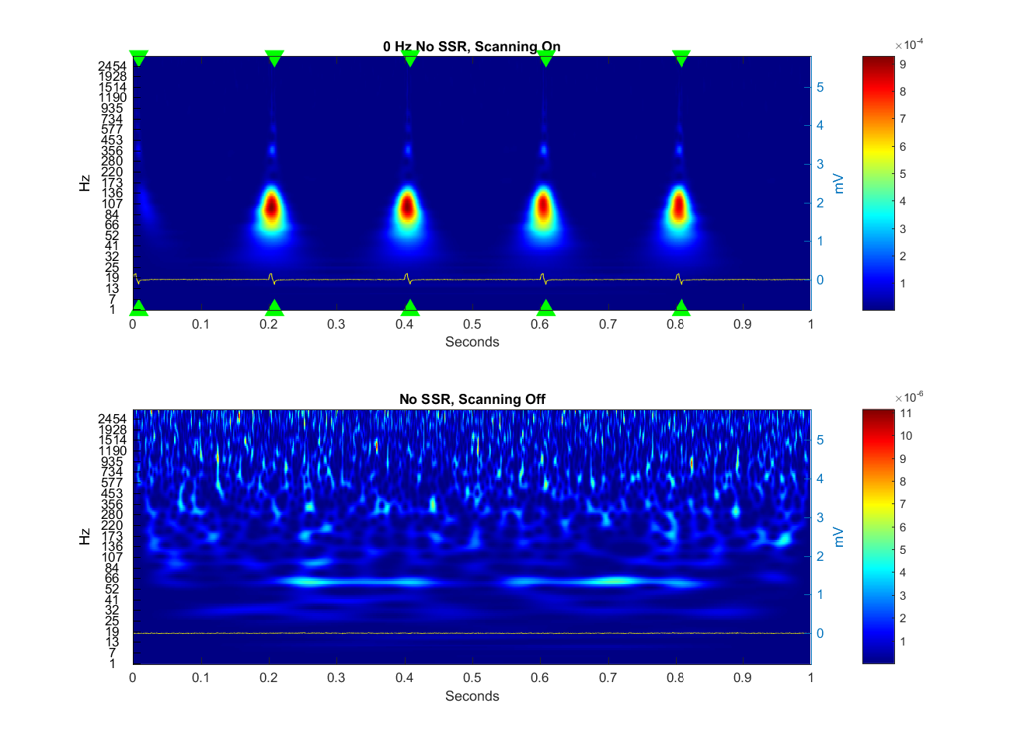
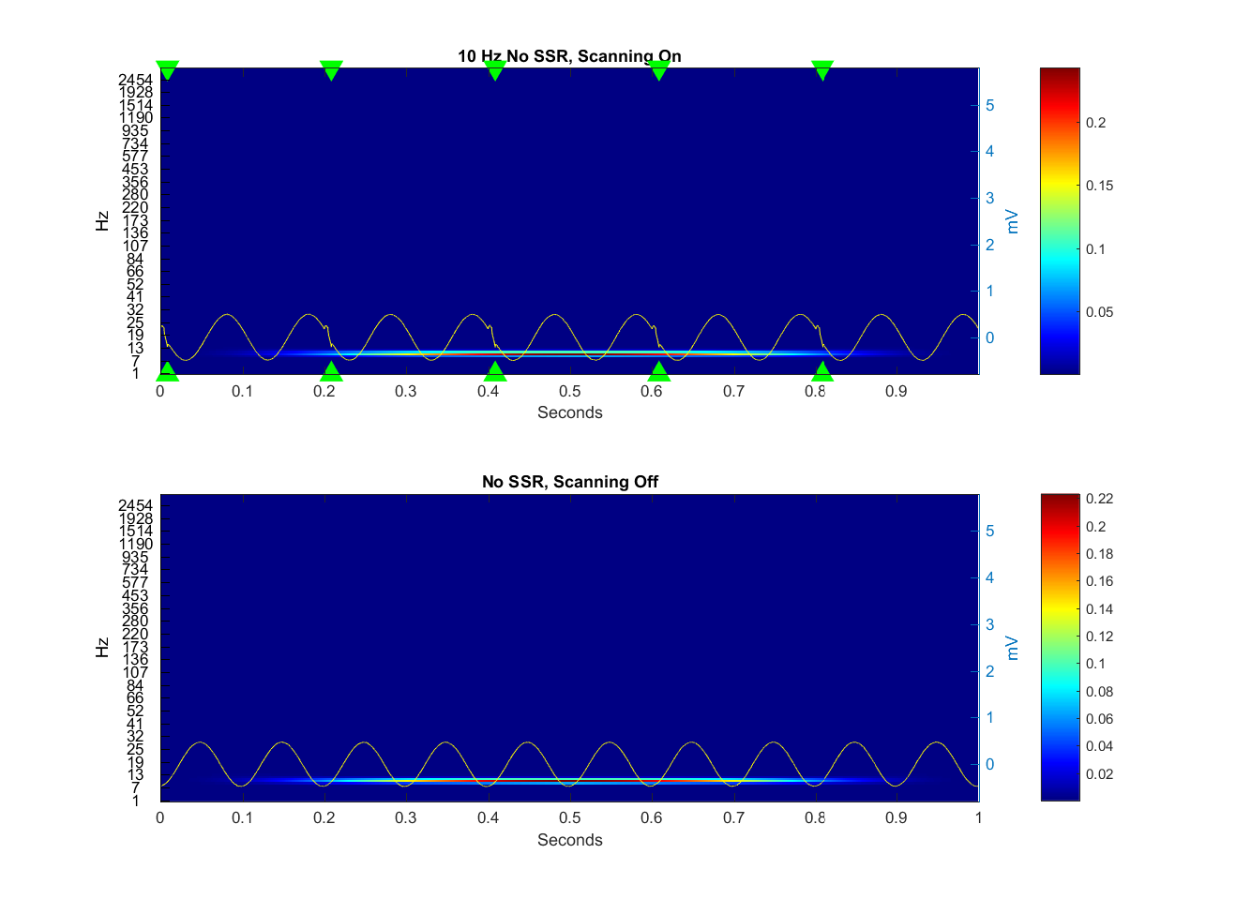
Do not include this: The impact of the Scan pulses on the neural signal:

