Slide 1
Q1_Does_OVX_affect_MWM_performance.R
Code is in the github repository.

Slide 2
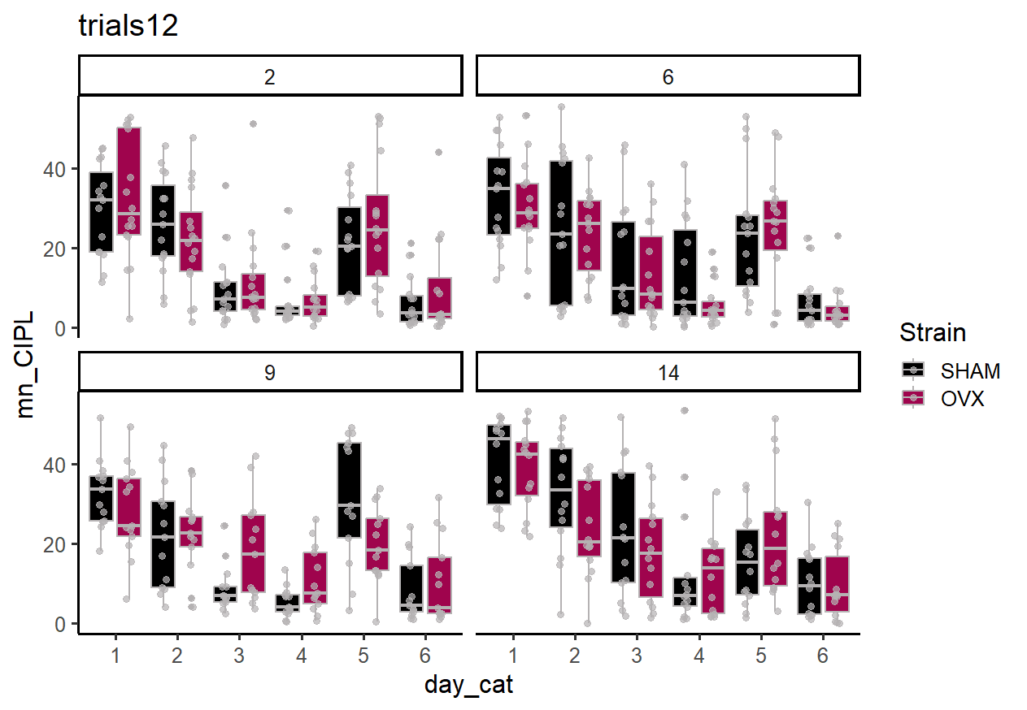

Slide 3
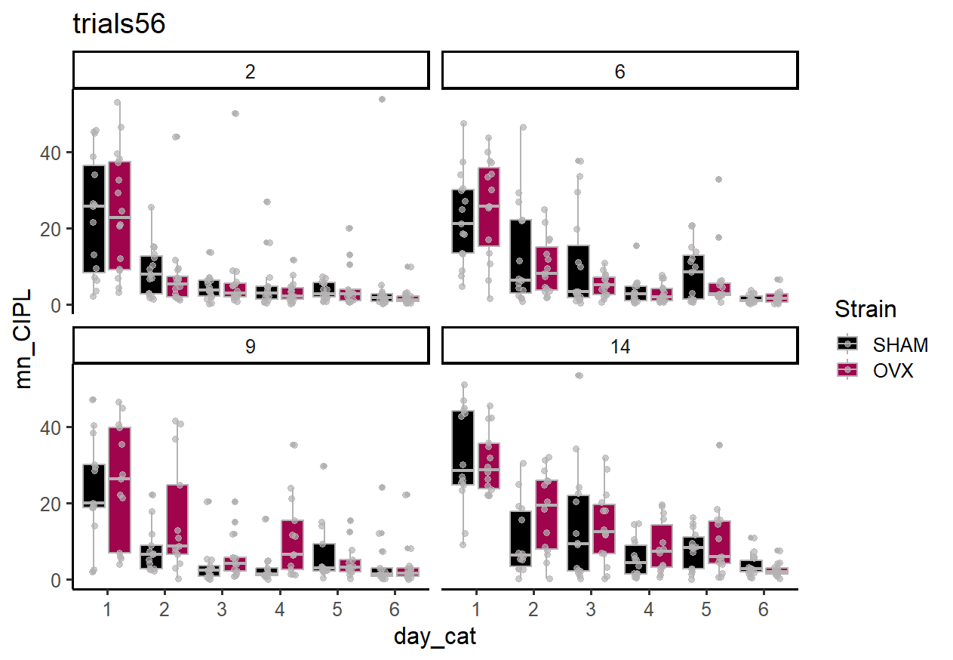

Slide 4
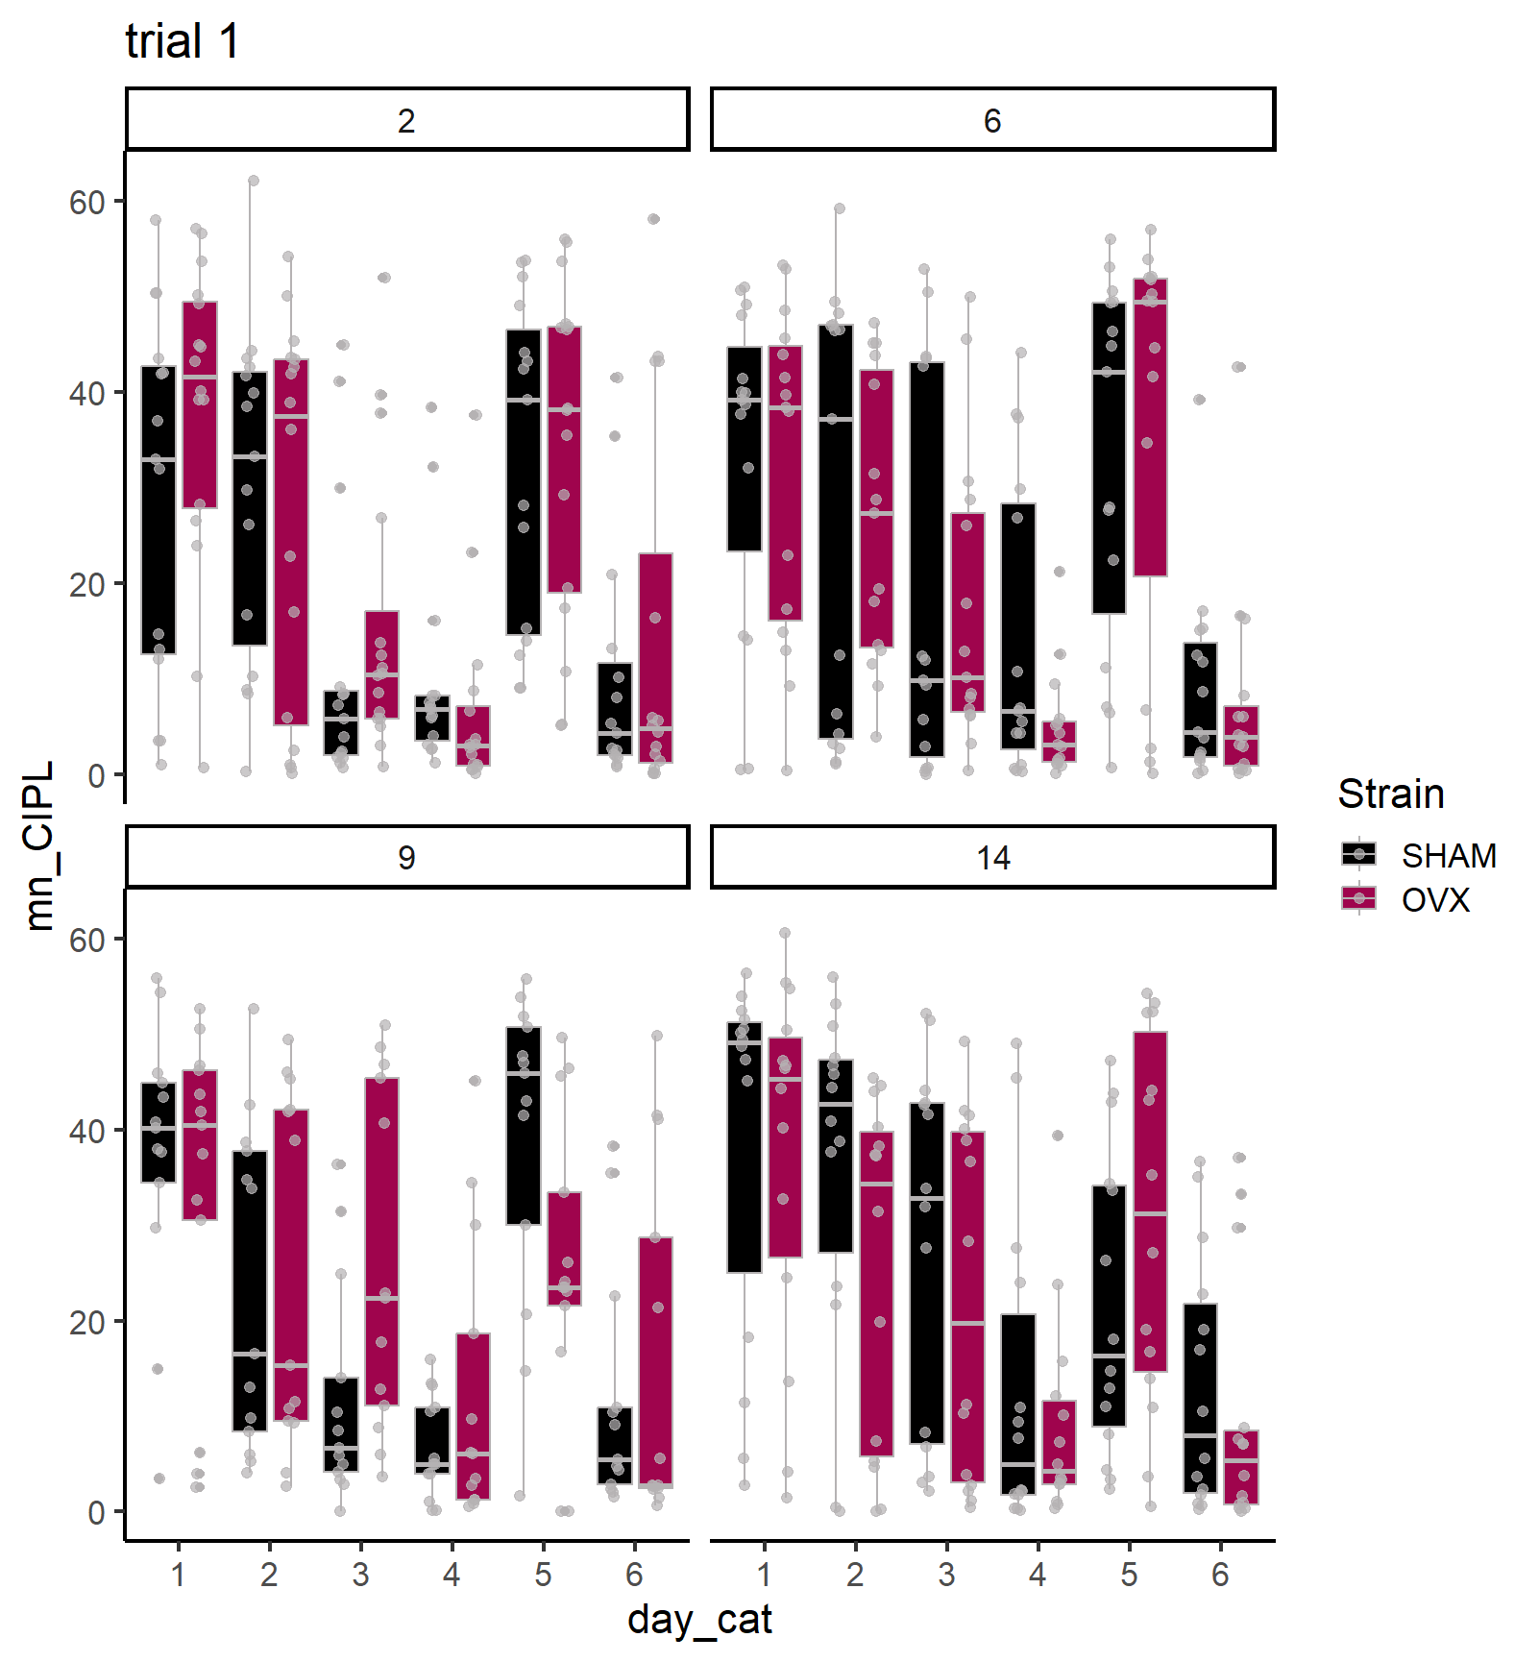
Trial 1 reflects the carryover from the previous day.

Slide 5
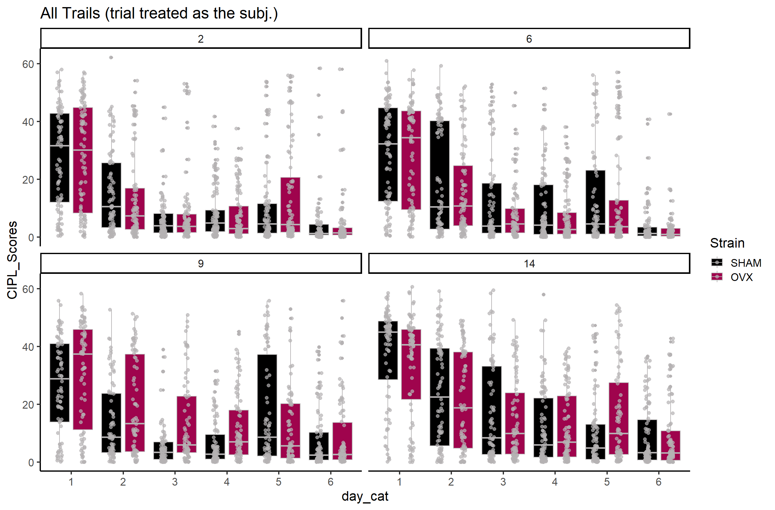

Slide 6
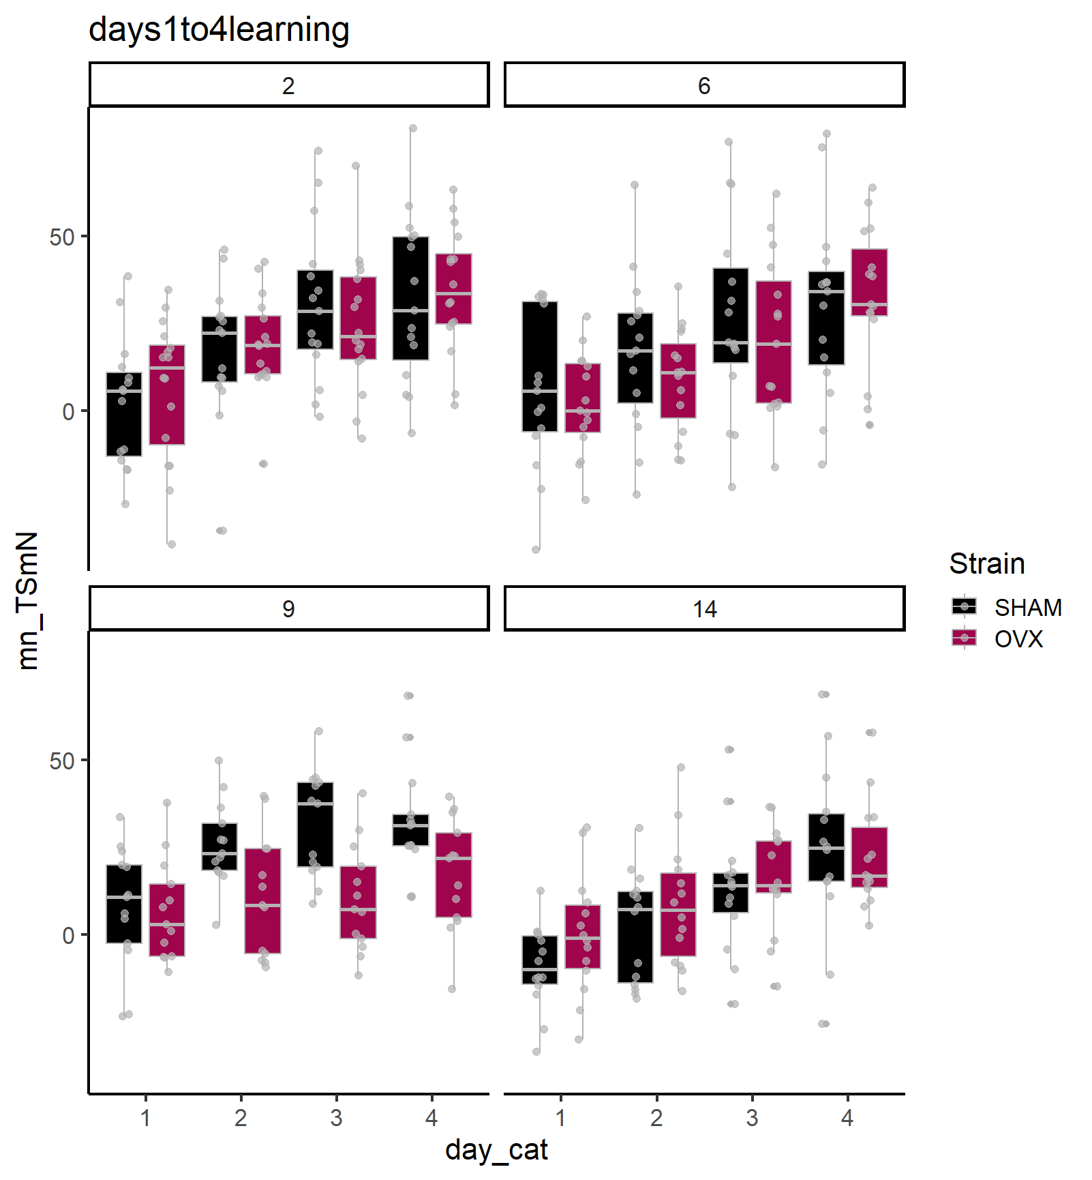
Time in the SOUTH quadrant (goal for days 1-4) minus time in the NORTH (goal days > 4).
Nice effect on day 9 across training.

Slide 7
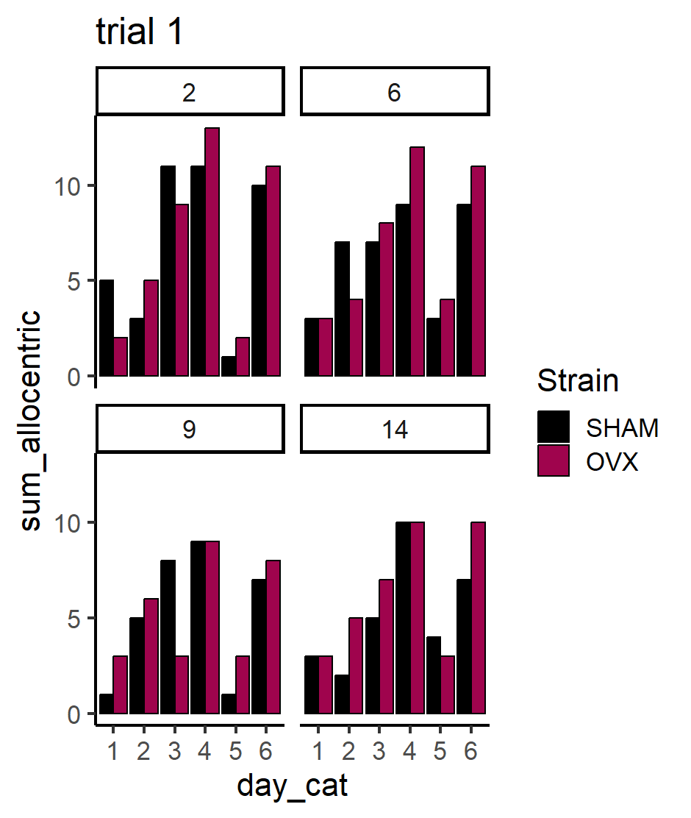

Slide 8
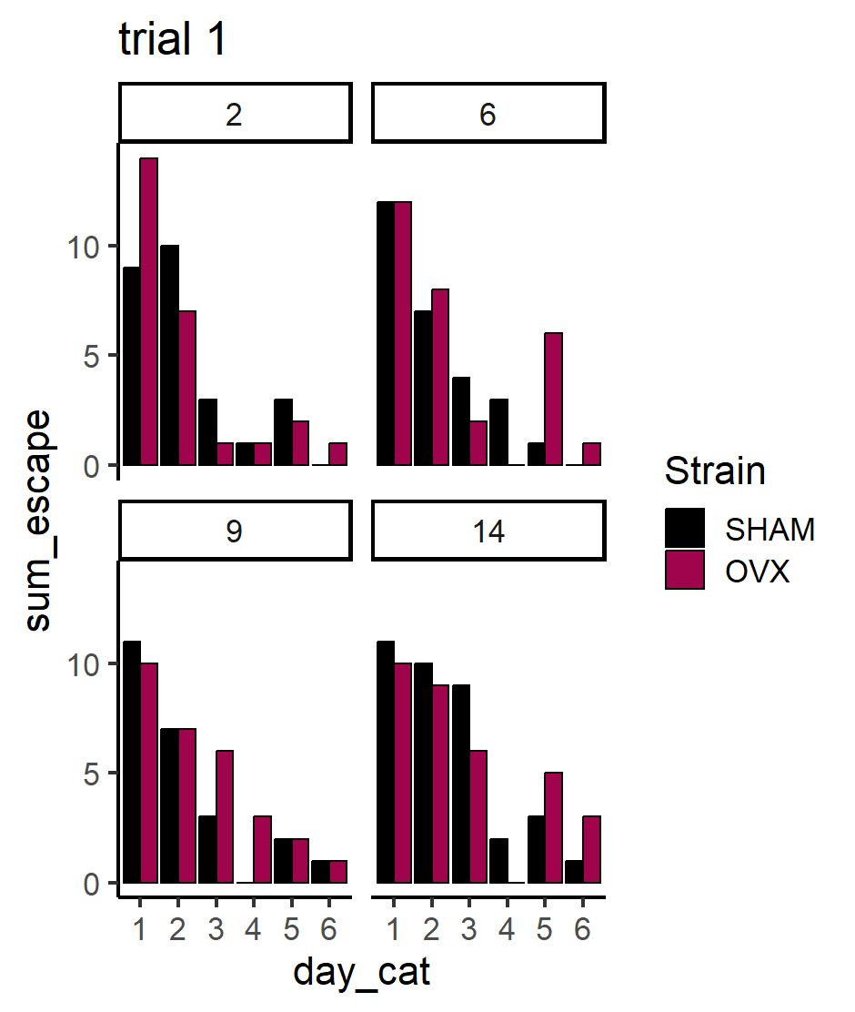

Slide 9
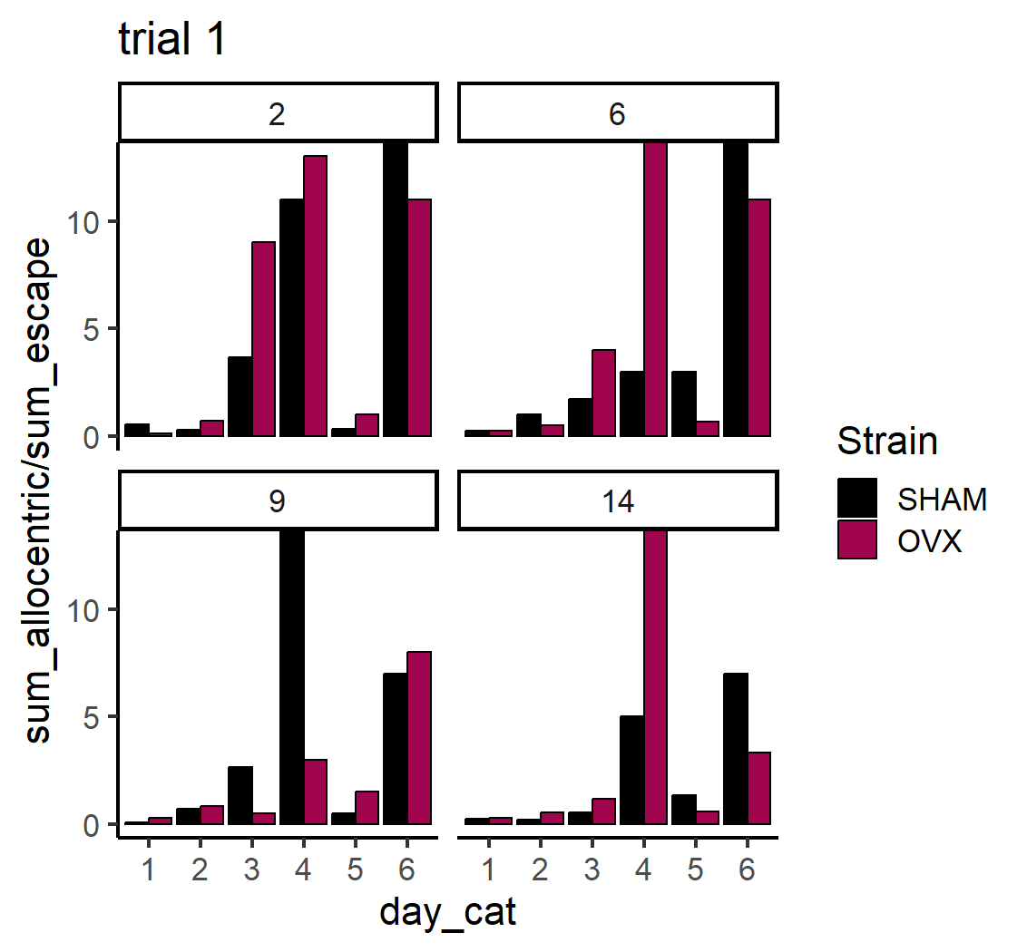

Slide 10
Probe trials on day 4 and 6 are strange: only really scanning or random path. Is there something wrong with how strategy is computed during probe trials?
Thus – there is virtually NO allocentric on any probe trial on days 4,6

Slide 11
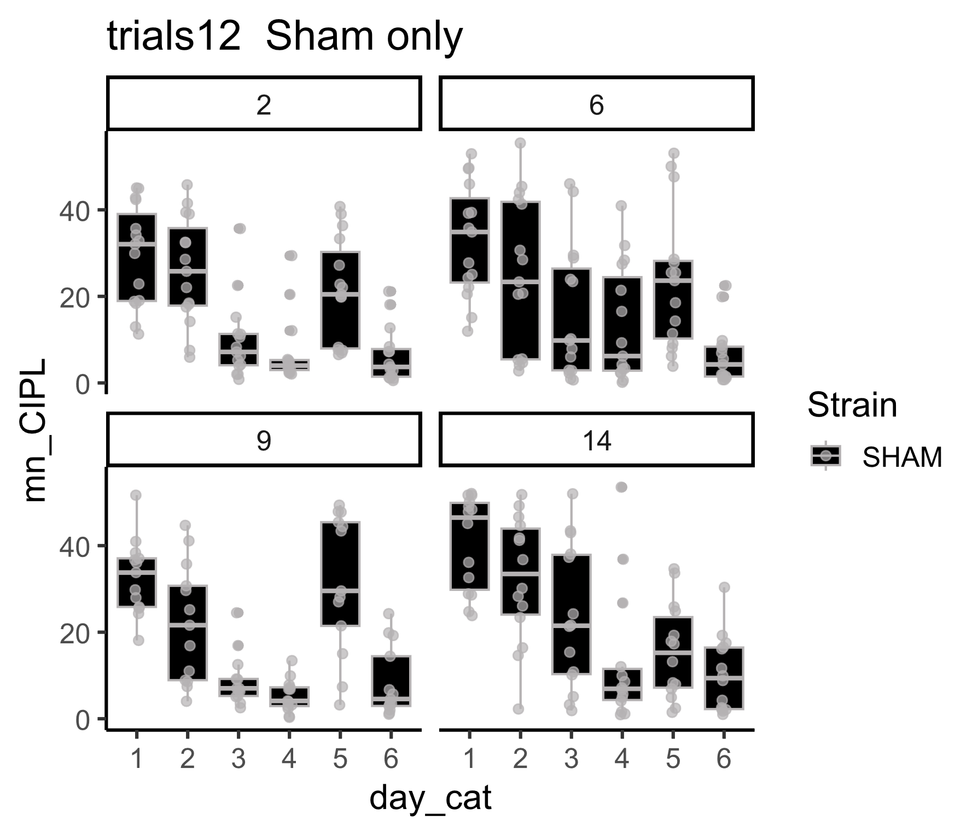

Slide 12
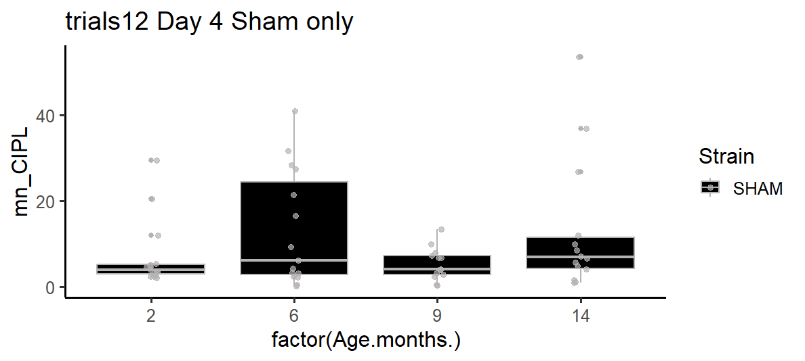

Slide 13
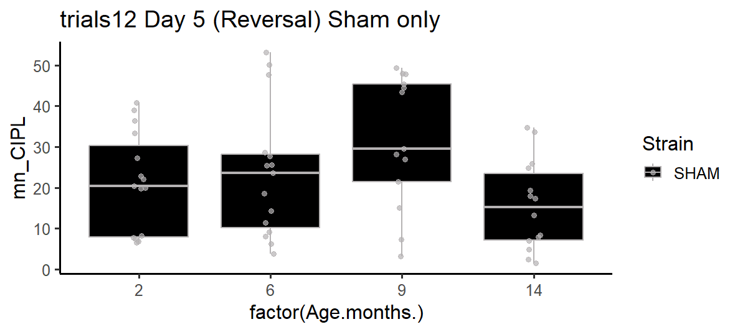
Reversal performance for Sham only.

Slide 14
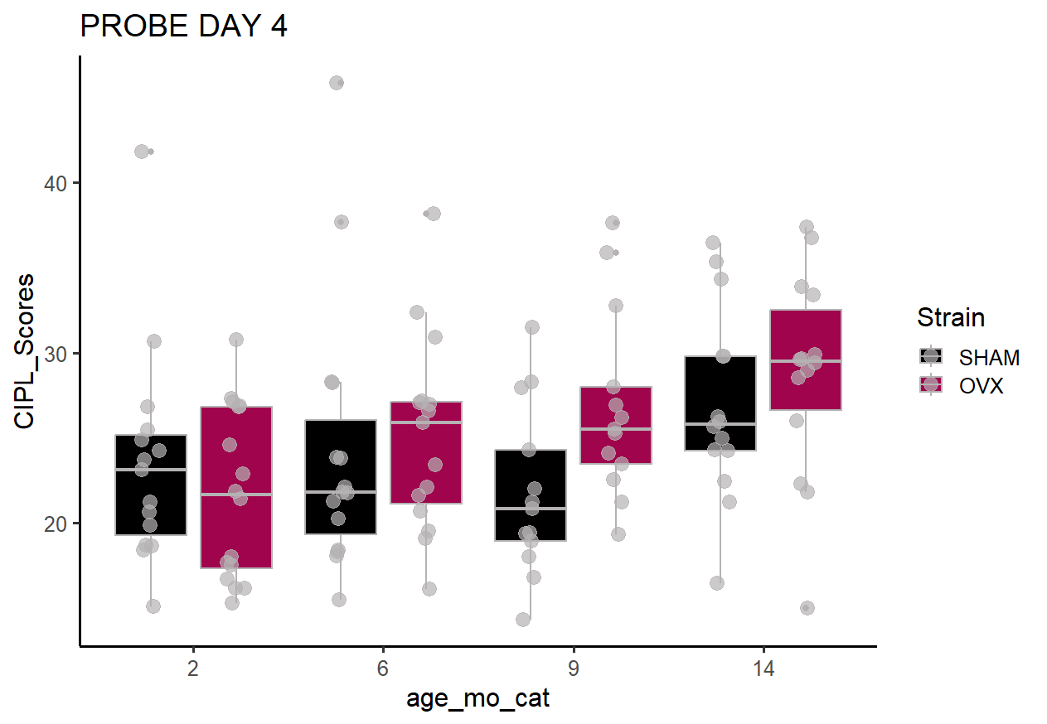

Slide 15
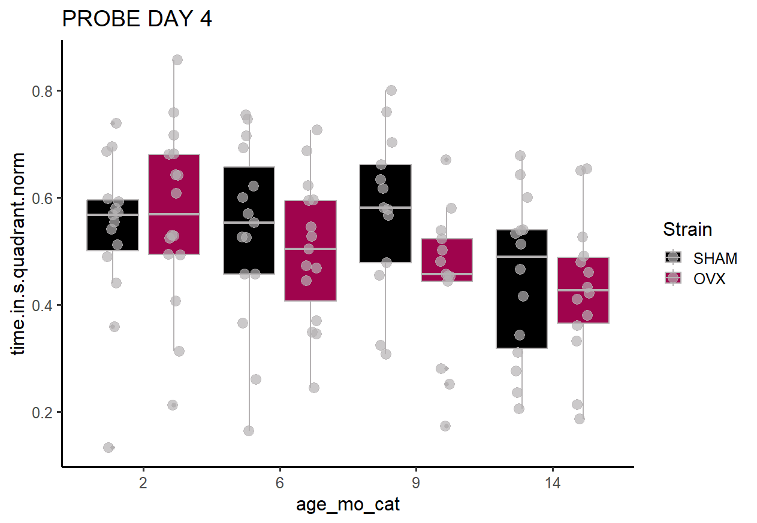

Slide 16
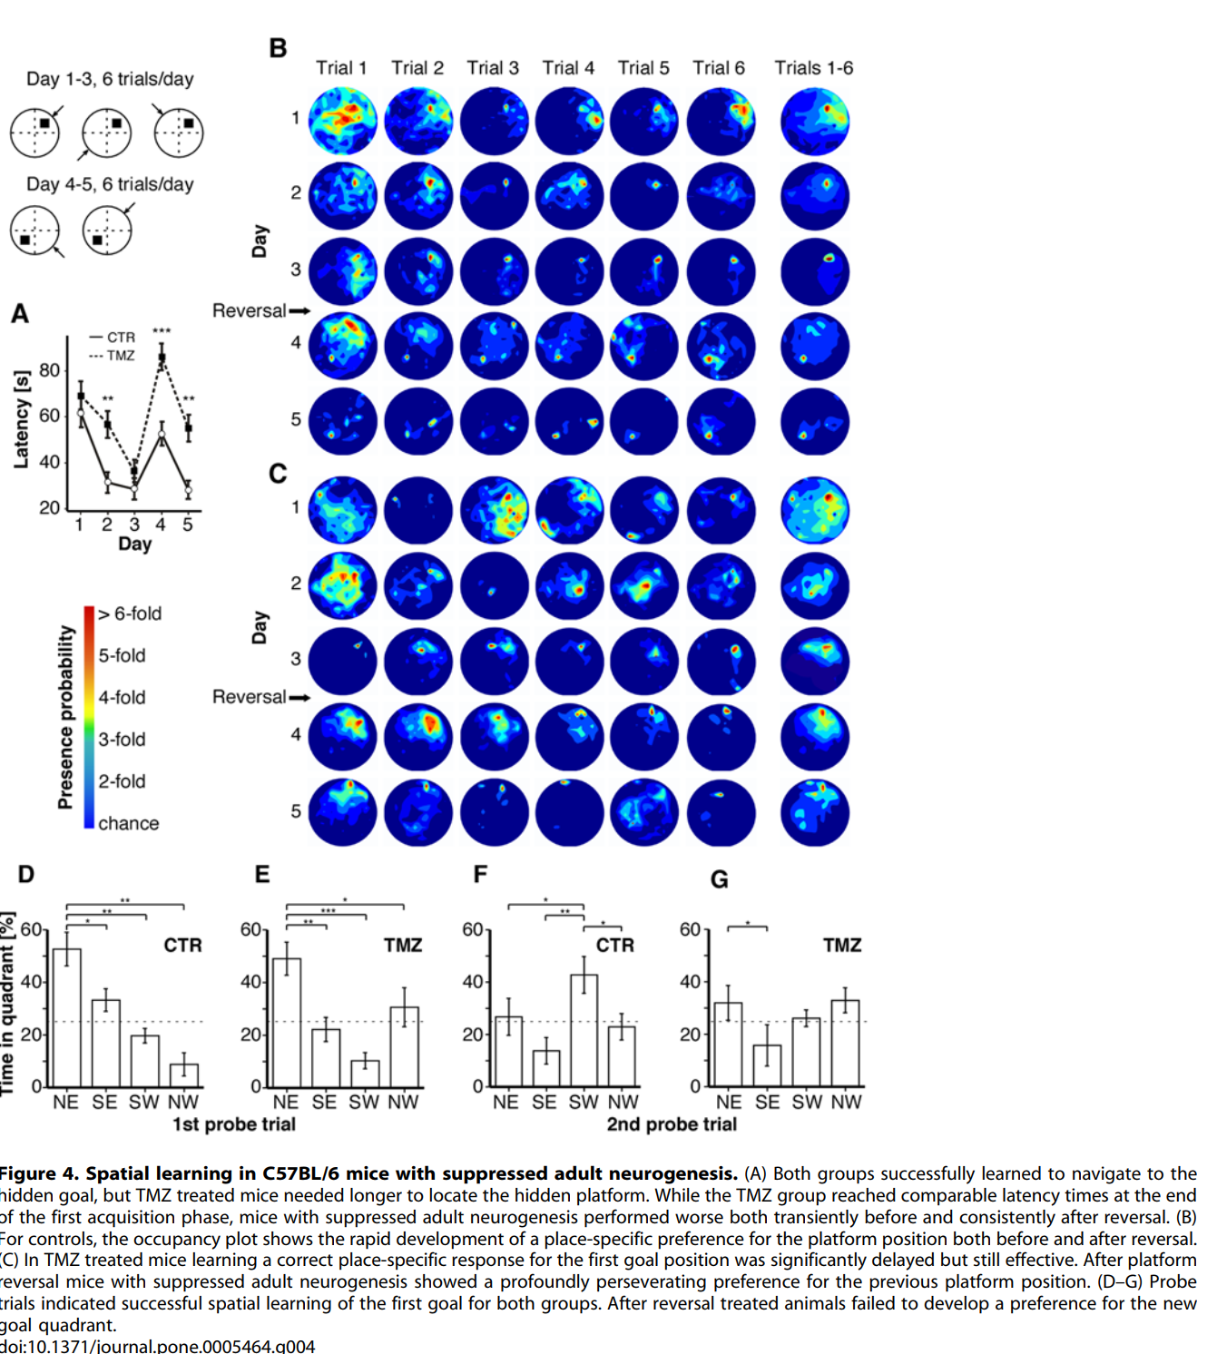
Garthe 2009

Slide 17
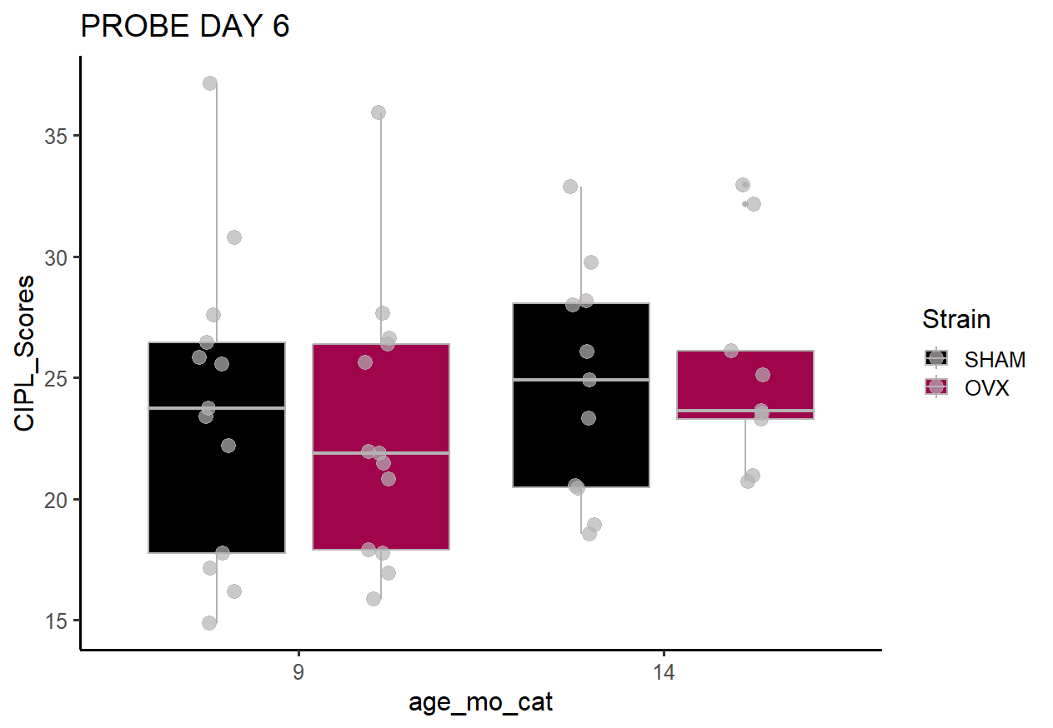

Slide 18
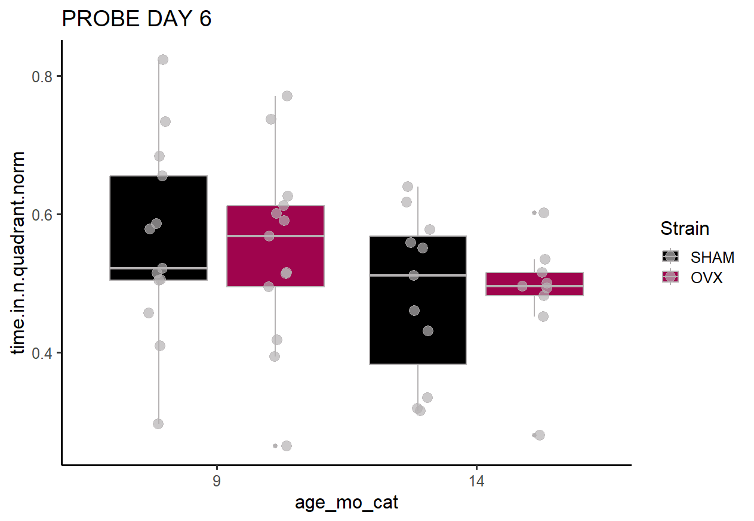

Slide 19
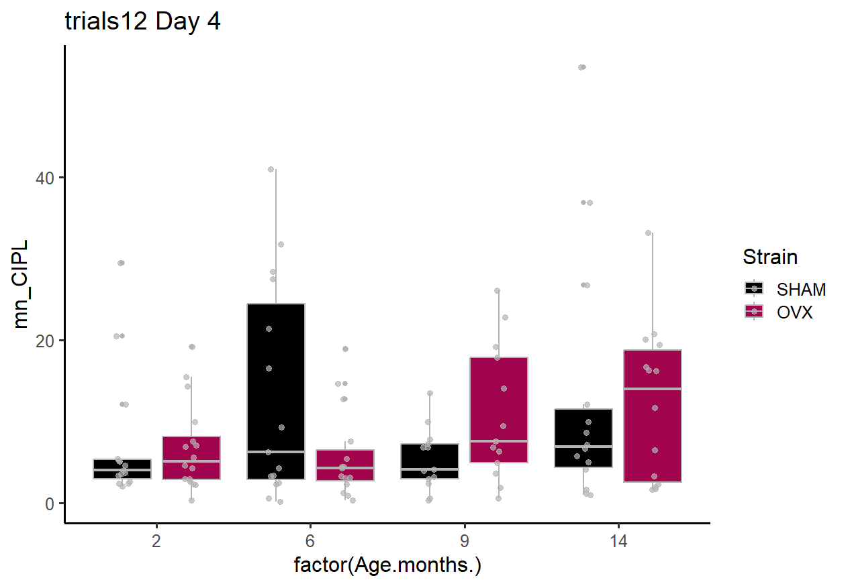

Slide 20
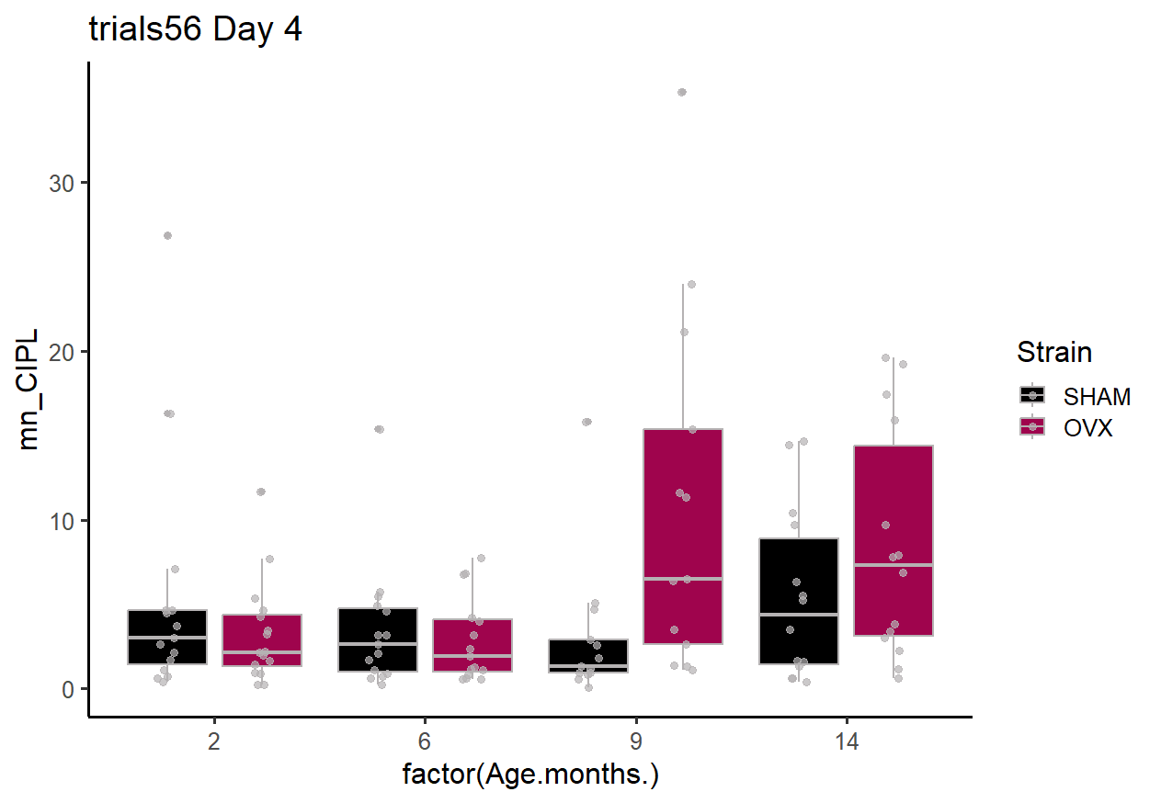

Slide 21
