Slide 1
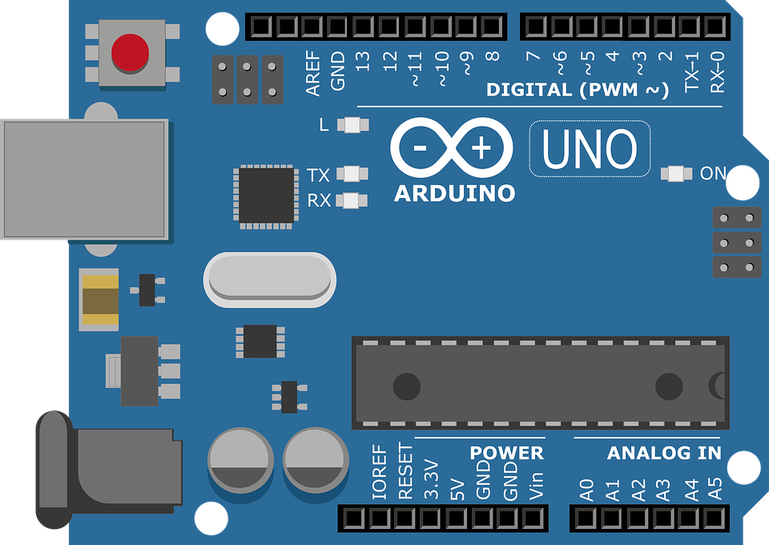
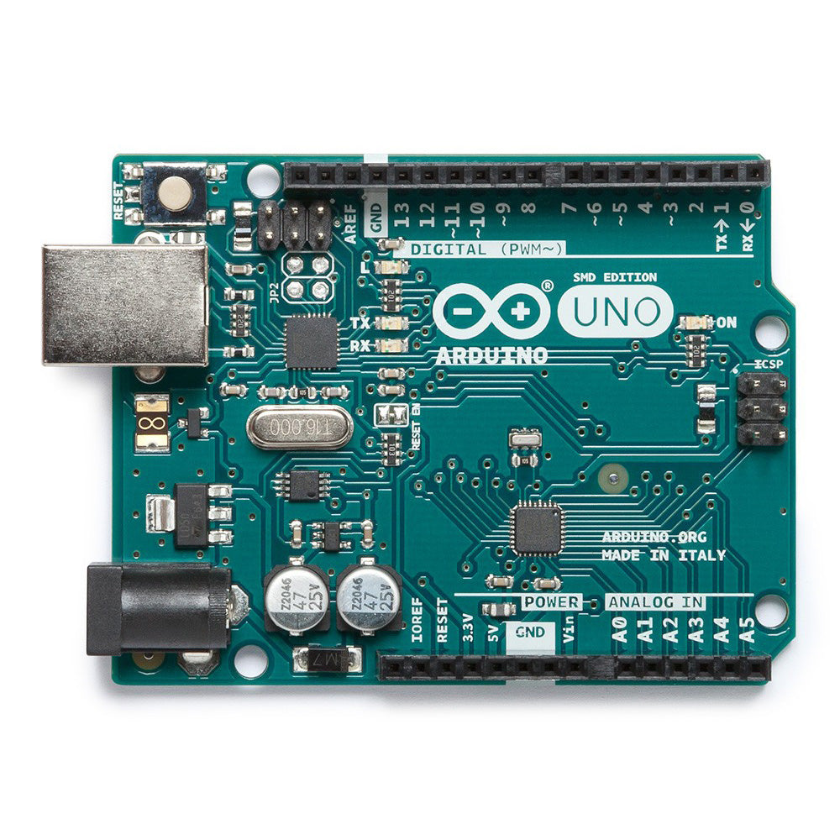
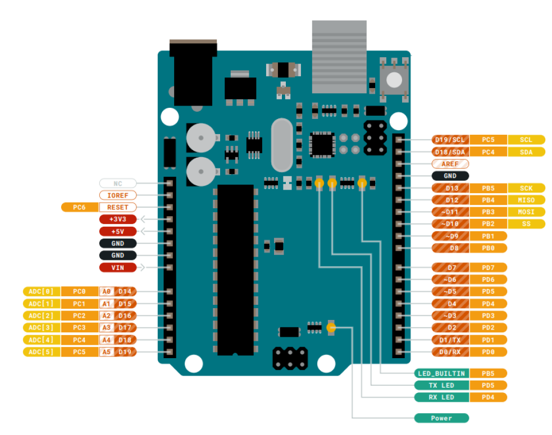
Picture from the Arduino website.
Dual Arduino setup
Experiment Control Microcontroller
Rotary Encoder Microcontroller
To Feeders
7-12V source
USB to PC
7-12V source
Acquisition System
12V Source
Feeder Relay
TO: Control Arduino AND
Acquisition Computer
12) Feeder Button
11) Rot2 B CCW
10) Rot2 B CW
9) Rot1 A CCW
8) Rot1 A CW
TO: Relays
5V
GND
11) Rot2 B CCW
10) Rot2 B CW
9) Rot1 A CCW
8) Rot1 A CW
5V
GND
14) Relay1
15) Relay2
TO/FROM: Rotary Encoders
5) Rot2 B
4) Rot1 B
3) Rot2 A
2) Rot1 A
FROM: Rotary Encoder Arduino
18) Clock
19) Signal
2,3) Sound Shield
FROM: Rotary Encoders
TO: Data Acquisition System

Slide 2
Picture from the Arduino website.
Single Arduino setup
Experiment Control Microcontroller
To Feeders
7-12V source
USB to PC
12V Source
Feeder Relay
TO: Relays
5V
GND
14) Relay1
15) Relay2
5) Rot2 B
4) Rot1 B
3) Rot2 A
2) Rot1 A
18) Clock
19) Signal
FROM: Rotary Encoders
TO: Data Acquisition System

Slide 3
This is from their datasheet so probably legit to use

Slide 4
