Slide 1
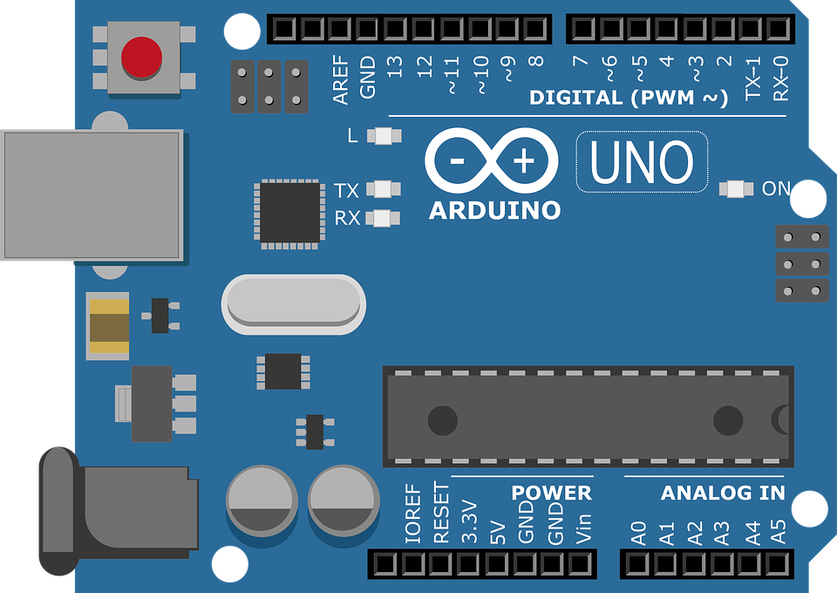
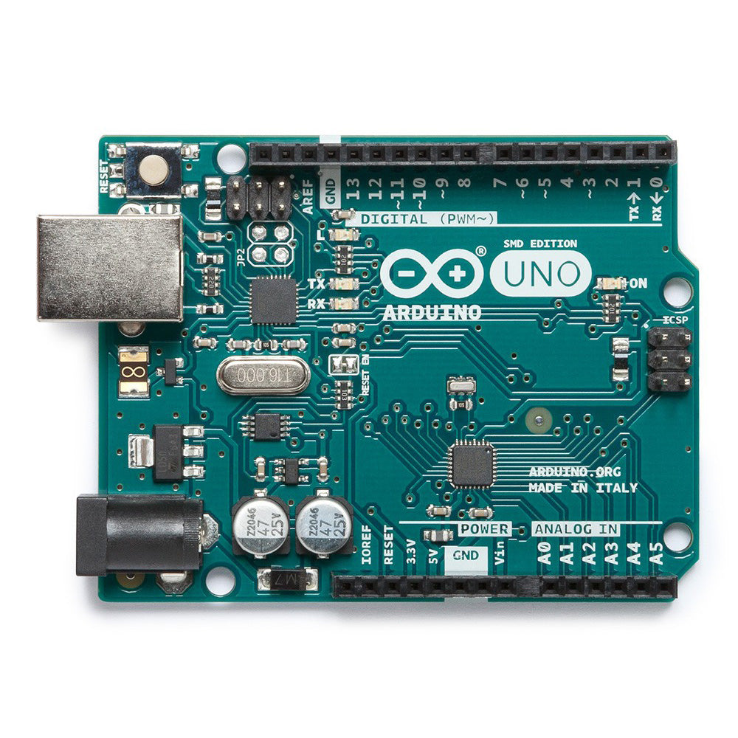
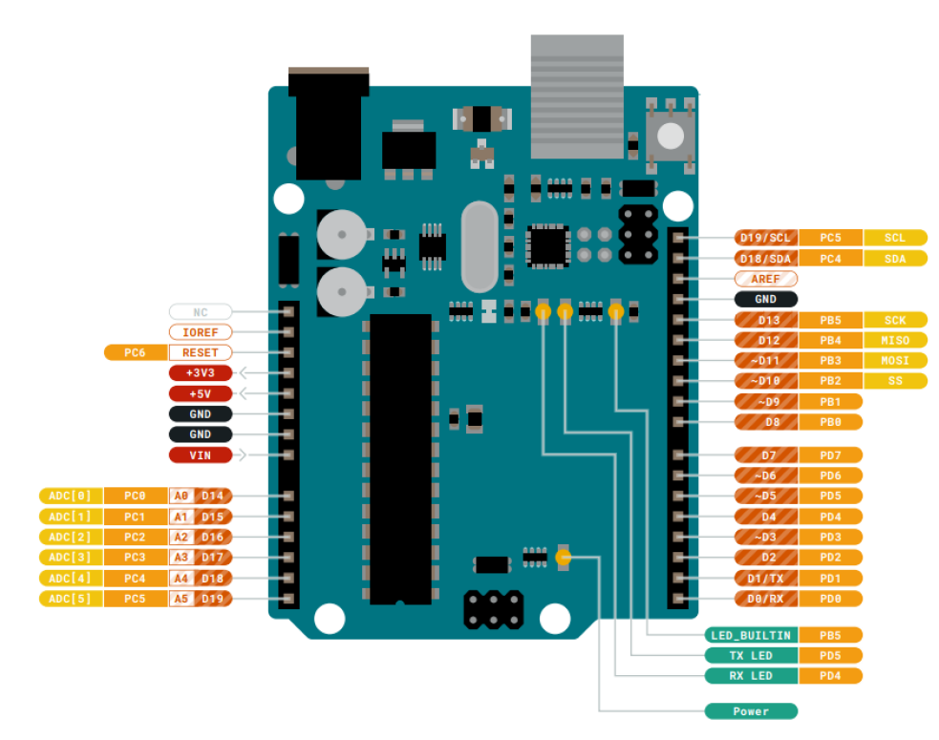
Picture from the Aruino website.
Control Microcontroller
Rotary Encoder Microcontroller
To Feeders
7-12V source
USB to PC
7-12V source
Acquisition System
12V Source
Feeder Relay
TO: Control Arduino AND
Acquisition Computer
FROM: Rotary Encoder Arduino
11) Rot2 B CCW
10) Rot2 B CW
9) Rot1 A CCW
8) Rot1 A CW
11) Rot2 B CCW
10) Rot2 B CW
9) Rot1 A CCW
8) Rot1 A CW
TO: Relays
5V
GND
5V
GND
14) Relay1
15) Relay2
TO/FROM: Rotary Encoders
5) Rot2 B
4) Rot1 B
3) Rot2 A
2) Rot1 A
18) Clock
19) Signal
TO: Sound Shield
FROM: Rotary Encoders
TO: Data Acquisition System

Slide 2
This is from their datasheet so probably legit to use

Slide 3
