Slide 1

Graduate Teaching Assistantship Management System

Slide 2

Team 18
Tubach Niko
Tyukina Iryna
Urquhart Kyle
Verbano Anthony

Slide 3
Graduate Teaching Assistantship Management System (GTAMS)
A website that help Graduate Committee evaluate nominees for Graduate Teaching Assistantship.
GTAMS allows:
the system administrator to set up a new nomination session
the faculty members to nominate Ph.D. students for a GTA for the next school year
the nominee to conveniently access an online application form
the Graduate Committee member to review the performance about a nominee and to score him/her

Slide 4
Technology
Programming language: JAVA, PHP
Front-End: HTML, CSS, JavaScript,
Database: MySQL Server
Web Server: Apache

Slide 5
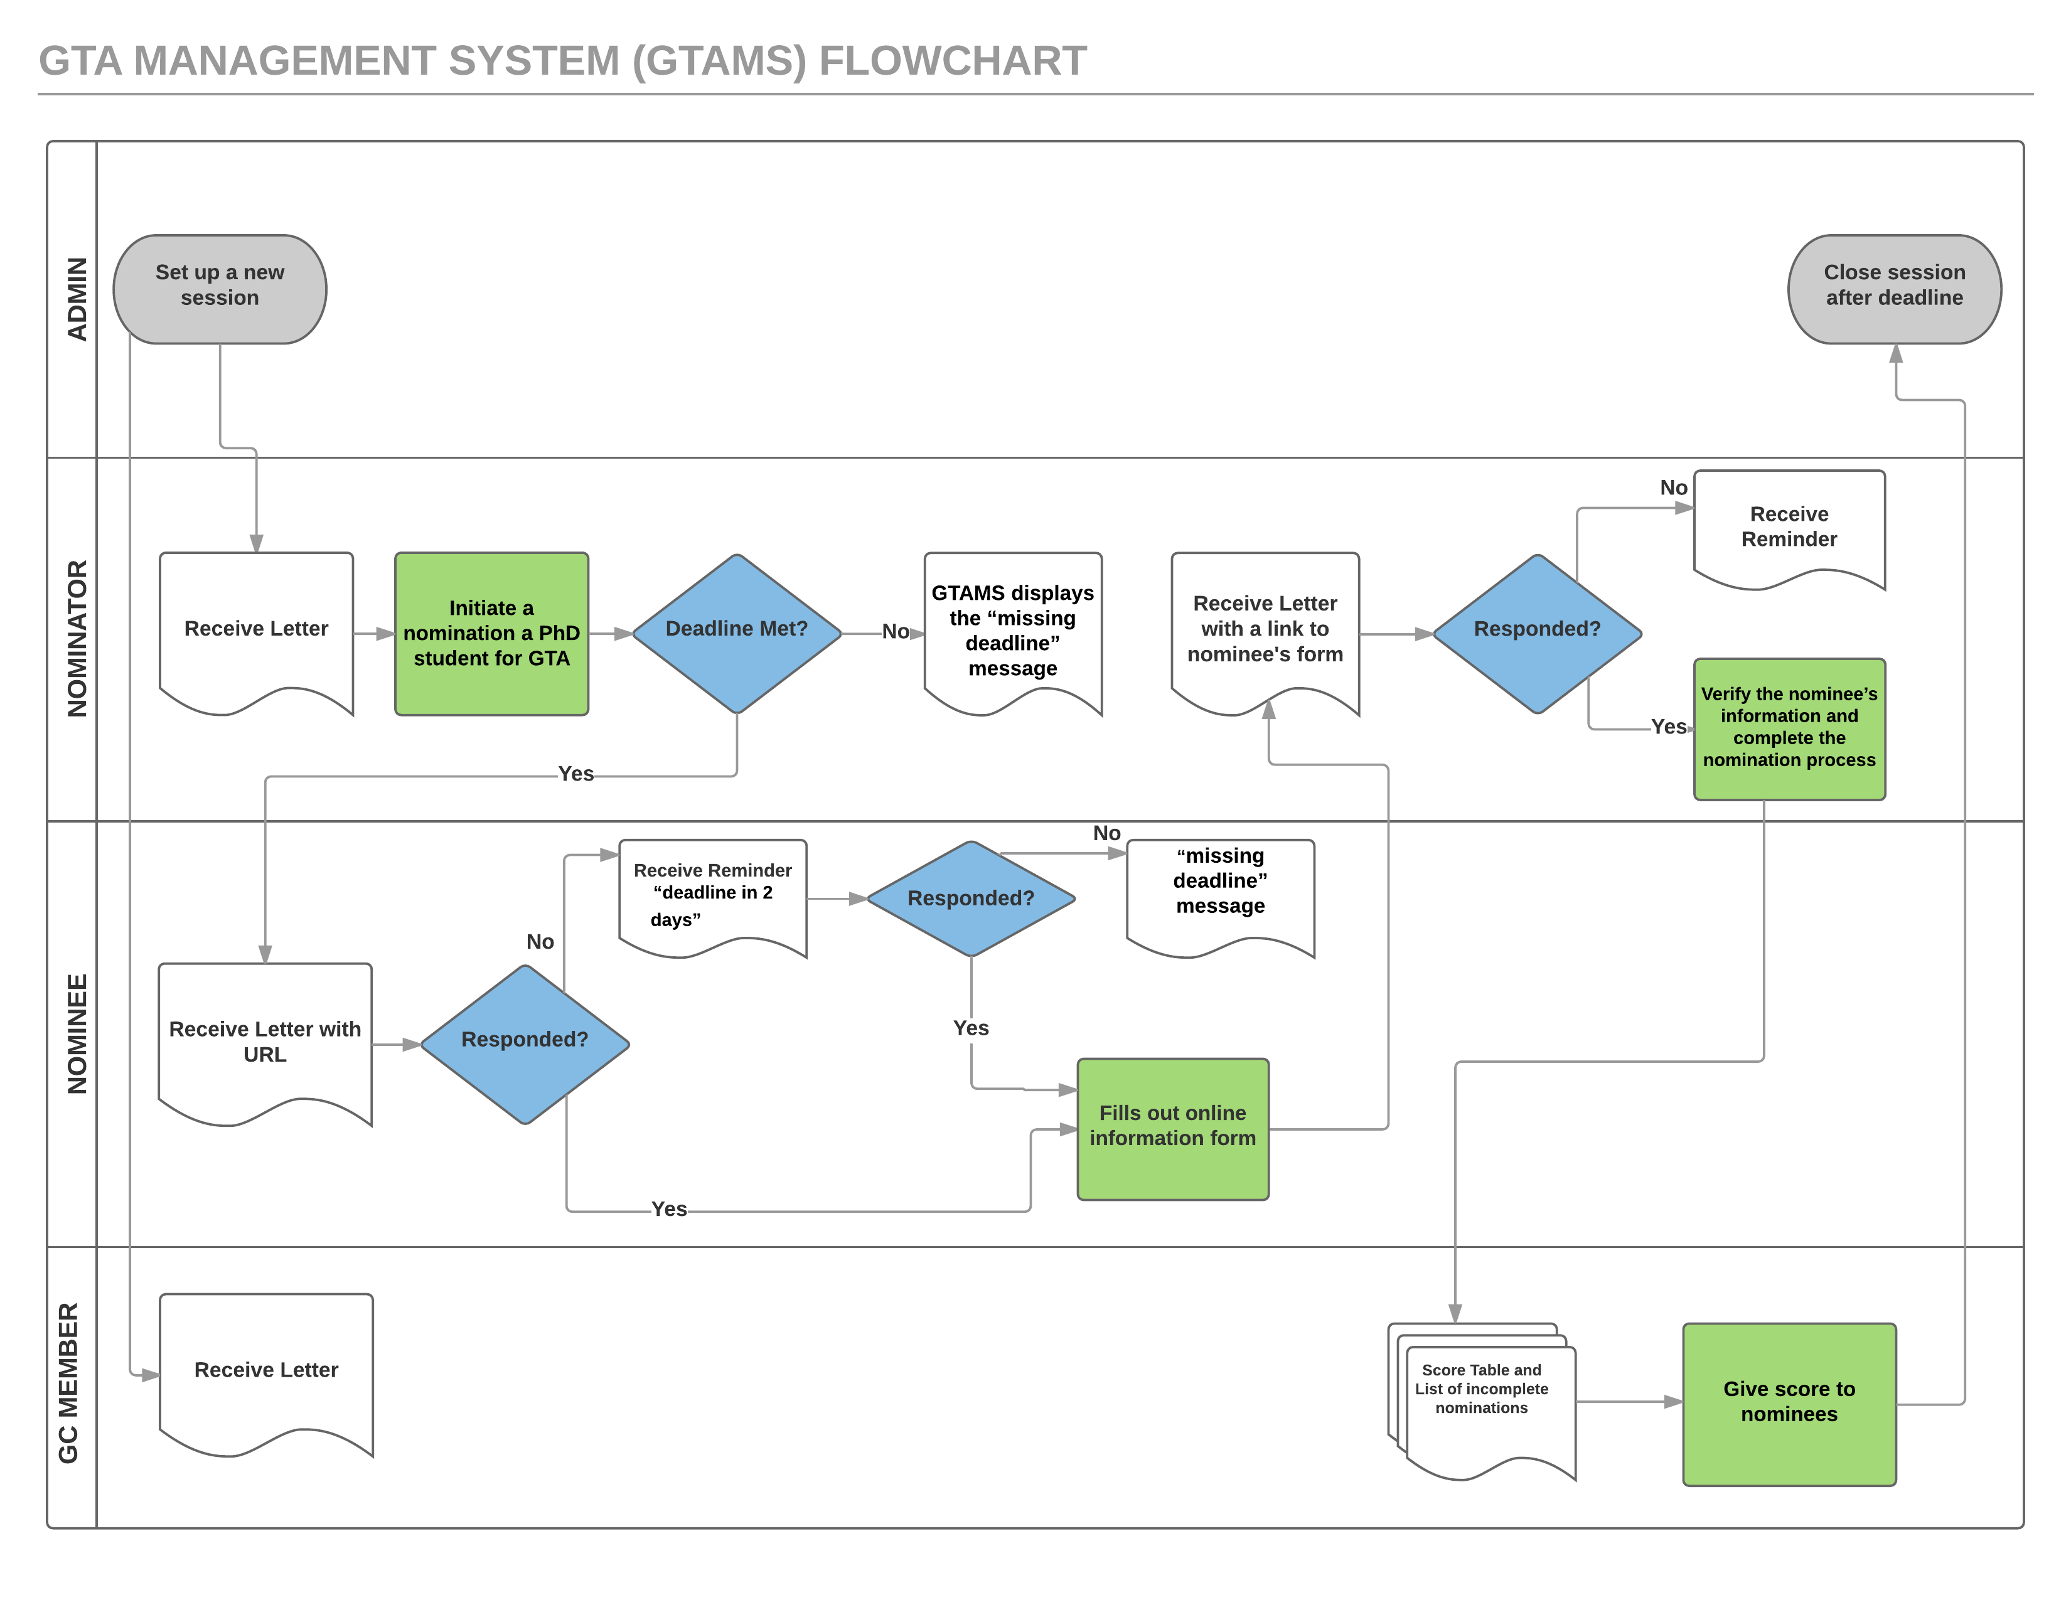

Slide 6
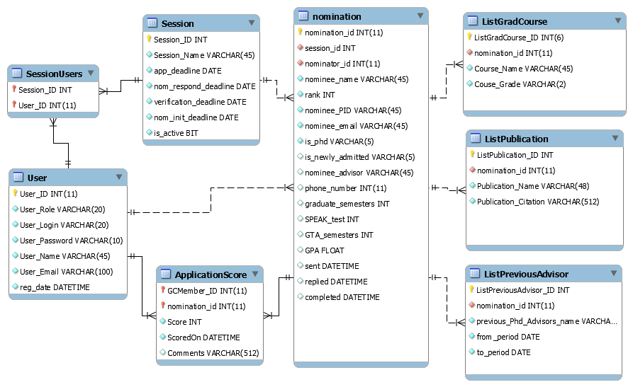
Conceptual Design (ER Diagram)

Slide 7
Logical Design (Relational Database Schema)
Column name | Primary key | Data type | Not NULL | Comment
nomination_id | Yes | int(11) unsigned | Yes
session_id | No | int(11) | Yes | the id for the session the Admin set up
nominator_id | No | int(11) unsigned | Yes | it is User_id with User_Role="Nominator"
nominee_name | No | varchar(45) | Yes
rank | No | int(11) | Yes
nominee_PID | No | varchar(45) | Yes
nominee_email | No | varchar(45) | Yes
is_phd | No | varchar(5) | Yes | Is the nominee currently a Ph.D. student in the Department of Computer Science?
is_newly_admitted | No | varchar(5) | No
nominee_advisor | No | varchar(45) | No
phone_number | No | int(11) | No
graduate_semesters | No | int(11) | No
SPEAK_test | No | int(11) | No | 1, 2, 3 = yes, no, graduated from US school
GTA_semesters | No | int(11) | No
GPA | No | float | No
sent | No | datetime | No | when the nomination was sent to the user
replied | No | datetime | No | when the nomination was replied to by the nominee
completed | No | datetime | No | when the nominee form was confirmed by the nominator

Slide 8
Physical database Design
#create table for the session database
CREATE TABLE IF NOT EXISTS `gtass`.`Session` (
`Session_ID` INT NOT NULL AUTO_INCREMENT,
`Session_Name` VARCHAR(45) NOT NULL,
`app_deadline` DATE NOT NULL,
`nom_respond_deadline` DATE NOT NULL,
`verification_deadline` DATE NOT NULL,
`nom_init_deadline` DATE NOT NULL,
`is_active` BIT NOT NULL,
PRIMARY KEY (`Session_ID`),
UNIQUE INDEX `GTASession_Name_UNIQUE` (`Session_Name` ASC))
ENGINE = InnoDB
;

