Slide 1

High Performance Graph Analytics on Manycore Processors
G. M. Slota • S. Rajamanickam • K. Madduri
2015 IEEE 29th International Parallel and Distributed Processing Symposium
COMP 4510, Cox

Slide 2
Overview
Problem
Motivation
Solution
Results
Conclusion
COMP 4510, Cox

Slide 3
Problem: Dilemma of Quality
1. Quality software: portable and architecturally sensitive
2. These are mutually exclusive
3. No such thing as quality software
COMP 4510, Cox

Slide 4
Problem: Dilemma of Quality
1. Quality software: portable and architecturally sensitive
2. These are mutually exclusive
3. No such thing as quality software ?
COMP 4510, Cox

Slide 5
Motivation: Reconcile Dilemma
No quality software: Counterintuitive
Authors: Refute (2)
COMP 4510, Cox

Slide 6
Solution: Patterns
Software and Hardware
COMP 4510, Cox

Slide 7
Use Patterns to show SW/HW compatible
Solution Domain: Graphs
Variable nature
Irregular structure
Large Problem Size
Many Applications
COMP 4510, Cox

Slide 8
SW Patterns: Portability
General Template for Graph Algorithms
Breadth-First Search
Color/Label Propagation
Strongly Connected Components
COMP 4510, Cox

Slide 9
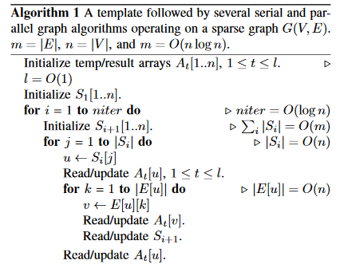
COMP 4510, Cox

Slide 10
HW Patterns: Capitalize on architecture
Domain: SIMD
Middleware: Kokkos
Thread Teams
Parallelization Hierarchy
Loop Collapse
COMP 4510, Cox

Slide 11
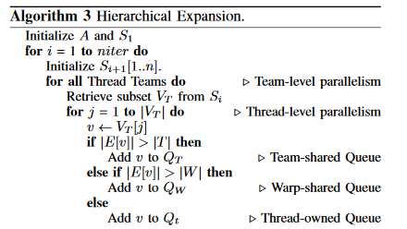
COMP 4510, Cox

Slide 12
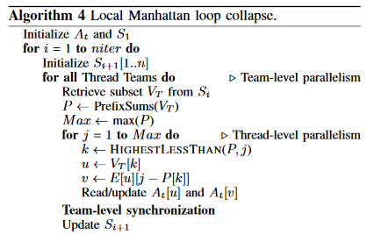
COMP 4510, Cox

Slide 13
Results
Show code is portable and utilizes architecture
Tested on multiple systems
→ Intel Sandy Bridge, Xeon Phi
→ NVIDIA Tesla
→ AMD Interlagos
COMP 4510, Cox

Slide 14
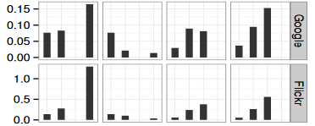
Cross Platform/Cross Domain Performance
Strongly Connected Components
Bottom up: GTEPS
Left to Right Metrics: Baseline, Manhattan-Global, Manhattan-Local, OpenMP
Left to Right Tables: Sandy Bridge, Xeon Phi, Tesla K20X, Tesla K40M
COMP 4510, Cox

Slide 15
Conclusion
Portable, Architecture-sensitive code achieved
Kokkos middleware: plug-and-play
Next step: More comparative metrics
COMP 4510, Cox

