Slide 1

Treewidth
Fundamentals • Significance • Practicality
COMP 4060, Cox

Slide 2
Outline
• Background
• Motivation
• Problem
• Solutions
• Results
• Future
COMP 4060, Cox

Slide 3
Background: Graph Genus
• Given G and ∑, does G embed on ∑?
• Fixed Parameter Tractable
• Dependent problem: Graph Minor Containment
COMP 4060, Cox

Slide 4
Deepdive: Minor Containment
• Given G and H, does G have a minor H?
• Also FPT
• Graph Minor Theory:
All minor-closed properties are polynomial time membership testable
• High-power result: Applies to Graph Genus and more
COMP 4060, Cox

Slide 5
Motivation: Graph Minor Algorithm
Dependent problem: Treewidth
If Treewidth is bounded, Minor Containment is O(n)
Many problems are in P for bounded TW*
COMP 4060, Cox

Slide 6
Problem Statement
Treewidth: How treelike is G?
Minimum width across all tree decompositions
Trees have Treewidth 1
K_{n} has Treewidth N-1
Grid_{n} has Treewidth N
COMP 4060, Cox

Slide 7
Problem Statement
Tree Decomposition: G = (V,E) → D = (X,T)
X_{1…n}: subsets of V. U_{Xi} = V. “Bags”
T is a tree connecting all X_{i}:
- If two vertices are edge-connected, they share a node
- If two nodes share a vertex, they are path-connected
Decomposition width: size of largest bag – 1
Graphs have many decompositions
COMP 4060, Cox

Slide 8
Solutions
Bounded Treewidth is generally NP-C
Fixed Parameter Tractable (new trend…)
H. Bodlaender 1992:
Reduce G until exponential algorithm feasible
“Linear Time”
COMP 4060, Cox

Slide 9
Bodlaender 1992
Until G is small enough for brute-force:
High number of low degree vertices:
Contract all edges in maximal matching
Low number of low degree vertices:
Add edge between low-degree vertices and remove simplicals
COMP 4060, Cox

Slide 10
Bodlaender 1992
Recurse until G is sufficiently small
Case 1 gives decomposition D’ = (X’, T’) of width ≤ 2k+1
Can transform to D = (X,T) of width ≤ k in O(n)
Case 2 gives decomposition of width ≤ k
COMP 4060, Cox

Slide 11
Bodlaender 1992: Analysis
Implementation is extremely involved
Data structure requirements
No implementation given for case 1 reduction
COMP 4060, Cox

Slide 12
Bodlaender 1992: Analysis
Recursion as deep as n⁸
Doubly exponential constant: k^{k3}
Not practical for general use
COMP 4060, Cox

Slide 13
What about the base case?
Sufficiently Small graph: Dynamic Programming
Bodlaender 2012. 20 years of no base-case.
2^{n}. Similar to Held-Karp (TSP)
COMP 4060, Cox

Slide 14
Bodlaender 2012
Recall: TW is minimum width of all possible decompositions
Decomposition width: max size bag -1
Minimax problem
Let S ⊆ V. Then TW(G) = max{TW(S), n-|S|-1}
Let C be a max clique in G. Then TW(G) = max{TW(V-C), |C|-1}
COMP 4060, Cox

Slide 15
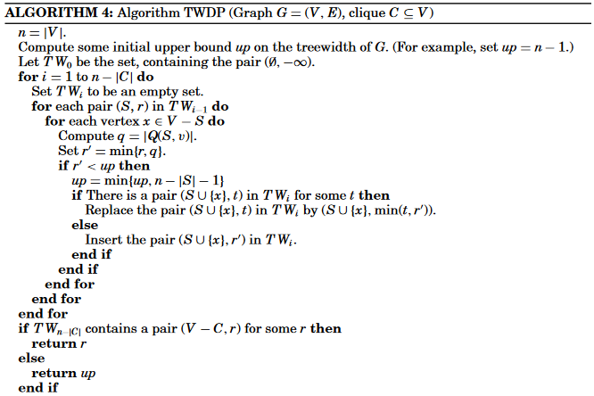
Bodlaender 2012
Bodlaender, H. L., Fomin, F. V., Koster, A. M., Kratsch, D., & Thilikos, D. M. (2012). On exact algorithms for treewidth. ACM Transactions on Algorithms (TALG), 9(1), 12.
COMP 4060, Cox

Slide 16
Results
Bodlaender 1992: Implementation unsuccessful
Comparison of Bodlaender 2012 against Sage
COMP 4060, Cox

Slide 17
Results
Small graphs: Benchmark mostly met
Graph | K4 | K5 | K6 | K33 | K45 | W6 | W7 | P3 | P5 | Tree | Cube3 | Cube4 | Petersen
Time: Sage | 0 | 0 | 0 | 0 | 0 | 0 | 0 | 0 | 0 | 0 | 0 | 6 | 0
Time: DP | 0 | 0 | 0 | 0 | 0 | 0 | 0 | 0 | 0 | 3 | 0 | 6 | 0
Treewidth | 3 | 4 | 5 | 3 | 4 | 3 | 3 | 1 | 1 | 1 | 3 | 6 | 4
COMP 4060, Cox

Slide 18
Results
Larger graphs: Intractable
Grid₅, Dodecahedron, Thomassen-34
Graph | Grid₅ | Dodecahedron | Thomassen
Time: Sage | 13 | 14 | 4
Treewidth | 5 | 6 | 4
COMP 4060, Cox

Slide 19
Results
Dodecahedron total time: 5 hours, 58 minutes, 29 seconds
COMP 4060, Cox

Slide 20
Results
Dynamic Programming did not meet benchmarks
O(n) search to grow decomposition could be optimized
Sage: Better approaches worth investigation
COMP 4060, Cox

Slide 21
Results
Treewidth said to be FPT
Is FPT in P?
Many problems depend on treewidth. Limited to theory?
COMP 4060, Cox

Slide 22
Treewidth: Significance
Some NP-Hard problems are in P when TW(G) is bounded
Max clique
Hamilton Cycle
COMP 4060, Cox

Slide 23
Treewidth and Automata
Courcelle’s theorem
Every graph property describable by EMSO logic is linear time decidable for graphs of bounded treewidth
EMSO: Extended monadic second order logic
Quantify over sets and subsets
Describe graph properties exclusively with quantifiers
Proof relies on tree automata
COMP 4060, Cox

Slide 24
Treewidth: Practicality
Some algorithms and heuristics for limited graphs
NP-Complete or dependent on large constant
No general decomposition algorithm
COMP 4060, Cox

Slide 25
Significance vs. Practicality
Treewidth is a very powerful tool
Key result of modern graph theory
Algorithmically underexplored
Does FPT count as P?
COMP 4060, Cox

Slide 26
Future
More effort required to realize theoretical benefits
Heuristics and Optimizations
FPT/Parameterized Complexity:
More accurate complexity classes or shifting goalposts?
COMP 4060, Cox

Slide 27
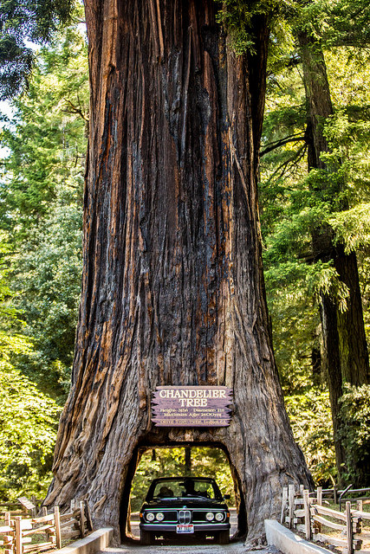
Fin
Credit: T. Hawk, Flickr
COMP 4060, Cox

