Slide 1
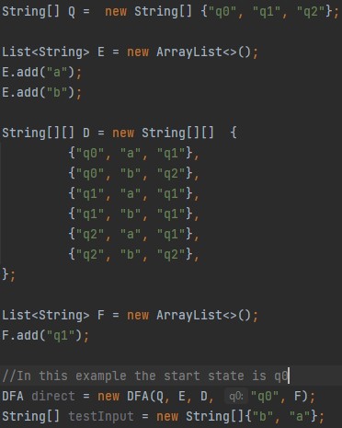
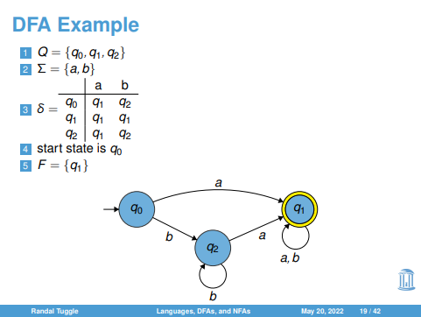
Provide the states (q0, q1, q2, etc.):
Transition table length = # of characters in alphabet
Transition table height = # of characters in alphabet * # of states
At most, each state will have one arrow for each character in alphabet
If NFA, there may be less
Phase 1: Should take input for each part of 5-tuple when specified exactly like in main.java
Phase 2: Should take input as seen on the left, in a more
user-friendly format, which is then converted to a way that
can be read by the implementation
DFA.readInput → returns last state
DFA.isInputAccepted → checks if input string is accepted
Provide the alphabet (a, b, c, etc.):
Fill in the transition table:
- - - Alphabet - - -
|
|
States
|
|
Define the start state (e.g., q0):
Define the accept states: (e.g., q1):
Input (string):
Main.java
Output
Sample
String is accepted by state q
- Or -
String is rejected

