Slide 1


The assignment, and what it left open
Four things the brief did not specify. Each was decided in code, and the decision is visible in the repository.
01
Left open | Decision taken | Where it lives
Where a booking that cannot be matched goes | A dedicated booking.flagged topic, not a status field | test-local.properties:31-33
How close a match must be | Confidence floor 0.85 plus an edit-distance cap | CityMatcher.java:21-26
What happens when two cities tie | Rejected as ambiguous, never tie-broken | AMBIGUOUS_*_CITY flag reasons
Real broker or in-memory fake | A real Kafka broker, and a real process boundary | KafkaServiceHarness, ServiceController
Notes:
Open with the reading, not the code. Each row is a decision a reviewer could have made differently; all four are visible in the repository rather than described in a document. [F-06] [F-10] [F-04] [F-05]

Slide 2
What was given, what was built
No system under test was supplied, so one was written. The suite is a separate project with no build-time knowledge of it.
02
Artefact | What it is | Measured
city-enrichment | The service under test, its own Maven project and git repository | separate repo
booking-enrichment-test-suite | The black-box suite, its own Maven project | separate repo
Dependency between them | None. The only mention in the build file asserts the deliberate absence | 0 dependencies
Test code reaching inside | No test imports a service internal package | 0 imports
How they meet | java -jar in a separate OS process, and a Kafka broker | ProcessBuilder
Notes:
The point: the boundary is enforced by the build, not by convention. If someone added a dependency on the service to make a test easier, the project would stop being a black-box suite and the build would show it. [F-01] [F-02] [F-03] [F-04]

Slide 3
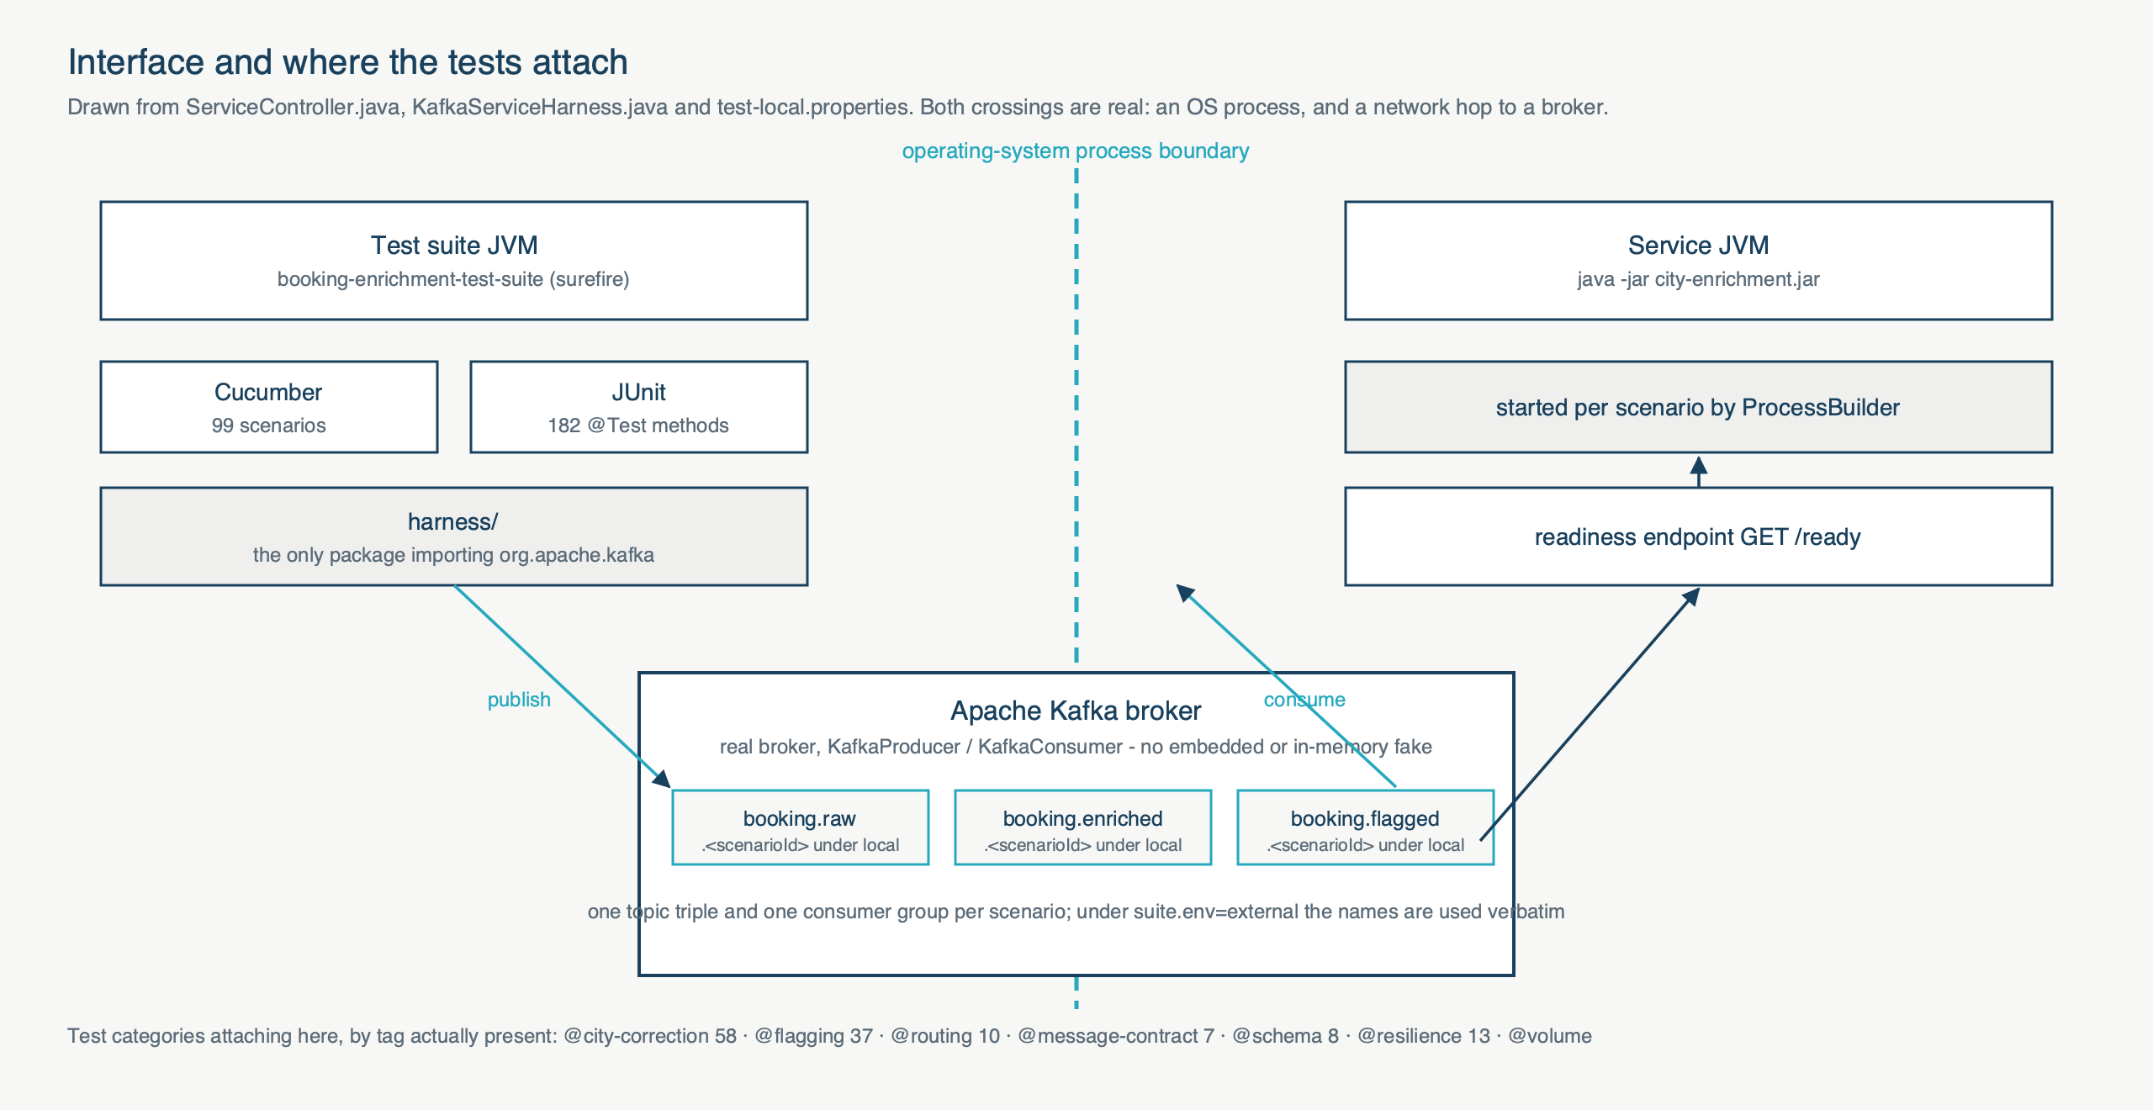
Interface, and where the tests attach
Both crossings are real: an operating-system process, and a network hop to a broker.
03
Notes:
Walk the diagram left to right. The dashed line is a real process boundary. The three topic names are read from test-local.properties. Under the local profile each scenario gets its own topic triple and consumer group; under external the configured names are used verbatim. [F-04] [F-05] [F-06] [F-07] [F-08]

Slide 4
Scope, and what is deliberately out
The exclusions are decisions with reasons, not omissions.
04
In scope
• City correction on both origin and destination
• Routing, proven in both directions
• Message contract: key, headers, timestamp, ordering
• Schema conformance against three JSON schemas
• Resilience: malformed input, duplicates, consumer restart
• Correctness at scale across 1,000 bookings
Out of scope, and why
• Throughput and latency - needs a dedicated environment
• Broker failure injection - needs Toxiproxy
• Schema evolution - needs a schema registry
• Contract testing against TMS - no contract supplied
• Code coverage - not producible from a black-box suite
Notes:
Say plainly that no throughput figure is asserted anywhere in the suite; the volume tier is correctness at scale. Code coverage belongs to the development team's unit tests. [GAPS 2.2] [GAPS 2.3]

Slide 5
Coverage, in real numbers
99 scenarios are declared and expand to 101 executions. Counts are parsed from cucumber.json, not read from build text.
05
Feature file | Scenarios
city_correction (generated) | 50
booking_enrichment | 12
schema_contract | 8
resilience | 7
message_contract | 6
edge_cases | 6
routing_and_flagging | 5
volume | 5
The data table drives 50 of them
src/test/resources/testdata/city-cases.csv - 50 rows, 9 columns.
TC-01,origin,Mumbai,Mumbai,ENRICHED,,exact
TC-11,origin,Pne,Pune,ENRICHED,,fuzzy
TC-13,origin,Pn,,FLAGGED,UNMATCHED,
TC-19,origin,<ABSENT>,,FLAGGED,MISSING,
Every case is stated once for origin and once for destination, so no rule is proven on one field only.
Notes:
Quote a row. The columns are caseId, field, input, expected, outcome, reason, confidence, tags, note. A business analyst adds a city variant by adding a row. [F-13] [F-14] [F-15] [F-16]

Slide 6
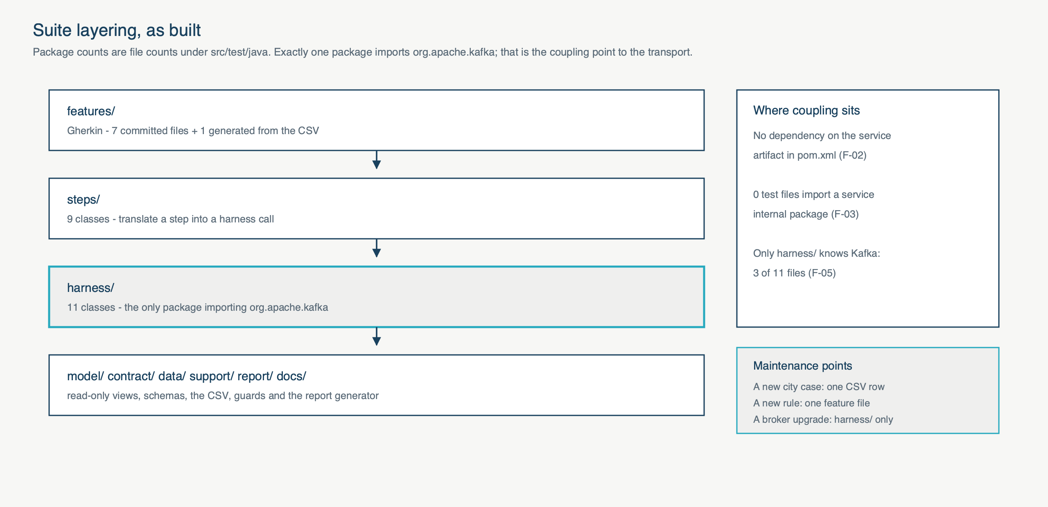
How it is built
One package touches the transport. That is the whole coupling surface to Kafka.
06
Notes:
The maintenance argument: a new city case is one CSV row; a new rule is one feature file; a Kafka client upgrade touches harness/ and nothing else. 3 of 11 files in harness/ import org.apache.kafka; no other package does. [F-05] [F-02] [F-03]

Slide 7
Execution and reporting
Measured on this machine: mvn clean test -Pkafka, exit 0, 4 minutes 9 seconds.
07
Command | Scenarios
./run-tests.sh smoke | 7
./run-tests.sh contract | 8
./run-tests.sh functional | 38
./run-tests.sh full | 95
mvn clean test -Pkafka | 101
What a run produces
• 282 tests, 0 failures, 0 errors
• cucumber.json, cucumber.xml, index.html
• report-data.json - every figure traces here
• scenario-coverage.md
• test-execution-summary-report.html
A run that selects no scenario fails the build, so a green build cannot mean nothing ran.
Notes:
The last line is the important one. A tag filter matching nothing used to report success; it now exits 1. [F-18] [F-19] [F-24] [F-32]

Slide 8
AI-assisted workflow
Only what was actually done in this repository.
08
Stage | What AI did | What kept it honest
Scenario derivation | Drafted scenarios and edge cases from the written spec | Every generated expectation verified by the mutation check
Test data | Generated misspelling variants for the CSV | Boundary rows measured against the running service, not assumed
Gap analysis | Enumerated what the contract allows and the suite never asserted | Build guards now fail if a gap reopens
Review | A second pass over assertions for ones that could not fail | Three were found and rewritten; a stub proves they now fail
Notes:
Be candid: the mutation check found a real bug in work produced this way - an assertion that located a message by the key it then asserted. The guardrail is that nothing generated is trusted until it has been shown to fail. [F-26] [GAPS 1]

Slide 9
Proving the suite can fail
A green suite proves nothing on its own. A contract stub replays fixtures in place of the service.
09
15 fixtures, each breaking exactly one rule. Last run: baseline green over 99 cases, and all 15 turned exactly their expected scenarios red - no more, no fewer.
Fixture | What it breaks | Turns red
mut-floor-lowered | Accepts an input below the confidence floor | TC-77, TC-177
mut-no-collapse | Leaves internal whitespace uncollapsed | TC-05, TC-80, TC-105, TC-180
mut-const-key | Emits a constant message key | TC-35, TC-36, TC-52
mut-silent | Emits nothing at all | TC-32, TC-63
mut-route-swap | Swaps one enriched and one flagged booking | TC-60
Notes:
The stub means the suite can be proved able to fail without touching the service - which matters because against a client-hosted service you could not touch it anyway. The whole check runs with the service jar absent from disk. [F-26]

Slide 10
Decisions, trade-offs, and what is next
Where the suite stands, stated as measured.
10
Held up
• Boundary enforced by the build, not convention
• Portable: runs against a service it did not start, jar absent
• Report computes its figures; none is a literal
• Traceability regenerated and guarded against drift
• Fails fast: 14s to abort on a dead broker
Open, and stated
• DEF-111: routing exclusivity has one mechanism, not the two the spec claims
• Two metrics render 'not measured' until history exists
• Reference data is 8 cities, not a real gazetteer
• The confidence threshold has no named owner
Report verdict: Proceed with conditions.
Notes:
Close on DEF-111. The mutation check disproved the specification's own claim: a flagged booking leaked onto the enriched topic while TC-42 stayed green. That is why the verdict is conditional rather than clean. [F-27] [F-31] [GAPS 2.4] [GAPS 2.5] [GAPS 2.6]

