Slide 1


Booking Enrichment Test Suite
Black-box test automation for a Kafka city-enrichment service
An independent suite that verifies the service only through its message contract - publish in, consume out - and that has been proven able to fail before it was trusted green.
99 scenarios · 282 tests · 15 mutation fixtures · 7 build guards
Notes:
Open with the framing: the brief asked for a test; the response is a test approach. Everything on the following slides is measured from the repository, not estimated.

Slide 2
At a glance
Every figure measured from a full run, not estimated.
01
99
Scenarios declared
101 executed
282
Tests in a full run
0 failures
50
Data-driven cases
from one CSV
15
Mutation fixtures
15 of 15 matched
7
Build guards
fail before tests run
14s
To abort on a dead broker
one clear statement
A full run is 4 minutes 9 seconds end to end. A tag-filtered slice is seconds. Nothing in this deck is rounded or approximated: each number came from a command that was run.
Notes:
Lead with the numbers so the rest is concrete. 99 scenarios expand to 101 executions because three are Scenario Outlines, two carrying two example rows.

Slide 3
What makes it different
Four properties a reviewer can verify, not take on trust.
02
The boundary is physical, not promised
No dependency on the service artifact, no test importing a service package, and the crossing is a real operating-system process plus a real Kafka broker.
The suite is proven able to fail
A contract stub replays fixtures in place of the service. 15 fixtures each break one rule, and all 15 turn exactly their expected scenarios red - no more, no fewer.
The threshold is tested without being stated
Two cases sit at the same edit distance and differ only in similarity, isolating the confidence floor. The suite states its value nowhere, so retuning it is a business decision, not a failure.
Regressions cannot land quietly
Seven build guards run around every execution: tag discipline, flag-reason coverage, planned-set alignment, traceability currency, threshold literals, and two that judge the run itself.
Notes:
The second point is the one that separates this from most suites. A green suite proves nothing on its own; this one has been shown to go red on demand, without touching the service - which matters because against a client-hosted service you could not touch it anyway.

Slide 4
Types of testing performed
One suite, many techniques, all asserted through the same Kafka message contract.
03
Technique | Evidence
System / end-to-end | Every scenario, in via booking.raw and out
Black-box | 0 imports of service internals, build-enforced
Functional | 73 scenarios
Smoke | 7 scenarios, under 60 seconds
Regression | 95 scenarios in the full profile
Data-driven | 50 cases generated from one CSV
Boundary value analysis | Accept and reject either side of each limit
Equivalence partitioning | Nine input classes across the data table
Technique | Evidence
Negative testing | Every flagged path
Contract testing | 8 scenarios, three JSON schemas
Resilience | 13 scenarios, malformed input tolerated
Recovery | No loss when the consumer restarts mid-batch
Idempotency | Duplicate delivery gives an identical outcome
Concurrency | Four publishers at once, nothing lost
Volume | 1,000 bookings, correctness at scale
Mutation | 15 fixtures - testing the tests
Notes:
If asked about volume: it answers 'did anything get lost, duplicated or misrouted across a thousand bookings' - every id appears exactly once across both topics, the flagged set equals the set the data says should flag, and per-reason counts match the oracle.

Slide 5
The tag-based approach
Five axes, and the build refuses a scenario that does not satisfy them.
04
Axis | Values | Rule
Type | @functional @contract @resilience @volume | exactly one
Priority | @critical @high @medium @low | exactly one
Area | @city-correction @routing @flagging @schema +4 | at least one
Selection | @fast @slow @nightly @smoke @regression | how a run is sliced
Traceability | @TC-nn | exactly one
Environment | @requires-service-config | enumerated
Slice it any way
run-tests.sh smoke
7 scenarios
run-tests.sh contract
8
run-tests.sh functional
38
run-tests.sh full
95
tags="@city-correction"
58
A tag filter that selects nothing fails the build - so a mistyped tag can never look like a passing run.
Notes:
The enforcement is the point. Tagging rots within a sprint otherwise. @smoke was originally listed as a type, which made it mutually exclusive with @functional - so the smoke profile selected zero scenarios and still reported success. Selection is now its own axis.

Slide 6
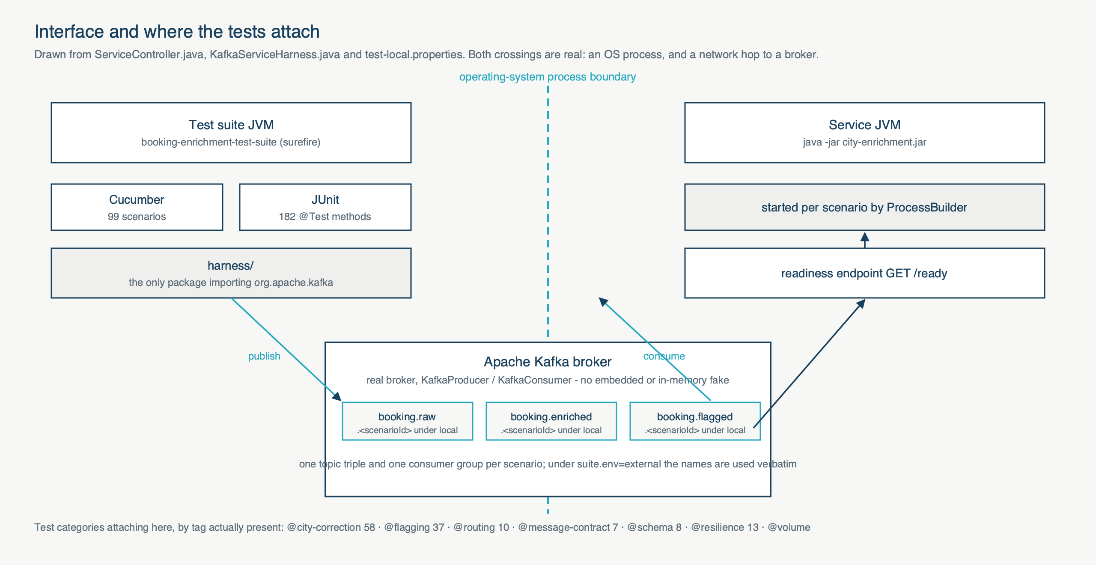
Where the tests attach
Both crossings are real: an operating-system process, and a network hop to a broker.
05
Notes:
Walk it left to right. The dashed line is a real process boundary. Under the local profile each scenario provisions its own topics and consumer group and starts its own service instance.

Slide 7
How the pipeline is designed
Three workflows, each answering one question, sharing one implementation.
06
Workflow | Trigger | What it does
test-suite | push, pull request | Guard on every change: unit, then the fast slice, then the report
bulk-nightly | 00:00 IST, or on demand | The volume tier, unattended
manual-run | Run workflow button | Pick a profile, or type any tag expression
_run-suite | called by the two above | Broker, deploy key, service build, report publishing
• Split by question, not convenience. The nightly asks whether anything is lost across a thousand bookings; the manual run asks whether the change just made works.
• One shared implementation, so the scheduled and on-demand runs cannot drift apart.
• Reports are published even when the run fails - which is exactly when they are worth reading.
• The service is built from source with a read-only deploy key, never a committed jar.
Notes:
Offer the live demo here: trigger manual-run with a single tag, about two minutes, and it produces the report at the end.

Slide 8
How the test data is given
One CSV. It generates the feature file, so there is no second copy to drift.
07
src/test/resources/testdata/city-cases.csv
50 rows, 9 columns
caseId · field · input · expected · outcome
reason · confidence · tags · note
Two sentinels carry what CSV cannot express: <ABSENT> omits the field from the JSON entirely, and a bare null writes a JSON null - distinct from an empty string. All three must flag as missing, which is why all three exist.
One scenario per row, never a Scenario Outline: Gherkin cannot tag an individual example row, so an outline would give fifty cases one shared tag.
Adding a case is refused politely, never silently
1. Add the CSV row
2. Add its destination mirror
3. Register both in the planned catalogue
4. State the clause each one proves
5. Regenerate, and run it
Miss step 2 and the build says: "a rule proven only on origin is not proven on destination". Miss step 3: "absent from the catalogue". Miss step 4: "cannot be traced to anything".
Notes:
The line to land: a business analyst adds a city variant by adding a row, and if they forget something the build tells them which file to open.

Slide 9
The Test Execution Summary Report
Templated over data, so every figure on the page traces to a file you can open.
08
cucumber.json
what actually ran
spec/*.yaml (7 files)
the plan, criteria, scope
defects.csv
the defect register
history.jsonl
previous cycles
ReportGenerator → report-data.json → report-template.html → the HTML report
• No figure is a literal. Search the template for a percentage and the only matches are stylesheet rules.
• Executed is shown against planned, taken from the case catalogue - so an incomplete run reads as incomplete.
• A metric that cannot be measured yet says "not measured" rather than publishing a constant.
• A golden test fails the build if any figure is ever replaced by a hard-coded one.
Notes:
The seven spec files supply what a single run cannot know - above all the planned set, which is the denominator for every completeness figure.

Slide 10
Proving the suite can fail
A stub replays fixtures in place of the service, so the suite can be broken on purpose.
09
Fixture | What it breaks | Scenarios that must go red
mut-floor-lowered | Accepts an input below the confidence floor | TC-77, TC-177
mut-no-collapse | Leaves internal whitespace uncollapsed | TC-05, TC-80, TC-105, TC-180
mut-field-swap | Reports destination outcomes under origin reasons | 8 scenarios
mut-const-key | Emits a constant message key | TC-35, TC-36, TC-52
mut-silent | Emits nothing at all | TC-32, TC-63
mut-route-swap | Swaps one enriched and one flagged booking | TC-60
Baseline green across 99 cases. All 15 fixtures turned exactly their expected scenarios red - no more, no fewer. The whole check runs with the service absent from disk, which is the point: against a service you host, we could not modify it to prove our tests work.
Notes:
Six of fifteen shown. The results table in the repository is generated from the runs, never typed. This mechanism found a genuine defect in our own assertions during development.

Slide 11
What this gives you
A suite that is portable, self-verifying, and honest about what it found.
10
Ready to point at your service
• Runs against a service it did not start, with no service jar present
• Uses your topic names verbatim, creates and deletes nothing
• Namespaces its own bookings, so it ignores traffic it did not publish
• A preflight reports broker, topics and readiness before any test runs
And it questions itself
• Every documented command is verified by the build
• The traceability matrix is generated, and drift fails the build
• The report recommends, and states the conditions
The mutation check contradicted our own specification
It claimed two independent mechanisms protected topic routing. One fixture proved there is one. That finding is why the report reads "proceed with conditions".
Notes:
Close here. A suite that contradicts its own specification, with evidence, is the suite doing its job. Offer to run any slice live.

