Slide 1
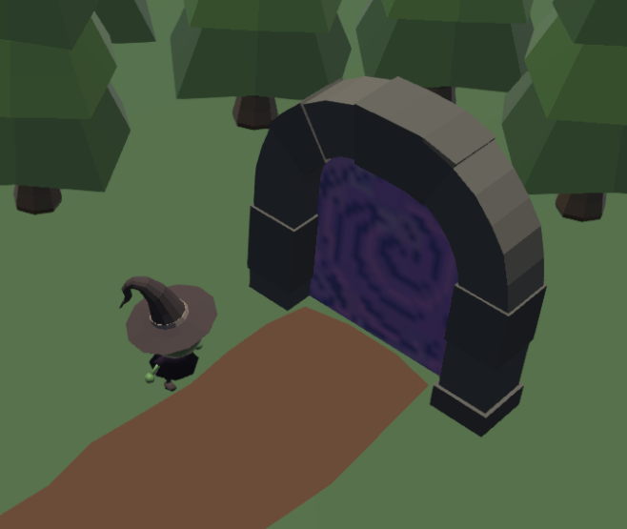
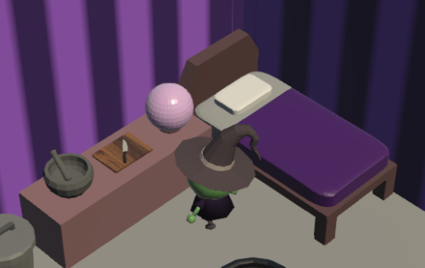

‘A’ to Interact
‘B’ to Exit
Use portals to travel around the lands for ingredients
Get Recipes from the Crystal Ball in your room!

Slide 2
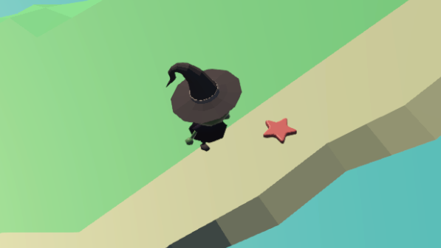

Find or complete minigames to get ingredients
‘C’ while moving the wand to complete a symbol

Slide 3
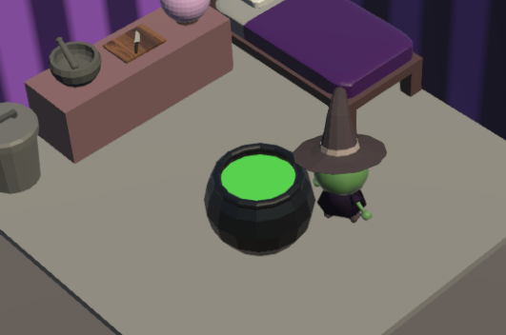
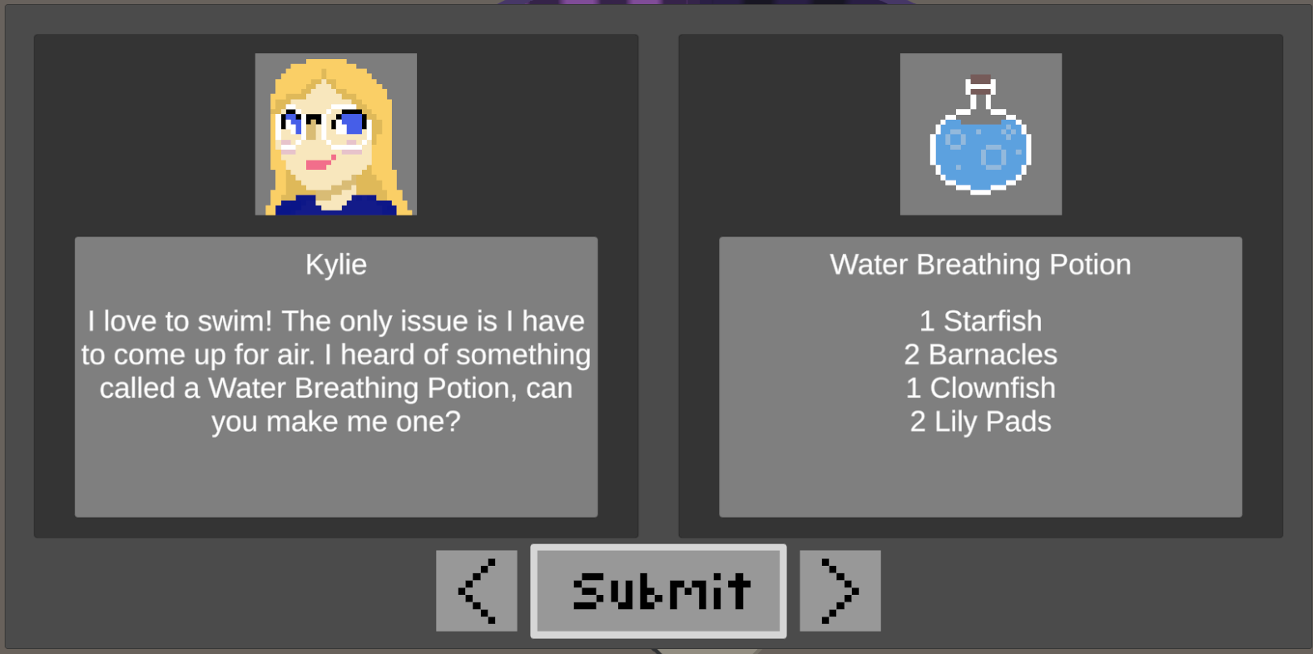
Use the cauldron to craft a potion
Return to the crystal ball to turn in the correct potion!

