Slide 1


Slide 2
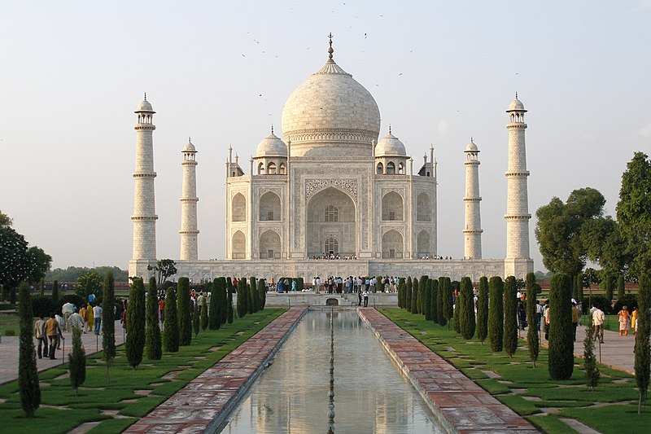

Slide 3

Indira Gandhi International Airport

Slide 4

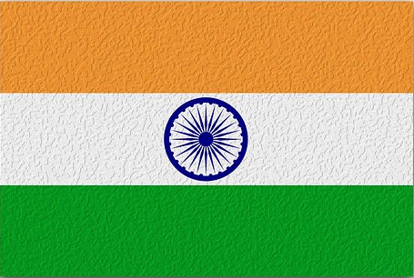

Slide 5
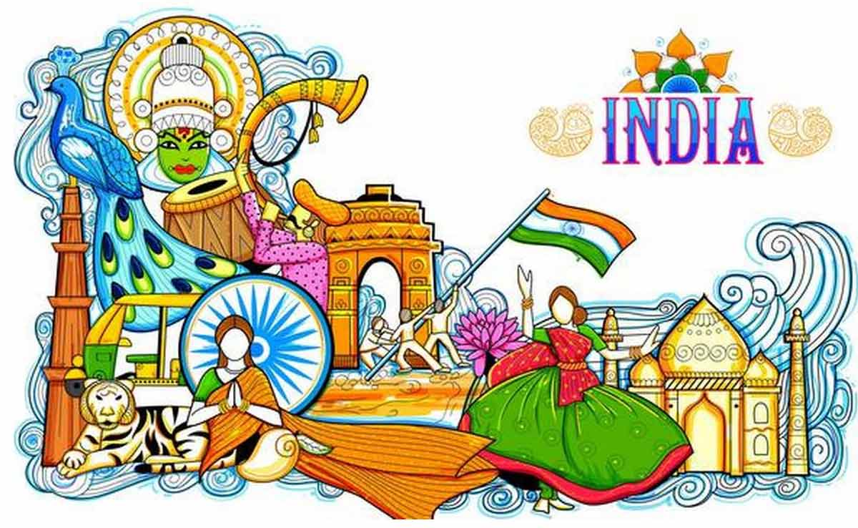

Slide 6

Music of India

Slide 7


INDIA
- known as the land of spirituality and philosophy
- inheritor of one of the oldest and most evolved music system in the world
- Indian music is called “sangeet”

Slide 8
- is a country in South Asia, its capital is NEW DELHI.
- is the seventh-largest country by area.
- In India, COWS are considered SACRED.

Slide 9
- India has over 300,000 mosques and over 2 million Hindu Temples.
- is home to one of the new world wonders – the TAJ MAHAL.

Slide 10
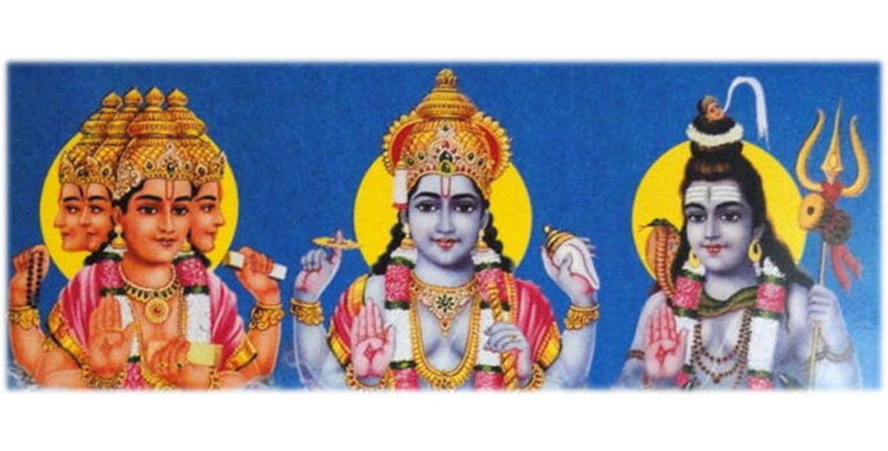
music is a gift from the Gods
Brahma – creator
Shiva – destroyer
Vishnu – preserver

Slide 11
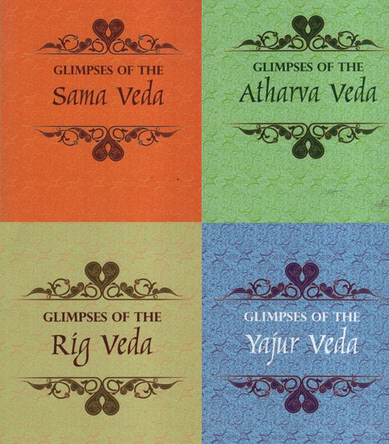
The development of Indian music began from VEDAS
VEDAS – religious chants that are sung without accompaniment

Slide 12


Important aspects that form the HEART of Indian Music
SADHANA
– which means practice and discipline, involves complete faithfulness in the craft
VINAYA
– teaches the students to be humble toward elders or those who are in authority
GURU
– teaches the Vedas through oral tradition

Slide 13

Characteristics of Indian Traditional Music
CARNATIC MUSIC
From South India
Temple music
Main emphasis on vocal music
Faster and shorter in tempo
Remained untouched by foreign influences
HINDUSTANI MUSIC
North Indian Music
Based on the RAGA system
Uses TALA
Instrumental music is more important
Has foreign elements

Slide 14
Elements of Indian Music

Slide 15
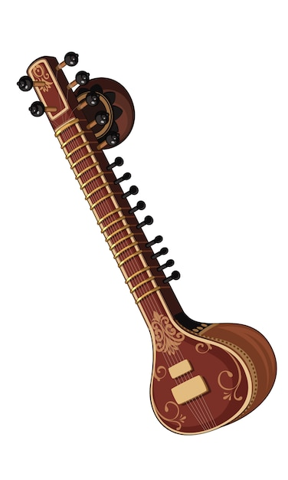
RAGA
- pitch system used in Indian classical music
- melodic pattern that can be ascending or descending in a scale where key notes and phrases bring out the entire character
it uses seven tones :
(sa-re-ga-ma-pa-dha-ni)
- played by SITAR

Slide 16
SITAR – the most popular stringed instrument in North India
Vadi – most important tone
Samvadi – second most important tone

Slide 17
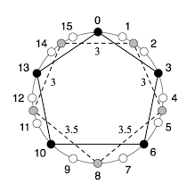
TALA
- rhythmic time cycle of Indian music
- composed of long and short accented and unaccented beats
Sam – first beat
Tali – accented beat
Khali – empty/unaccented beats
- played by Mridangam (South) and Tabla (North)

Slide 18
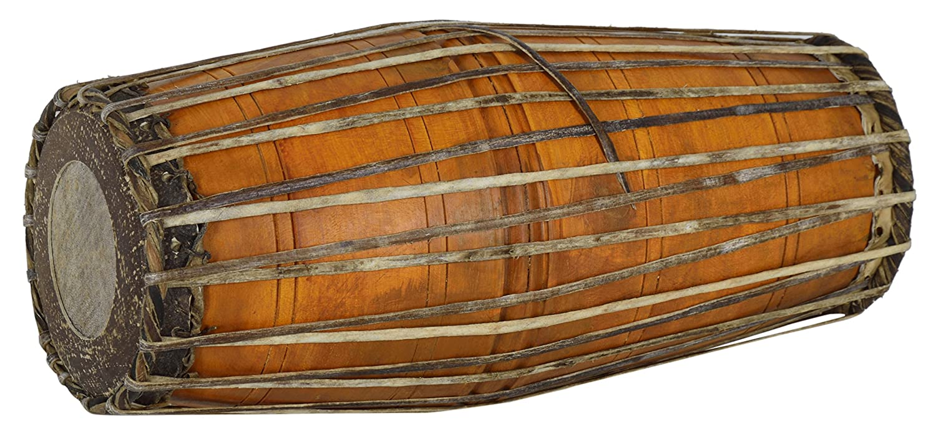
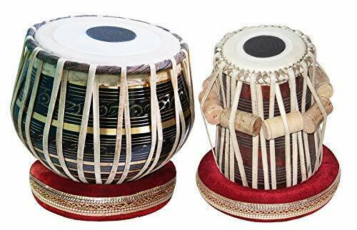
Mridangam – classical drum of Southern India
Tabla – most common and popular drums in Northern India

Slide 19
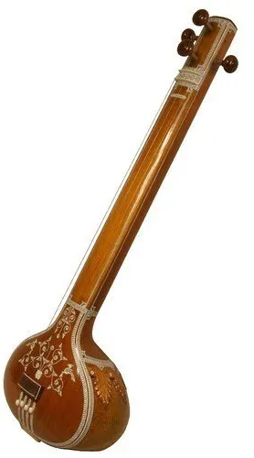
DRONE
– constantly sounding pitch or set of pitches which gives reference point to the ear in hearing the intricacies of the raga being performed
- played by Tambura
Tambura – India’s most important plucked stringed instrument

Slide 20
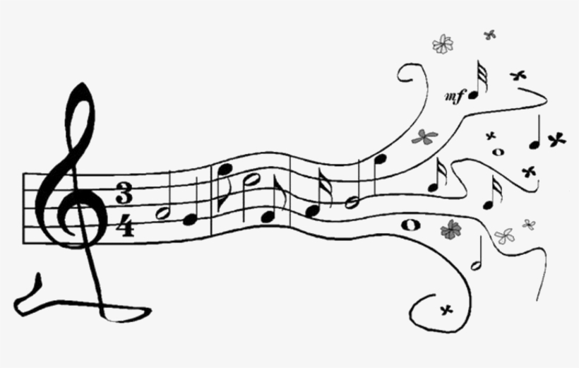
SHRUTIS
use of 22 microtones used as ornamentation for the raga
RASA
dynamics used in Indian music

Slide 21
Kinds of TALA

Slide 22
Legend:
X – tap the drum (accented beat)
O – wave hand for silence (unaccented beat)
- clap hands for unmarked beats

Slide 23
Dadra (6 beats)
1 2 3 4 5 6
X O

Slide 24
Kehrwa (8 beats)
1 2 3 4 5 6 7 8
X O

Slide 25
Tintal (16 beats)
1 2 3 4 5 6 7 8 9 10 11 12 13 14 15 16
X X O X

Slide 26
Jheptal (10 beats)
1 2 3 4 5 6 7 8 9 10
X X O X

Slide 27
Dupak (7 beats)
1 2 3 4 5 6 7
X X O

Slide 28
Ektal (12 beats)
1 2 3 4 5 6 7 8 9 10 11 12
X O X O X

Slide 29
Dipehandi (14 beats)
1 2 3 4 5 6 7 8 9 10 11 12 13 14
X X O O

Slide 30
Shamar (14 beats)
1 2 3 4 5 6 7 8 9 10 11 12 13 14
X X O

Slide 31
VOCAL MUSIC
– performed by one or more singers without any accompaniment
- oldest form of music in the world

Slide 32
Indian Vocal Music
- considered as the most ancient of all musical traditions
- medium of communication between the worshipper and the deity

Slide 33
Hymn To Shiva
- is essentially a devotional chant to Lord Shiva, which acknowledges him as pure consciousness and calls on his powers.

Slide 34
HYMN TO SHIVA
Pon-nai mata-rai bhumiyai na dide
Yen-nai nadiya yen uyir natha ne
Un-nai naduvan un narultu ve li
Tan-nai naduvan tan nan ta ni ya ne

Slide 35
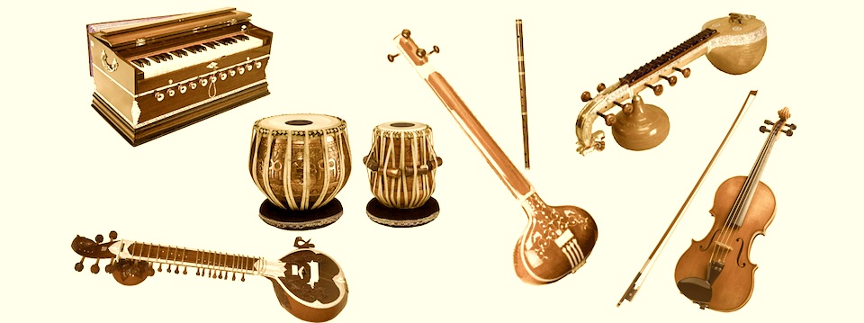
Classification of Indian Musical Instruments

Slide 36
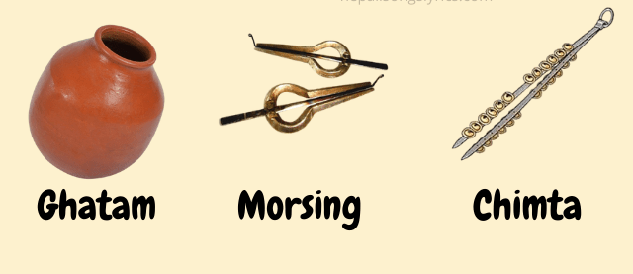
Ghan - non-membranous percussion

Slide 37
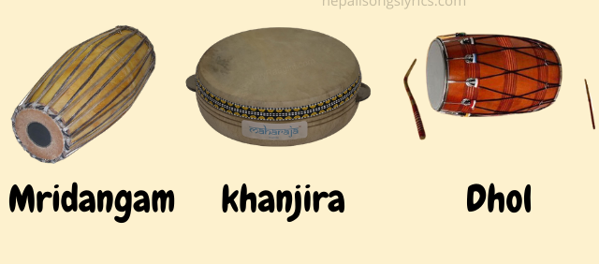
Avanadoh – membranous percussion (drums)

Slide 38
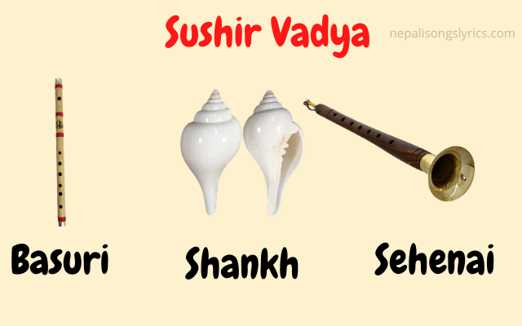
Sushir – wind blown instruments

Slide 39
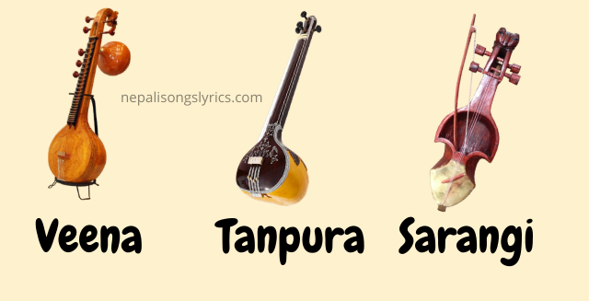
Tat – plucked stringed instruments

Slide 40
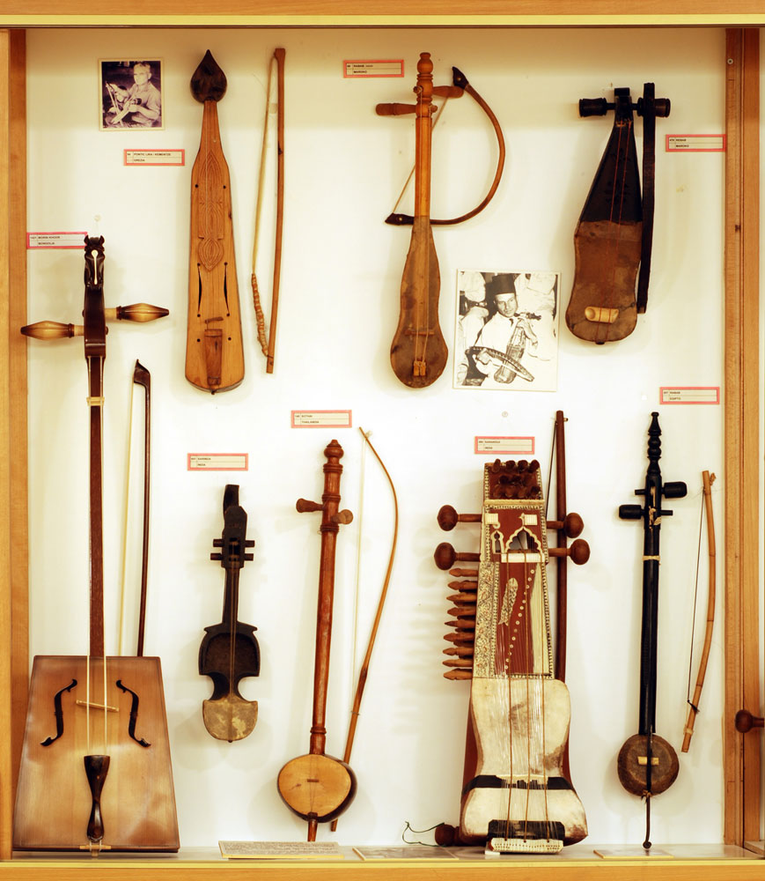
Vitat – bowed stringed instruments

Slide 41
PERFORMANCE TASK
Memorize the kinds of TALA for an individual performance next meeting.

