Slide 1
INTRODUCTION TO the periodic table

Slide 2
In this lesson, you will…
Trace the historical development of periodic table;
Distinguish the element’s group/period and the arrangement of elements in a periodic table;
Create a timeline of the important people behind the development of the periodic table.

Slide 3


Slide 4
It is a fundamental item that can't be easily broken into smaller pieces
E
L
E
M
E
N
T
___ ___ ___ ___ ___ ___ ___

Slide 5
A set of facts or figures systematically displayed, especially in columns.
T
A
B
L
E
___ ___ ___ ___ ___

Slide 6
Appearing or occurring at intervals.
E O D I
P
R
I
C
___ ___ ___ ___ ___ ___ ___ ___

Slide 7
Also called the table of elements, it is an organized arrangement of the 118 known chemical elements
P
E
R O D I C
I
___ ___ ___ ___ ___ ___ ___ ___
T A B
L E
___ ___ ___ ___ ___

Slide 8

Group Activity
• Group yourselves into 5.
• Using your coloring materials, color the different elements in the periodic table as to what group they are part of. Take note of the legend and don’t forget to write the members of your group.

Slide 9
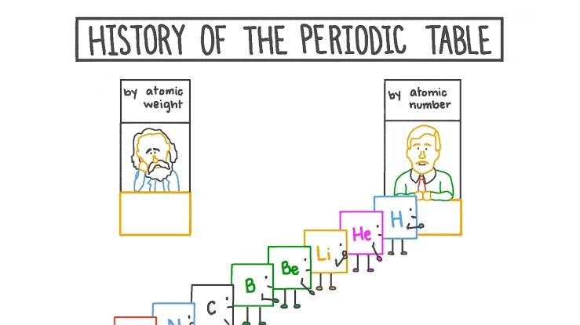
History of the Periodic Table

Slide 10
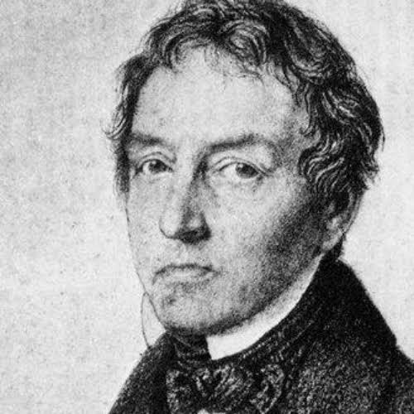
Johann Wolfgang Döbereiner
Known for his “Law of Triads” in 1817
First scientist to observe an important trend
Noticed certain groups of three elements had similar physical and chemical properties but different masses
Ex. Li,Na,K Cl,Br,I Cu,Ag,Au Be,Mg,Ca

Slide 11
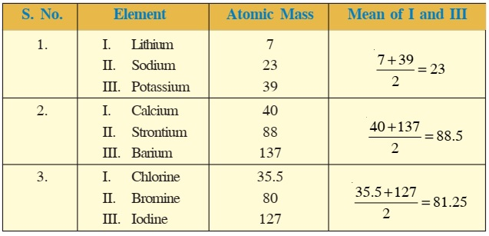

Slide 12
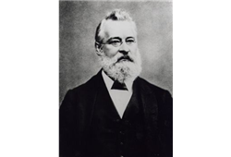
John Alexander Reina Newlands
Known for his “Law of Octaves” in 1864
Noted connection of properties and mass were a repeating pattern in order of increasing mass
Every 8th element had similar properties(Dobereiner’s Triads)
Li, Be, B, C, N, O, F and Na

Slide 13
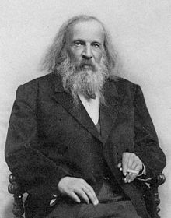
Dmitri Ivanovich Mendeleev (1869)
Considered as the “Father of the periodic table”
Arranged the chemical elements by atomic mass.
He predicted the discovery of other elements, and left spaces open in his periodic table for them.

Slide 14
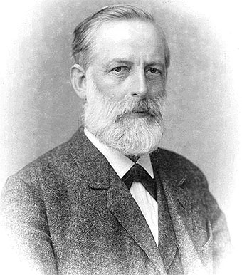
Julius Lothar Meyer
1869
One of two scientists to independently discover the periodic law of chemical elements and pioneer the earliest periodic tables.

Slide 15
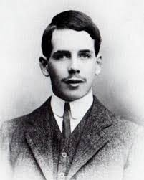
Henry Moseley
In 1913, he discovered that the ordering of the wavelengths of the x-ray emissions of the elements coincided with the ordering of the elements by atomic number.
This discovery established that “the properties of the elements varied periodically with atomic number,” not atomic weight.
He organized the periodic table based on atomic number.

Slide 16
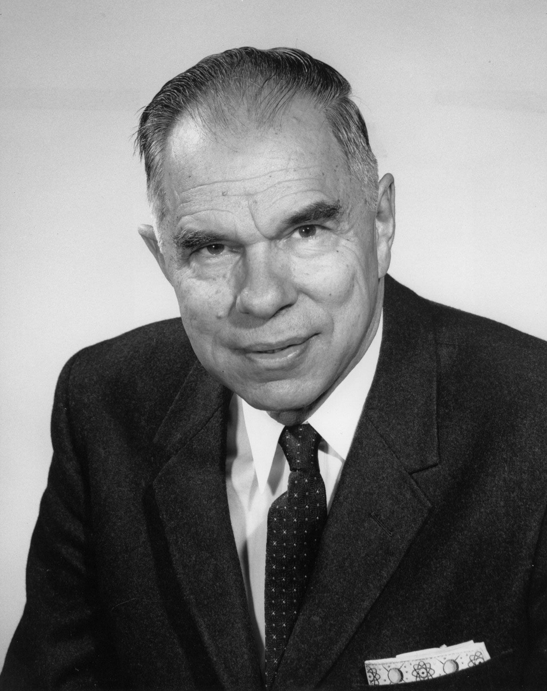
Glenn Seaborg
• Identified lanthanides and actinides (atomic number >92), which are usually placed below the periodic table in 1945.

Slide 17
Group vs. Period
Groups are the columns of the periodic table, and periods are the rows. There are 18 groups, and there are 7 periods plus the lanthanides and actinides.

Slide 18


Slide 19
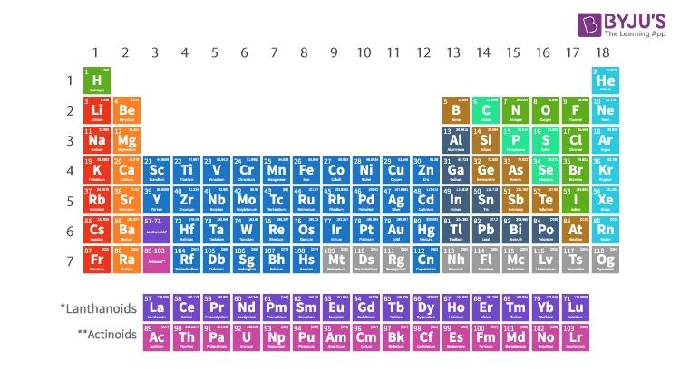

Slide 20
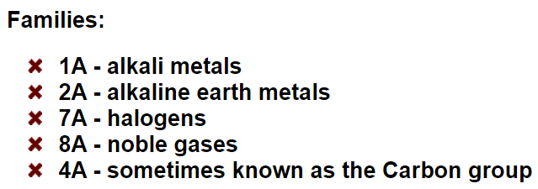

Slide 21
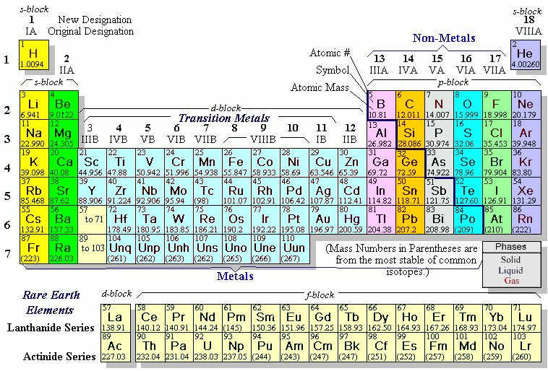

Slide 22
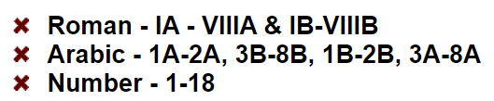

Slide 24
Grouping the Elements: Metals/Non-Metals/ Metalloids

Slide 25
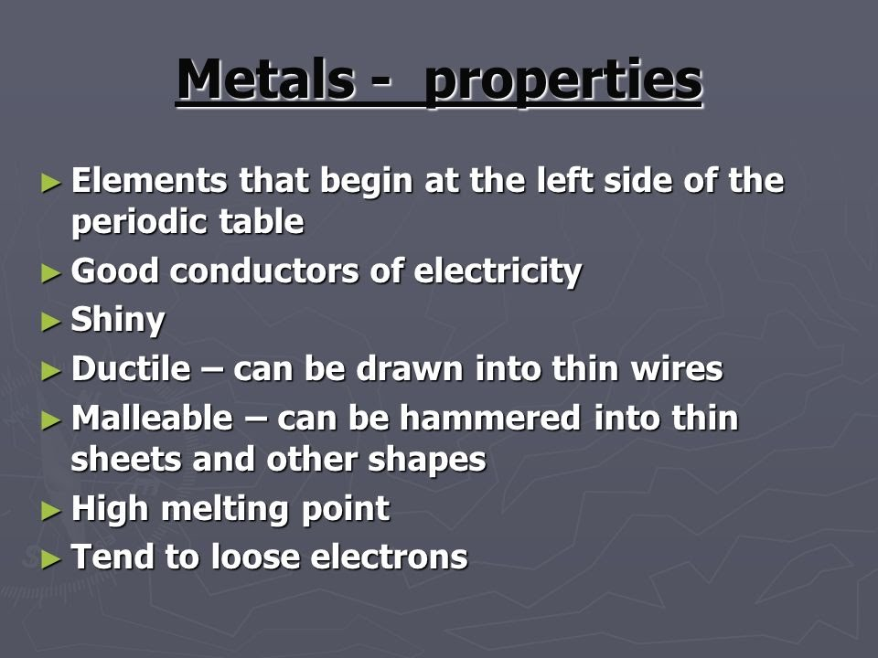
Metals

Slide 26
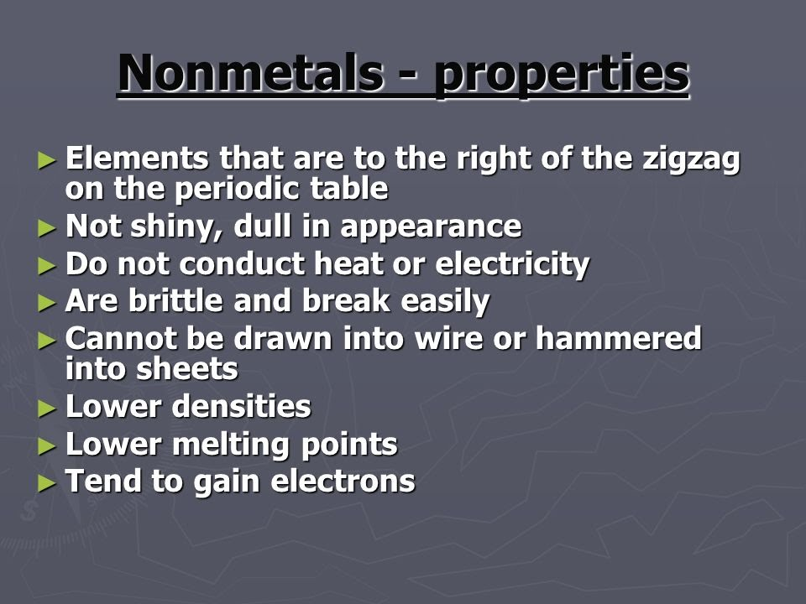
Non-metals

Slide 27
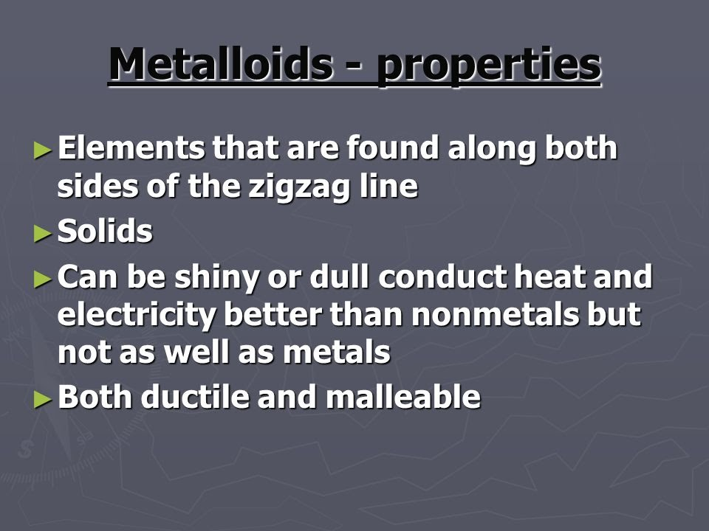
Metalloids

Slide 29
The s, p, d and f block Elements
T

Slide 30
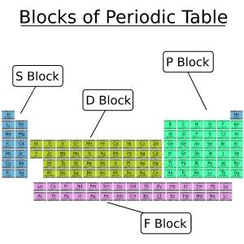

Slide 31
Application
Using the same groupings, create a timeline of the important people behind the development of the periodic table.

Slide 32
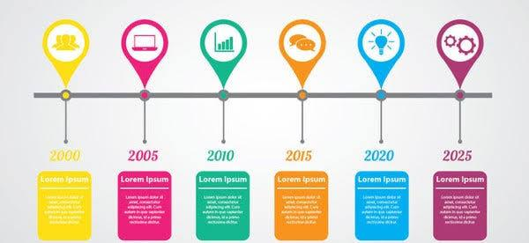

Slide 33

ASSESSMENT
Multiple Choice: Write your answers in a ¼ sheet of paper

Slide 34

Share your Insights!

Slide 35

“If all the elements are arranged in the order of their atomic weights, a periodic repetition of properties is obtained. This is expressed by the law of periodicity.” - Dmitri Ivanovich Mendeleev

