Slide 1
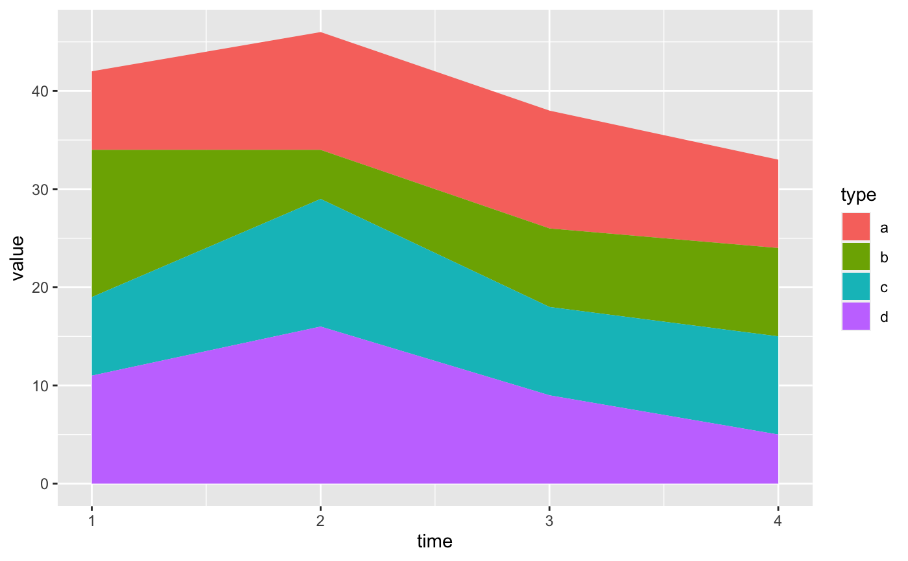
Stack Plot - Matplotlib
Daniel Clark
CTEC 298

Slide 2
What is a Stack Plot?
A stack plot or graph is a visualization that shows the values of data on top of each other in the same column or side by side in the same row.
Stack plots are used to convey the importance of both the sum of values and the individual pieces.

Slide 3
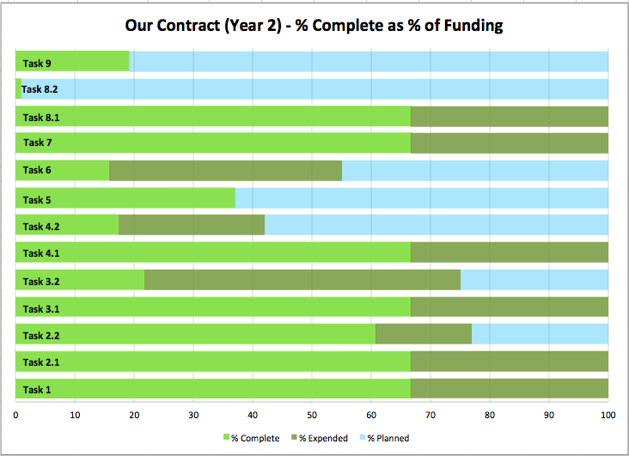
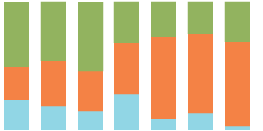
Examples of Stack Plots

Slide 4
When Is a Stack Plot Used?
Stack plots are used when percentages of a whole number are just as important as the whole.
One example would be the progress of a task. (% out of 100)
Another example would be to show the breakdown of the various items a whole resource was used on. (Time in a day for activities, budget for various purchases, etc.)

Slide 5
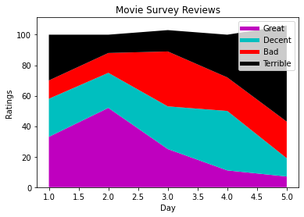
Code for Stack Plot
import matplotlib.pyplot as plt
days = [1,2,3,4,5]
great = [33,52,25,11,7]
decent = [25,23,28,39,12]
bad = [12,13,36,22,24]
terrible = [30,12,14,28,63]
plt.plot([],[],color='m',label=‘Great',linewidth=5)
plt.plot([],[],color='c',label=‘Decent',linewidth=5)
plt.plot([],[],color='r',label=‘Bad',linewidth=5)
plt.plot([],[],color='k',label=‘Terrible’,linewidth=5)
plt.stackplot(days,great,decent,bad,terrible,colors=['m','c','r','k'])
plt.xlabel('Day')
plt.ylabel('Ratings')
plt.title('Movie Survey Reviews')
plt.legend()
plt.show()

Slide 6
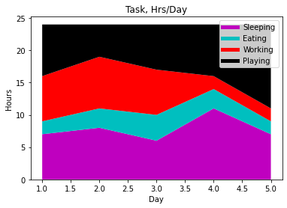
Stack Plot Visual
import matplotlib.pyplot as plt
days = [1,2,3,4,5]
sleeping = [7,8,6,11,7]
eating = [2,3,4,3,2]
working = [7,8,7,2,2]
playing = [8,5,7,8,13]
plt.plot([],[],color='m',label='Sleeping',linewidth=5)
plt.plot([],[],color='c',label='Eating',linewidth=5)
plt.plot([],[],color='r',label='Working',linewidth=5)
plt.plot([],[],color='k',label='Playing',linewidth=5)
plt.stackplot(days,sleeping,eating,working,playing,colors=['m','c','r','k'])
plt.xlabel('Day')
plt.ylabel('Hours')
plt.title('Stack Plot')
plt.legend()
plt.show()

Slide 7
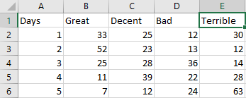
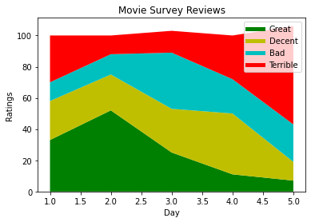
Stack Plot From Data File
import numpy as np
import matplotlib.pyplot as plt
data = np.genfromtxt("C:/users/raxus/Desktop/HW/298/movie.csv",delimiter=",",names=["days","great","decent","bad","terrible"])
print (data["great"])
plt.plot([],[],color='g',label='Great',linewidth=5)
plt.plot([],[],color='y',label='Decent',linewidth=5)
plt.plot([],[],color='c',label='Bad',linewidth=5)
plt.plot([],[],color='r',label='Terrible',linewidth=5)
plt.stackplot(data['days'],data['great'],data['decent'],data['bad'],data['terrible'],colors=['g','y','c','r'])
plt.xlabel('Day')
plt.ylabel('Ratings')
plt.title('Movie Survey Reviews')
plt.legend()
plt.show()

Slide 8
References
Edureka! (Director). (2017, April 19). Python Matplotlib Tutorial | Matplotlib Tutorial | Python Tutorial | Python Training | Edureka [Video file]. Retrieved February 24, 2021, from https://www.youtube.com/watch?v=yZTBMMdPOww
Salm, M., Evergreen, S., Laidlaw, J., & Shellard, D. (2014, October 01). Stacked graph. Retrieved February 24, 2021, from https://www.betterevaluation.org/en/evaluation-options/stacked_graph

