Slide 1

PulsePy:
Oscilloscope Data Analysis
Kiryeong Park, Joshua Talbot, Ellen Lee
July 3rd, 2018
Notes:
Name, slide number, uncertainty, date

Slide 2
Objectives
Analyze existing pulse data
Simulate a new pulse

Slide 3
Overview
ScopeTrace
ScopeData
Simulation

Slide 4
Overview
2. ScopeData
Store parameters of curvefitting
Search pulses
Analyze parameters

Slide 5
Overview of Package
3. Simulation function
Number of events, time range
Jitter
Parameters

Slide 6
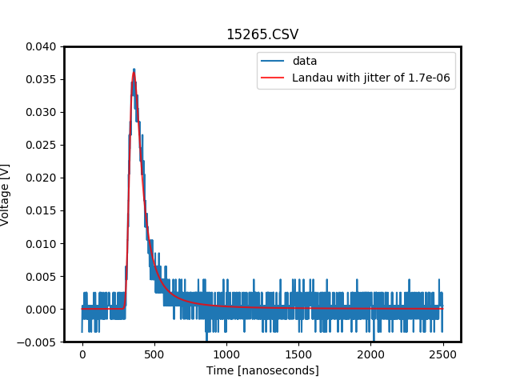
Results (Landau Fitting)

Slide 7
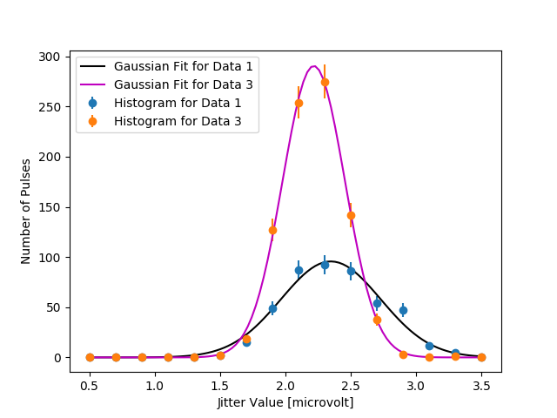
Results (Jitter Distribution)
Histogram
Notes:
ji

Slide 8
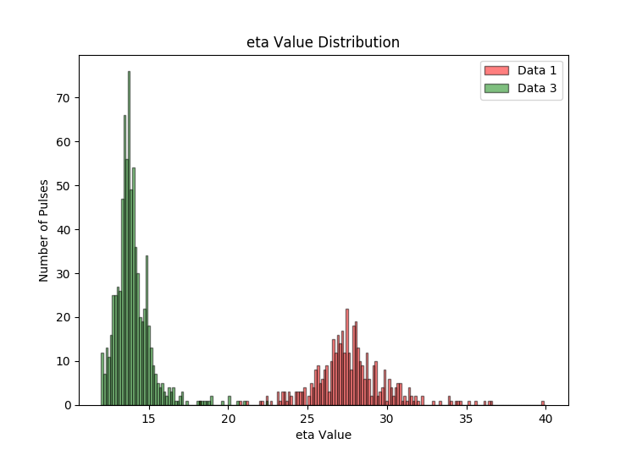
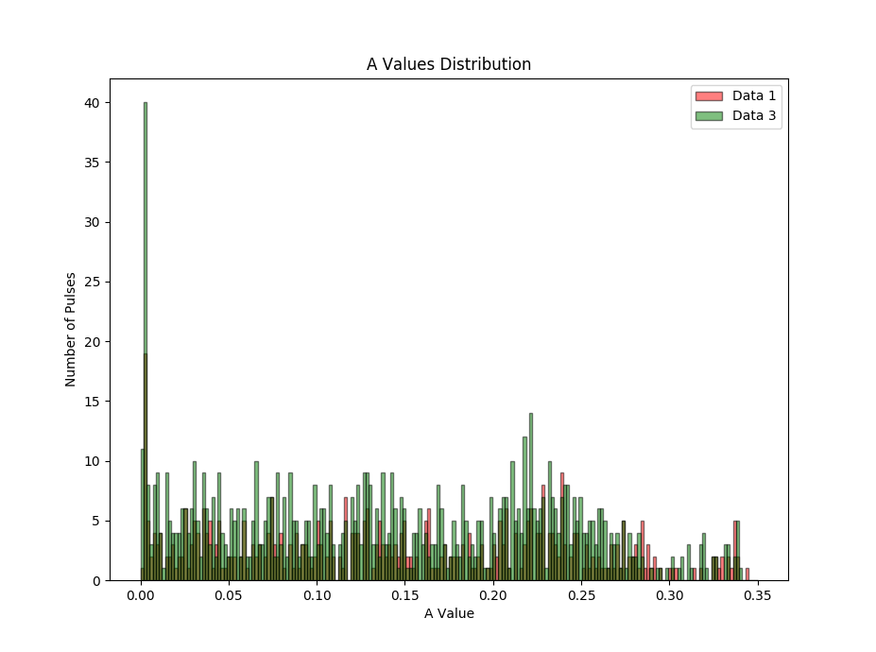
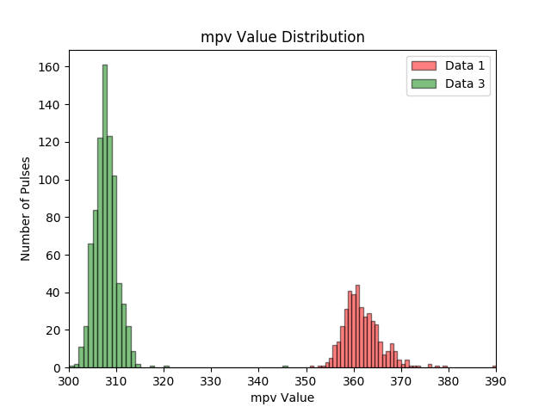
Results (mpv, eta, A Distribution)

Slide 9
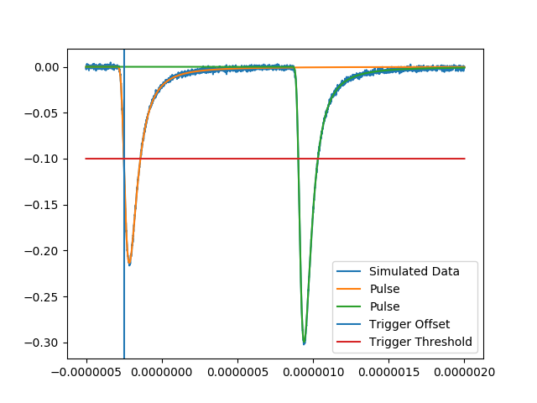
Results (Simulated Data)
Simulated Pulse
Voltage (V)
Time (s)
Notes:
ji

Slide 10
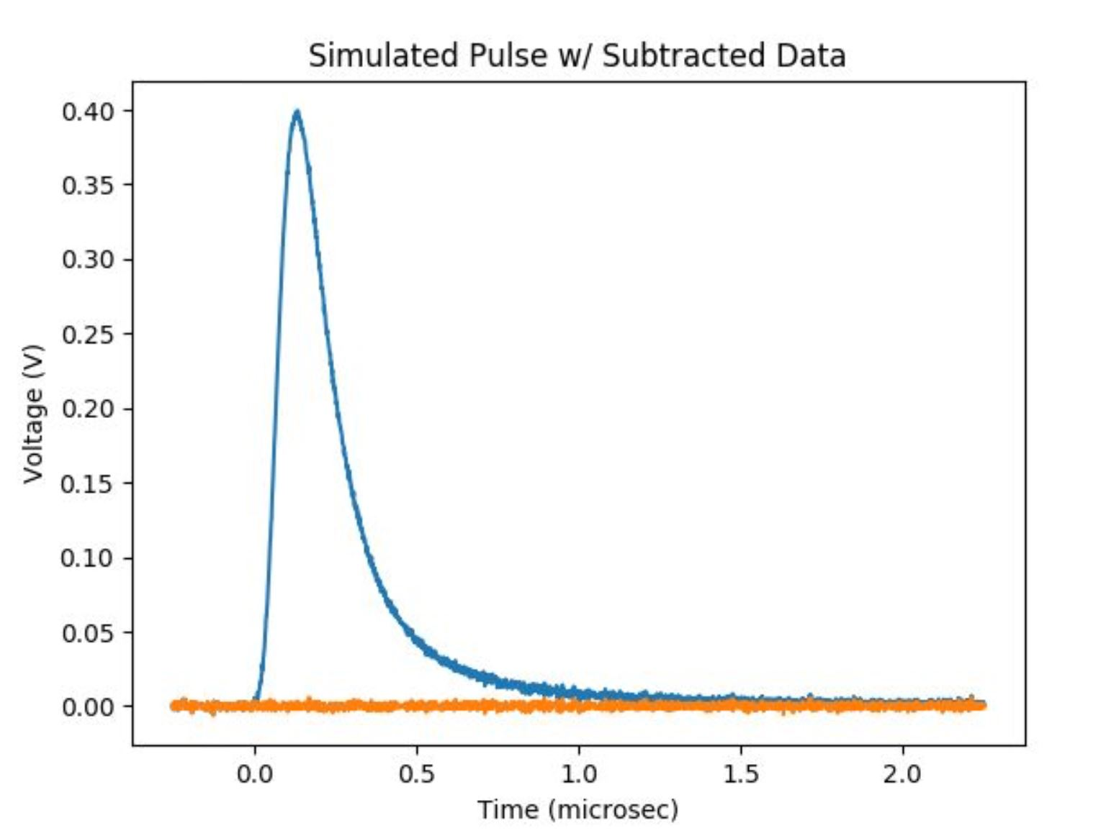
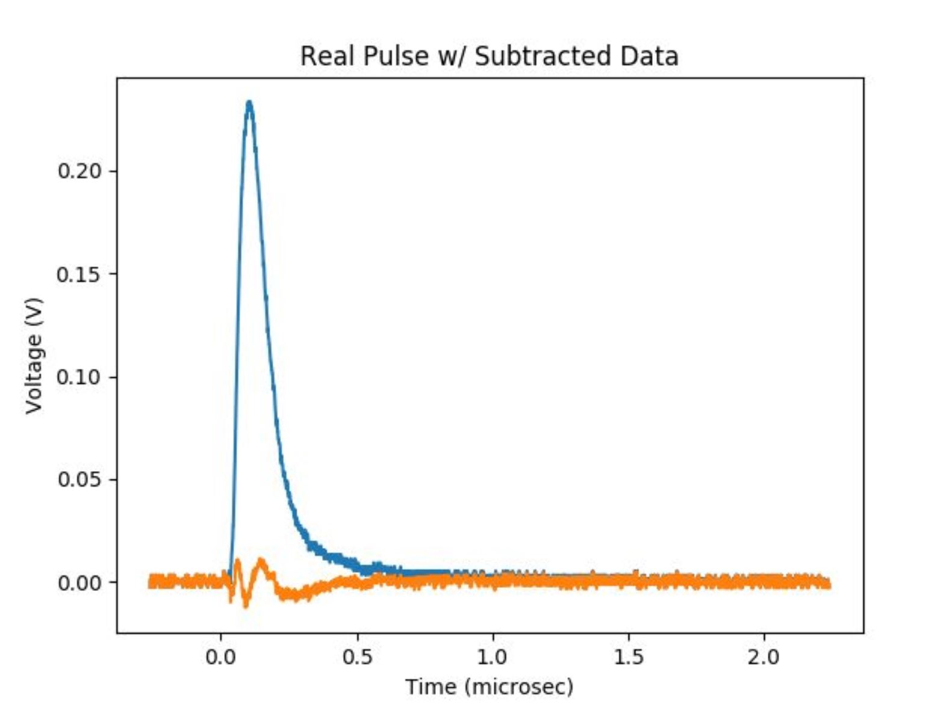
Results (Residual Test)

Slide 11
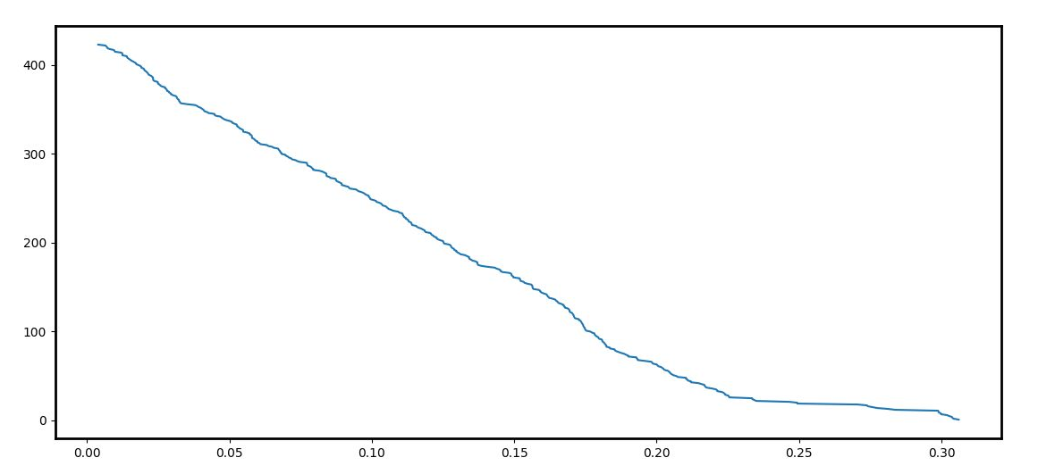
Results (Threshold)
Threshold vs # of files
# of files
Threshold(V)
Notes:
Max y val > threshold given by users

Slide 12
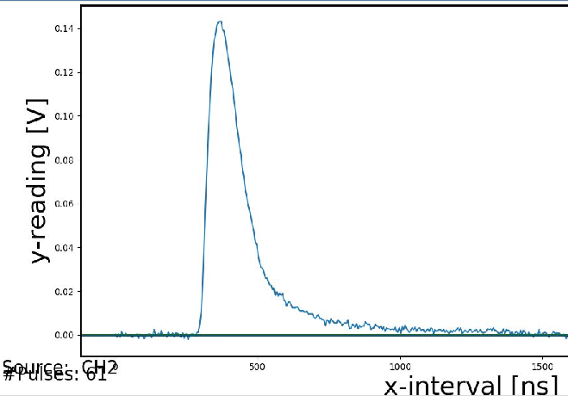
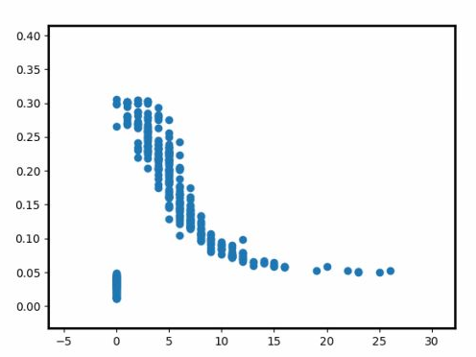
Results (Threshold)
Amplitude (V)
Δt(ns)
Notes:
Max y val > threshold given by users

Slide 13
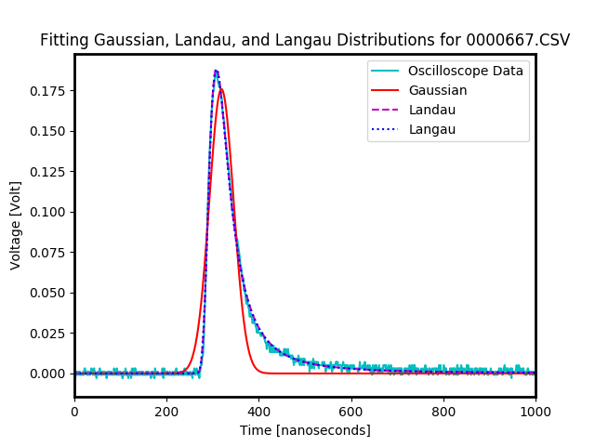
In future
Notes:
Better curve

