Slide 1

Pulse Analysis & Simulation
Eli Wirth-Apley, Sanjay Raman, Josh Talbot, Kiryeong Park, Ellen Lee
With instruction from Dr. Christoph Paus

Slide 2
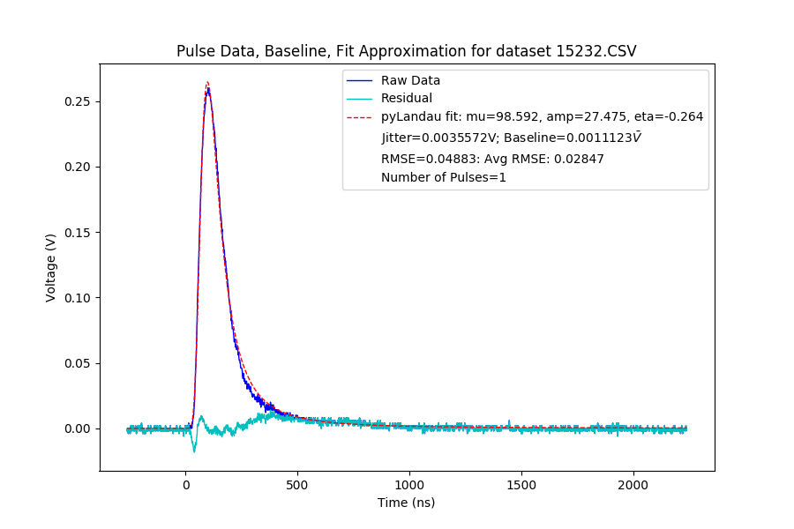
Visual
Figure 3: Shown here as a visual for context of background.
Credit: Eli W-A

Slide 3
Background
Pulse data/raw data is a function of voltage over time.
Residuals: Whatever is left over when the computationally fitted curve is subtracted from pulse data.
Jitter: The noisiness of data. Measured in Volts. Calculated from the standard deviation of the residuals. Closer to zero is better. Due to a number of factors including quantization error (non-linear, signal dependent rounding error).
Baseline: The mean of the residuals. Closer to zero is better. Measured in Volts.
Photomultiplier Tube (PMT): Device used to record pulses.

Slide 4
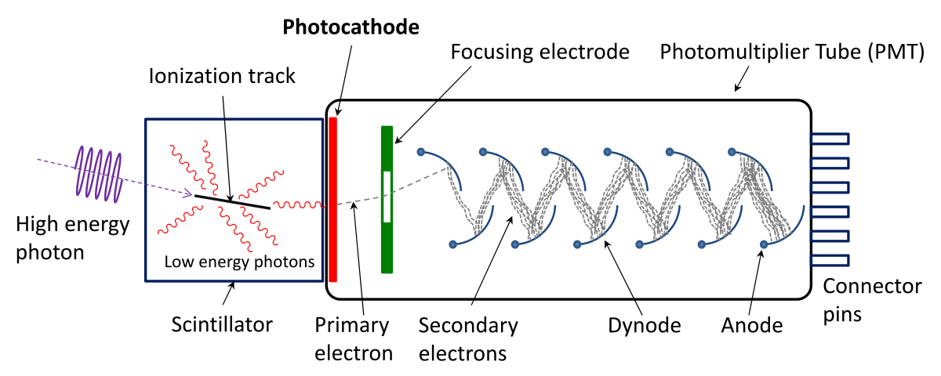
Background (Cont.)
Figure 1: Shows schematic view of a photomultiplier and scintillator.
Credit: Wikimedia Commons
Notes:
Graph is smeared out, signal from individual particles is smeared because of cascade of electrons

Slide 5
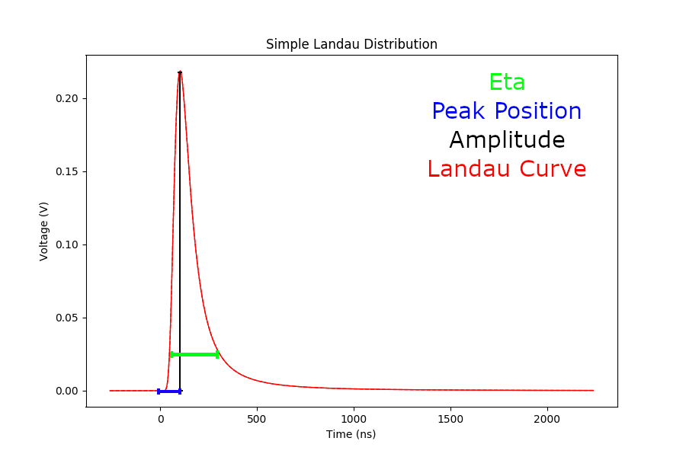
Landau Distribution
Figure 2: Shows key components of Landau Curve.
Credit: Eli W-A

Slide 6
Goals
Reliably count number of pulses from a scope trace.
  Accomplished by comparing the amplitude of pulse with a fixed value.
  Accuracy of this method is improved by less noisy residuals.
  Secondary pulses are detected by comparing the amplitude of the residuals with a fixed value.
Create a reliable fit function to compare with scope traces. This will improve accuracy of residuals.
  Initially used pyLandau and optimizing packages to fit pulses.
  Then used templates to try and further reduce residuals.
  To test these fits, simulated data is used initially, then real data is used.

Slide 7
pyLandau & Optimize
Figure 3: Shows raw data, regression and residuals from pyLandau curve fitting.
Credit: Eli W-A

Slide 8
pyLandau & Optimize
Residuals are not as even as they could be, Baseline could be smaller.
RMSE values are generally good.
For this method, the main way to improve residuals is to better optimize automatically generated parameters of Landau distribution and initial parameters.

Slide 9
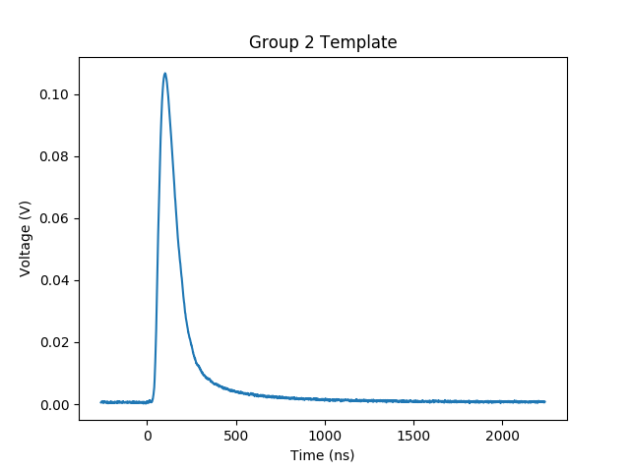
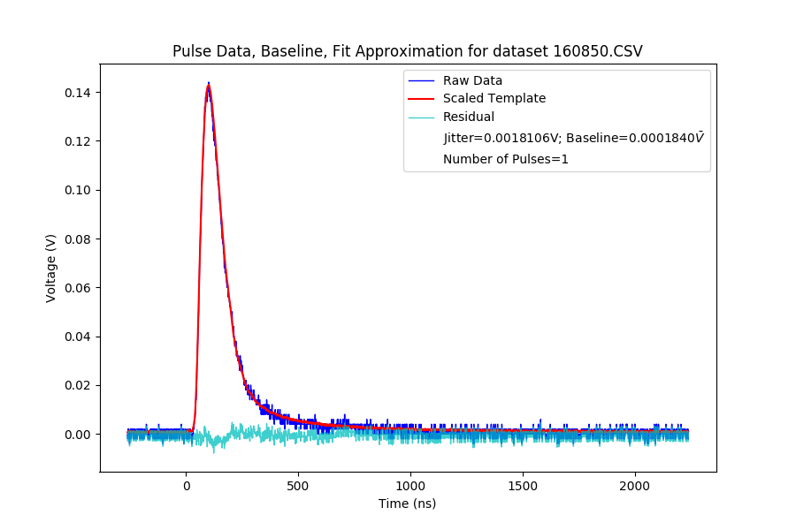
Templates
Figure 4a: Shows one template used to sort pulses based on amplitude.
Credit: Eli W-A
Figure 4b: Shows a scaled template fit and its residuals.
Credit: Eli W-A

Slide 10
Templates
Generated from histogram values, within the amplitude histogram a few general categories were made and pulses were sorted
Once a pulse is grouped based on amplitude, the template corresponding to that group is scaled to the raw data and fitted.
Residuals are much more even, Baseline is lower on average.
Residuals can be greatly improved by more varied/accurate templates.

Slide 11
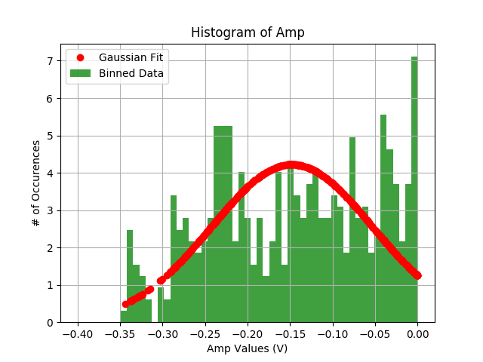
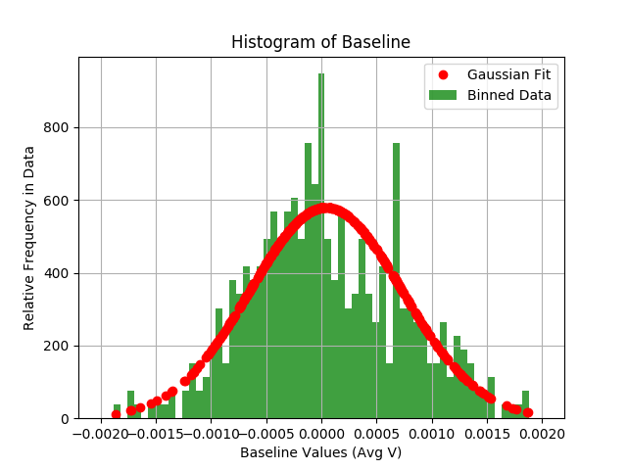
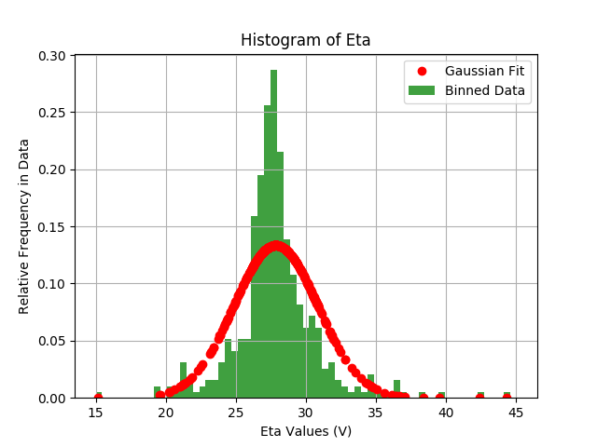
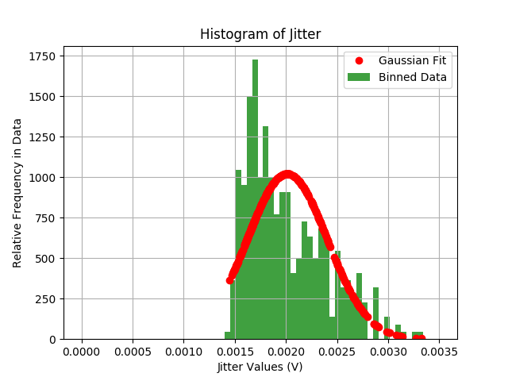
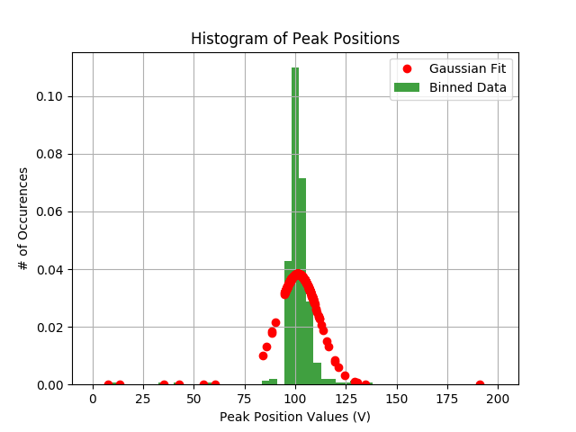
Histograms
a.) Amplitude
b.) Baseline
c.) Eta
d.) Jitter
e.) Peak Positions
Figure 5: Shows various histograms of regression parameters.
Credit: Eli W-A

Slide 12
Simulation
Histograms generated from pyLandau optimized fit parameters of raw data, Baseline values and Jitter values.
A random value for each of these is taken from their normal distributions, shown by the Gaussian curve.
Multiple pulses can be generated by superimposing two Landau fits (took max value of either curve at each point).

Slide 13
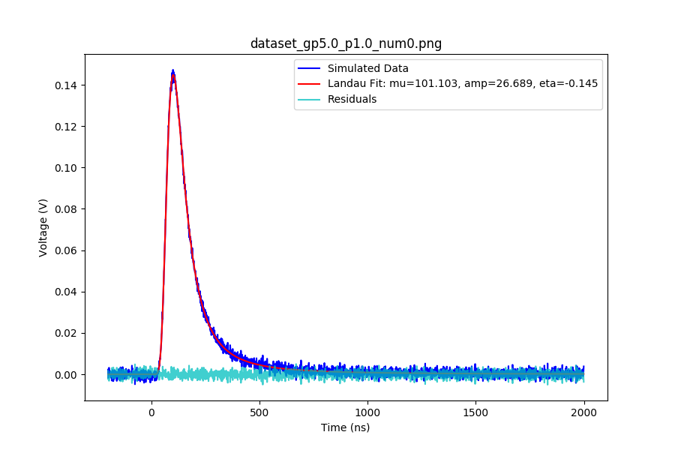
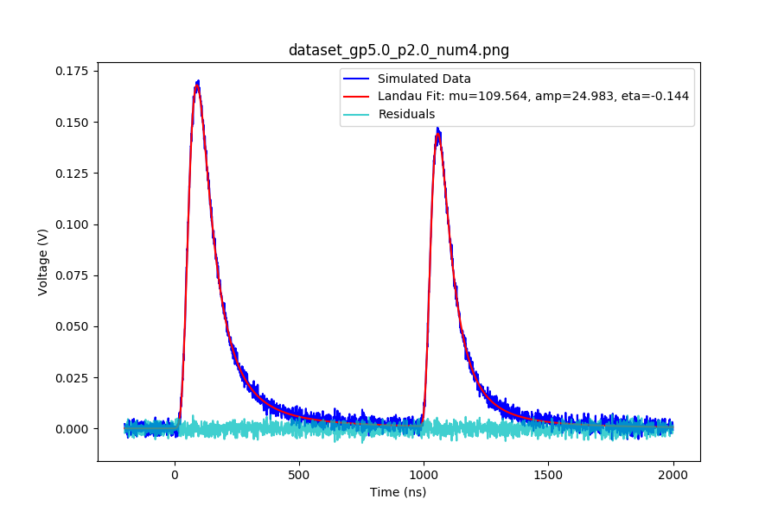
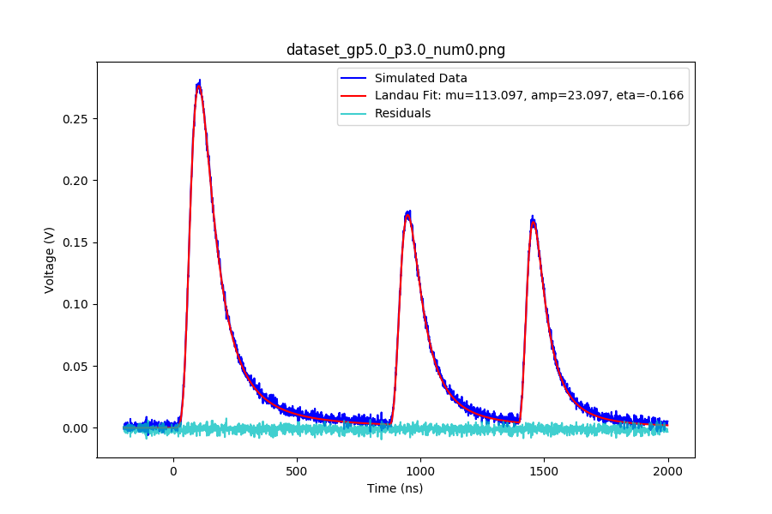
Simulated Pulses
a.) Single Pulse
b.) Two Pulses
c.) Three Pulses
Figure 6: Pulse Simulations.
Credit: Eli W-A

Slide 14
Results
Based on simulation data, the automatic curve fit from pyLandau has an accuracy of 96%, that is 96 out of 100 simulated pulses are correctly categorized.
Based on raw data the template method achieved 94% accuracy (425/452 graphs correctly categorized). These are with first pass template ranges.
With further investigation into optimal template ranges, the template method could be much more effective than simply automatically curve fitting. This is because the template method factors qualities of PMT not taken into account by the more generalized auto curve fit regression package.

Slide 15
Conclusion
For general analysis, the Landau regression package works very well.
If more accurate residuals are needed, the template method may be a better option.
Further research is clearly needed before the template method can be completely viable, but it is an extremely promising method of analysis.
This further research would have to take into account specifics about the PMT being used to create more effective templates.
Comparison of RMSE values would also be beneficial.
Overall, this foray into pulse analysis and identification has been successful.

