Slide 1
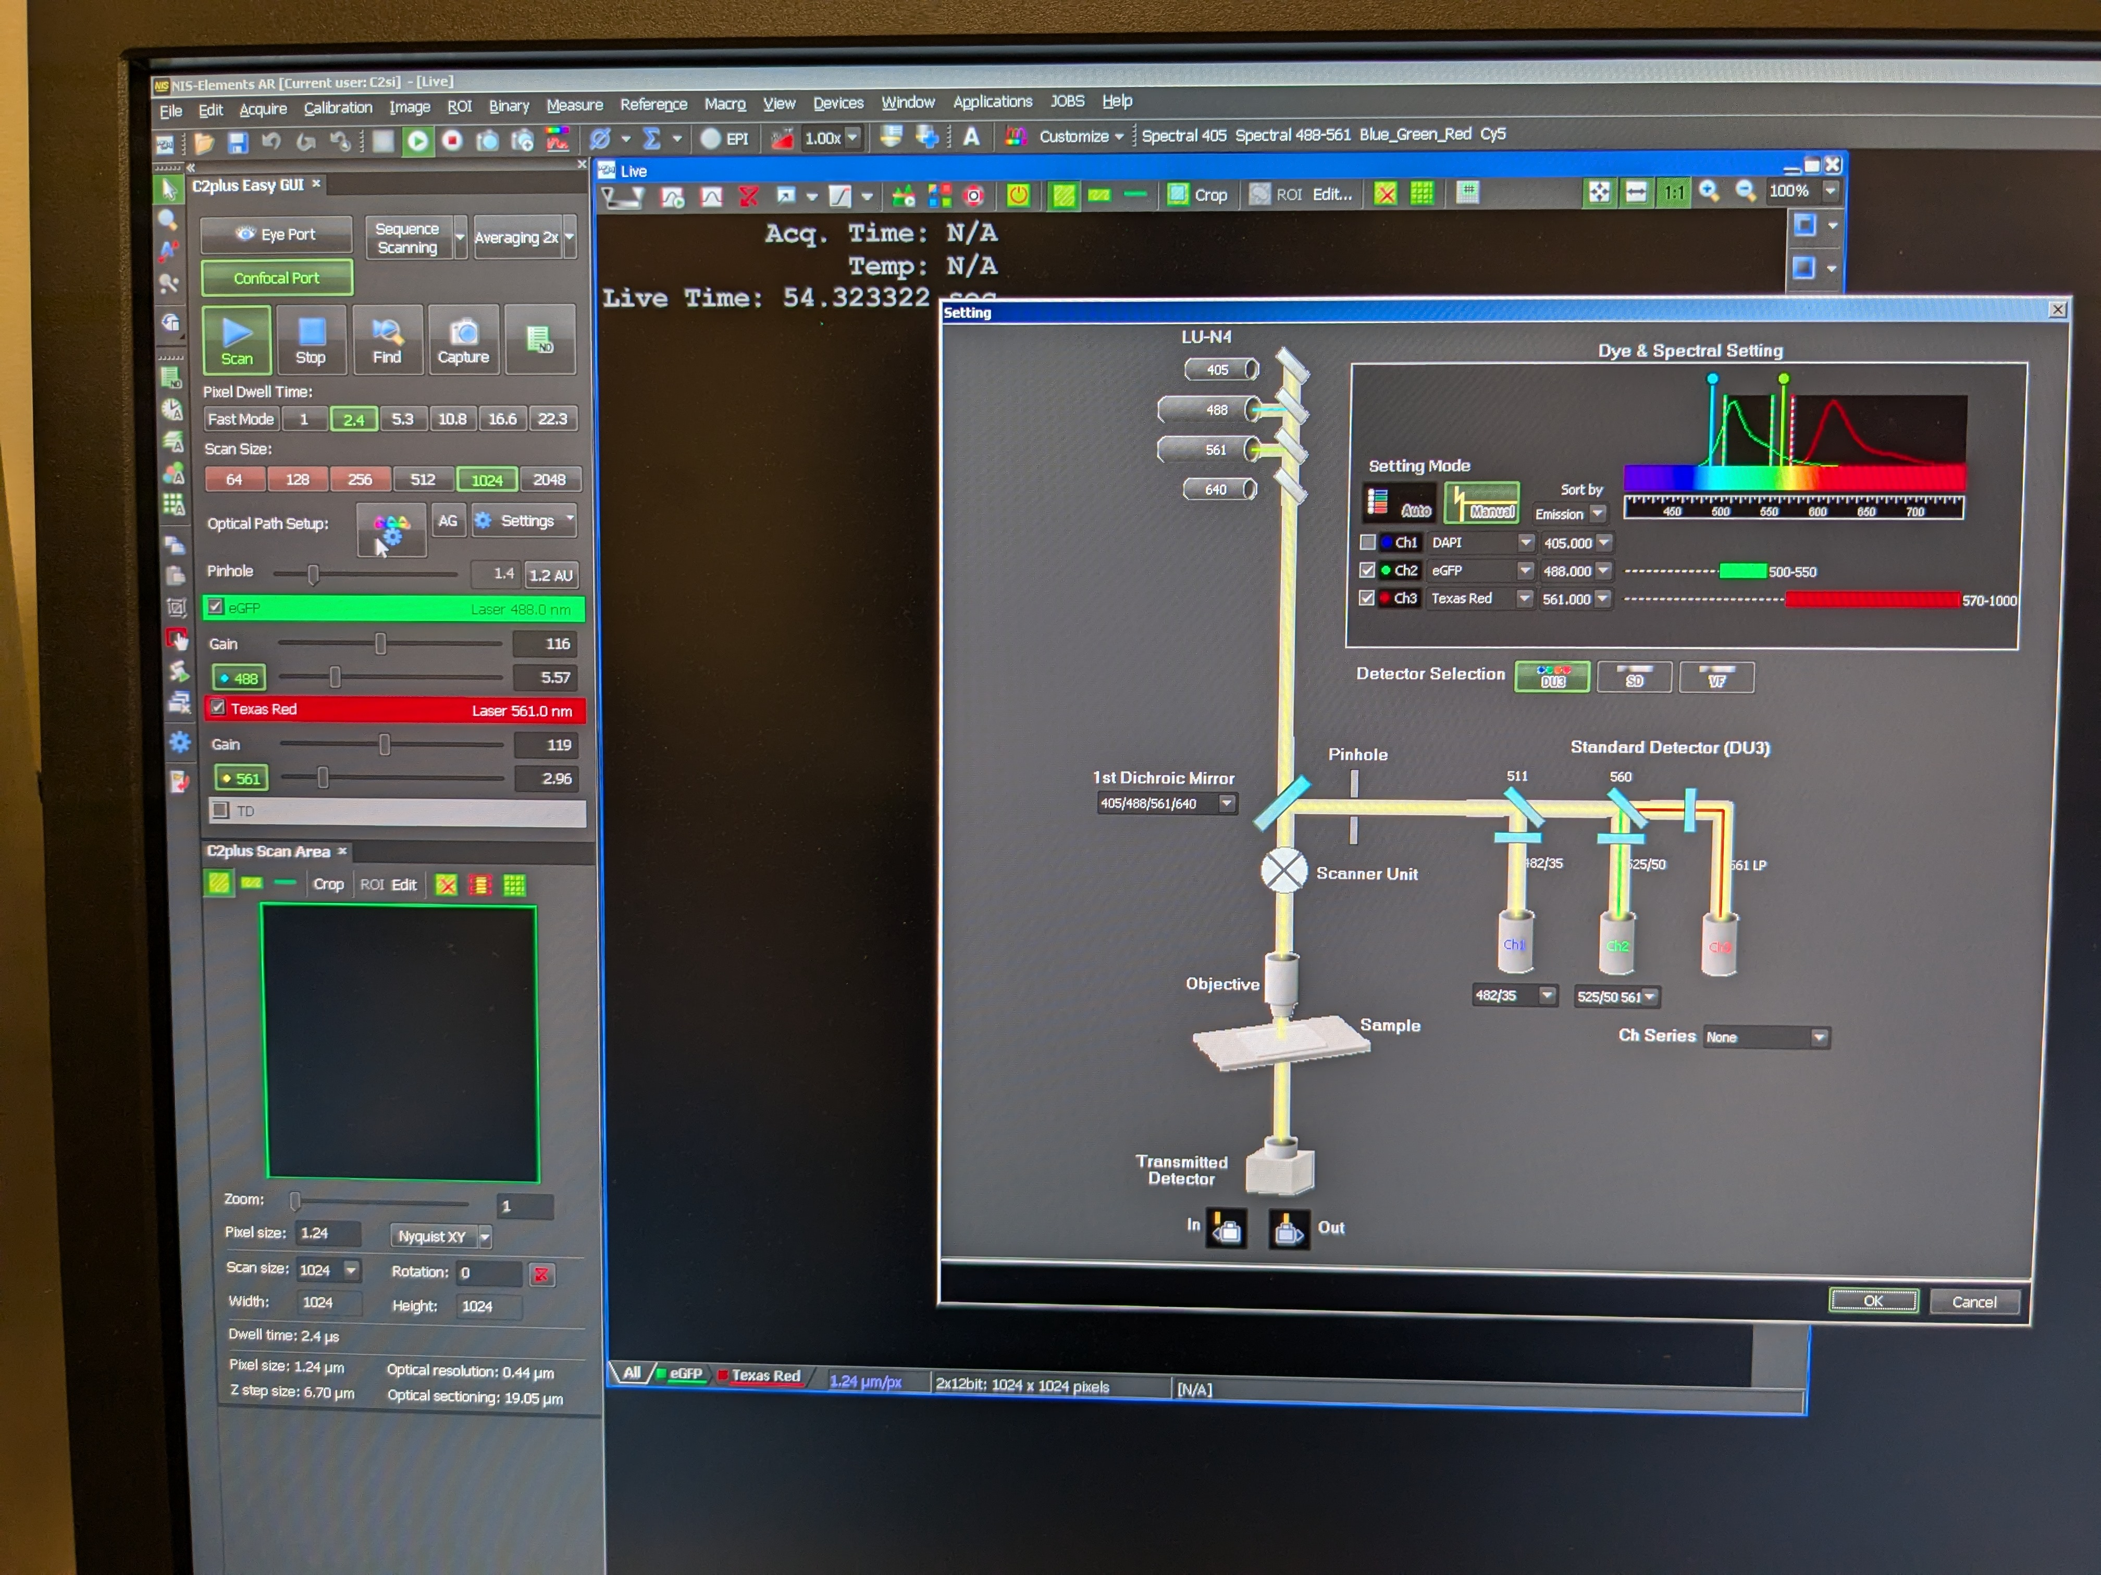
Switching between eye and computer views
There is a trade-off between the update speed and the resolution
Fluorescent light on/off button
Fluorescence set-up pop-up window
Changing these values change the metadata saved in the file and the color the software shows to represent different signals, doesn’t influence wavelengths etc. Ch1 is set up to be blue, Ch2 is green, Ch3 is red inside the machine so do not adjust in software!
How much light to let in. Adjusts signal intensity as well as background noise levels.
Fluorescent light intensity
Switching on TD here and checking the box on the left allows natural light view of sample.
This is where your sample will appear.
Colored combined view of all fluorescent signals.
Individual greyscale views.

