Slide 1

Operating System Linux – Day 2.

Slide 2
Day 2.
Download and install java as root
Upload javax.mail.jar to the "right place"
Translating mail program including classpath during translation and execution

Slide 3
Linux Commands

Slide 4
File Management
In Linux are three basic types of files
Ordinary Files − An ordinary file is a file on the system that contains data, text, or program instructions. In this tutorial, you look at working with ordinary files.
Directories − Directories store both special and ordinary files. For users familiar with Windows or Mac OS, UNIX directories are equivalent to folders.
Special Files − Some special files provide access to hardware such as hard drives, CD-ROM drives, modems, and Ethernet adapters. Other special files are similar to aliases or shortcuts and enable you to access a single file using different names.

Slide 5
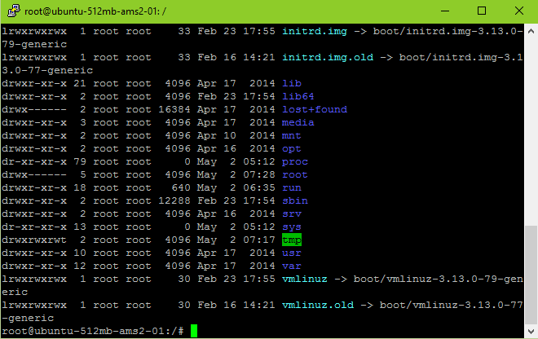
File Management – Listing files
To list the files and directories stored in the current directory. Use the following command – ls
Here is the information about all the listed columns
First Column: represents file type and permission given on the file. Below is the description of all type of files.
Second Column: represents the number of memory blocks taken by the file or directory.
Third Column: represents owner of the file. This is the Unix user who created this file.
Fourth Column: represents group of the owner. Every Unix user would have an associated group.
Fifth Column: represents file size in bytes.
Sixth Column: represents date and time when this file was created or modified last time.
Seventh Column: represents file or directory name.

Slide 6
File Management – Listing files
Prefix | Description
- | Regular file, such as an ASCII text file, binary executable, or hard link.
b | Block special file. Block input/output device file such as a physical hard drive.
c | Character special file. Raw input/output device file such as a physical hard drive
d | Directory file that contains a listing of other files and directories.
l | Symbolic link file. Links on any regular file.
p | Named pipe. A mechanism for interprocess communications
s | Socket used for interprocess communication.
a | All files – including hidden files

Slide 7
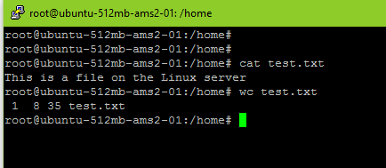
Display content of a file
You can use cat command to see the content of a file.
cat test.txt
Count the numbers of words in a file is very easy just use
wc test.txt

Slide 8
Directory Related Commands
cp – Copy of file - cp source_file destination_file
mv – Renaming - mv old_file new_file
rm – Delete – rm filename
cd – Change dir – cd~ (home dir) – cd- (last dir)
mkdir – Create directory - mkdir dirname
rmdir – Remove directory – rmdir dirname
pwd – print working directory - pwd
cd – Changing directory – cd dirname

Slide 9
Process Related Commands
ss Obtain a listing of processes and their id's. Including the option aux will show all processes.
top provides an ongoing look at processor activity in real time. It displays a listing of the most CPU-intensive tasks on the system, and can provide an interactive interface for manipulating processes.
netstat Print network connections, routing tables, interface statistics, masquerade connections, and multicast memberships
pstree shows running processes as a tree
kill send signal to a process
who am i Display information about the user

Slide 10
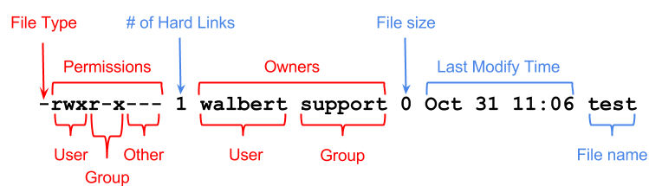
File permissions
If the command ls -l is given, a long list of file names is displayed. The first column in this list details the permissions applying to the file.
The chmod command changes the permission on a given file or directory.
chmod sets permissions in two ways.
Using symbols
Using octal values
Octal | Symbol | Permission
0 | --- | No Permissions
1 | --x | Execute
2 | -w- | Write
3 | -wx | Write and Execute
4 | r-- | Read
5 | r-x | Read and Execute
6 | rw- | Read and Write
7 | rwx | Read, Write, and Execute

Slide 11
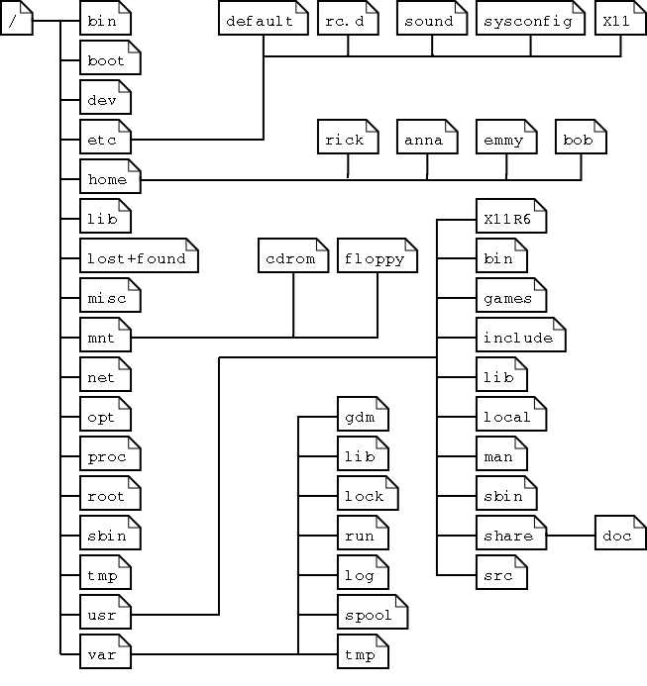
Linux file system layout
This is a layout from a RedHat system.
Depending on the system admin, the operating system and the mission of the UNIX machine, the structure may vary, and directories may be left out or added at will.
The names are not even required; they are only a convention.

Slide 12
Subdirectories of the root directory
Directory | Content
/bin | Common programs, shared by the system, the system administrator and the users.
/boot | The startup files and the kernel, vmlinuz. In some recent distributions also grub data. Grub is the GRand Unified Boot loader and is an attempt to get rid of the many different boot-loaders we know today.
/dev | Contains references to all the CPU peripheral hardware, which are represented as files with special properties.
/etc | Most important system configuration files are in /etc, this directory contains data similar to those in the Control Panel in Windows
/home | Home directories of the common users.
/initrd | (on some distributions) Information for booting. Do not remove!
/lib | Library files, includes files for all kinds of programs needed by the system and the users.
/lost+found | Every partition has a lost+found in its upper directory. Files that were saved during failures are here.
/misc | For miscellaneous purposes.
/mnt | Standard mount point for external file systems, e.g. a CD-ROM or a digital camera.
/net | Standard mount point for entire remote file systems
/opt | Typically contains extra and third party software.
/proc | A virtual file system containing information about system resources. More information about the meaning of the files in proc is obtained by entering the command man proc in a terminal window. The file proc.txt discusses the virtual file system in detail.
/root | The administrative user's home directory. Mind the difference between /, the root directory and /root, the home directory of the root user.
/sbin | Programs for use by the system and the system administrator.
/tmp | Temporary space for use by the system, cleaned upon reboot, so don't use this for saving any work!
/usr | Programs, libraries, documentation etc. for all user-related programs.
/var | Storage for all variable files and temporary files created by users, such as log files, the mail queue, the print spooler area, space for temporary storage of files downloaded from the Internet, or to keep an image of a CD before burning it.

Slide 13
Exercises – 2. day
Some of the initial exercises will be in a group, where the rest should be done individually. However, we recommend you sit together, as part of the exercises are to set up users and work with permissions

Slide 14
Exercises – Day 2.
The program for today is to compile and run a java program on the Linux machine. Each member of the group should do from task 3. Task 1 can only be done by the root user. There is no Java on the Linux machine. You need to install java on the Linux machine such that all users can compile and run java programs.
Task 1 It is not common practice to log in as root. Instead, one use the command “sudo”. Sudo is a command, which allow a user to do things only root can normally do. However, a user need to be allowed to have this permission, and giving this permission can only be done by root. Log in as root, and give one of the user sudo rights.
Task 2. The user who got sudo’ers right need to install java - remember to get the version of java which has the compiler. What is the meaning behind SDK and RTE when talking about java versions, and which one should you get? We suggest getting hold of Java 8.
Task 3. The java program we will work with is on Fronter as SendMail.java. You need to get that java program to your Linux account.
Task 4. The java program depends on a library (javax.mail.jar) which is not part of the standard distribution. The jar files should be shared between the users in the group, and you should agree on where, and you must place it “the right place”. See http://stackoverflow.com/questions/2707793/the-conventional-location-for-storing-my-java-libraries-and-applications-in-unix and http://www.pathname.com/fhs/pub/fhs-2.3.html for where the right place might be. A user with sudo rights can put the file in its place. Is that place visible to all users by default?
Task 5. To compile the java program on the Linux machine, you use the javac (javacompile) command installed in Task 2. The compiler need to be told what file to compile, and where to look for unusual libraries. For this, there it will look in the classpath - what is classpath, how to tell the compiler about it? Finally, compile the java sendmail program.
Task 6. The sendmail program assumes you will send emails using Gmail. In Gmail you might get an error that you are using a non-secure app for sending email. If you follow the error messages, there is a check-box which allow this kind of mail sending. If you do not have a Gmail account, you can either try to change the program to fit that of your provider - or (easier) make a Gmail account for these exercises. See http://www.mkyong.com/java/javamail-api-sending-email-via-gmail-smtp-example/ https://java.net/projects/javamail/pages/Home (need to change the settings in Gmail as: https://support.google.com/accounts/answer/6010255)
Task 7. Run the java program to verify that you are able to send an email. Again, to run the java program you need to tell where the external libraries are located - classpath again.

Slide 15
Resources

Slide 16
Resources
Day 1.
http://ryanstutorials.net/linuxtutorial/commandline.php
http://ryanstutorials.net/linuxtutorial/cheatsheet.php
http://www.howtogeek.com/howto/42980/the-beginners-guide-to-nano-the-linux-command-line-text-editor
http://www.tutorialspoint.com/unix_commands/nano.htm
Day 2.
http://tecadmin.net/install-oracle-java-8-jdk-8-ubuntu-via-ppa
http://kevinboone.net/classpath.html
Day 3.
http://ryanstutorials.net/linuxtutorial/scripting.php
Java files on Fronter

