Slide 1

Operating System Linux

Slide 2
Exercises – 2. day
Some of the initial exercises will be in a group, where the rest should be done individually. However, we recommend you sit together, as part of the exercises are to set up users and work with permissions

Slide 3
Exercises – Day 2.
The program for today is to compile and run a java program on the Linux machine. Each member of the group should do from task 3. Task 1 can only be done by the root user. There is no Java on the Linux machine. You need to install java on the Linux machine such that all users can compile and run java programs.
Task 1 It is not common practice to log in as root. Instead, one use the command “sudo”. Sudo is a command, which allow a user to do things only root can normally do. However, a user need to be allowed to have this permission, and giving this permission can only be done by root. Log in as root, and give one of the user sudo rights.
Task 2. The user who got sudo’ers right need to install java - remember to get the version of java which has the compiler. What is the meaning behind SDK and RTE when talking about java versions, and which one should you get? We suggest getting hold of Java 8.
Task 3. The java program we will work with is on Fronter as SendMail.java. You need to get that java program to your Linux account.
Task 4. The java program depends on a library (javax.mail.jar) which is not part of the standard distribution. The jar files should be shared between the users in the group, and you should agree on where, and you must place it “the right place”. See http://stackoverflow.com/questions/2707793/the-conventional-location-for-storing-my-java-libraries-and-applications-in-unix and http://www.pathname.com/fhs/pub/fhs-2.3.html for where the right place might be. A user with sudo rights can put the file in its place. Is that place visible to all users by default?
Task 5. To compile the java program on the Linux machine, you use the javac (javacompile) command installed in Task 2. The compiler need to be told what file to compile, and where to look for unusual libraries. For this, there it will look in the classpath - what is classpath, how to tell the compiler about it? Finally, compile the java sendmail program.
Task 6. The sendmail program assumes you will send emails using Gmail. In Gmail you might get an error that you are using a non-secure app for sending email. If you follow the error messages, there is a check-box which allow this kind of mail sending. If you do not have a Gmail account, you can either try to change the program to fit that of your provider - or (easier) make a Gmail account for these exercises. See http://www.mkyong.com/java/javamail-api-sending-email-via-gmail-smtp-example/ https://java.net/projects/javamail/pages/Home (need to change the settings in Gmail as: https://support.google.com/accounts/answer/6010255)
Task 7. Run the java program to verify that you are able to send an email. Again, to run the java program you need to tell where the external libraries are located - classpath again.

Slide 4
Java program
Change the mail server – Google or another one
Change the receiver e-mail to your own e-mail for test
Change the receiver e-mail to tuhe@cphbusiness.dk for Study Points
Place the file in the ”right” folder – could be:
javax.mail.jar in /usr/local/share/java/
MailTest.java in mailtest under your home
Run the javac command
javac -cp /usr/local/share/java/javax.mail.jar mailtest/MailTest.java
Run the Java command
java -cp /usr/local/share/java/javax.mail.jar:. mailtest.MailTest

Slide 5
javac
javac is the primary Java compiler, included in the Java Development Kit (JDK) from Oracle Corporation.
A Java compiler is a compiler for the programming language Java.
The most common form of output from a Java compiler is Java class files containing platform-neutral Java bytecode, but there are also compilers that emit optimized native machine code for a particular hardware/operating system combination.
javac -cp /usr/local/share/java/javax.mail.jar mailtest/MailTest.java
-cp classpath
Specifies a list of directories, JAR files, and ZIP archives to search for class files. Separate class path entries with semicolons (;).
Specifying -classpath or -cp overrides any setting of the CLASSPATH environment variable.

Slide 6
java
The java command starts a Java application. It does this by starting a Java runtime environment, loading a specified class, and calling that class's main method.
java -cp /usr/local/share/java/javax.mail.jar:. mailtest.MailTest
A Java application can accept any number of arguments from the command line. This allows the user to specify configuration information when the application is launched.
-cp classpath
Specifies a list of directories, JAR files, and ZIP archives to search for class files. Separate class path entries with semicolons (;).
Specifying -classpath or -cp overrides any setting of the CLASSPATH environment variable.

Slide 7
Exercises – 3. day
Some of the initial exercises will be in a group, where the rest should be done individually. However, we recommend you sit together, as part of the exercises are to set up users and work with permissions

Slide 8
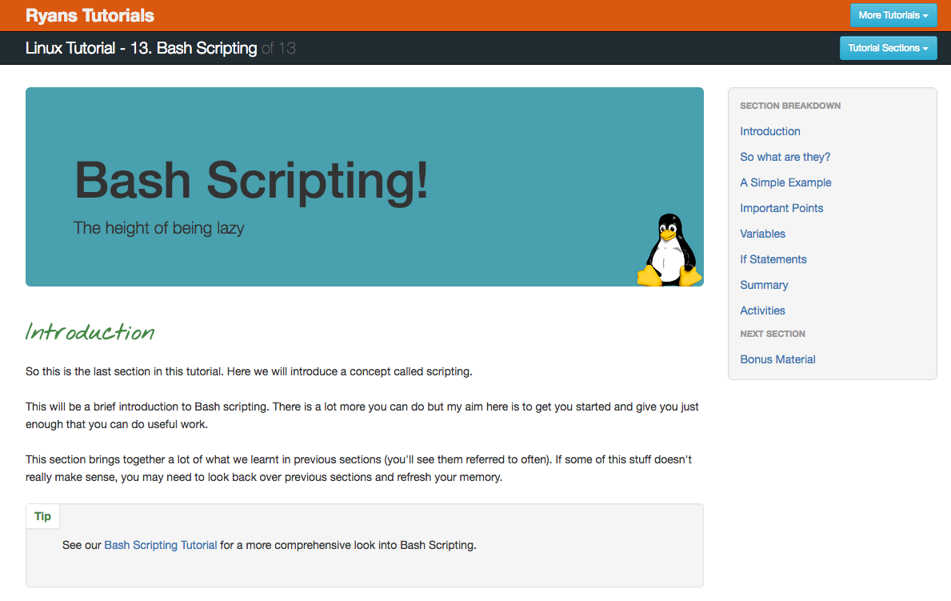
Linux Tutorial - 13. Bash Scripting
http://ryanstutorials.net/linuxtutorial/scripting.php

Slide 9
Exercises – Study Point
Read part 13 in Linux bash tutorial http://ryanstutorials.net/linuxtutorial/scripting.php
Write a simple shell script that can translate mail program
Must mail program read from standard in, or to be read from a file?
You get Study Point when I get an e-mail from the remote server E-mail is koe@cphbusiness.dk

Slide 10
Resources

Slide 11
Resources
Day 1.
http://ryanstutorials.net/linuxtutorial/commandline.php
http://ryanstutorials.net/linuxtutorial/cheatsheet.php
Day 2.
http://tecadmin.net/install-oracle-java-8-jdk-8-ubuntu-via-ppa
http://kevinboone.net/classpath.html
Day 3.
http://ryanstutorials.net/linuxtutorial/scripting.php
Java Files on Fronter

